Slide 1

Warmly Welcome to our class!
0
Teacher: Nguyen Thi Hai
T THAI SON SECONDARY SCHOOL

Slide 2
Wednesday,January 26th 2022
UNIT 8 :Sports and Games
Lesson 2 : A closer look 1!
0
Teacher: Nguyen Thi Hai
THAI SON SECONDARY SCHOOL

Slide 4

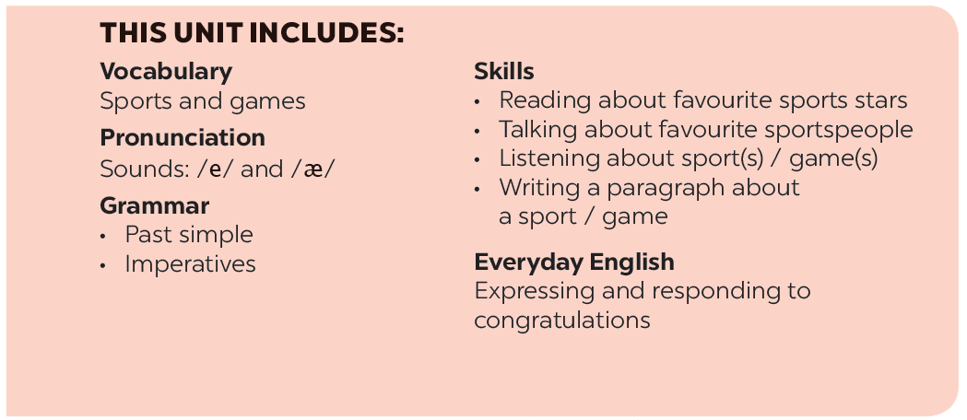

Slide 5

I. Warm up
Names of some sports

Slide 6
Aerobic
Cycling
Table tennis
Name of some sports
chess
Badmonton
volleyball
football
Swimming

Slide 7







Vocabulary
Pronunciation
/e/ and /æ/
Write the right words under the pictures.
Listen and repeat. Pay attention Track to the sounds /e/ and /æ/.
What sports are these things for? Match each thing in column A with a sport in column B.
Listen and repeat. Underline the words having the sounds /e/ and /æ/.
Fill each blank with one of the words from the box.

Slide 8
Vocabulary

Slide 9
* II. Vocabulary :
goggles (n):/ ˈgoglz/
competition(n):/kom pə’tiʃn/
Congratulations(n): /kən,grӕtʃə’leiʃn /
Marathon (n): /ˈmӕrə ən/
Kính bơi
Cuộc đua
Lời chúc mừng
ᶿ
Cuộc đua ma-ra-tông

Slide 10
Unit 8 : Sport and games
Lesson 2: A closer look 1
Warm up : names of some sports
Vocabulary :
goggles (n):/ ˈgoglz/
competition(n):/kom pə’tiʃn/
Congratulations(n): /kən,grӕtʃə’leiʃn /
Marathon (n): /ˈmӕrə ən/
III. Practice
Activity 1: Write the words under the pictures

Slide 11



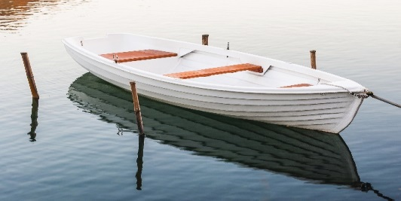
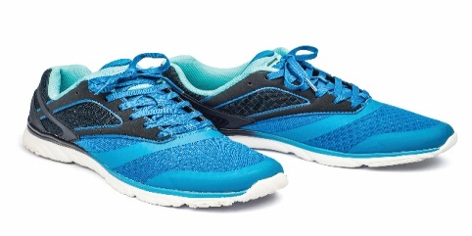
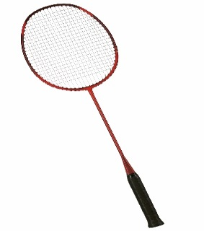
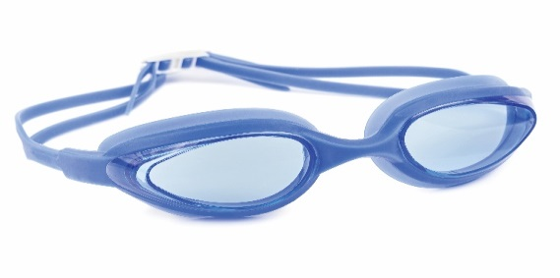
Activity 1: Write the right words under the pictures.
ball
racket
sports shoes
boat
goggles
1. ball
2. sports shoes
1.
2.
3.
3. boat
4. racket
5. goggles
4.
5.

Slide 12
Unit 8 : Sport and games
Lesson 2: A closer look 1
Warm up : names of some sports
Vocabulary :
goggles (n):/ ˈgoglz/
competition(n):/kom pə’tiʃn/
Congratulations(n): /kən,grӕtʃə’leiʃn /
Marathon (n): /ˈmӕrə ən/
III. Practice
Activity 1: Write the words under the pictures
1.Ball 2. sport shoes 3.boat 4. racket 5.goggles
Activity 2. What sporrts are these things for ?

Slide 13

What sports are these things for? Match each thing in column A with a sport in column B.
A
B
1.
bicycle
a.
boating
2.
ball
b.
Swimming
3.
boat
c.
Cycling
4.
goggles
d.
ball game
5.
racket
e.
badminton

Slide 14

Fill each blank with one of the words from the box.
champion
competition
sporty
marathon
congratulations
She won an international sports
competition.
1.
_______.
2.
He became the world tennis
_______ when he was very young.
champion when he was very young.
“Can you send my
_______ to the winner of the contest?”
3.
congratulations to the winner of the contest?”
_______. He does exercise every day.
4.
My friend David is very
sporty. He does exercise every day.
5.
The first
_______ took place in 1896.
marathon took place in 1896.

Slide 15
Pronunciation
/e/ and /æ/

Slide 16


Listen and repeat the words. Pay attention to the sounds /e/ and /æ/.
/e/ | /æ/
chess tennis exerise contest | racket match marathon active

Slide 17

Listen and repeat. Underline the words having the sounds /e/ and /æ/.
1.
They cannot take part in this contest.
2.
They began the match very late.
3.
Please get the racket for me.
4.
We play chess every Saturday.
5.
My grandpa is old, but he’s active.

Slide 18
Home Assignments
- Review vocabulary
- Do EX in part A,B p.9-10 in WB.

Slide 19







Slide 20
What sports are these things for? Match each thing in column A with a sport in column B.
A
B
1.
c.
bicycle
a.
cycling
boating
2.
b.
d.
swimming
ball
ball games
c.
a.
cycling
3.
boat
boating
b.
swimming
4.
goggles
d.
ball games
e.
e.
badminton
5.
racket
badminton

