Slide 2

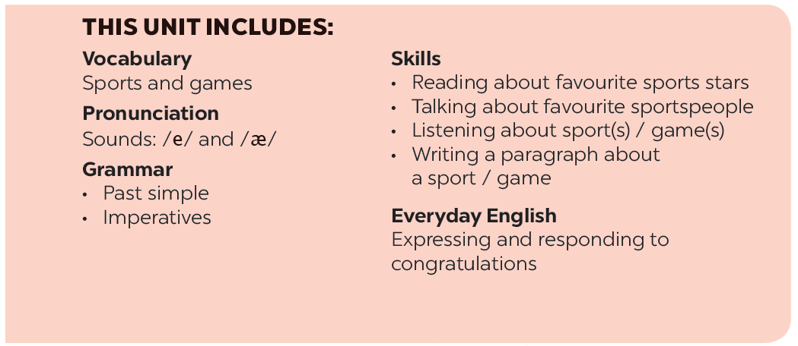

Slide 3







Everyday English
The sport / game you like
Expressing and responding to congratulations
Listen and read the short conversation below, paying attention to the highlighted parts.
Work in pairs. Do the quiz.
Work in pairs. Student A has won a prize in the school’s singing contest / sports competition. Student B congratulates him / her. Make a similar dialogue. Remember to use the highlighted sentences in 1. Then change roles.
Work in groups. Interview your partners using the following questions. You may ask for more information.

Slide 4
Everyday English
Expressing and responding to congratulations

Slide 5



Listen and read the short conversation below, paying attention to the highlighted parts.
Duong: Last week I played table tennis with Duy, and I won for the first time.
Mai: Congratulations!
Duong: Thank you, Mai.
Mai: So you’re our class champion now.

Slide 6

Work in pairs. Student A has won a prize in the school’s singing contest / sports competition. Student B congratulates him / her. Make a similar dialogue. Remember to use the highlighted sentences in 1. Then change roles.

Slide 7
The sport / game you like

Slide 8


Work in pairs. Do the quiz.
1.
How many players are there in a football match?
There are usually 22 players (11 on each side).
2.
How long does a football match last?
It normally lasts 90 minutes (divided into two halves).
3.
How often do the Olympic Games take place?
They take place every four years.
4.
How long is a marathon?
A marathon is 42.195 kilometres long (26 mile and 385 yards).
5.
Where did the first Olympic Games take place?
They took place in Olympia (in Ancient Greece) (in 776 BC).

Slide 9

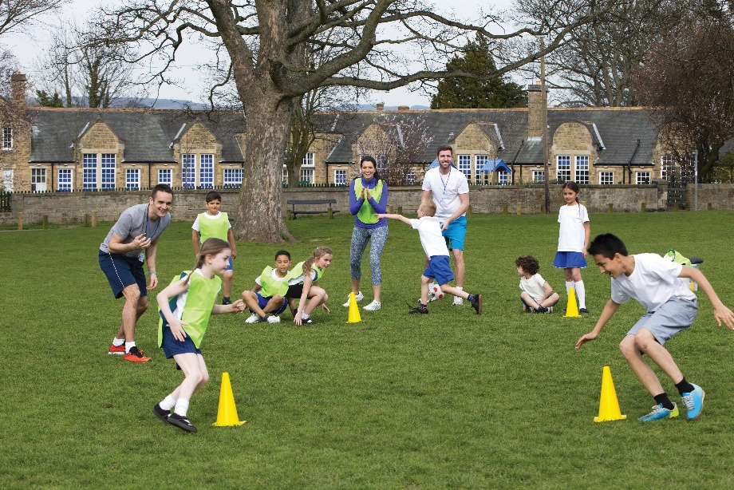
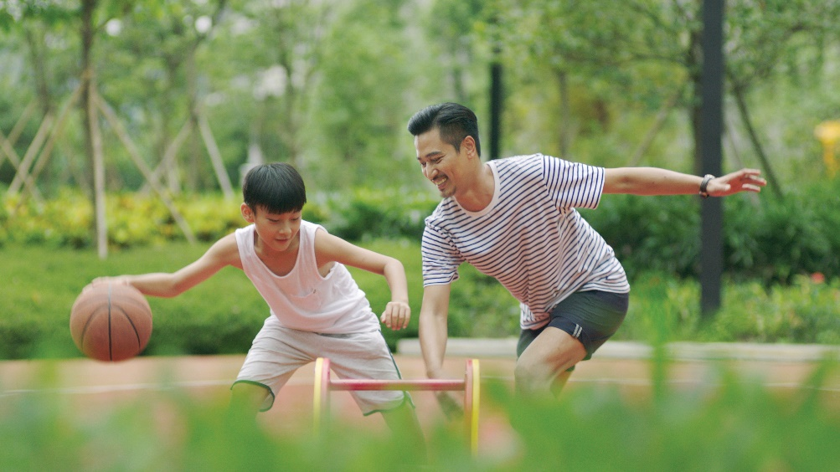
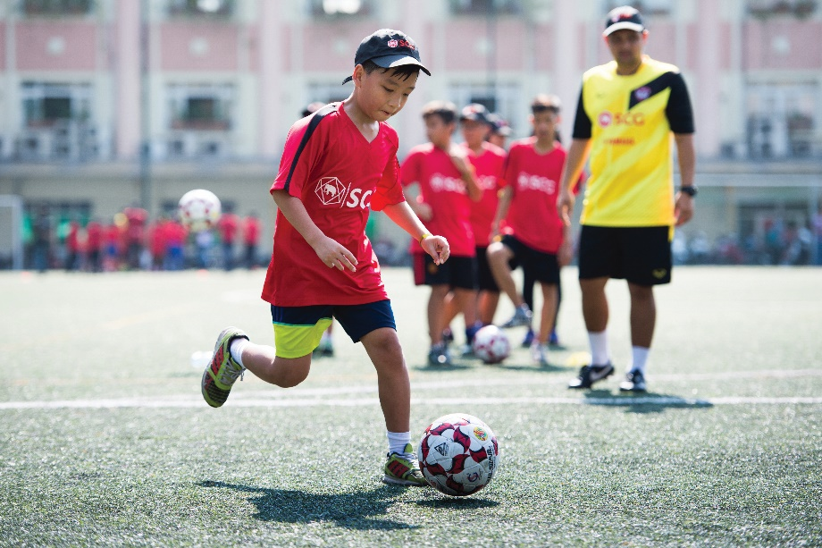
Work in groups. Interview your partners using the following questions. You may ask for more information.
Notes:
City landmarks phải ở trên mục 3

Slide 10
1.
What sports / games do you play in your free time? Do you play them well? When and how often do you play them?
2.
Which sport / game do you like watching on TV?
3.
Did you join any clubs?
4.
If you don’t play sport, what do you often do in your spare time?
Report your interviews to the class.

Slide 11







