Slide 1

Warmly welcome to our class
English 8
Teacher : Nguyen Thi Kieu Anh --- Trang Cat Secondary School

Slide 2
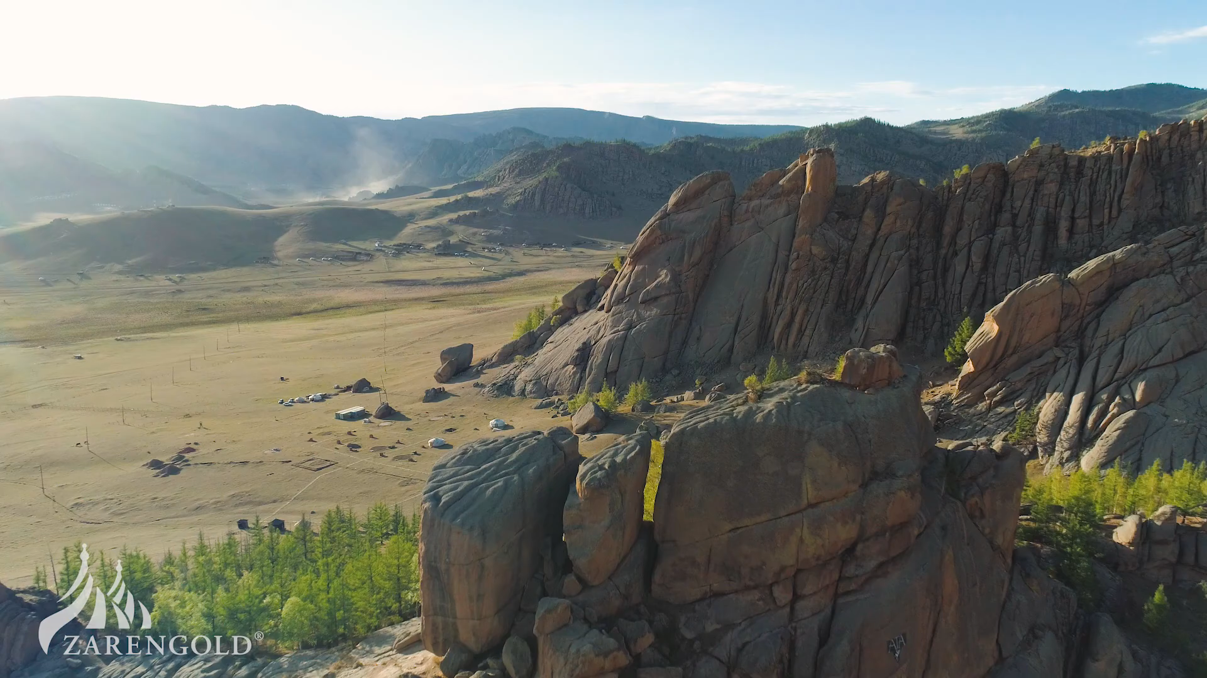
What have you seen in the pictures?
What place is this?
Where is it?
What is the life?
Who are the people?

Slide 3
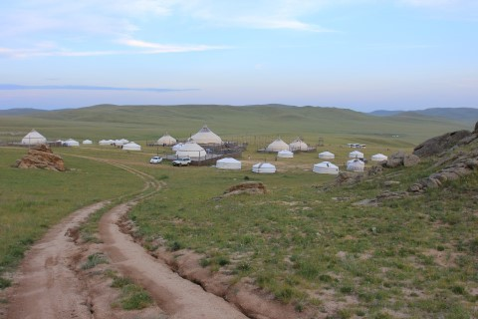
Nomadic life on the Gobi highlands

Slide 4


Period 13
UNIT 2 . LIFE IN THE COUNTRYSISE
Lesson 5: SKILLS 1(P22/23)

Slide 5
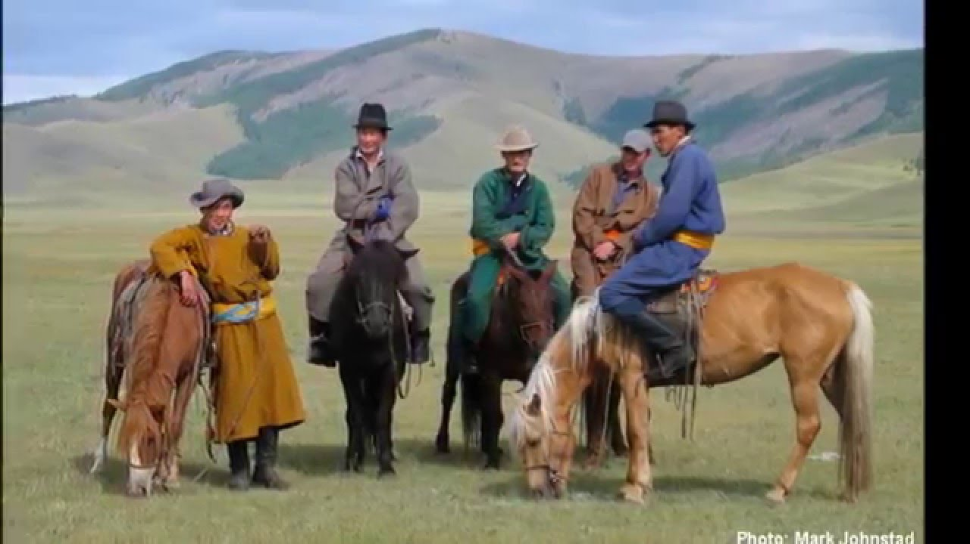
Nomad/ˈnəʊ.mæd/ (n)
Dân du mục
Nomadic /nəʊˈmæd.ɪk/( a)
Thuộc về du mục

Slide 6
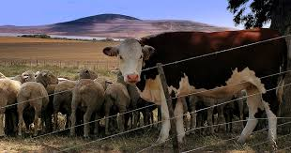
Cattle /ˈkæt.əl/(n)
Gia súc

Slide 7
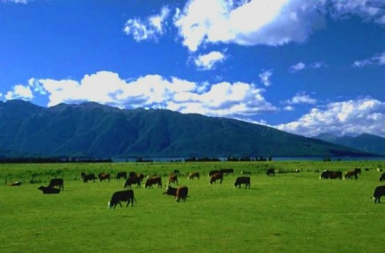
Pasture /ˈpɑːs.tʃər/(n) = Grassland /ˈɡrɑːs.lænd/ (n)
Đồng cỏ

Slide 8
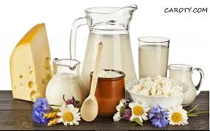
Dairy product /ˈdeə.ri ˈprɒd.ʌkt/
Sản phẩm từ sữa

Slide 9
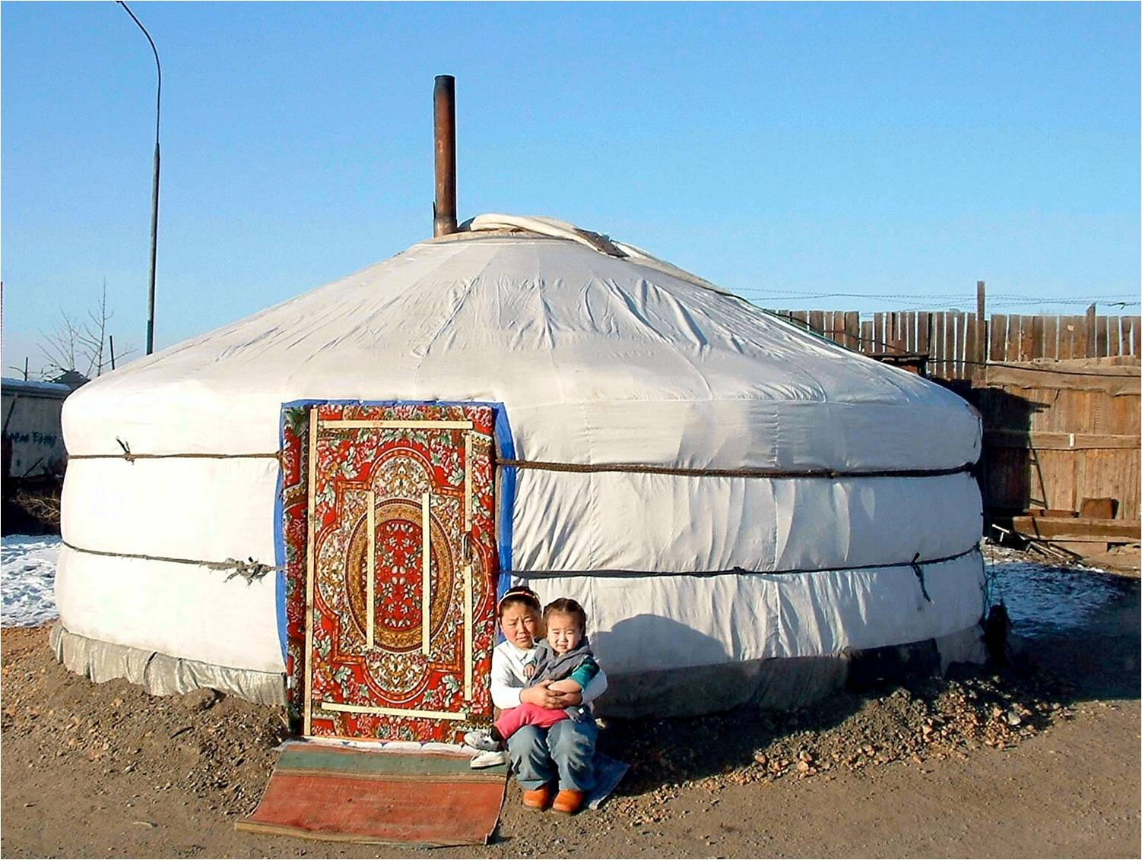
Ger /gər/ (n)
Lều di động

Slide 10
Checking vocabulary:
nomad /ˈnəʊmæd/ (n)
nomadic /nəʊˈmædɪk/ (a)
cattle /’kætl/ (n)
pasture /ˈpɑːstʃə(r)/ (n)
Dairy product /ˈdeə.ri ˈprɒd.ʌkt/(n)
- Ger / gər / (n)
: dân du mục
: thuôc về du mục
: gia súc
= grassland
: sản phẩm từ sữa
:lều di động

Slide 11
1. Match the descriptions with the words/ phrases from the passage.
Words/ Phrases | Descriptions
a ger dairy products cattle nomadic life pastures | a life on the move a circular tent in which Mongolian nomads live grasslands milk, butter, cheese cows, goats, buffaloes ...

Slide 12
2. Quickly read the passage and choose the most suitable heading A, B, or C for each paragraph.
A. Nomadic children’s lives B. The importance of cattle to the nomads C. The nomads’ home
NOMADIC LIFE ON THE
GOBI HIGHLANDS
1. ________________________________________ We don’t live a normal life like many other people. We live a nomadic life. This means we move two or three times a year to look for new pastures - grasslands - for our cattle. The cattle provide most of our needs: dairy products, meat, and clothing.
2. ______________________________________ We live in a ger, our traditional circular tent. It keeps us cool in summer and warm in winter, even when the temperature drops to -50°C. It can be put up then taken down and transported.
3. ______________________________________
For most of the year, we are surrounded by vast pastures, rivers and mountains. We see few people from the outside world. When we are small, we play on our land and with the animals. The horse is our best friend. Any nomadic child can ride a horse. We learn from an early age to help in the family, from household chores to heavier work like herding the cattle. We also learn to be brave.
B. The importance of cattle to the nomads
C. The nomads’ home
A. Nomadic children’s lives

Slide 13
3. Read the passage again and choose the best answer A, B, C, or D.
1. We live __________ other people.
A. a different life to
B. similarly to
C. the same life as
in exactly the same way as
2. We have to move in order to __________.
A. change our lifestyle
B. look for better weather
C. look for food for our cattle
be closer to the city
3. Our cattle can provide us with __________.
A. most of our needs
B. food only
C. means of transport only
anything we want

Slide 14
4. When we move to a new place, we __________.
A. have to make a new ger
B. put up the ger
C. buy a new ger
share a ger with our neighbours
5. Nomadic children __________.
A. play the same games as other children in the world
B. use nature and their animals as playthings
C. do not like toys
spend all their time helping with housework
6. Mongolian children in the Gobi learn __________.
A. to ride a goat
B. to live in the mountains
C. to be generous
D. to help with household chores

Slide 15

1
5
2
6
3
4
LUCKY STAR
pipi

Slide 16



1. We live __________ other people.
A. a different life to
B. similarly to
C. the same life as
in exactly the same way as
You are given 3 candies
A. a different life to
We don’t live a normal life like many other people. We live a nomadic life. This means we move two or three times a year to look for new pastures - grasslands - for our cattle. The cattle provide most of our needs: dairy products, meat, and clothing.
GO HOME

Slide 17
2. We have to move in order to __________.
A. change our lifestyle
B. look for better weather
C. look for food for our cattle
be closer to the city
You are given 1 candies
C. look for food for our cattle
We don’t live a normal life like many other people. We live a nomadic life. This means we move two or three times a year to look for new pastures - grasslands - for our cattle. The cattle provide most of our needs: dairy products, meat, and clothing.
GO HOME

Slide 18

3. Our cattle can provide us with __________.
A. most of our needs
B. food only
C. means of transport only
anything we want
You are given 5 candies
A. most of our needs
We don’t live a normal life like many other people. We live a nomadic life. This means we move two or three times a year to look for new pastures - grasslands - for our cattle. The cattle provide most of our needs: dairy products, meat, and clothing.
GO HOME

Slide 19
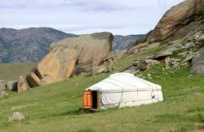
4. When we move to a new place, we __________.
A. have to make a new ger
B. put up the ger
C. buy a new ger
share a ger with our neighbours
You are given 8 candies
B. put up the ger
We live in a ger, our traditional circular tent. It keeps us cool in summer and warm in winter, even when the temperature drops to -50°C. It can be put up then taken down and transported.
GO HOME

Slide 20
5. Nomadic children __________.
A. play the same games as other children in the world
B. use nature and their animals as playthings
C. do not like toys
spend all their time helping with housework
You are given 10 candies
B. use nature and their animals as playthings
For most of the year, we are surrounded by vast pastures, rivers and mountains. We see few people from the outside world. When we are small, we play on our land and with the animals. The horse is our best friend. Any nomadic child can ride a horse. We learn from an early age to help in the family, from household chores to heavier work like herding the cattle. We also learn to be brave.
GO HOME

Slide 21
6. Mongolian children in the Gobi learn __________.
A. to ride a goat
B. to live in the mountains
C. to be generous
D. to help with household chores
You are given 2 candies
D. to help with household chores
For most of the year, we are surrounded by vast pastures, rivers and mountains. We see few people from the outside world. When we are small, we play on our land and with the animals. The horse is our best friend. Any nomadic child can ride a horse. We learn from an early age to help in the family, from household chores to heavier work like herding the cattle. We also learn to be brave.
GO HOME

Slide 22
speaking
Tick (√)the sentences mentioned in the passage about the nomadic life.
They are able to live and visit anywhere
√
They are surrounded by vast pastures, rivers and mountains
Children play on vast pastures
√
Children learn to ride a horse
√
Children learn to be brave.
The family are together every minute of every day
√
They have to live in a ger .
√
They have to move two or three times a year.
They don’t live a normal life like many other people
√
They see few people from the outside world
They are always being alone

Slide 23
speaking
4. Work in pairs: Interview your partner to find out what he/ she likes/ doesn’t like about the life of the nomads.
LIKE | DISLIKE
They are able to live and visit anywhere
√
They are surrounded by vast pastures, rivers and mountains
Children learn to ride a horse.
They see few people from the outside world.
Children play on vast pastures
√
Children learn to ride a horse
√
Children learn to be brave.
Example:
A: What do you like about their nomadic life?
B: Well, the children learn to ride a horse.
A: And what don’t you like about it?
B: They see few people from the outside world
The family are together every minute of every day
√
They have to live in a ger .
√
They have to move two or three times a year.
They don’t live a normal life like many other people
√
They see few people from the outside world
They are always being alone

Slide 24
speaking
Report what you and your friend like or dislike about the life of the nomads.
Both of us like/ dislike ...
None of us like ...
He/ She likes ... and so do I.
He/ She dislikes ... and neither do I.
He/ She likes ... but I’m not interested in it.
He/ She dislikes ... but I find it interesting.
Both of us like their living space. Lan is very keen on riding horses but I’m not interested in it.

Slide 25
speaking
5a. Work in pairs. Discuss and find:
two things you like about life in the countryside
- two things you don’t like about life in the countryside

Slide 26
HOME ASSIGNMENTS
Practice reading the passage at page 22 and translate it into Vietnamese.
Write a short paragraph to tell what you like and dislike about life in the countryside.

Slide 27


