Slide 1


Slide 2
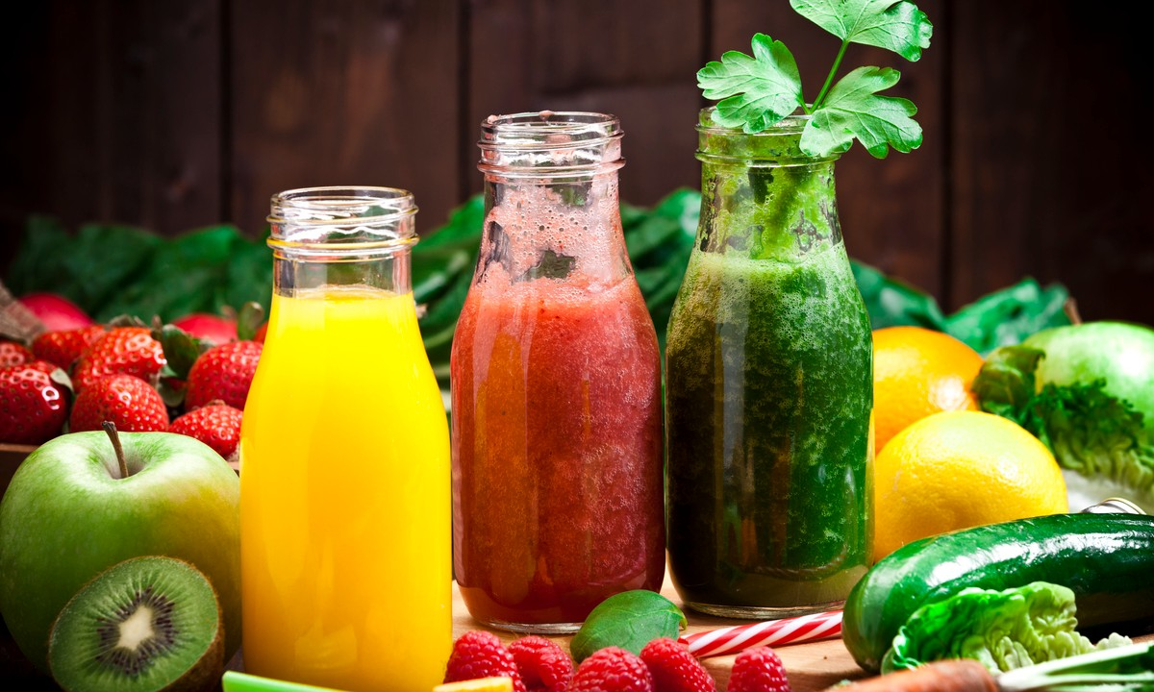


Unit
5
FOOD AND DRINK
LESSON 3: A CLOSER LOOK 2

Slide 3

GRAMMAR
We use some, a lot of, lots of with both countable nouns and uncountable nouns to describe quantities.
Example:
- I need some apples for this recipe.
- There's some water in the bottle.
- There are a lot of/ lots of people in the room.
- She likes coffee with a lot of / lots of sugar.

Slide 4
1
Circle the correct words or phrases to complete the following sentences.
1. Minh is very popular. He has got some / a lot of friends.
2. Linh is very busy. She has got some / lots of homework.
3. Put some / a lot of sugar in my tea. But not too much.
4. There are some / a lot of cars in our city. Too many. I don't like it.
5. There is some / lots of rice left. Not much but just enough for our breakfast.
a lot of
lots of
some
a lot of
some

Slide 5

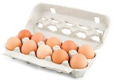



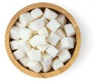
1
2
Look at the pictures and complete each sentence. Write some, any or a lot of/ lots of in the blanks.
Example: There is some orange juice in the glass.
1. There are _____________ eggs in the carton.
2. There aren't _________ biscuits on the plate.
3. Susie went to the cinema with _________ friends.
4. I'd like a pizza with ____________ cheese.
5. There is _____________ sugar in the bowl.
a lot of/ lots of
any
some
a lot of/ lots of
a lot of/ lots of

Slide 6




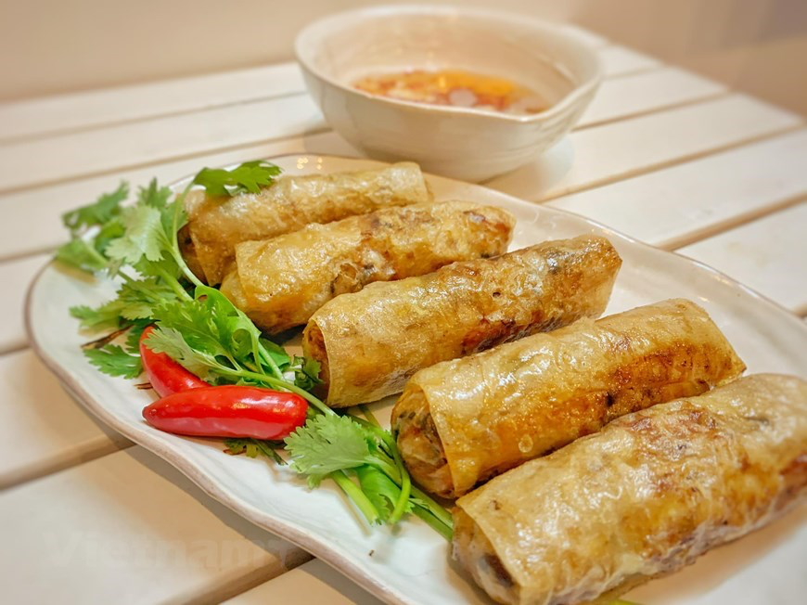
3
Fill in each blank with How many or How much. Answer the questions, using the pictures.
1. __________ water do you drink every day? _________
2. ___________ books did you read last month? _________
3. ___________ films did you watch last year? ________
4. ___________ bananas do you eat every week? ___________
5. ___________ spring rolls did your mother cook last month? ___________
2L
How much
2 litters
How many
2 books
How many
2 films
How many
3 bananas
How many
5 spring rolls

Slide 7
4
Work in pairs. Ask and answer, using the questions in 3.
1
1. How much water do you drink everyday?
2. How many books did you read last month?
3. How many films did you watch last year?
4. How many bananas do you eat every week?
5. How many spring rolls did your mother cook last mont

Slide 8
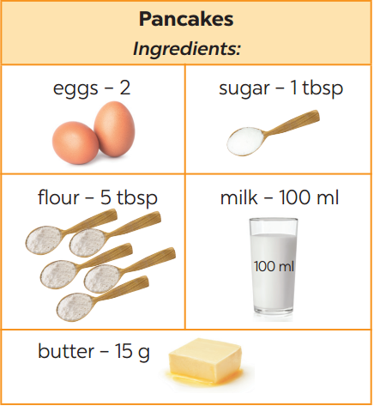
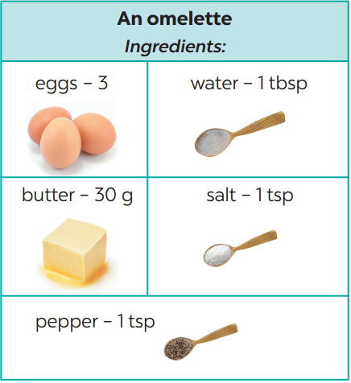
5
Example:
A: What do we need to make pancakes?
B: We need eggs, sugar, flour, milk, and butter.
A: How many eggs do we need?
B: Two.
Work in groups. Take turns to ask and answer about the recipes.
1

Slide 9
1. ……water do you drink everyday?
a. How much b. How often c. How many
2. There’s……water in the bottle
a. an b. some c. any
3. Linh is very busy and tired because she often has… homework to do.
a. lot b. some c. a lot of

Slide 10

HOMe ASSIGNMENTS
Make 10 sentences with some, a lot of, lots of, How many, How much.
- Do exercise B1 – B7 Workbook

Slide 11


