Slide 1


Slide 2
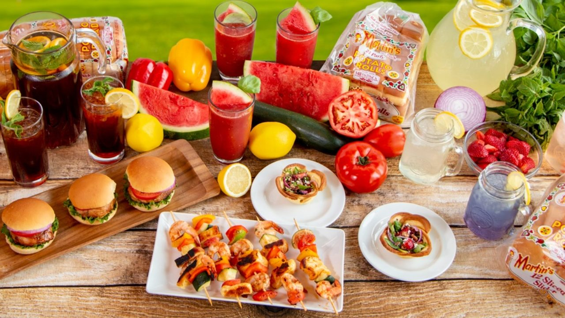


Unit
5
FOOD AND DRINK
LESSON 4: COMMUNICATION

Slide 3
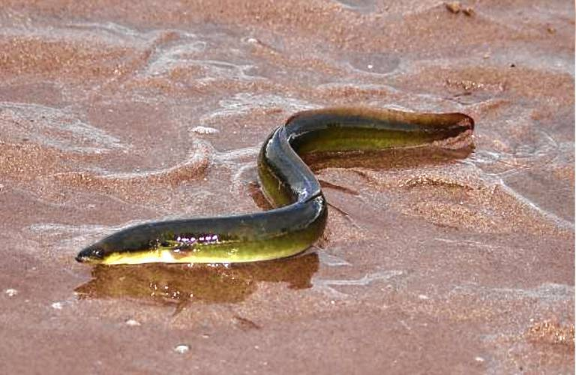
eel
/iːl/
con lươn

Slide 4
foreign
/ˈfɒr.ən/
ngoại quốc

Slide 5

interview
/ˈɪn.tə.vjuː/
cuộc phỏng vấn

Slide 6
1
Listen and repeat the conversation. Pay attention to the questions and answers.
Mark: How much is a bottle of mineral water?
Mi: It's 5,000 dong.
Mark: And how much are two kilos of apples?
Mi: They're 50,000 dong.

Slide 7
1
Work in pairs. Take turns to ask and answer about the prices of the food and drink on the menu.
2
LY'S RESTAURANT Breakfast Menu
Food
bowl of beef noodle soup | 30,000 dong
bowl of eel soup | 35,000 dong
toast | 20,000 dong
Drink
glass of milk | 9,000 dong
bottle of mineral water | 8,000 dong
cup of green tea | 5,000 dong
Sample:
A: How much is a glass of milk?
B: It’s 9,000 dong.

Slide 8
YOUR FAVOURITE FOOD AND DRINK
3
Listen to the conversation and answer the following questions.
2
1. What's Nam's favourite food?
2. What's his favourite drink?
3. What foreign food does he like?
4. What food does he want to try?
5. What food can he cook?
Spring rolls.
Lemonade.
Apple pie and pancakes.
Hu tieu (in Ho Chi Minh City).
Omelettes, rice, and spring rolls.

Slide 9
2
Work in groups. Interview two of you friends about their favourite food and drink. Write their answers in the table below.
4
Questions | Student 1 | Student 2
1. What's your favourite food?
2. What's your favourite drink?
3. What food or drink do you want to try?
4. What foreign food or drink do you like?
5. What can you cook?

Slide 10
REPORT YOUR FRIENDS’ FAVOURITE FOOD AND DRINK
Report your results to the class

Slide 11

HOMe ASSIGNMENTS
Do exercise C1,C2,D1,D2 Workbook
Prepare for the next lesson: Skills 1

Slide 12


