Slide 1



Unit
5
FOOD AND DRINK
Lesson 7: LOOKING BACK & PROJECT
Vocabulary review
Grammar review
Project: Eating habits around the world
HOBBIES

Slide 2

OBJECTIVES
By the end of this lesson, Ss will be able to:
1. Knowledge
Review the vocabulary and grammar of Unit 1
Apply what they have learnt into practice through a project
2. Core competence
Develop communication, presentation & critical thinking skills and creativity
Be collaborative and supportive in pairwork and teamwork
Actively join in class activities
3. Personal qualities
Be more creative when doing the project
Develop self-study skills

Slide 3
LESSON 7: LOOKING BACK & PROJECT
WARM-UP
Mini game: What are these dishes?
Task 1: Add the words and phrases you have learnt in the correct columns. Compare with your partner's.
Task 2: Read the recipe and write sentences as in the example.
VOCABULARY REVIEW
Task 3: Complete the sentences. Write some, any, much, or a lot of/ lots of.
Task 4: Make questions with How many/ How much for the underlined words in the following sentences.
GRAMMAR REVIEW
Work in groups. Design a poster about eating habits in an area or a foreign country you know.
Organise an exhibition of all the posters in your class. Present your poster to the class.
PROJECT
CONSOLIDATION
Wrap-up
Homework

Slide 4
UNIT 5: FOOD AND DRINK
Lesson 7: looking back&project

Slide 5
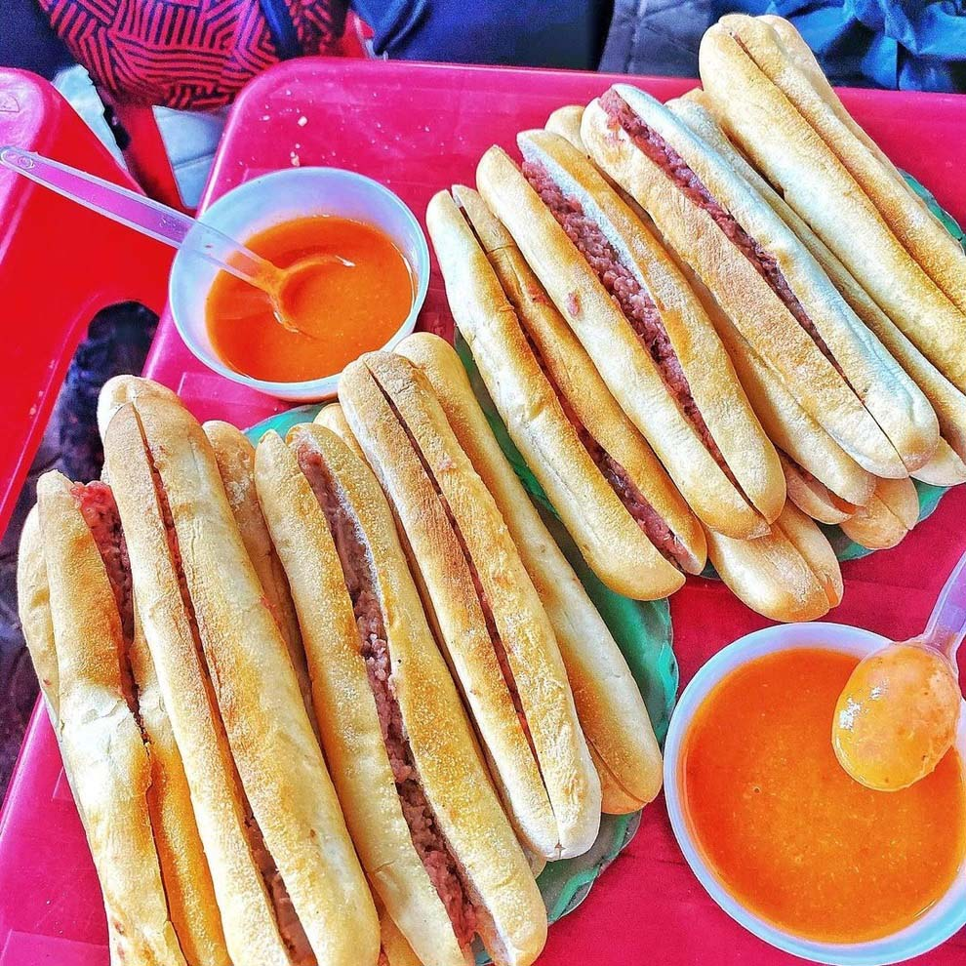
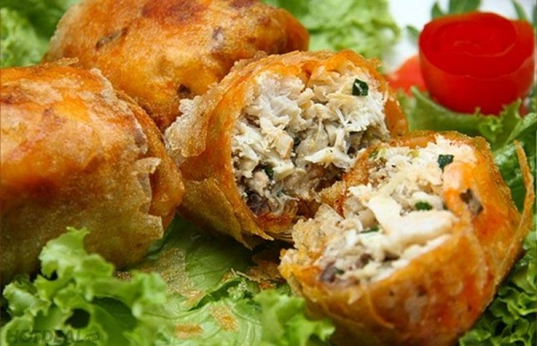
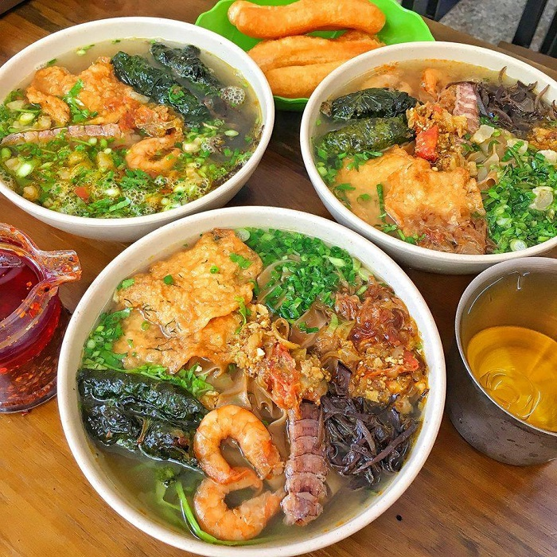
UNIT 5: FOOD AND DRINK
Lesson 7: looking back&project
I. WARM UP: Look at the pictures and rename the dishes?

Slide 6
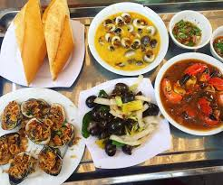
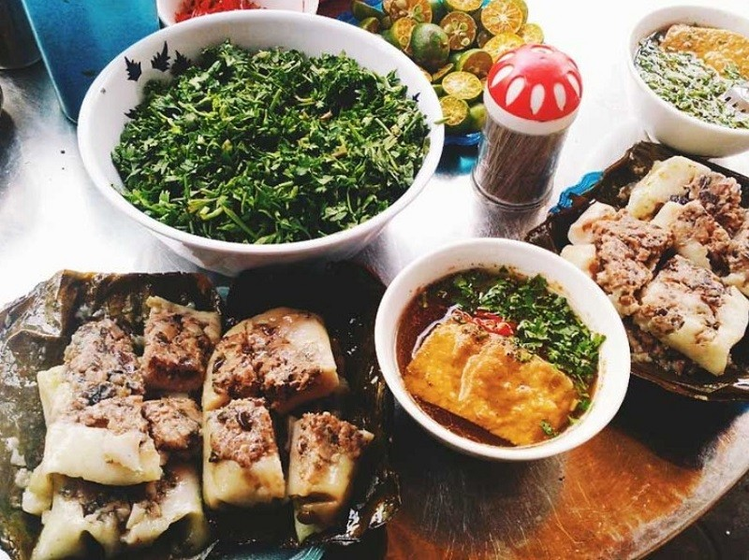
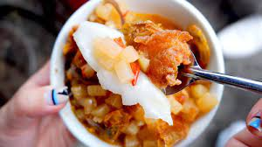
UNIT 5: FOOD AND DRINK
Lesson 7: looking back&project
I. WARM UP: Look at the pictures and rename the dishes?

Slide 7
UNIT 5: FOOD AND DRINK
Lesson 7: looking back&project
WARM UP:
Where are these dishes from?

Slide 8
I. VOCABULARY: - Words related to food and drink:
Add the words and phrases you have learnt in the correct columns. Compare with your partner's. Who has more words and phrases? Add any that you did not write.
1
Dishes | Ingredients | Units of measurement
pancakes | flour | gram (g)

Slide 9
I. VOCABULARY:
1
Add the words and phrases you have learnt in the correct columns. Compare with your partner's. Who has more words and phrases? Add any that you did not write.
Dishes | Ingredients | Units of measurement
pancakes | flour | gram (g)
Cakes
Rice
Pho
Beefsteak
Apple pie
Spring rolls
Toast
Omelette
Beef noodles soup
Litre
Tablespoon
Teaspoon
Gram
Kilo
Mililitre
Rice
Rice noodle
Beef
Meat
Pork
Chicken
Fish
Onion
pepper

Slide 10
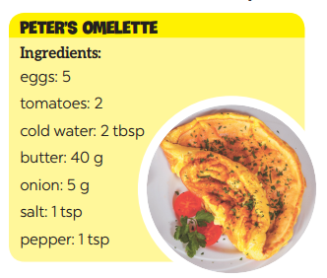
I. VOCABULARY:
2
Read the recipe and write sentences as in the example.
Suggested answers:
We need 5 eggs.
We need 2 tomatoes.
We need 2 tablespoons of cold water.
We need 40 grams of butter.
We need 5 grams of onion.
We need 1 teaspoon of salt.
We need a teaspoon of pepper.
Ingredients
eggs: 5
tomatoes: 2
cold water: 2 tbsp
butter: 40 g
onion: 5 g
salt: 1 tsp
pepper: 1 tsp

Slide 11
II. GRAMMAR:
1. some, any, much, or a lot of/ lots of.
3
Complete the sentences. Write some, any, much, or a lot of/ lots of.
any
1. I have to go to the market now. There isn't _________ food for our dinner.
2. Would you like _________ sugar for your coffee?
3. There are ______________ trees in our village, so the air here is very fresh.
4. I'm very busy, I have ______________ things to do today.
5. We didn't have _________ beef left, so we had _________ fish for lunch.
some
a lot of/ lots of
a lot of/ lots of
any
some

Slide 12
II. GRAMMAR:
2. How much/ How many…?
4
Make questions with How many/ How much for the underlined words in the following sentences.
Example: Minh has three apples.
How many apples does Minh have?
1. There are six bottles of juice in the fridge.
_________________________________________________ ?
2. I need some butter for my pancakes.
_________________________________________________ ?
3. We have only one bottle of fish sauce.
_________________________________________________ ?
4. We need ten chairs for the party.
_________________________________________________ ?
5. She put a lot of sugar in her lemonade.
_________________________________________________ ?
How many bottles of juice are there in the fridge?
How much butter do you need for your pancakes?
How many bottles of fish sauce do you/ we have?
How many chairs do you/ we need (for the party)?
How much sugar did she put in her lemonade?

Slide 13
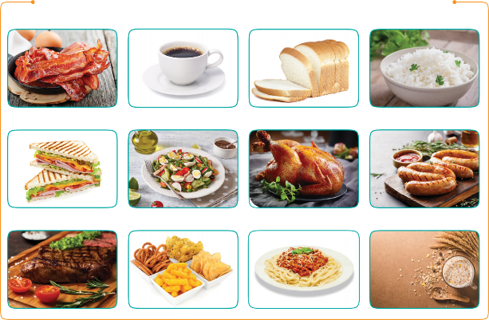
III. PROJECT
Eating habits around the world
1
Work in groups. Design a poster about eating habits in an area or a foreign country you know, including:
EATING HABITS AROUND THE WORLD
names of main meals and mealtimes
names of common food/ drink for each meal
pictures or photos to illustrate the meals

Slide 14

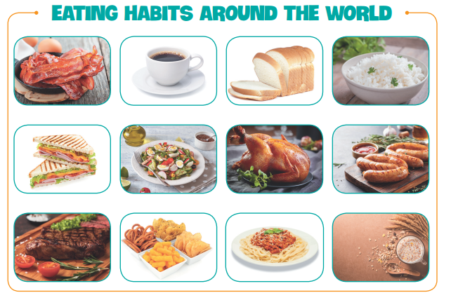
III. PROJECT
Eating habits around the world
2
Then organise an exhibition of all the posters in your class.
Present your poster to the class.

Slide 15
HOME ASSIGNMENTS
Review Unit 5
Ex E1,2,3 WB

