Slide 1


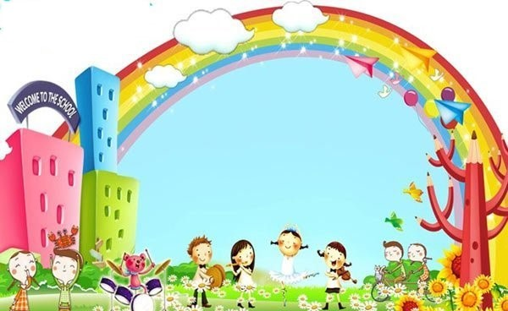
Unit 14 What does he look like?
Lesson 2
Grade 4
Teacher: Le Thi Thu Huong
Dang Cuong primary school

Slide 2


WARM- UP

Slide 3

Game: Matching
big
-
shorter
small
-
older/ elder
tall
-
bigger
short
-
smaller
old
-
younger
young
-
taller

Slide 4
Keys
big
-
bigger
: to hơn
small
-
smaller
: nhỏ hơn
tall
-
taller
: cao hơn
short
-
shorter
: thấp hơn
old
-
older/ elder
: già hơn
young
-
younger
: trẻ hơn

Slide 5

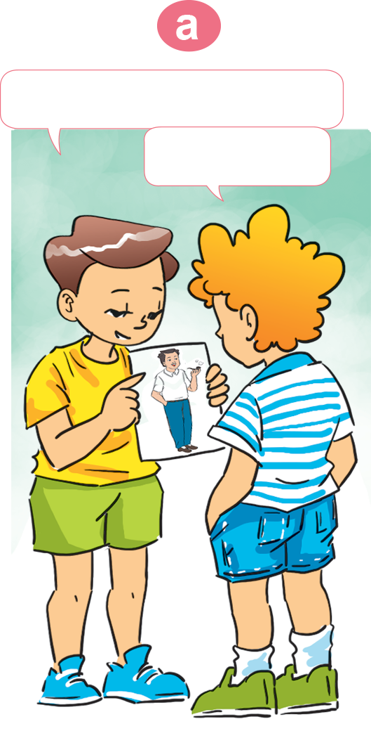
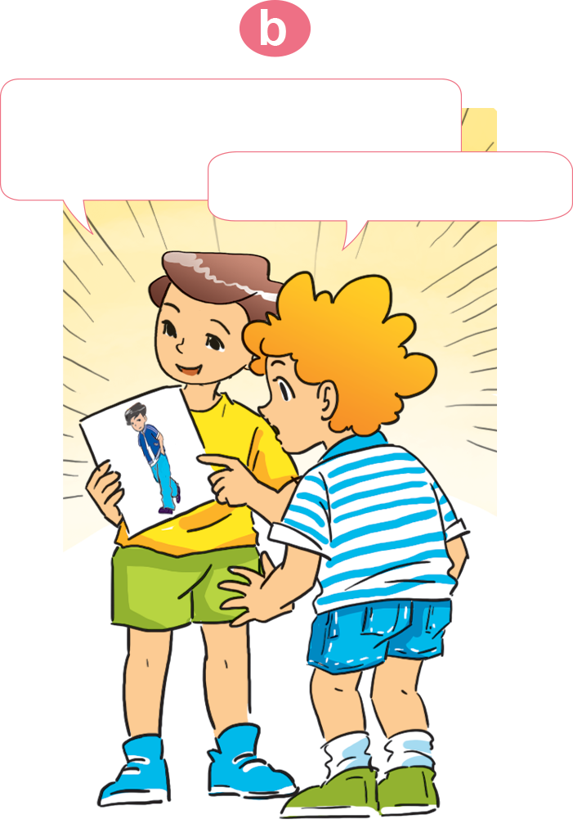
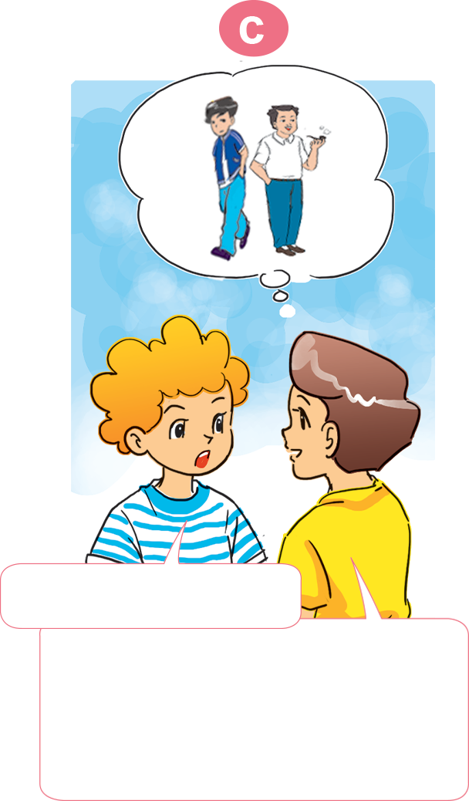
Tuesday, March 8th, 2022
Unit 14-Lesson 2
1. Look, listen and repeat.

Slide 6
This is my father
And this is my elder brother.
He’s tall.
Oh, he’s tall, too.
Who’s taller?
My brother is. My brother’s taller than my father.

Slide 7
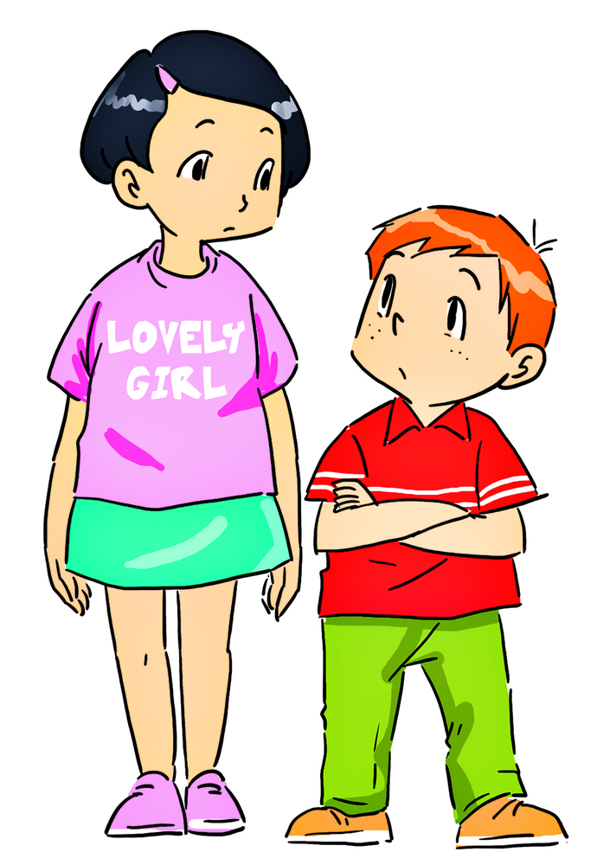
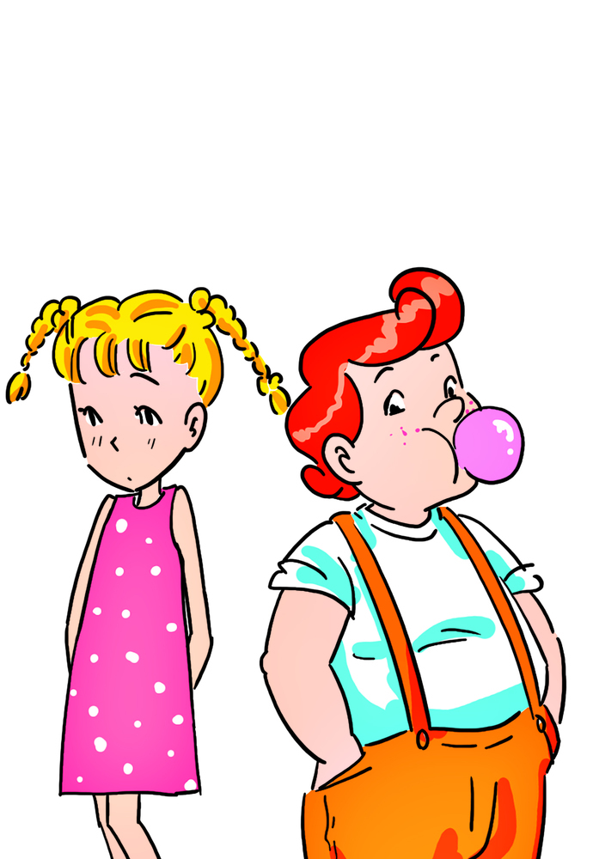
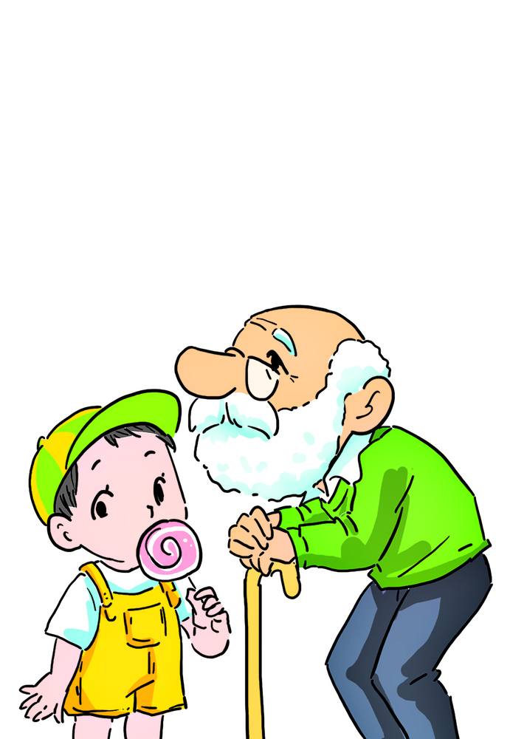
2. Point and say.
The man
a. tall-taller short-shorter
b. big-bigger
small-smaller
c. old-older
young-younger
Model sentences: Hỏi về so sánh hơn.
taller
taller
a. Who’s…………?
– The girl is
than the boy.
shorter
– The boy is
shorter
than the girl.
Who’s…………?

Slide 8
2. Point and say.
a. tall-taller short-shorter
b. big-bigger
small-smaller
c. old-older
young-younger
Model sentences: Hỏi về so sánh hơn.
bigger
– The boy is
bigger
than the girl.
a. Who’s…………?
smaller
– The girl is
smaller
than the boy.
Who’s…………?

Slide 9
2. Point and say.
a. tall-taller short-shorter
b. big-bigger
small-smaller
c. old-older
young-younger
Model sentences: Hỏi về so sánh hơn.
older
older
c. Who’s…………?
– The old man is
than the boy.
younger
– The boy is
younger
than the old man.
Who’s…………?

Slide 10
a. tall-taller short-shorter
Who’s ………..?
The …..… is …….. than the ……..

Slide 11
b. big-bigger
small-smaller
Who’s ………..?
The …..… is …….. than the ……..

Slide 12
c. old-older
young-younger
Who’s ………..?
The …..… is …….. than the ……..

Slide 13
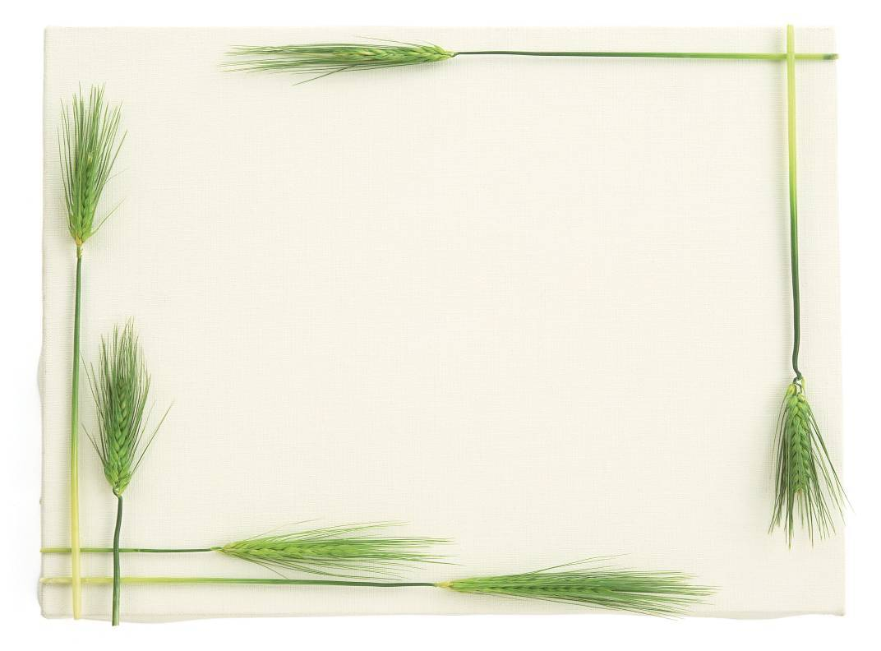

3. Let’s talk.
Golden Bell Challenge

Slide 14

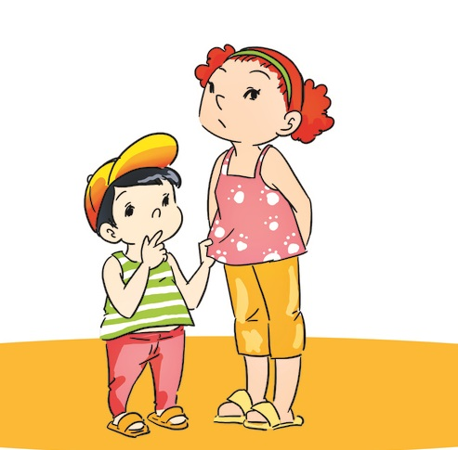

Question 1:
Who’s ………? – The brother’s younger than the sister.
A. older B. younger C. smaller
B. younger
15
14
13
12
11
10
9
8
7
6
5
4
3
2
1
Time up
Time

Slide 15
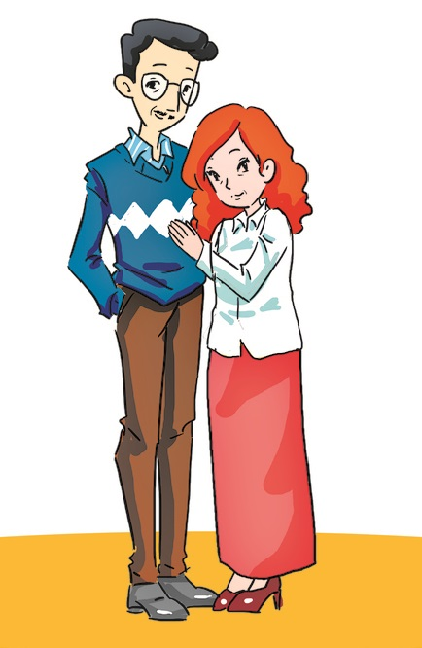
Question 2:
Who’s shorter? The ……is shorter than the father.
A. brother B. sister C. mother
C. mother
15
14
13
12
11
10
9
8
7
6
5
4
3
2
1
Time up
Time

Slide 16
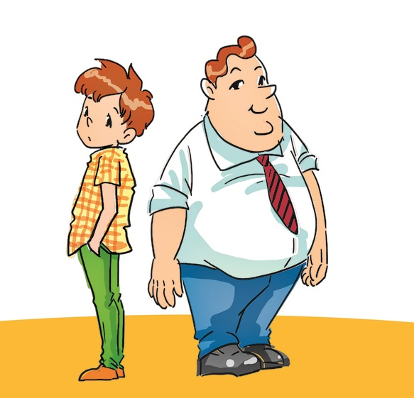
Question 3
Who’s bigger? –The father is …….than the brother.
A. bigger B. smaller C. taller
A. bigger
15
14
13
12
11
10
9
8
7
6
5
4
3
2
1
Time up
Time

Slide 17
Tuesday, March 8th, 2022
Unit 14-Lesson 2
1. Vocabulary.
bigger
: to hơn
smaller
: nhỏ hơn
taller
: cao hơn
shorter
: thấp hơn
older/ elder
: già hơn
younger
: trẻ hơn
than
: so với
the man
: cụ già
2. Model sentences: Hỏi về so sánh hơn.
a. Who’s taller? – The girl is taller than the boy.
Who’s shorter? – The boy is shorter than the girl.

Slide 18



Thank you very much!
Goodbye!

