Slide 1
UBND QUẬN HẢI AN TRƯỜNG TIỀU HỌC ĐẰNG HẢI
MÔN TOÁN 3
Tiết 45: Em ôn lại những gì đã học(tiết 1)

Slide 2



KHỞI ĐỘNG

Slide 3


Chào mừng quý thầy cô và các em học sinh lên chuyến tàu THĐH
số hiệu 3A6.
SE8 - QTH

Slide 4
Thứ sáu, ngày 4 tháng 11 năm 2022
Toán
EM ÔN LẠI NHỮNG GÌ ĐÃ HỌC
TIẾT 1

Slide 5
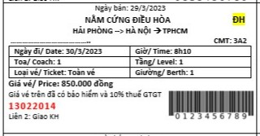
CHECK VÉ KHI LÊN TÀU

Slide 6
Hết giờ
30
29
28
27
26
25
24
23
22
21
20
19
18
17
16
15
14
13
12
11
10
09
08
07
06
05
04
03
02
01
00
SƠ ĐỒ TRẠM
Hải Phòng
Hà Nội
TP Hồ Chí Minh
Bắt đầu

Slide 7
Hết giờ
SƠ ĐỒ DI CHUYỂN
19
18
17
16
15
14
13
12
11
10
09
08
07
06
05
04
03
02
01
00
20
Hải Phòng
Hà Nội
TP Hồ Chí Minh
Bắt đầu

Slide 8

TRẠM 1

Slide 9
03:00
START

Slide 10
03:00
02:59
02:58
02:57
02:56
02:55
02:54
02:53
02:52
02:51
02:50
02:49
02:48
02:47
02:46
02:45
02:44
02:43
02:42
02:41
02:40
02:39
02:38
02:37
02:36
02:35
02:34
02:33
02:32
02:31
02:30
02:29
02:28
02:27
02:26
02:25
02:24
02:23
02:22
02:21
02:20
02:19
02:18
02:17
02:16
02:15
02:14
02:13
02:12
02:11
02:10
02:09
02:08
02:07
02:06
02:05
02:04
02:03
02:02
02:01
02:00
01:59
01:58
01:57
01:56
01:55
01:54
01:53
01:52
01:51
01:50
01:49
01:48
01:47
01:46
01:45
01:44
01:43
01:42
01:41
01:40
01:39
01:38
01:37
01:36
01:35
01:34
01:33
01:32
01:31
01:30
01:29
01:28
01:27
01:26
01:25
01:24
01:23
01:22
01:21
01:20
01:19
01:18
01:17
01:16
01:15
01:14
01:13
01:12
01:11
01:10
01:09
01:08
01:07
01:06
01:05
01:04
01:03
01:02
01:01
01:00
00:59
00:58
00:57
00:56
00:55
00:54
00:53
00:52
00:51
00:50
00:49
00:48
00:47
00:46
00:45
00:44
00:43
00:42
00:41
00:40
00:39
00:38
00:37
00:36
00:35
00:34
00:33
00:32
00:31
00:30
00:29
00:28
00:27
00:26
00:25
00:24
00:23
00:22
00:21
00:20
00:19
00:18
00:17
00:16
00:15
00:14
00:13
00:12
00:11
00:10
00:09
00:08
00:07
00:06
00:05
00:04
00:03
00:02
00:01
00:00
STOP

Slide 11
TRẠM 2

Slide 12
03:00
START

Slide 13
03:00
02:59
02:58
02:57
02:56
02:55
02:54
02:53
02:52
02:51
02:50
02:49
02:48
02:47
02:46
02:45
02:44
02:43
02:42
02:41
02:40
02:39
02:38
02:37
02:36
02:35
02:34
02:33
02:32
02:31
02:30
02:29
02:28
02:27
02:26
02:25
02:24
02:23
02:22
02:21
02:20
02:19
02:18
02:17
02:16
02:15
02:14
02:13
02:12
02:11
02:10
02:09
02:08
02:07
02:06
02:05
02:04
02:03
02:02
02:01
02:00
01:59
01:58
01:57
01:56
01:55
01:54
01:53
01:52
01:51
01:50
01:49
01:48
01:47
01:46
01:45
01:44
01:43
01:42
01:41
01:40
01:39
01:38
01:37
01:36
01:35
01:34
01:33
01:32
01:31
01:30
01:29
01:28
01:27
01:26
01:25
01:24
01:23
01:22
01:21
01:20
01:19
01:18
01:17
01:16
01:15
01:14
01:13
01:12
01:11
01:10
01:09
01:08
01:07
01:06
01:05
01:04
01:03
01:02
01:01
01:00
00:59
00:58
00:57
00:56
00:55
00:54
00:53
00:52
00:51
00:50
00:49
00:48
00:47
00:46
00:45
00:44
00:43
00:42
00:41
00:40
00:39
00:38
00:37
00:36
00:35
00:34
00:33
00:32
00:31
00:30
00:29
00:28
00:27
00:26
00:25
00:24
00:23
00:22
00:21
00:20
00:19
00:18
00:17
00:16
00:15
00:14
00:13
00:12
00:11
00:10
00:09
00:08
00:07
00:06
00:05
00:04
00:03
00:02
00:01
00:00
STOP

Slide 14
TRẠM 3

Slide 15
03:00
START

Slide 16
03:00
02:59
02:58
02:57
02:56
02:55
02:54
02:53
02:52
02:51
02:50
02:49
02:48
02:47
02:46
02:45
02:44
02:43
02:42
02:41
02:40
02:39
02:38
02:37
02:36
02:35
02:34
02:33
02:32
02:31
02:30
02:29
02:28
02:27
02:26
02:25
02:24
02:23
02:22
02:21
02:20
02:19
02:18
02:17
02:16
02:15
02:14
02:13
02:12
02:11
02:10
02:09
02:08
02:07
02:06
02:05
02:04
02:03
02:02
02:01
02:00
01:59
01:58
01:57
01:56
01:55
01:54
01:53
01:52
01:51
01:50
01:49
01:48
01:47
01:46
01:45
01:44
01:43
01:42
01:41
01:40
01:39
01:38
01:37
01:36
01:35
01:34
01:33
01:32
01:31
01:30
01:29
01:28
01:27
01:26
01:25
01:24
01:23
01:22
01:21
01:20
01:19
01:18
01:17
01:16
01:15
01:14
01:13
01:12
01:11
01:10
01:09
01:08
01:07
01:06
01:05
01:04
01:03
01:02
01:01
01:00
00:59
00:58
00:57
00:56
00:55
00:54
00:53
00:52
00:51
00:50
00:49
00:48
00:47
00:46
00:45
00:44
00:43
00:42
00:41
00:40
00:39
00:38
00:37
00:36
00:35
00:34
00:33
00:32
00:31
00:30
00:29
00:28
00:27
00:26
00:25
00:24
00:23
00:22
00:21
00:20
00:19
00:18
00:17
00:16
00:15
00:14
00:13
00:12
00:11
00:10
00:09
00:08
00:07
00:06
00:05
00:04
00:03
00:02
00:01
00:00
STOP

Slide 17





GIẢI MÃ MẬT THƯ!
Notes:
Bấm vô chú bướm với trái tim để chuyển sang phần khám phá

Slide 18
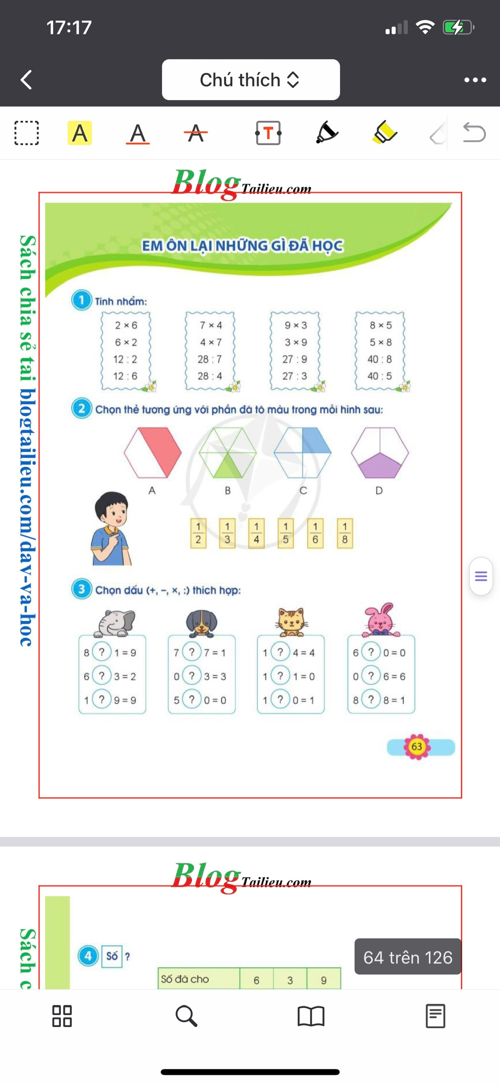
MẬT THƯ 1
1
Tính nhẩm:
= 12
= 28
= 27
= 40
= 12
= 28
= 27
= 40
= 6
= 4
= 3
= 5
= 2
= 7
= 9
= 8

Slide 19
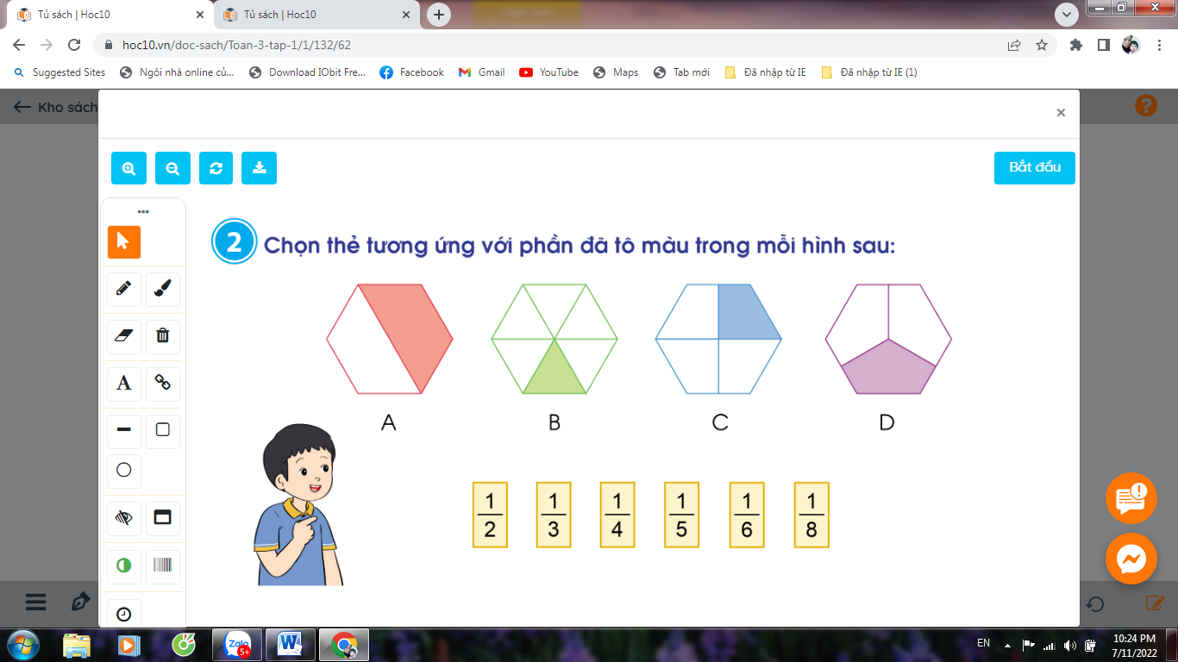
MẬT THƯ 2
2
Chọn thẻ tương ứng với phần đã tô màu trong mỗi hình sau:

Slide 20
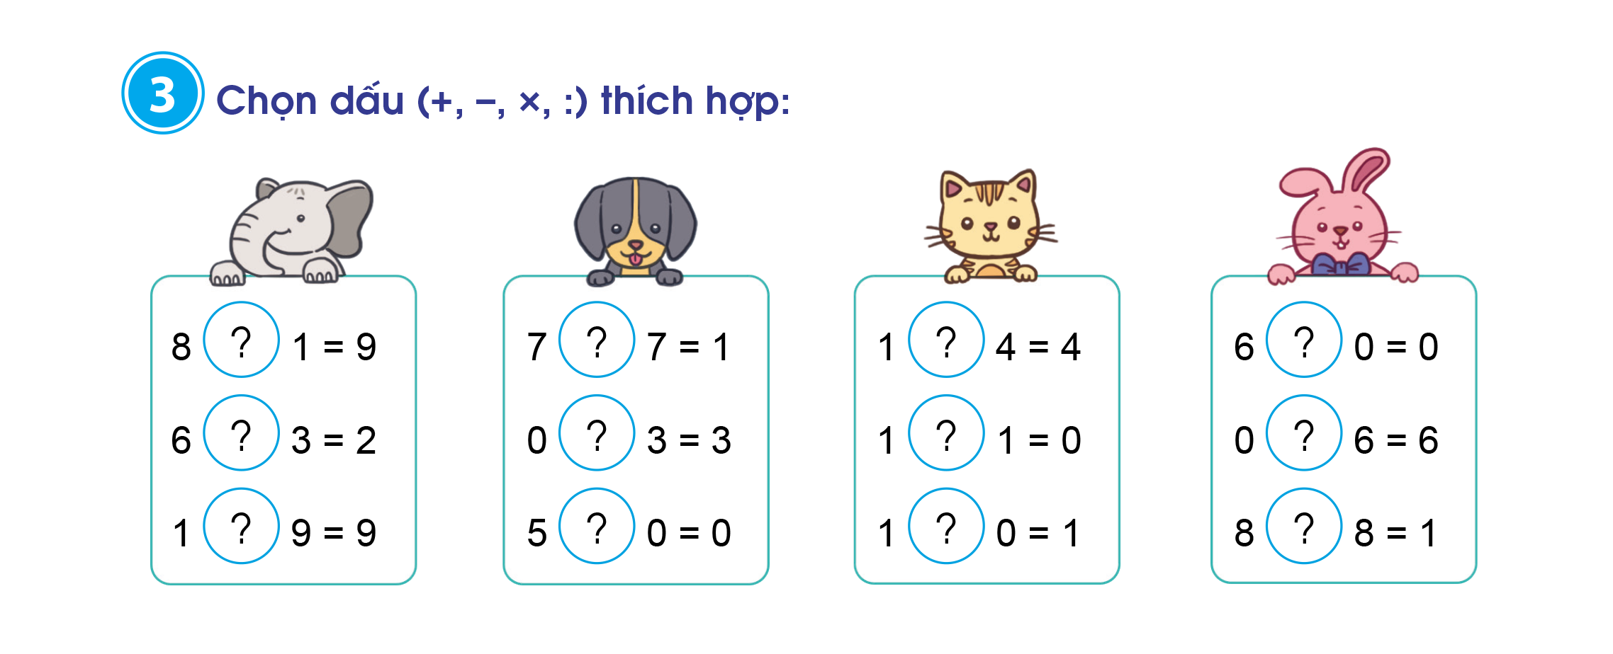
MẬT THƯ 3

Slide 21
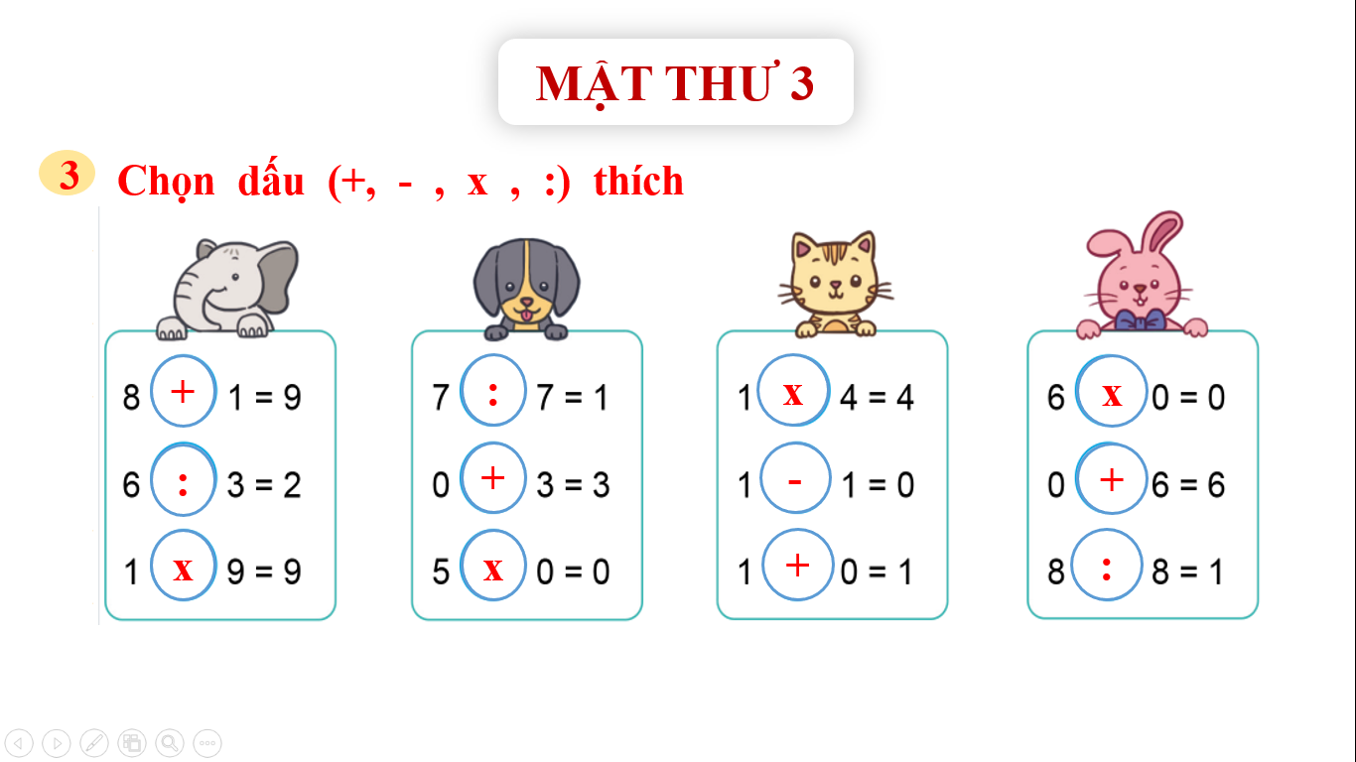

Slide 22
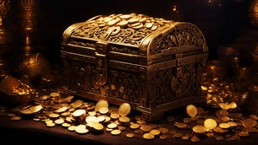

Slide 23
CHÀO TẠM BIỆT VÀ HẸN GẶP LẠI CÁC BẠN TRONG CHUYẾN ĐI TIẾP THEO.

