Slide 1

THEME 5: SPORTS AND FITNESS
Lesson 2
Grade 5
GIÁO VIÊN: LÊ THỊ XUYẾN
Trường Tiểu học Đoàn Lập

Slide 2


Slide 3
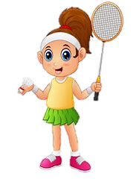
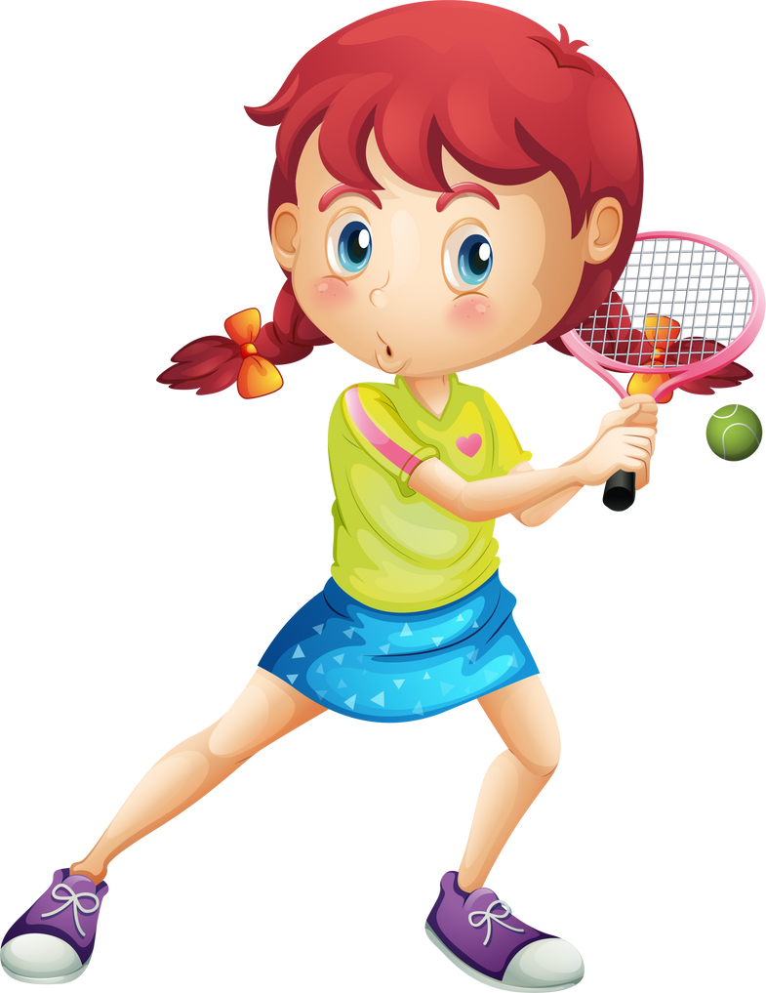
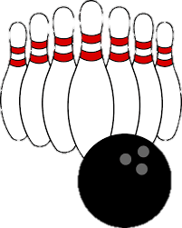
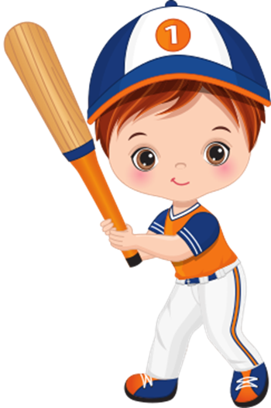
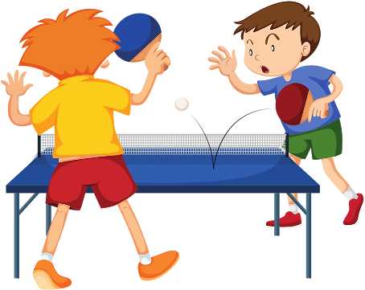

THEME 5: SPORTS AND FITNESS
Lesson 2

Slide 4
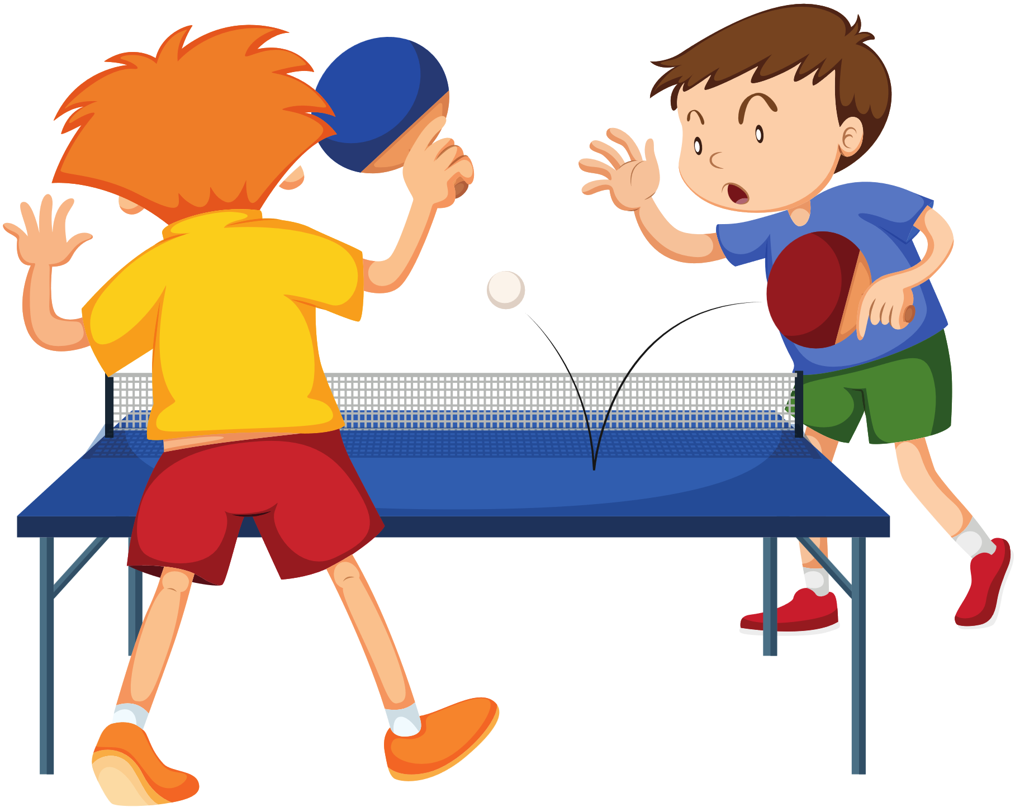
Play baseball

Slide 5
Go bowling
Play baseball
Play tennis
Go bowling
Play table tennis

Slide 6
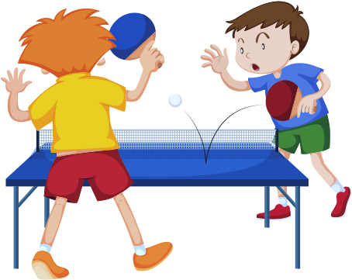
Play baseball
Play table tennis
Go bowling
Play baseball
Play tennis

Slide 7
Play tennis
Play baseball
Play table tennis
Go bowling

Slide 8
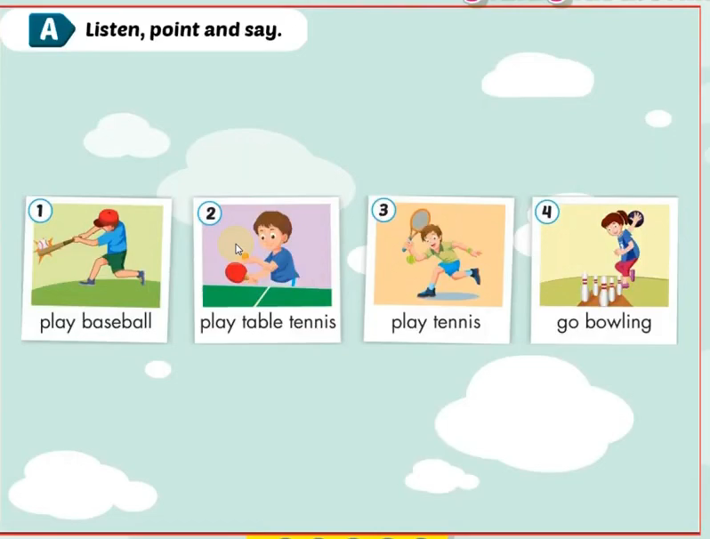


Slide 9
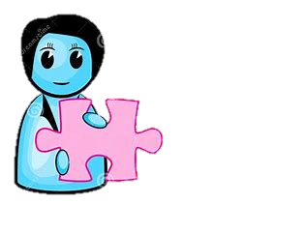
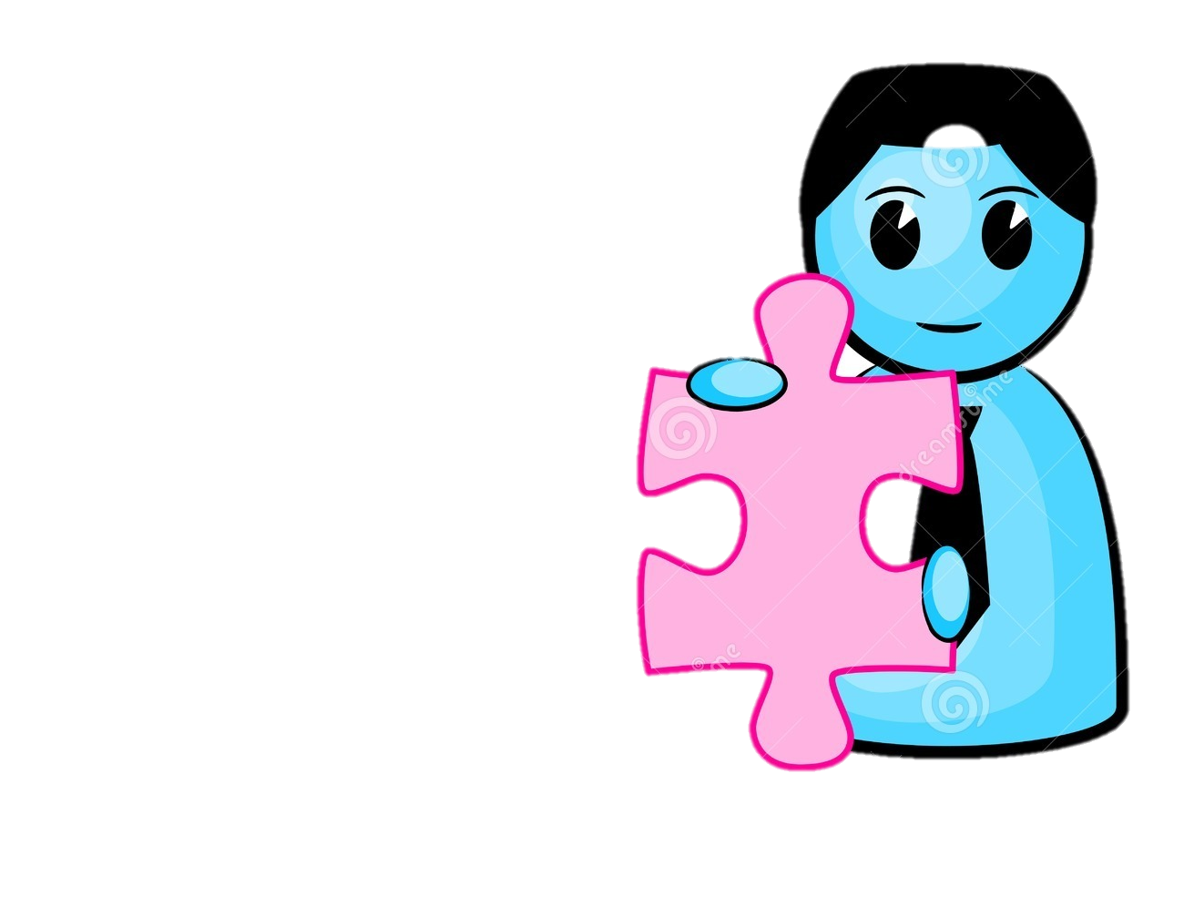
G
A
M
E
MATCHING

Slide 10


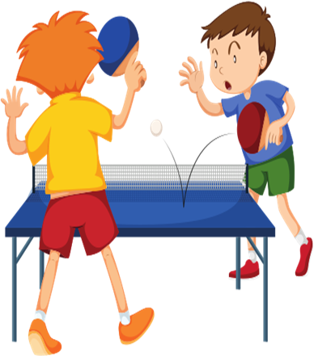
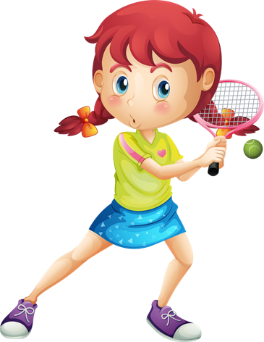


a. Play table tennis
1
b. Go bowling
2
c. Play baseball
3
d. Play tennis
4

Slide 11


Slide 12
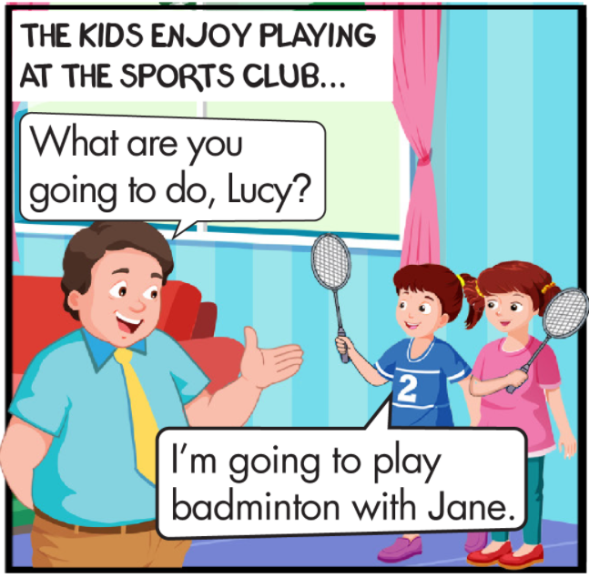
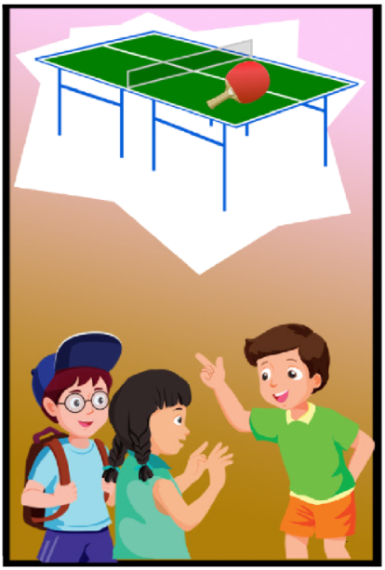
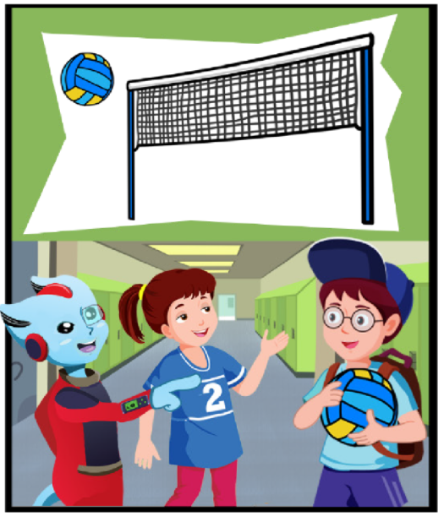
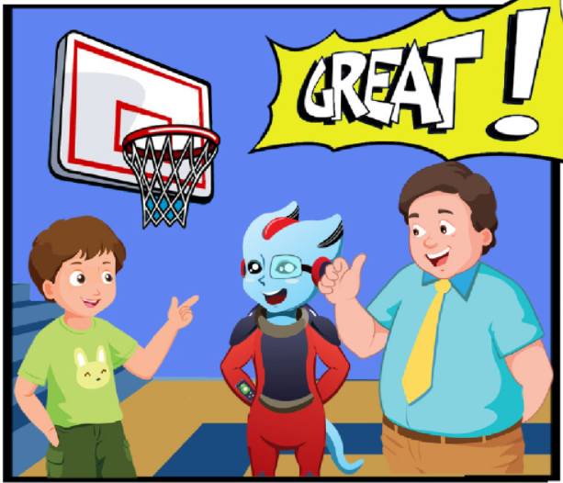
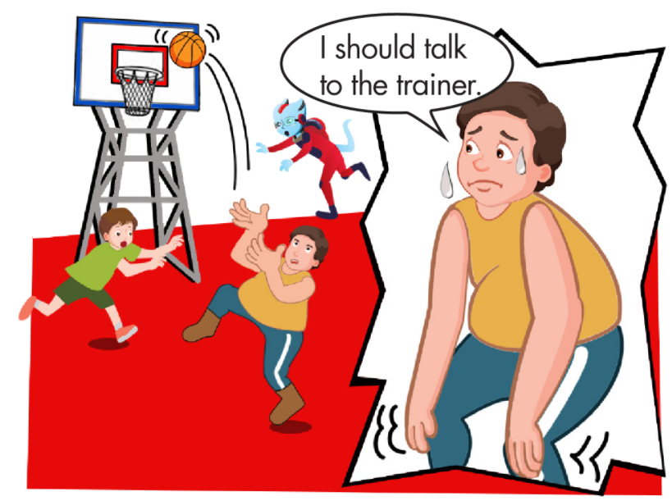
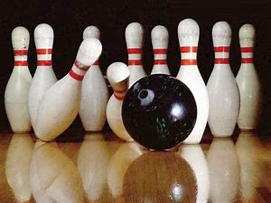

Slide 13
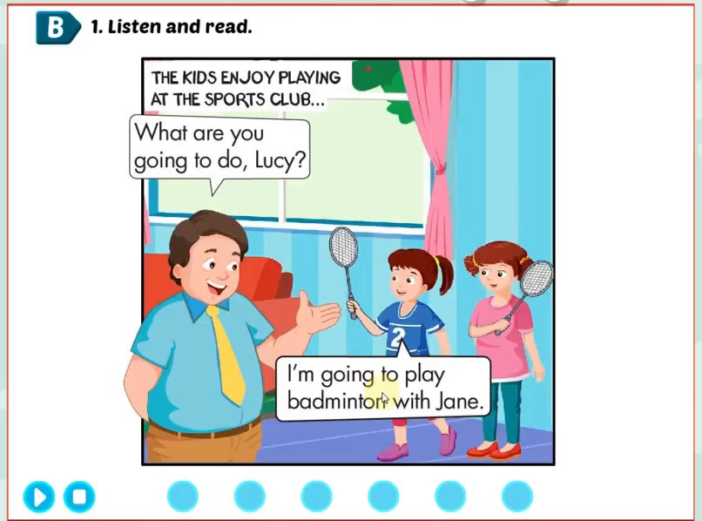

Slide 14
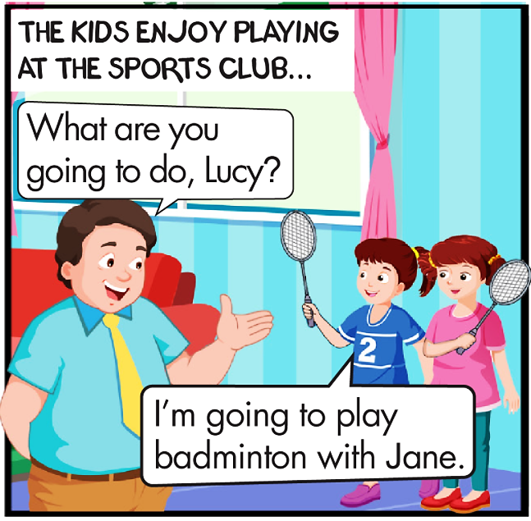
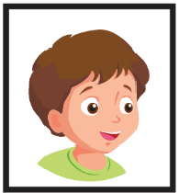


Hey, It’s Jane, Mai and Charlie.
OK, kids! Find something to play!
What are you going to do, Lucy ?
I’m going to play badminton with Jane.

Slide 15
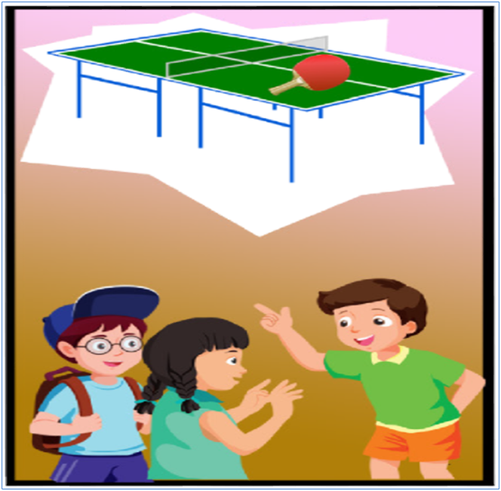

Ben, What are you going to do ?
I’m going to play table tennis with Mai

Slide 16
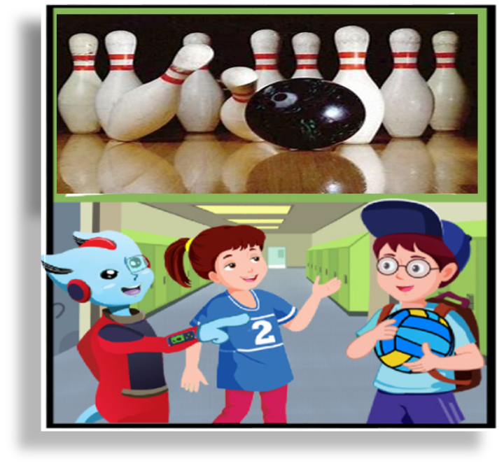

What are you going to do, Charlie ?
I’m going to go bowling with Alfie.

Slide 17
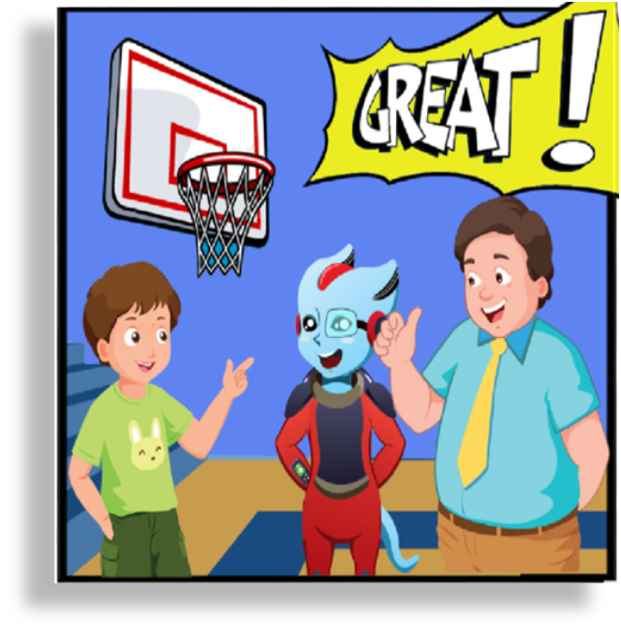

What about you, Tom ?
What are you going to do ?
I’m going to play basketball with you. Daddy.
Great

Slide 18
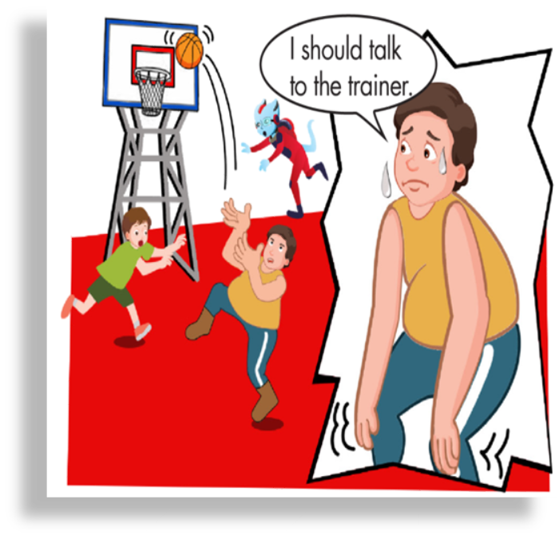

Yah.
Huh… huh… . I should talk to the trainer

Slide 19
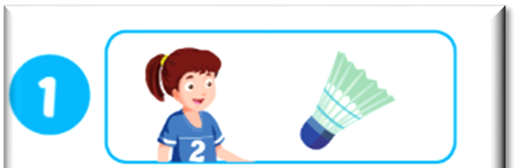
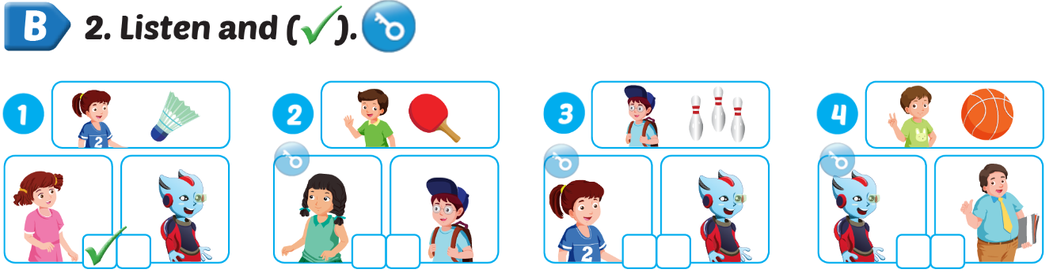







Listen and tick (✓)

Slide 20

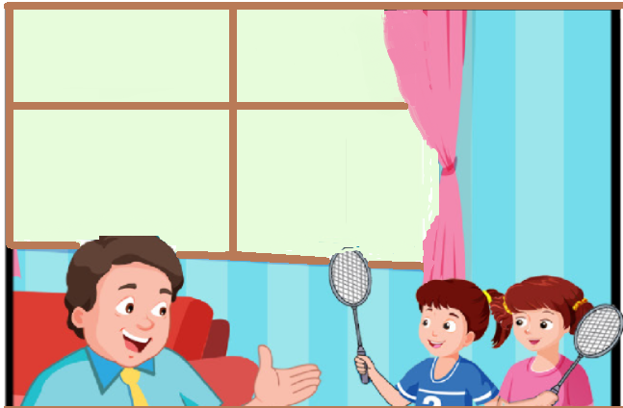
What are you going to do, Lucy ?
I’m going to play badminton
with Jane

Slide 21
Sam: What are you going to do, Lucy ?
Lucy: I’m going to play badminton with Jane.
Use this structure to ask and answer about the person who is going to play with you

Slide 22
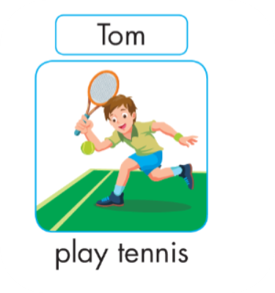
Tom
play tennis
What are you going to do ?
I’m going to ……………………………………………………………….. with ……………………………. .

Slide 23
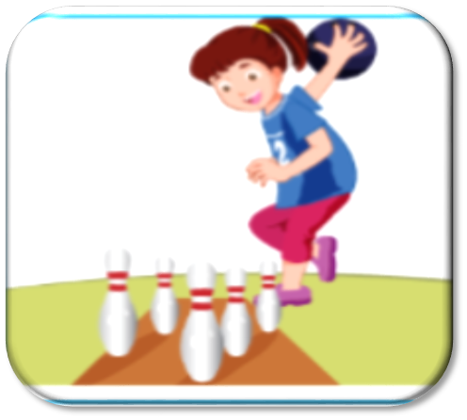
Lucy
go bowling
What are you going to do ?
I’m going to ……………………………………………………………….. with ……………………………. .

Slide 24

Ben
play baseball
What are you going to do ?
I’m going to ……………………………………………………………….. with ……………………………. .

Slide 25

G
A
M
E
Lucky boxes

Slide 26

1
2
3
4
5
6

Slide 27
1
2
3
4
5
6

Slide 28



Look, ask and answer
What are you going to do ?
I’m going to play soccer with Ben .

Slide 29


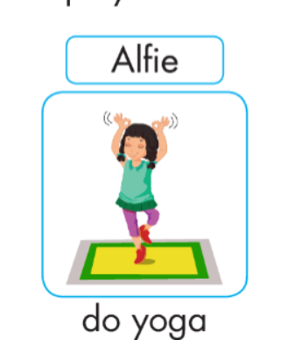
What are you going to do ?
I’m going to do yoga with Mai .

Slide 30



Slide 31



What are you going to do ?
I’m going to play badminton with Tom .

Slide 32



Slide 33

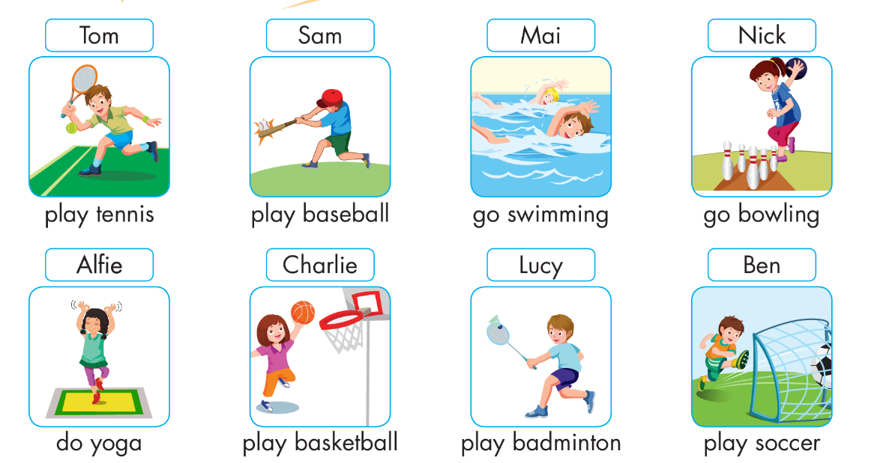

What are you going to do ?
I’m going to go swimming with Tom and Nick .

Slide 34


What are you going to do ?
I’m going to ………………. with …………….
play baseball
play table tennis
play tennis
go bowling

Slide 35
Home link :
Practice with your friends in your free time
Do excecises in workbook

Slide 36

Thank you

