Slide 1

WELCOME  TO  OUR  CLASS
ENGLISH 6

Slide 2
I. Warm up
Game: Hang man

Slide 3
UNIT 3: My friends
Lesson 1: Getting started (P26,27)

Slide 4
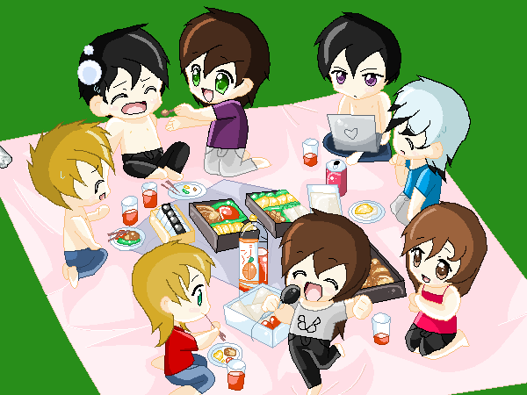
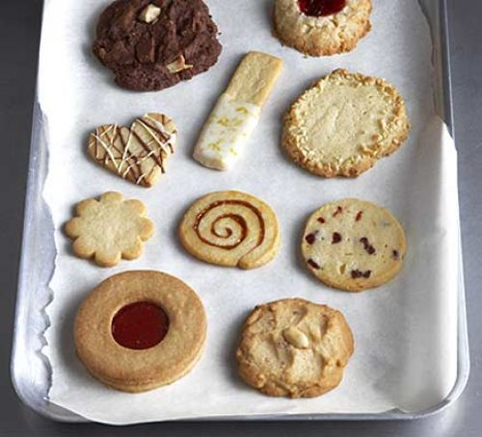
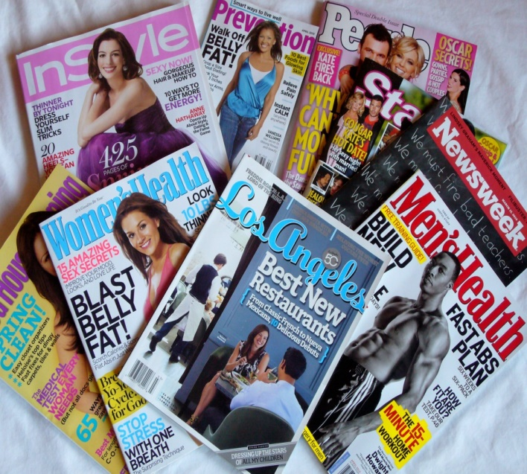
I. Vocabulary:
- picnic (n):
dã ngoại
-- biscuit (n): (n):
bánh quy
pass (v) :
chuyển qua, đưa qua
magazine (n):
tạp chí
- surprise (adj):
bất ngờ, ngạc nhiên

Slide 5
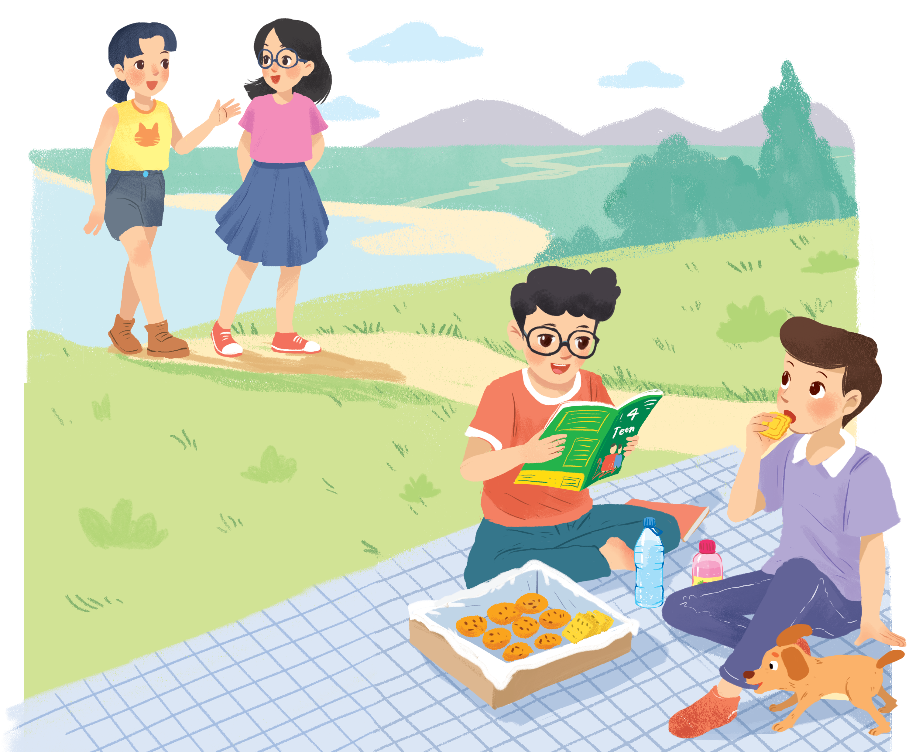
Look and answer.
Who are they?
Nam
They are Mai, Chau, Phong and Nam.
Mai
Chau
Phong
Listen and check

Slide 6

II.Reading (P.26)
A surprise guest
Phong: That was a great idea, Nam. I love picnics!
Nam: Please pass me the biscuits.
Phong: Sure. Here you are.
Nam: Thanks. What are you reading, Phong?
Phong: 4Teen. It's my favourite magazine!
Nam: Look! It's Mai. And she is with someone.
Phong:Oh, who's that? She has glasses and long black hair.
Nam: I don't know. They're coming over.
Mai: Hi there. This is my friend Chau.
Phong & Nam: Hi, Chau. Nice to meet you.
Chau: Nice to meet you, too.
Nam: Would you like to sit down? We have lots of food.
Mai: Oh, sorry, we can't. We are going to the bookshop.
Chau: Bye for now.
Phong & Nam: Bye bye.

Slide 7
2. Read again and fill in the words!
1. Phong and Nam are having a ____________.
2. 4Teen is Phong's ____________________ .
3. Phong and Nam see _______ and ___________.
4. Chau has ________, and _________________.
5. Mai and Chau _____________ the bookshop.

Slide 8
Let’s check!
1. Phong and Nam are having a ____________.
picnic
Phong: That was a great idea, Nam. I love picnics!
Nam: Please pass me the biscuits.
2. 4Teen is Phong's __________________.
favourite magazine
Nam: Thanks. What are you reading, Phong?
Phong: 4Teen. It's my favourite magazine!

Slide 9
Let’s check!
3. Phong and Nam see ___________ and ___________.
Mai
Chau
Nam: Look! It's Mai. And she is with someone.
Phong: Oh, who's that? She has glasses and long black hair.
Mai: Hi there. This is my friend Chau.

Slide 10
Let’s check!
4. Chau has _____________, and _________________.
glasses
long black hair
Nam: Look! It's Mai. And she is with someone.
Phong: Oh, who's that? She has glasses and long black hair.
Mai: Hi there. This is my friend Chau.

Slide 11
Let’s check!
5. Mai and Chau _____________ the bookshop.
are going to
Mai: Oh, sorry, we can't. We're going to the bookshop.

Slide 12

Fill the blanks with the words from the conversation.
1.
Phong and Nam are having a .
picnic
favourite magazine.
2.
4Teen is Phong’s
Mai
Chau.
Phong and Nam see and
3.
.
Chau has and
long black hair.
4.
glasses
.
are going to
the bookshop.
5.
Mai and Chau

Slide 13
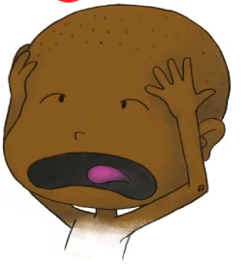
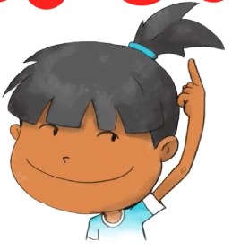
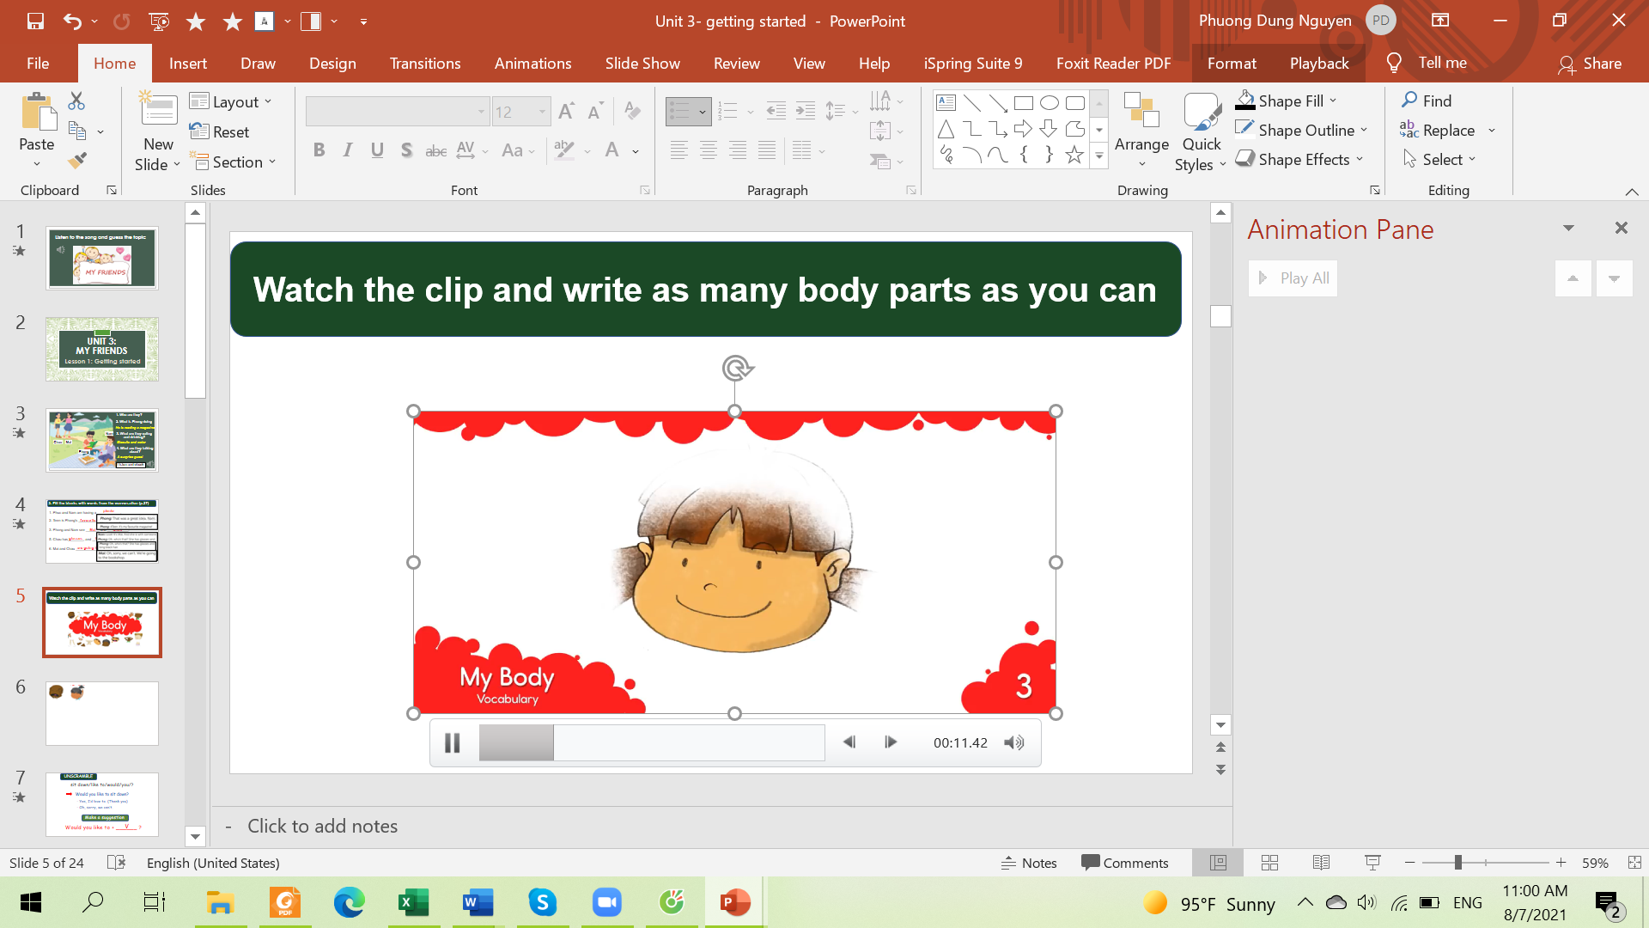
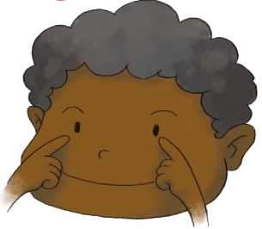
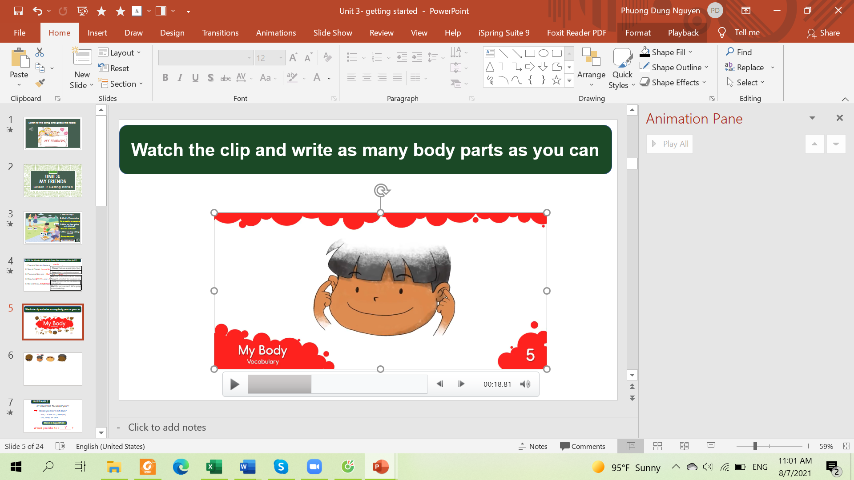
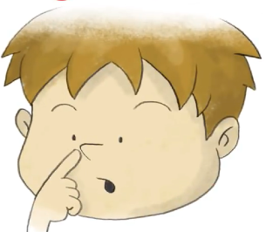
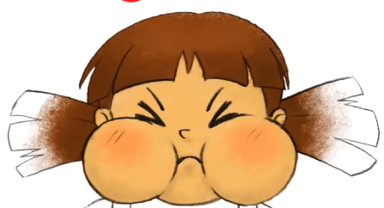
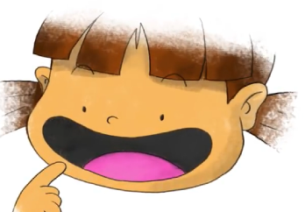


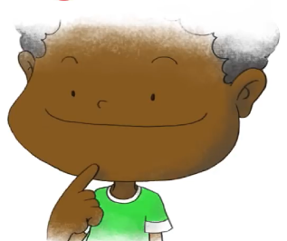
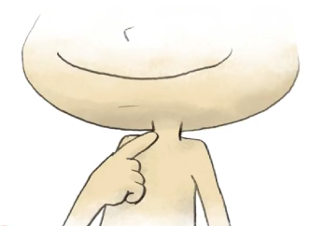
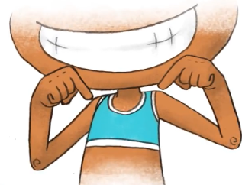
head
hair
face
eyes
ears
nose
cheeks
mouth
teeth
tongue
Listen and repeat
chin
neck
shoulders

Slide 14
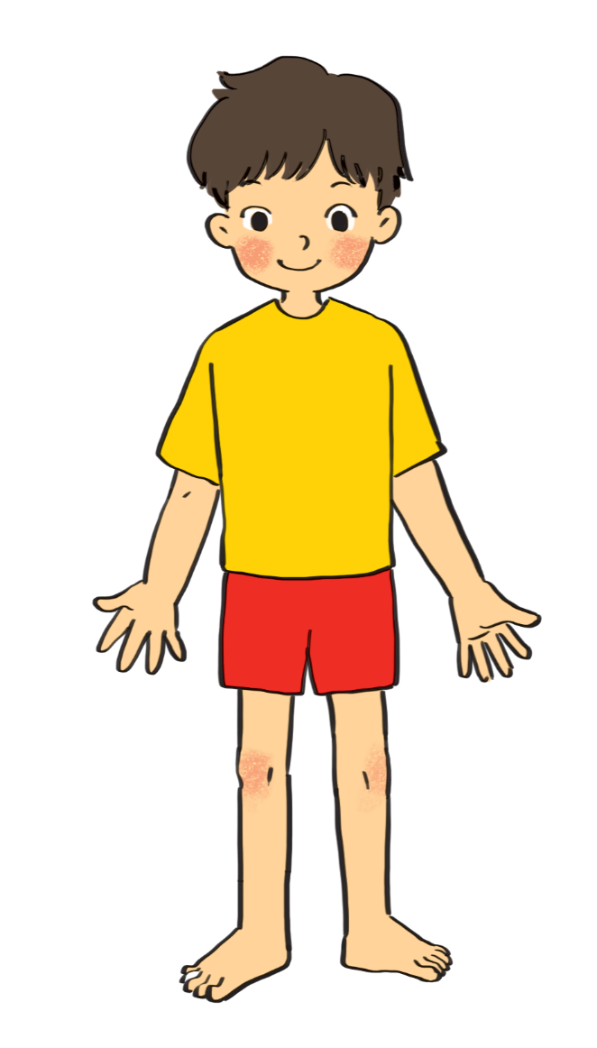
3. Label the body parts (p.27)
1.
eye
10.
hair
9.
cheek
2.
nose
8.
mouth
3.
shoulder
7.
arm
4.
hand
5.
leg
6.
foot

Slide 15


Work in groups. Complete the word webs.
Example:
arms
hair
nose
eyes
long / short
big / small
blonde
curly
hair

Slide 16
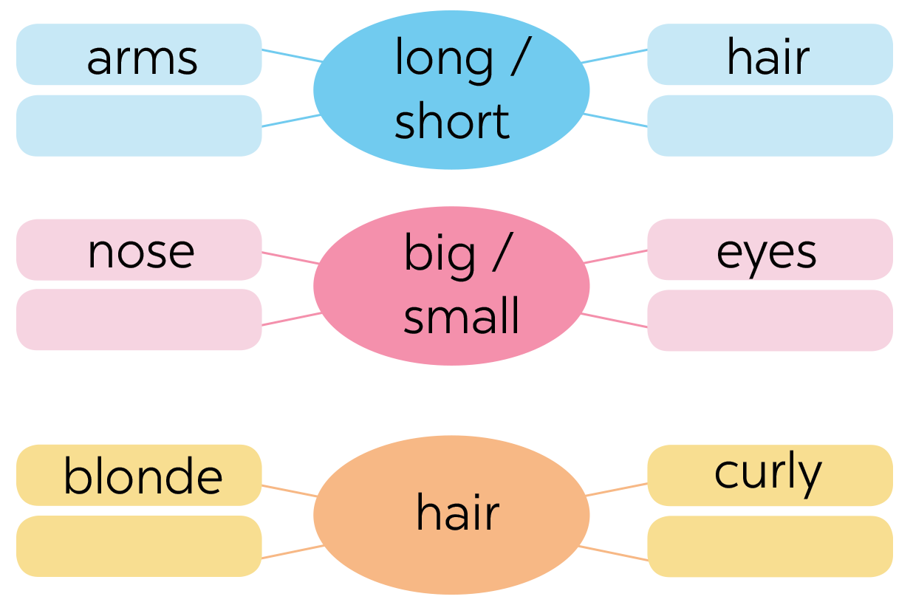
4. Work in groups. Complete the word webs.
legs
feet
hands
ears
black
straight

Slide 17


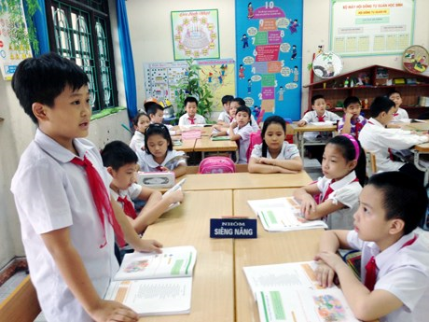
Guessing
Work in groups. Take turns to describe a classmate. Other group members guess who he / she is.
Example:
A: She has long hair and big eyes.
B: Is that Lan?
A: That’s right.

Slide 18
6. Homework - Learn by heart all the new words. - Prepare lesson 2 ( A closer look 1).

Slide 19
Goodbye
See you again!!!

