Slide 1




Unit 1
What’s your address?
Lesson 2
Teacher: Ms. Huyền Phạm
Facebook: Học Tiếng Anh cùng Ms.Pham

Slide 2
VOCABULARY

Slide 3

Vocabulary
Big
/big/
Small
/smɔːl/
(a) nhỏ

Slide 4

Vocabulary
Noisy
/ˈnɔɪzi/
(a) Ồn ào
quiet
/ˈkwaɪət/
(a) Yên tĩnh

Slide 5
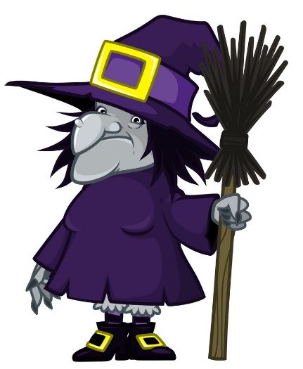

Vocabulary
beautiful
/ˈbjuːtɪfl/
(a) đẹp, xinh

Slide 6
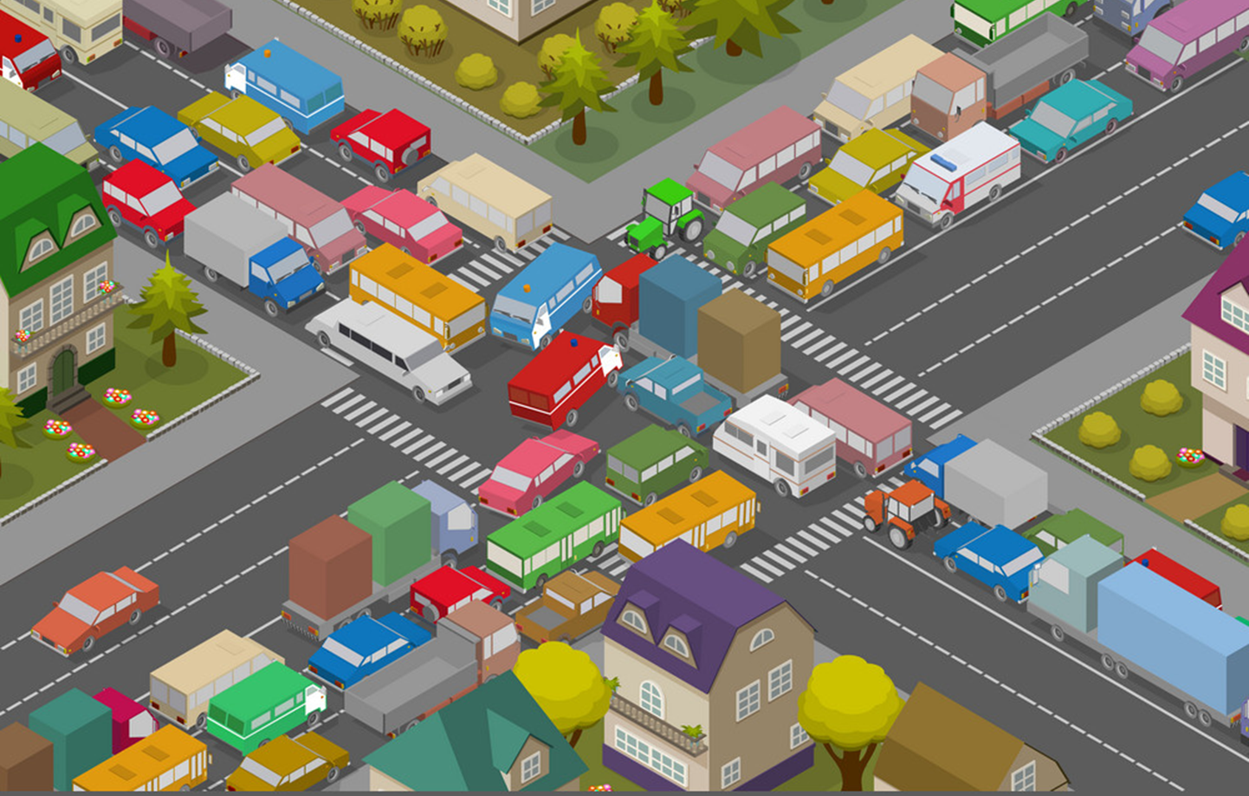
Vocabulary
crowded
/ˈkraʊdɪd/
(a) Đông đúc

Slide 7

Vocabulary
busy
/ˈbɪzi/
(a) bận rộn

Slide 8

Vocabulary
large
/lɑːrdʒ/
(a) rộng

Slide 9

Vocabulary
far
/fɑː/
(a) xa

Slide 10


Vocabulary
hometown
/ˈhəʊmtaʊn/
(n) quê

Slide 11

Vocabulary
mountain
/ˈmaʊntən/
(n) núi

Slide 12

Vocabulary
island
ˈaɪlənd/
(n) Hòn đảo

Slide 13




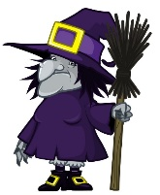

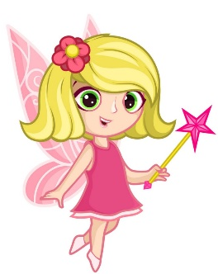
Vocabulary
island
mountain
hometown
far
noisy
big
large
quiet
small
beautiful
crowded

Slide 14
Vocabulary
island
(n)
Hòn đảo
mountain
(n)
Ngọn núi
hometown
(n)
Quê hương
far
(a)
xa
noisy
(a)
Ồn ào
big
(a)
to
crowded
(a)
Đông đúc
quiet
(a)
Yên tĩnh
beautiful
(a)
Đẹp, xinh
small
(a)
Nhỏ, bé
large
(a)
Rộng lớn

Slide 15
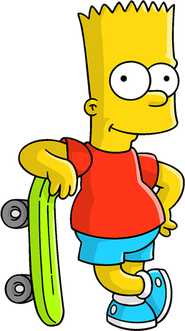

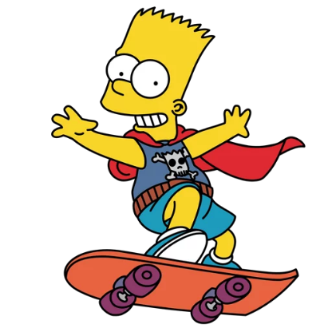

WHERE IS
BART
?

Slide 16





TIME’S UP
NEXT
A
I live on an village.
B
I live on an Island.
C
I live on an mountain.

Slide 17

TIME’S UP
NEXT
A
Hai Phong is my mountain.
B
Hai Phong is my island.
C
Hai Phong is my hometown.

Slide 18
TIME’S UP
NEXT
A
Near
B
Far
C
Small

Slide 19

TIME’S UP
NEXT
A
moutain
B
city
C
village

Slide 20


TIME’S UP
NEXT
A
Crowded
B
Beautiful
C
Quiet

Slide 21

TIME’S UP
NEXT
A
Large
B
Small
C
Noisy

Slide 22
TIME’S UP
NEXT
A
Noisy
B
Busy
C
Quiet

Slide 23
TIME’S UP
NEXT
A
Noisy
B
Small
C
Big

Slide 24
TIME’S UP
NEXT
A
Crowded
B
Quiet
C
Moutain

Slide 25
TIME’S UP
NEXT
A
Big
B
Small
C
Noisy

Slide 26
Welldone!
END

Slide 27

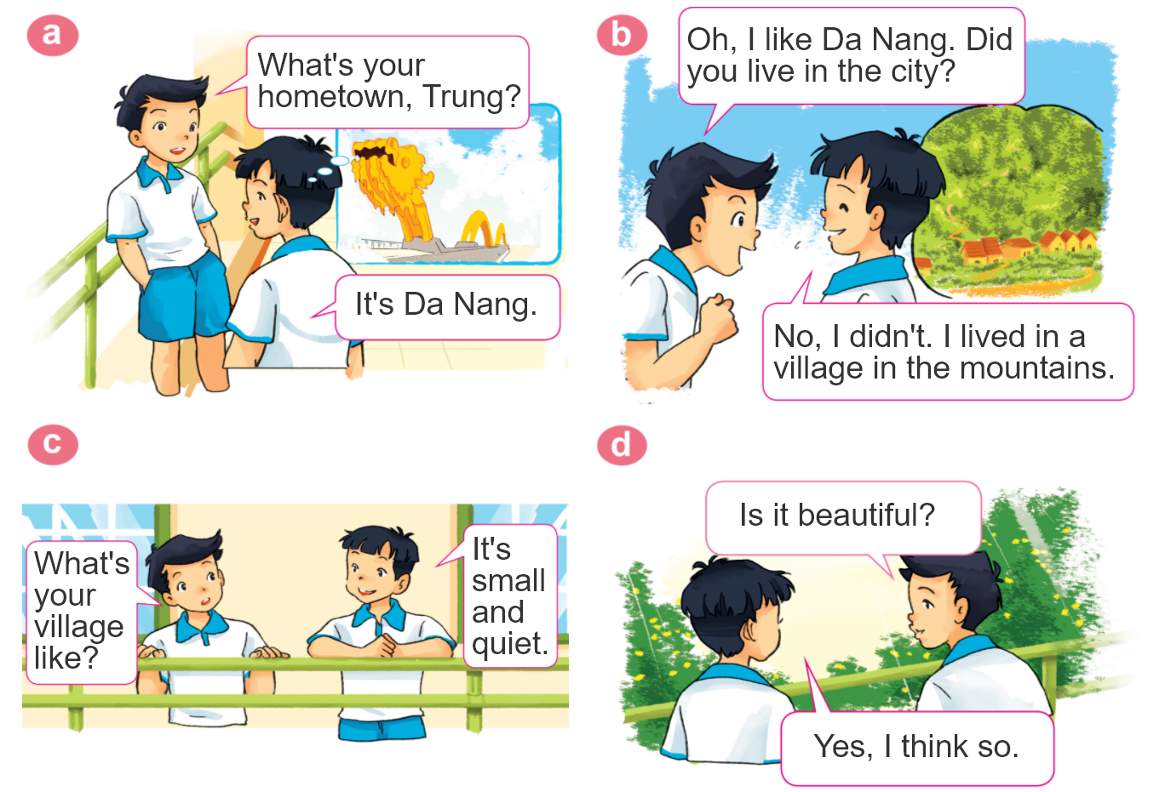
1. Look, listen and repeat.

Slide 28
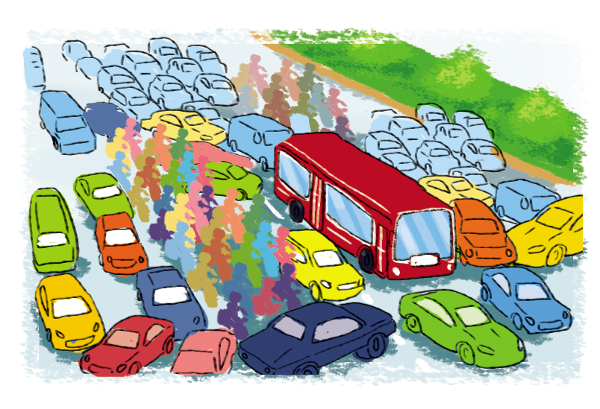

2. Point and say
city,
big and busy
What's the ________ like?
city
It's __________________.
big and busy

Slide 29
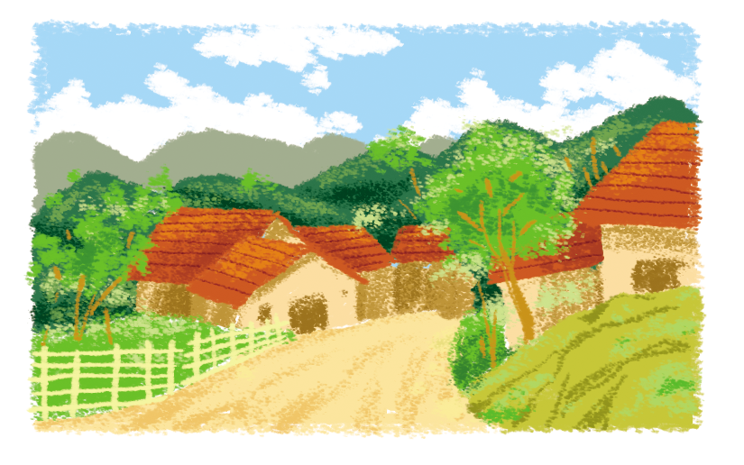
2. Point and say
village,
far and quiet
What's the ________ like?
village
It's __________________.
far and quiet

Slide 30
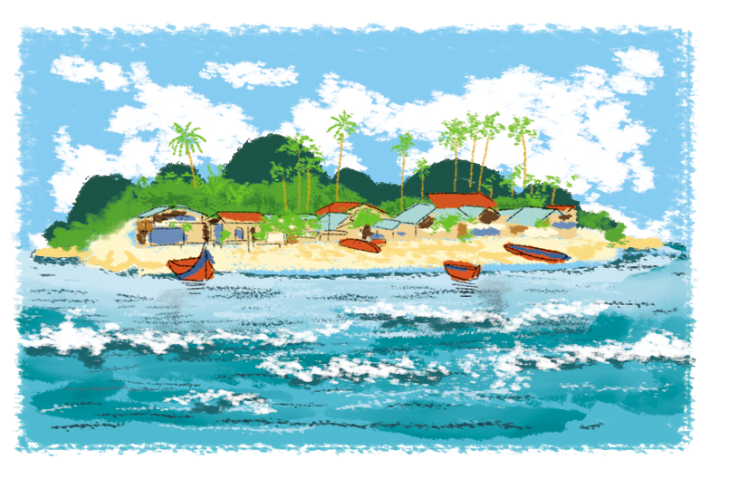
2. Point and say
island,
small and pretty
What's the ________ like?
island
It's __________________.
small and pretty

Slide 31
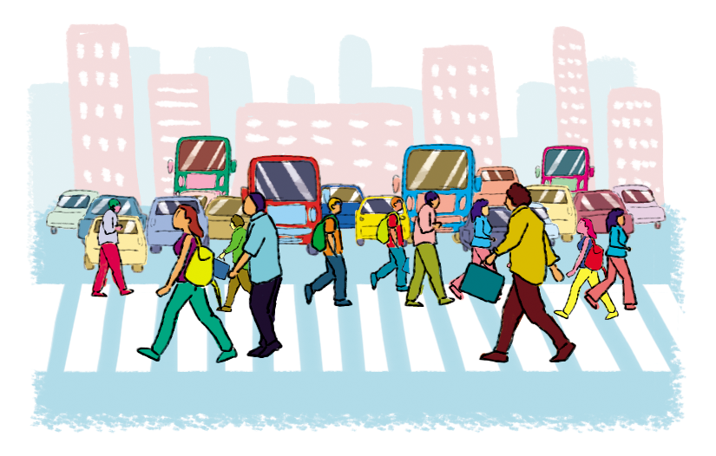
2. Point and say
town,
large and crowded
What's the ________ like?
town
It's __________________.
large and crowded

Slide 32




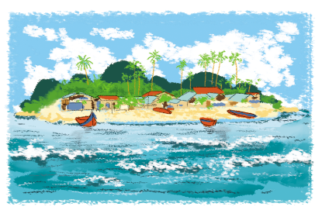
2. Point and say
What's the ________ like?
It's ___________.
city,
big and busy
town,
large and crowded
village,
far and quiet
island,
small and pretty

Slide 33
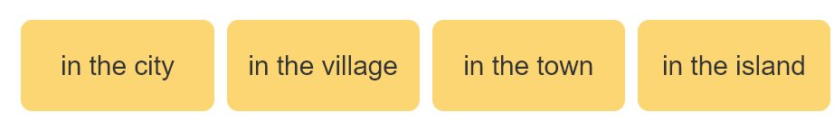
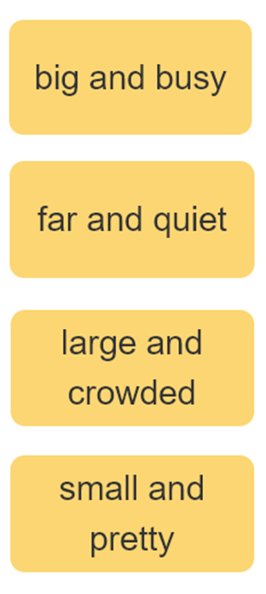

3. Let’s talk
I live ____________.
Where do you live?
What's it like?
It’s ______.
Who do you live with?
I live with ________.
parents
grandparents

Slide 34
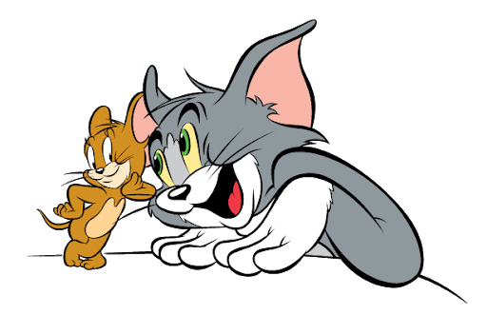
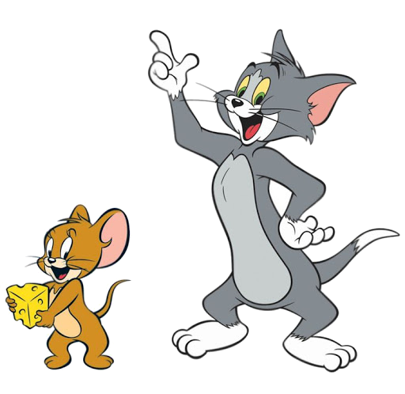


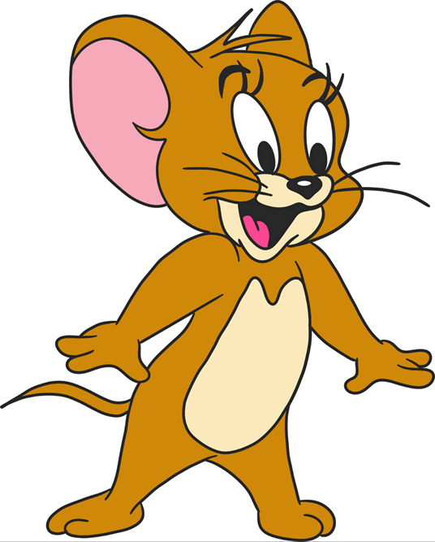


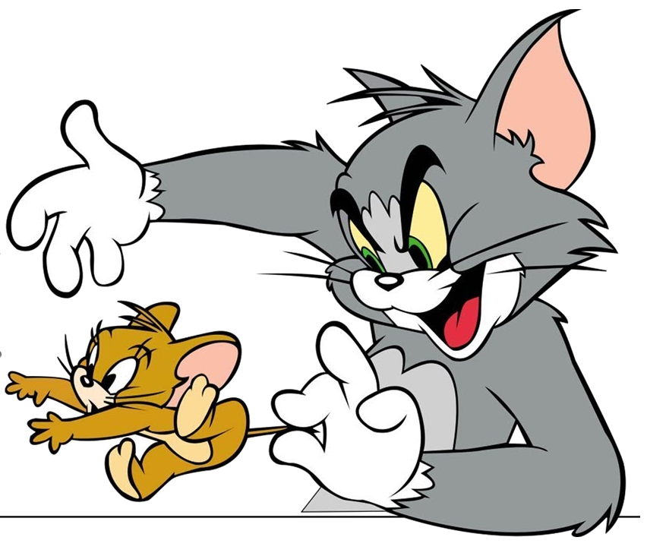

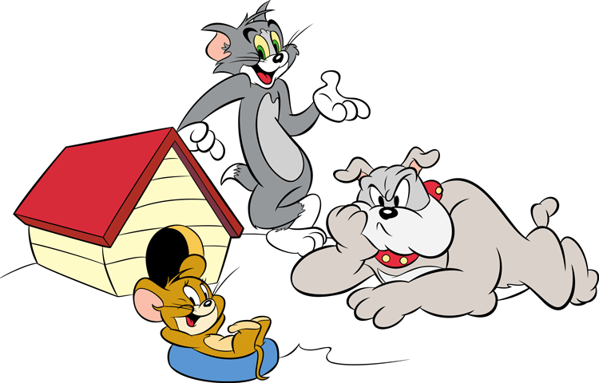
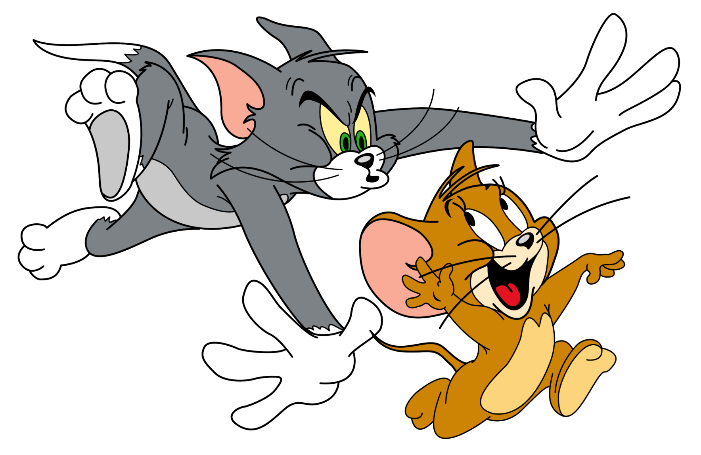

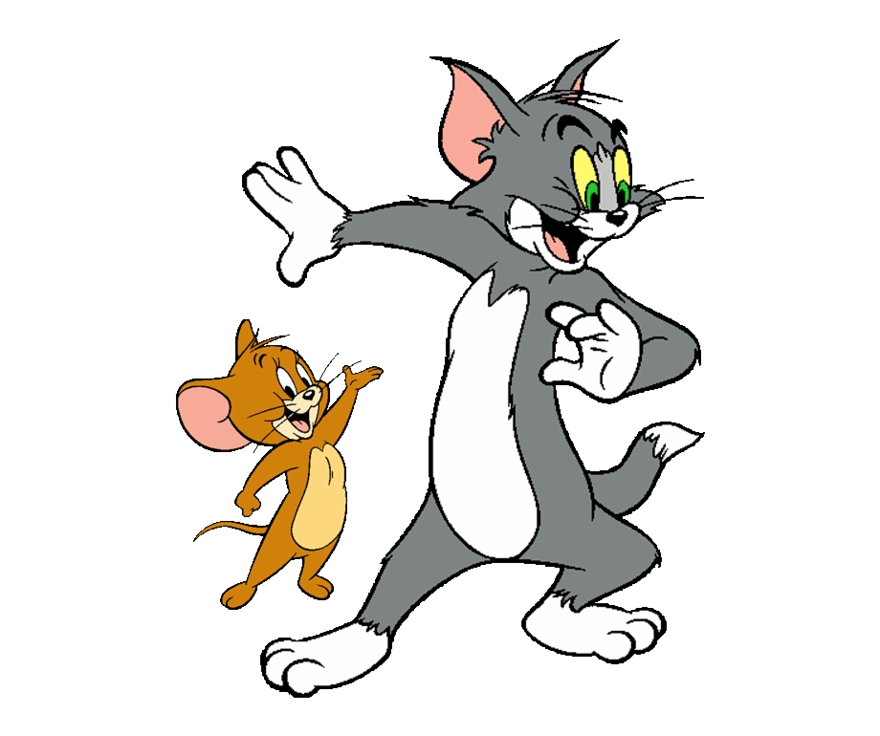

GAME
Notes:
Ms Huyền Phạm - 0936.082.789 – YOUTUBE: MsPham. Facebook: Dạy và học cùng công nghệ.

Slide 35

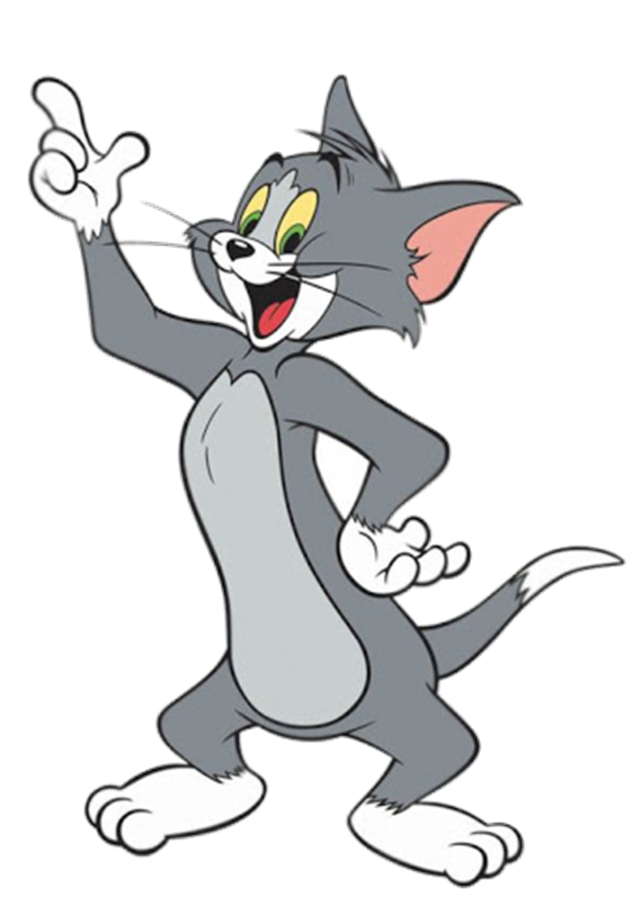

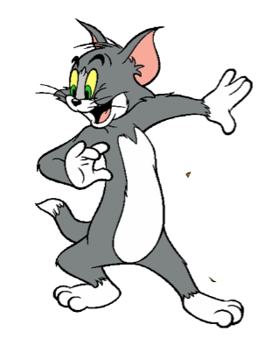






Where do you live?
I live in Quang Ninh.
I live ____________.
What's it like?
It’s ______.
Who do you live with?
I live with ________.
Notes:
Ms Huyền Phạm - 0936.082.789 – YOUTUBE: MsPham. Facebook: Dạy và học cùng công nghệ.

Slide 36
Mai: (1) your address?
Trung: (2) 81, Tran Hung Dao Street.
Mai: (3) do you live with?
Trung: My grandparents.
Mai: Do you (4) living in Ha Noi?
Trung: Yes, very much.
Mai: (5) your hometown like?
Trung: It's small and quiet.
What’s your hometown like? It’s large and far.
I live ____________.
It’s ______.
I live with ________.
Notes:
Ms Huyền Phạm - 0936.082.789 – YOUTUBE: MsPham. Facebook: Dạy và học cùng công nghệ.

Slide 37
What’s your flat like?
It’s beautiful.
Notes:
Ms Huyền Phạm - 0936.082.789 – YOUTUBE: MsPham. Facebook: Dạy và học cùng công nghệ.

Slide 38
Check
Who do you live with?
I live in a village.
Where do you live?
Notes:
Ms Huyền Phạm - 0936.082.789 – YOUTUBE: MsPham. Facebook: Dạy và học cùng công nghệ.

Slide 39
Check
Where’s your address? It’s 81, Orange street.
What’s
Notes:
Ms Huyền Phạm - 0936.082.789 – YOUTUBE: MsPham. Facebook: Dạy và học cùng công nghệ.

Slide 40
Check
How’s the village like? It’s small and quiet.
What’s
Notes:
Ms Huyền Phạm - 0936.082.789 – YOUTUBE: MsPham. Facebook: Dạy và học cùng công nghệ.

Slide 41
Mai: Who do you live with?
Trung: My grandparents
Notes:
Ms Huyền Phạm - 0936.082.789 – YOUTUBE: MsPham. Facebook: Dạy và học cùng công nghệ.

Slide 42
What’s the village like?
It’s small and pretty.
Notes:
Ms Huyền Phạm - 0936.082.789 – YOUTUBE: MsPham. Facebook: Dạy và học cùng công nghệ.

Slide 43
Where do you live?
It’s in Quang Ninh.
Check
I live
Notes:
Ms Huyền Phạm - 0936.082.789 – YOUTUBE: MsPham. Facebook: Dạy và học cùng công nghệ.

Slide 44


Good job!
Notes:
Ms Huyền Phạm - 0936.082.789 – YOUTUBE: MsPham. Facebook: Dạy và học cùng công nghệ.

Slide 45
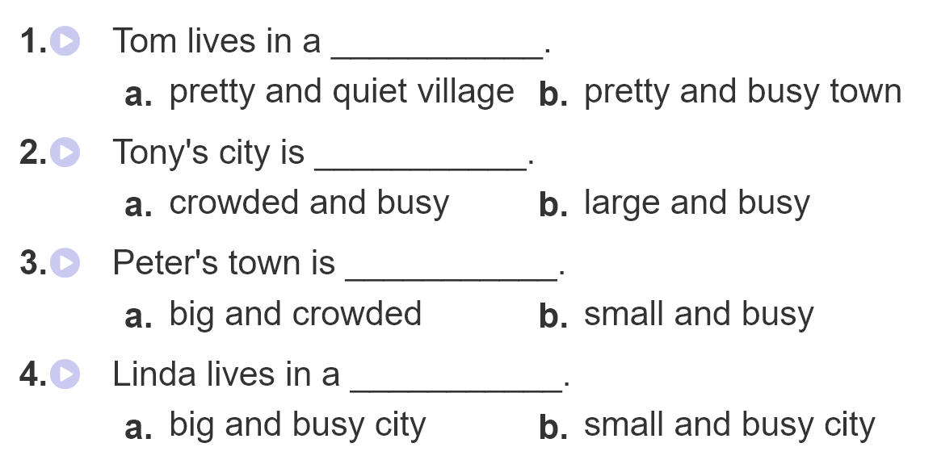
4. Listen and circle

Slide 46
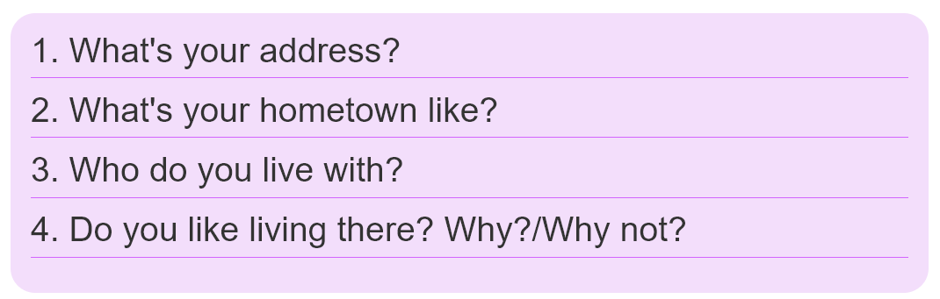
5. Write about you.

Slide 47
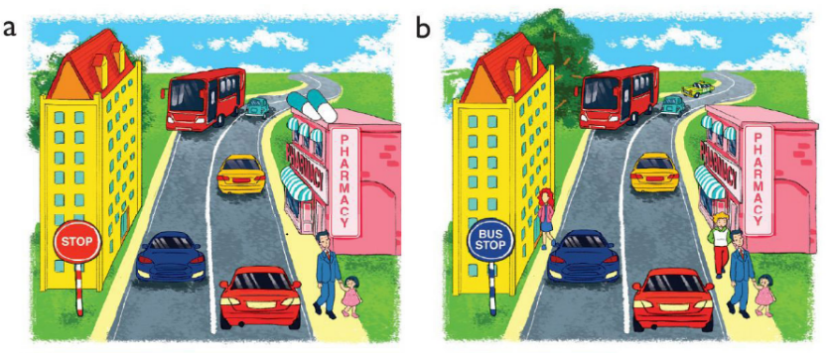
6. Let’s play
Spot the difference
(Click the different spot)

Slide 48



THANK YOU!
Welcome to join with me!
MsPham Powerpoint
Mspham

