Slide 1



Unit 1
What’s your address?
Lesson 2
Teacher: Ms. Huyền Phạm
Facebook: Học Tiếng Anh cùng Ms.Pham

Slide 2








Slide 3




live
address
My _____ is 187B, Giang Vo Street.
from

Slide 4
house
flat
I live on the second _______ of a tower
floor

Slide 5
street
village
My grandparents live in a small __________ in the countryside
city

Slide 6
Tower
Town
There are two tall_________ in my street.
City

Slide 7
big
small
Ha Noi and Ho Chi Minh City are two ____ cities in the country
quiet

Slide 8

It's small and quiet.
My family.
What's your address?
It's 201, Tran Hung Dao Street.

Slide 9
It's small and quiet.
In Hai Phong Province.
What's your hometown like?
With my parents

Slide 10
It's 201, Tran Hung Dao Street.
In Hau Giang Province.
Where do you live?
I live with my family.

Slide 11
In Hau Giang Province.
It's 201, Tran Hung Dao Street
Who do you live with?
My family

Slide 12
Good job!

Slide 13
PRONUNCIATION

Slide 14
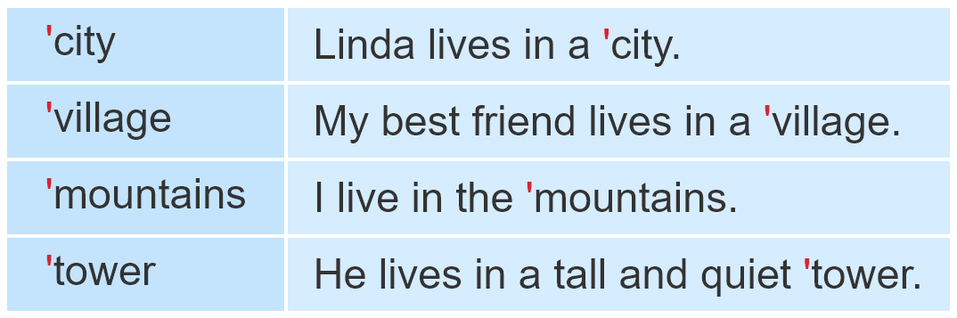

1. Listen and repeat.

Slide 15
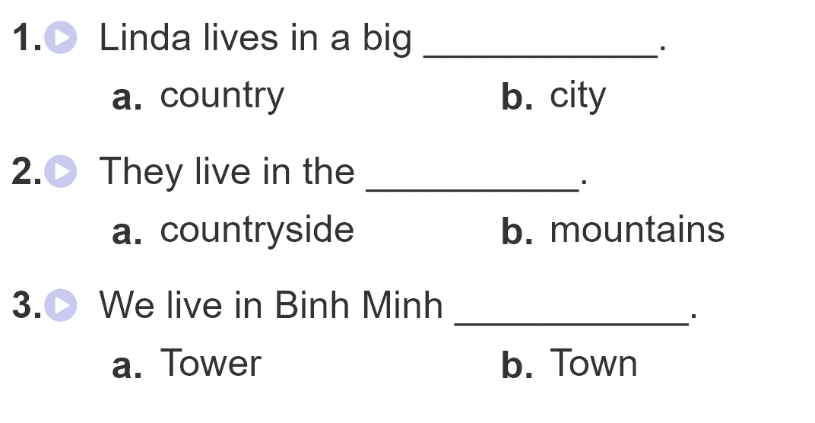
2.Listen and circle

Slide 16
PRACTISE

Slide 17
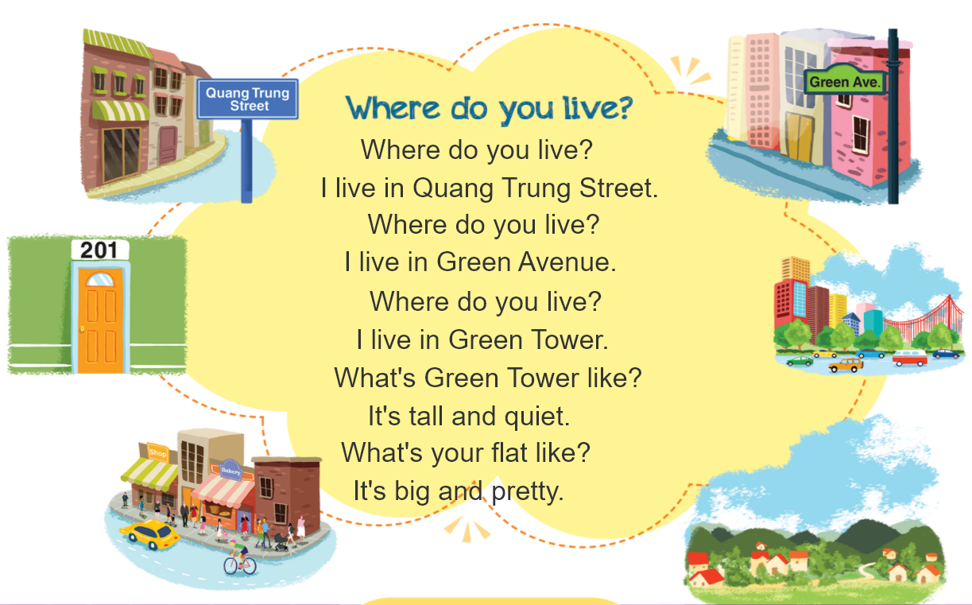


3. Let’s chant

Slide 18
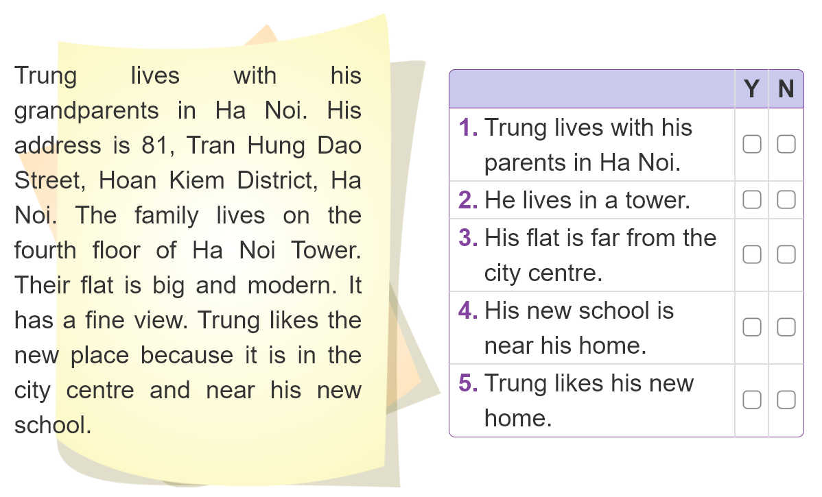

4. Listen and circle

Slide 19
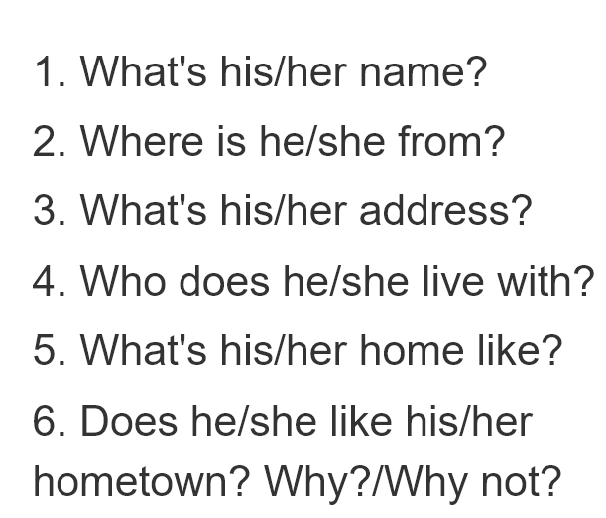
5. Write about your friend.
_________________________________________________________________________________________________________________________________________________________________________________________________________________________________________________________________________________

Slide 20
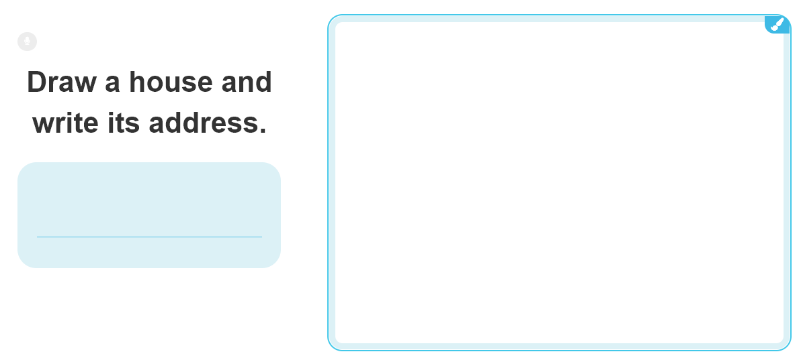
6. Let’s play

Slide 21



THANK YOU!
Welcome to join with me!
MsPham Powerpoint
Mspham

