Slide 1
Unit 16
LET'S GO TO
THE BOOKSHOP
Lesson 3

Slide 2
















Trò chơi
HÁI TÁO
Notes:
Ms Huyền Phạm - 0936.082.789 – YOUTUBE: MsPham. Facebook: Dạy và học cùng công nghệ.

Slide 3

see the books
I want to go to the zoo because I want to _________________.
A
see the animals
B
see a film
C
Notes:
Ms Huyền Phạm - 0936.082.789 – YOUTUBE: MsPham. Facebook: Dạy và học cùng công nghệ.

Slide 4
Why do you
_________ want to the cinema?
Because I want to see a film.
A
Why does she
B
Why does he
C
Notes:
Ms Huyền Phạm - 0936.082.789 – YOUTUBE: MsPham. Facebook: Dạy và học cùng công nghệ.

Slide 5
Why do you
_________ want to the sweetshop?
Because he wants to buy some chocolate.
A
Why does Mai
B
Why does Tony
C
Notes:
Ms Huyền Phạm - 0936.082.789 – YOUTUBE: MsPham. Facebook: Dạy và học cùng công nghệ.

Slide 6
Why do you
_________ want to the bakery?
Because he wants to buy some bread.
A
Why does Tony
B
Why does Linda
C
Notes:
Ms Huyền Phạm - 0936.082.789 – YOUTUBE: MsPham. Facebook: Dạy và học cùng công nghệ.

Slide 7
Why do you want to
________ the supermarket. I want to buy some food.
A
Let’s go
B
Let’s go to
C
Notes:
Ms Huyền Phạm - 0936.082.789 – YOUTUBE: MsPham. Facebook: Dạy và học cùng công nghệ.

Slide 8

Sorry! I’m busy.
Let’s go to the pharmacy. I want to buy some medicine.
A
Yes, please.
B
Great idea.
C
Notes:
Ms Huyền Phạm - 0936.082.789 – YOUTUBE: MsPham. Facebook: Dạy và học cùng công nghệ.

Slide 9

Sorry! I’m late.
Let’s go to the swimming pool. I want to swim.
A
Great idea.
B
Sorry! I’m busy.
C
Notes:
Ms Huyền Phạm - 0936.082.789 – YOUTUBE: MsPham. Facebook: Dạy và học cùng công nghệ.

Slide 10
Great idea.
Let’s go to the zoo. I want to see animals.
A
No, thanks.
B
Sorry! I’m busy.
C
Notes:
Ms Huyền Phạm - 0936.082.789 – YOUTUBE: MsPham. Facebook: Dạy và học cùng công nghệ.

Slide 11
Great idea.
Let’s go to the cinema. I want to see a film.
A
Sorry. I’m busy.
B
Yes, I do
C
Notes:
Ms Huyền Phạm - 0936.082.789 – YOUTUBE: MsPham. Facebook: Dạy và học cùng công nghệ.

Slide 12
PRONOUNCIATION

Slide 13

1. Listen and repeat
book | I want to buy a book.
book|shop | Let's go to the book|shop.
ba|ke|ry | The bread in this ba|ke|ry is delicious.
su|per|mar|ket | Let's go to the su|per|mar|ket.
Let's go to the book|shop.
I want to buy a book
Let's go to the su|per|mar|ket.
The bread in this ba|ke|ry is delicious

Slide 14
2. Listen, circle and write. Then say aloud
1. Let's go to the ___________.
a. bookshop b. supermarket
2. I want to buy a ___________.
a. ruler b. book
3. There is a ___________ near my home.
a. bakery b. supermarket
4. Her sister works in a ___________.
a. pharmacy b. supermarket

Slide 15
PRACTISE

Slide 16

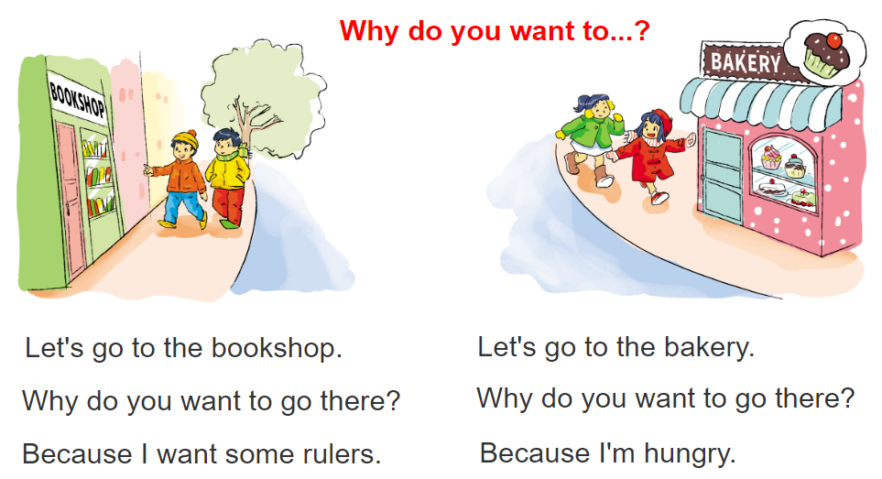

3. Let's chant

Slide 17
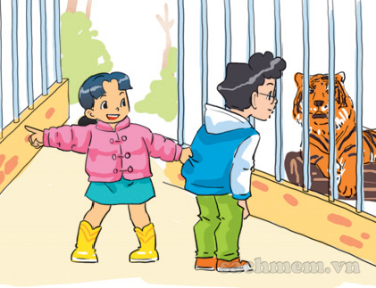
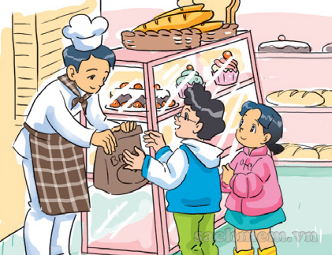
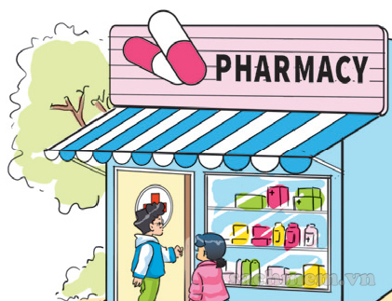

4. Read and number
It is Sunday today. Phong and Mai go to many places. First, they go to the bookshop because Mai wants to buy some books and pens. Then they go to the pharmacy because Phong wants to buy some medicine. After that, they go to the zoo because they want to see animals. Finally, they go to the bakery. They want to buy something to eat because they are hungry.
a
b
c
d
3
4
2
1

Slide 18
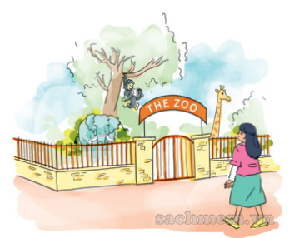


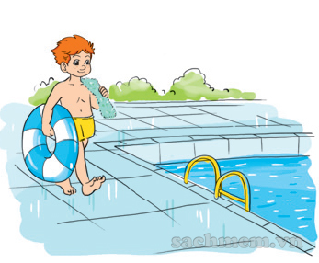
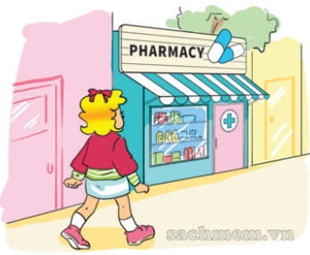


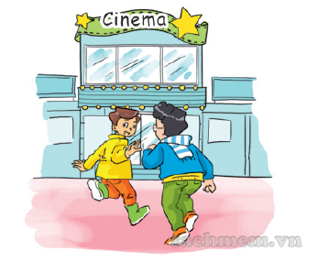
5. Look and write.
Tony wants to go to the ______________
because ____________________________.
Phong and Nam want to go to the _________
because ____________________________.
I want to go to the __________
because _______________________.
Linda wants to go to the __________
because ______________________.
zoo
I want to see the animals
swimming pool
he wants to swim
cinema
she wants to buy some
pharmacy
because they want to see a film

