Slide 1
Unit 17 – Lesson 2
HOW MUCH IS THE T-SHIRT

Slide 2
VOCABULARY

Slide 3
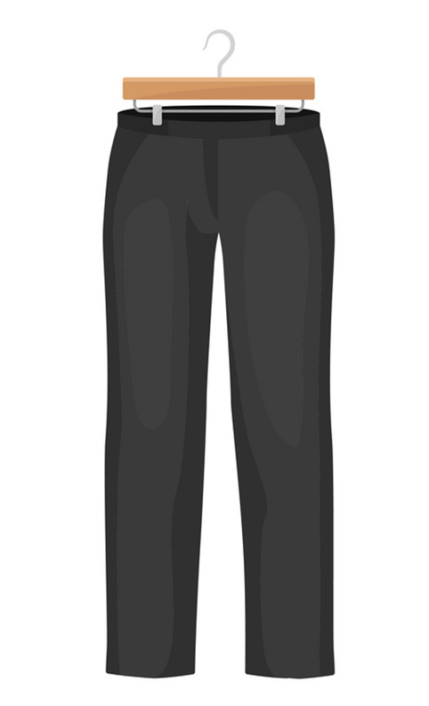
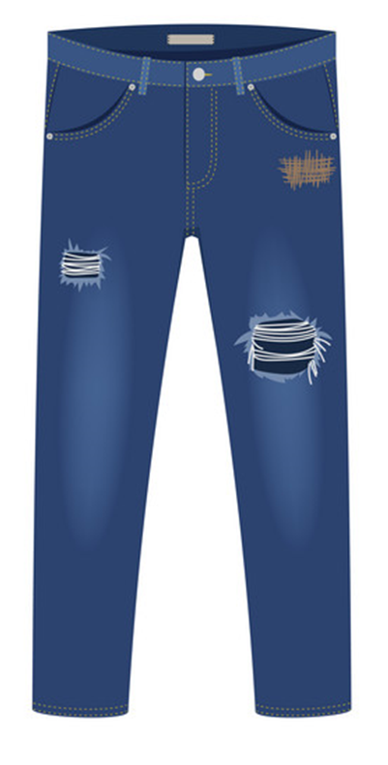
Vocabulary
jeans
trousers
/dʒiːnz/
/ˈtraʊzərz/

Slide 4
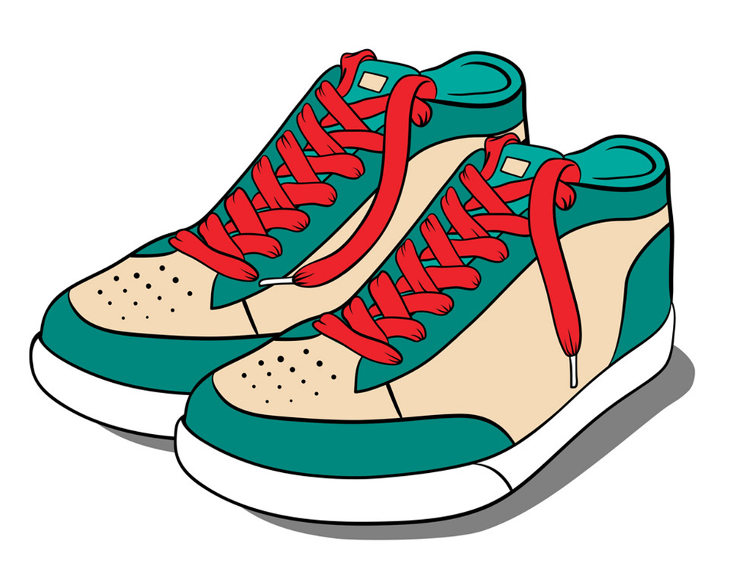

Vocabulary
sandals
shoes
/ˈsændl/
/ʃuː/

Slide 5
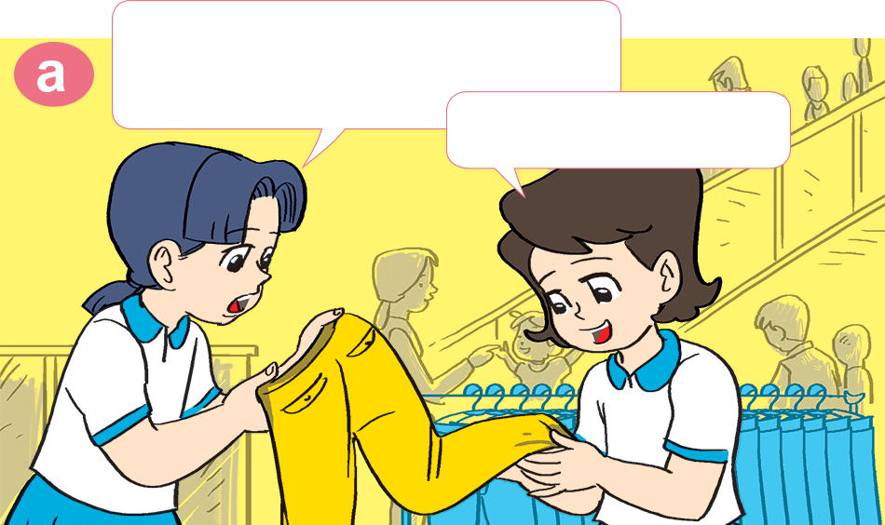
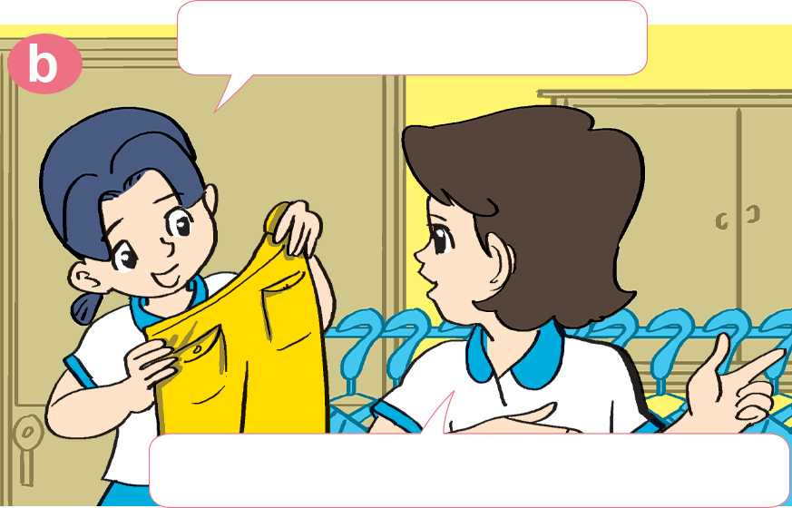

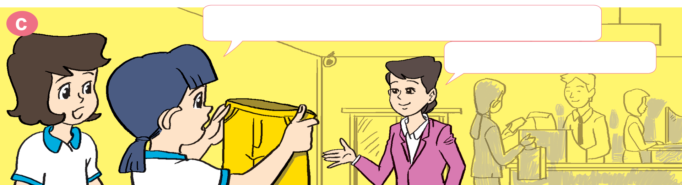
1. Look, listen and repeat
These yellow trousers are very nice.
How much are they?
Yes, they are.
Let's ask the sales assistant.
Excuse me. How much are these trousers?
They're 99,000 dong.

Slide 6


2. Point and say
How much are the _________?
They're _________________.
jeans
75,000 dong

Slide 7
2. Point and say
How much are the _________?
They're _________________.
shoes
93,000 dong

Slide 8
2. Point and say
How much are the _________?
They're _________________.
sandals
85,000 dong

Slide 9
2. Point and say
How much are the _________?
They're _________________.
trousers
98,000 dong

Slide 10
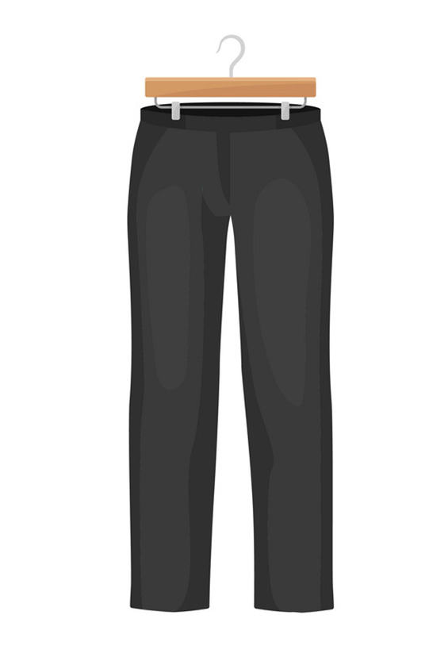
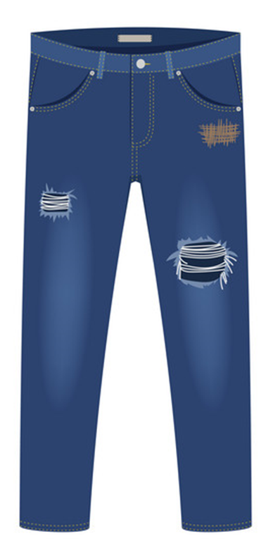

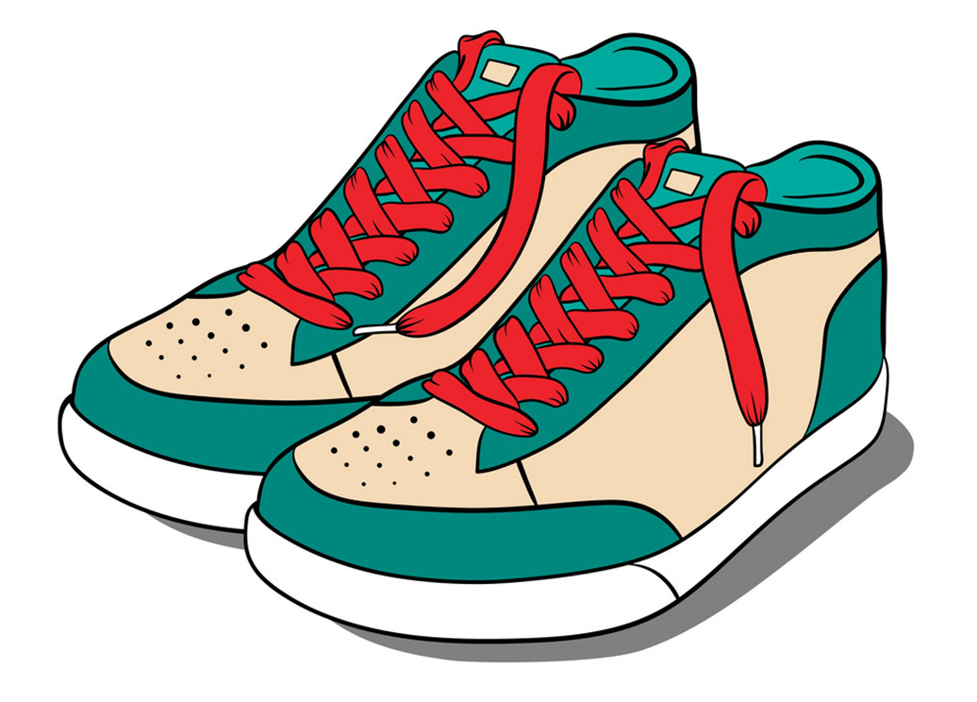
3. Let's talk
How much are the _____?
They’re ___________.
99.000 DONG
85.000 DONG
63.000 DONG
74.000 DONG
trousers
jeans
sandals
shoes

Slide 11
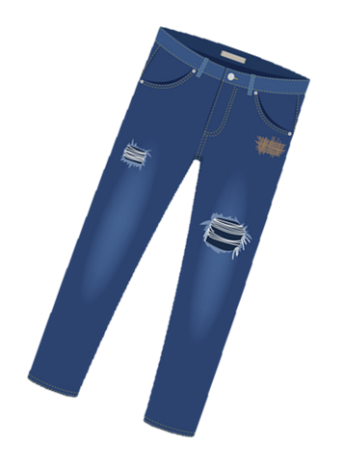
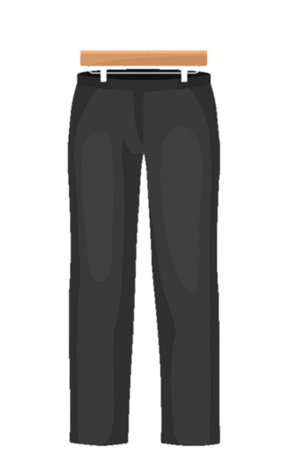
4. Listen and write the prices.
1
2
90.0000
dong
73.0000
dong
3
4
80.0000
dong
95.0000
dong

Slide 12
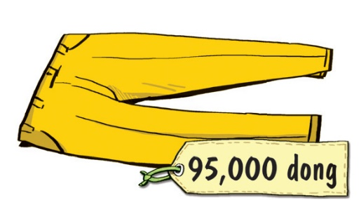
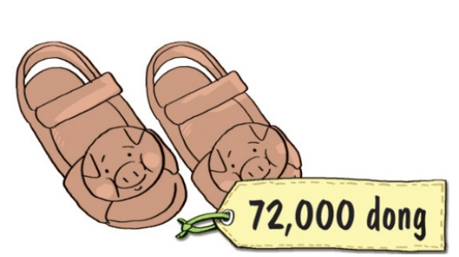
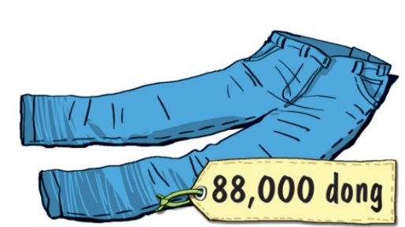

5. Look and write
yellow trousers
The pair of yellow ________________ is ________________________________.
The pair of _____________ is ___________
__________________________.
_______________________________________________________________________.
_______________________________________________________________________.
ninety-five thousand dong
brown sandals
seventy-two
thousand dong
The pair of blue jeans is eighty-eight thousand dong
The pair of black and white shoes is eighty thousand dong

Slide 13



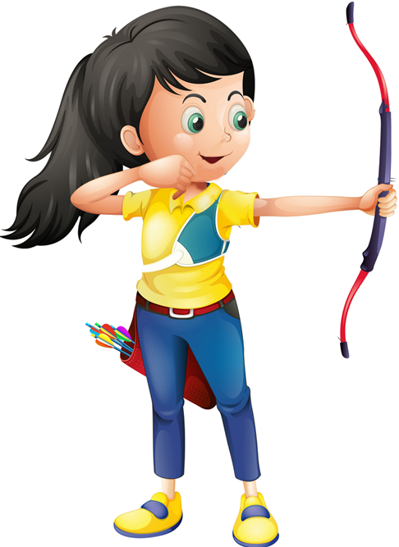




Ms Huyền Phạm
0936.082.789
Notes:
Ms Huyền Phạm - 0936.082.789 – YOUTUBE: MsPham. Facebook: Dạy và học cùng công nghệ.

Slide 14

How much _____ the trousers?
is
are
Ms Huyền Phạm
0936.082.789
Notes:
Ms Huyền Phạm - 0936.082.789 – YOUTUBE: MsPham. Facebook: Dạy và học cùng công nghệ.

Slide 15
How much _____ the jeans?
are
is
Ms Huyền Phạm
0936.082.789
Notes:
Ms Huyền Phạm - 0936.082.789 – YOUTUBE: MsPham. Facebook: Dạy và học cùng công nghệ.

Slide 16
How much _____ the shirt?
are
is
Ms Huyền Phạm
0936.082.789
Notes:
Ms Huyền Phạm - 0936.082.789 – YOUTUBE: MsPham. Facebook: Dạy và học cùng công nghệ.

Slide 17
How much _____ the shoes?
are
is
Ms Huyền Phạm
0936.082.789
Notes:
Ms Huyền Phạm - 0936.082.789 – YOUTUBE: MsPham. Facebook: Dạy và học cùng công nghệ.

Slide 18
How much _____ the sandals?
is
are
Ms Huyền Phạm
0936.082.789
Notes:
Ms Huyền Phạm - 0936.082.789 – YOUTUBE: MsPham. Facebook: Dạy và học cùng công nghệ.

Slide 19
How much _____ the scarfs?
are
is
Ms Huyền Phạm
0936.082.789
Notes:
Ms Huyền Phạm - 0936.082.789 – YOUTUBE: MsPham. Facebook: Dạy và học cùng công nghệ.

Slide 20
How much _____ the jumpers?
is
are
Ms Huyền Phạm
0936.082.789
Notes:
Ms Huyền Phạm - 0936.082.789 – YOUTUBE: MsPham. Facebook: Dạy và học cùng công nghệ.

Slide 21
How much _____ the skirts?
are
is
Ms Huyền Phạm
0936.082.789
Notes:
Ms Huyền Phạm - 0936.082.789 – YOUTUBE: MsPham. Facebook: Dạy và học cùng công nghệ.

Slide 22

Good job!
Ms Huyền Phạm
0936.082.789
Notes:
Ms Huyền Phạm - 0936.082.789 – YOUTUBE: MsPham. Facebook: Dạy và học cùng công nghệ.

Slide 23
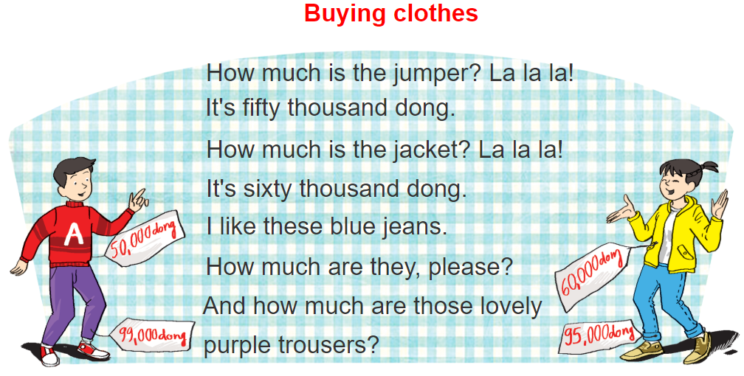

6. Let's sing

