Slide 1


Unit
19
What animal do
you want to see?
Lesson 1

Slide 2
VOCABULARY

Slide 3
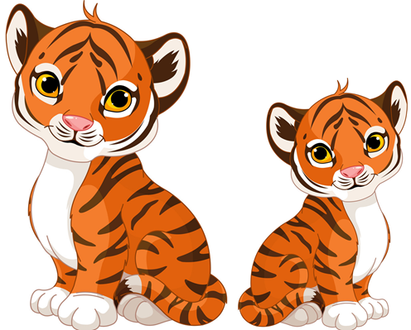
Vocabulary
a
tiger
tigers
/ˈtaɪɡər/
/ˈtaɪɡərz/

Slide 4
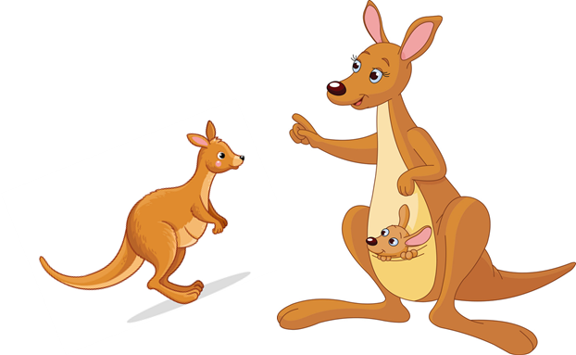
Vocabulary
a
kangaroo
kangaroos
/ˌkæŋɡəˈruː/
/ˌkæŋɡəˈruːz/

Slide 5
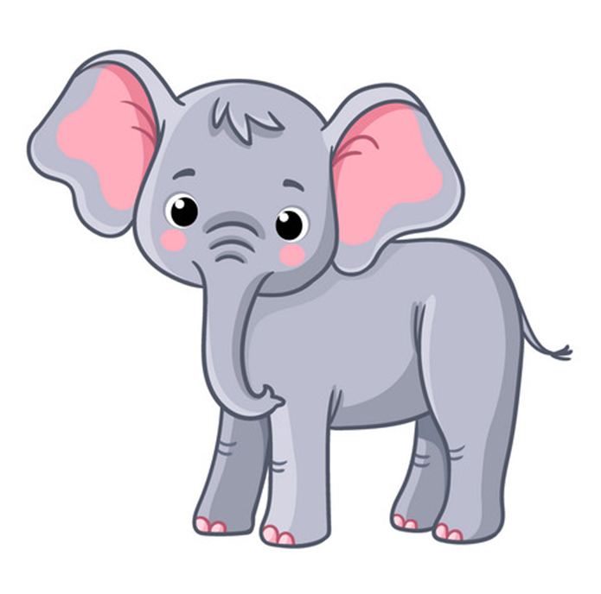
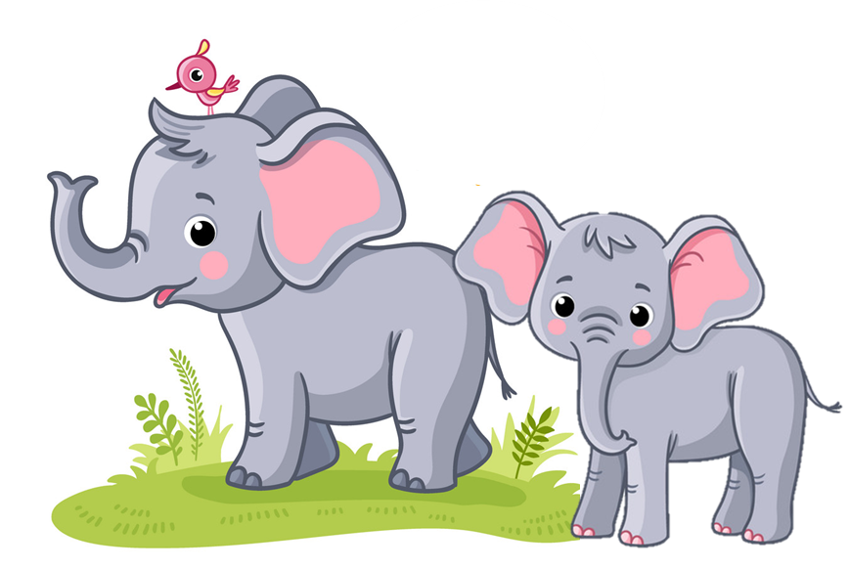
Vocabulary
elephant
elephants
an
/ˈelɪfənt/
/ˈelɪfənts/

Slide 6

Vocabulary
a
crocodile
crocodiles
/ˈkrɑːkədaɪl/
/ˈkrɑːkədaɪlz/

Slide 7
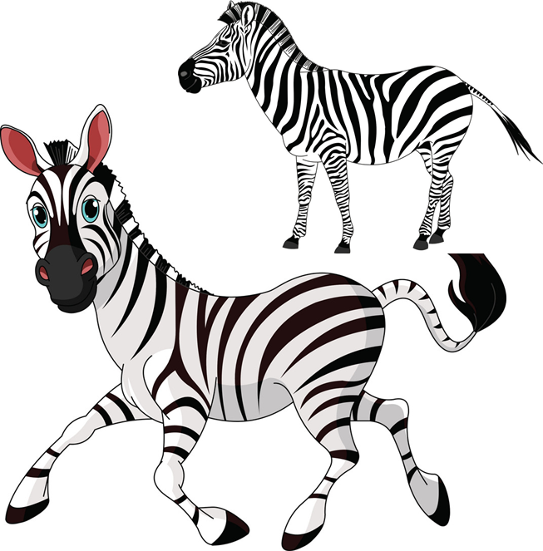
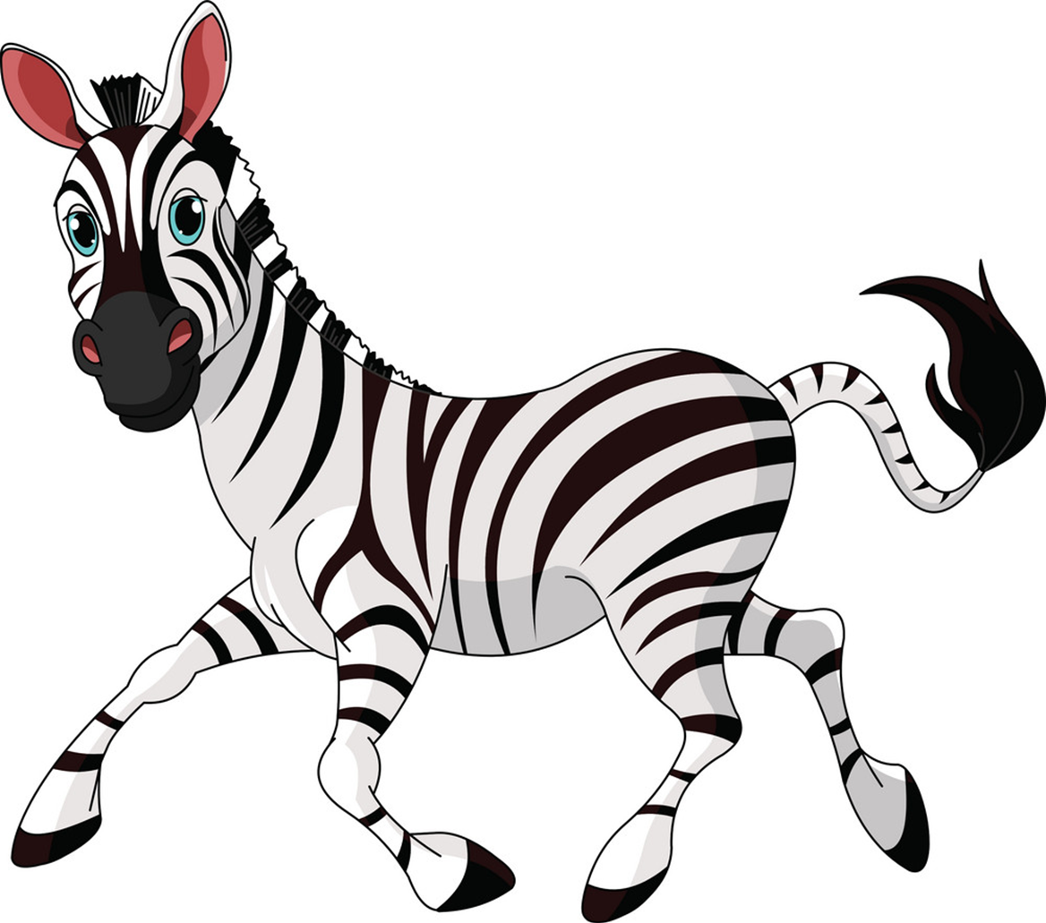
Vocabulary
zebra
zebras
a
/ˈziːbrə/
/ˈziːbrəz/

Slide 8
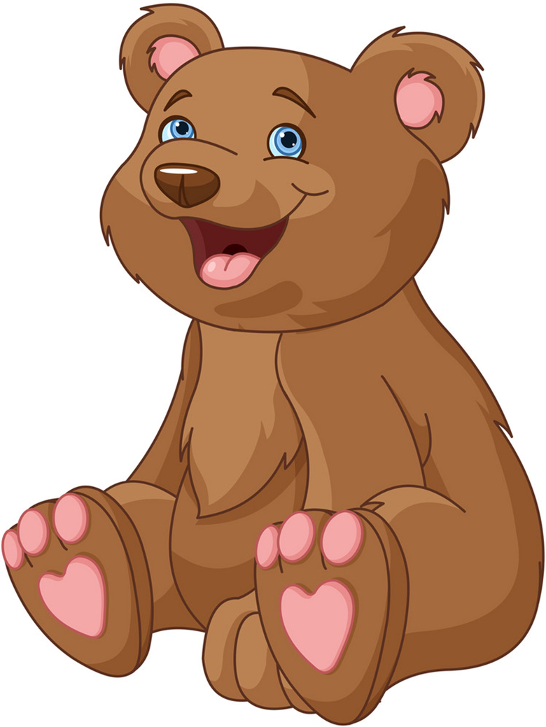
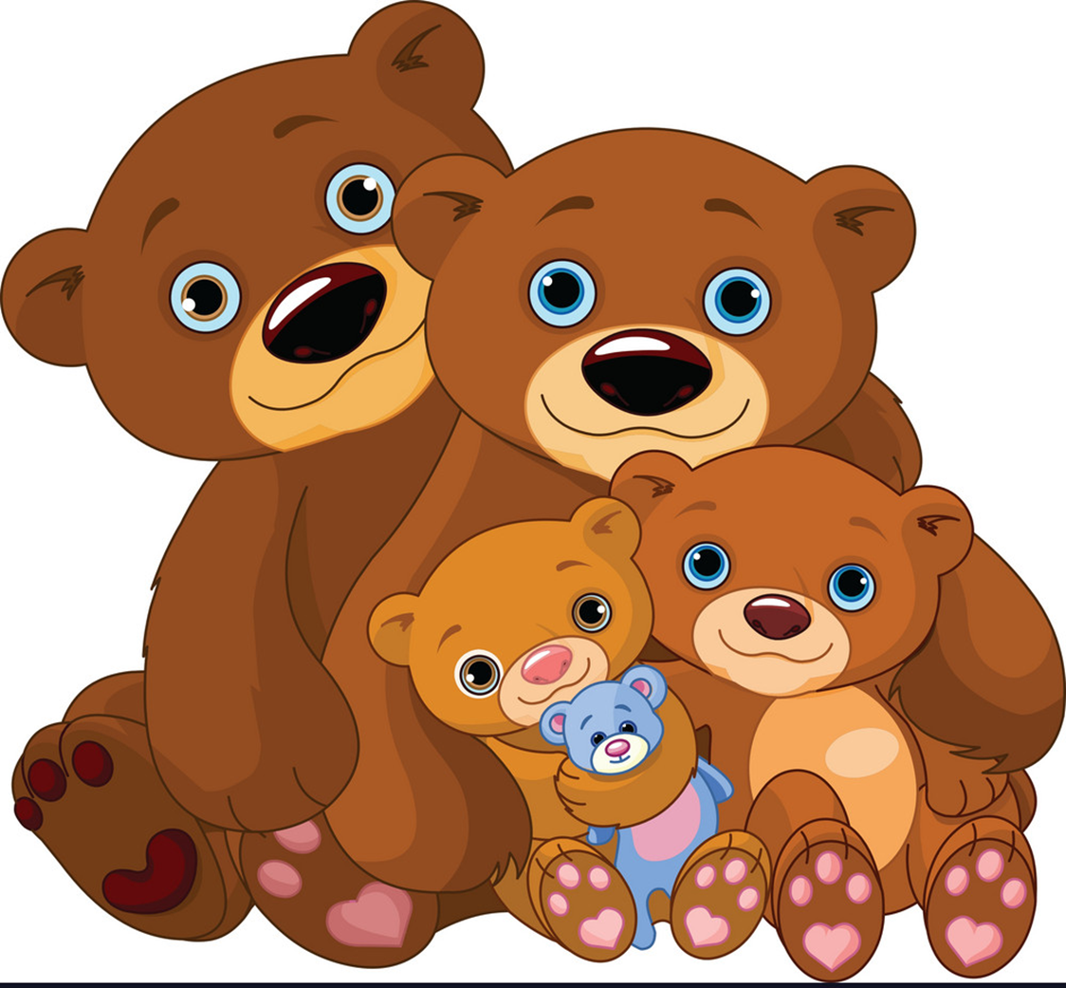
Vocabulary
bear
bears
a
/beər/
/beərz/

Slide 9
Vocabulary
kangaroos
crocodiles
bears
tigers
elephants
zebras

Slide 10
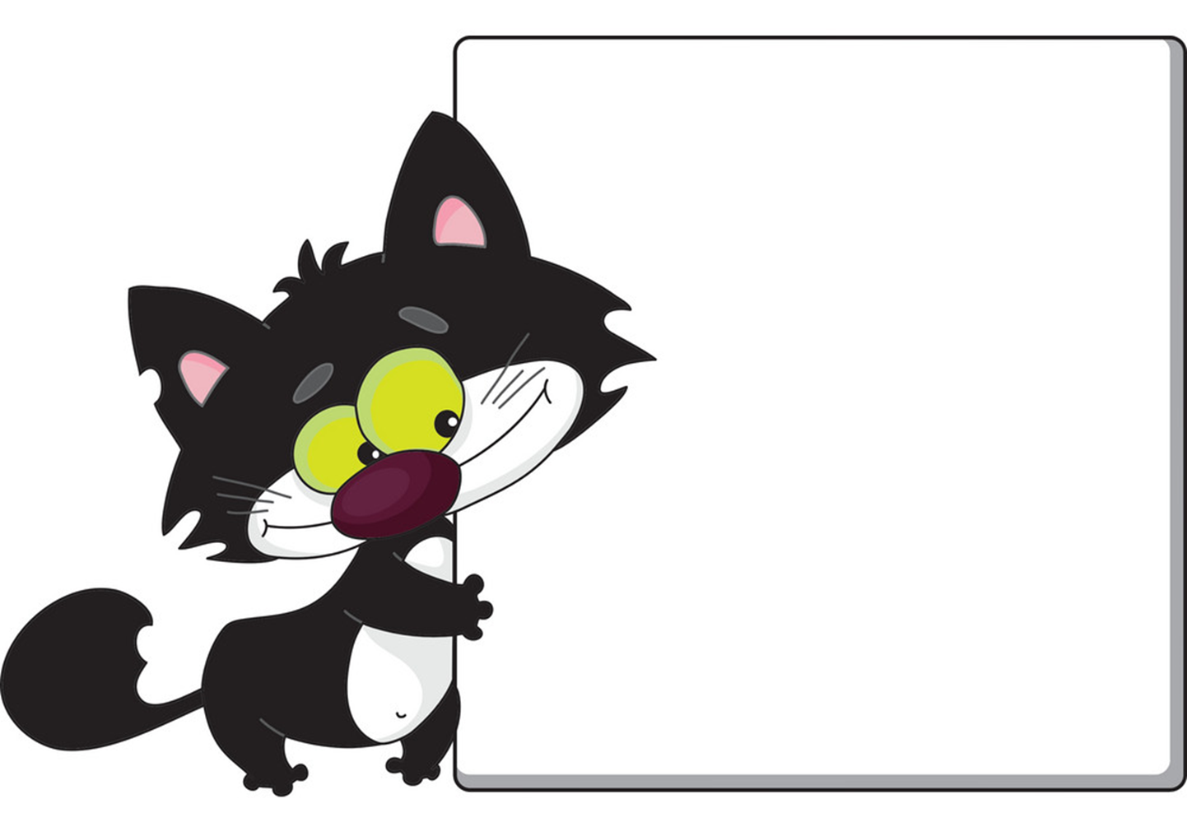

Black
cat
Yellow
cat
&

Slide 11


kangaroos

Slide 12
Crocodiles

Slide 13
Elephants

Slide 14
Bears

Slide 15
Tigers

Slide 16
Zebras

Slide 17
Well
Done

Slide 18
GRAMMAR

Slide 19
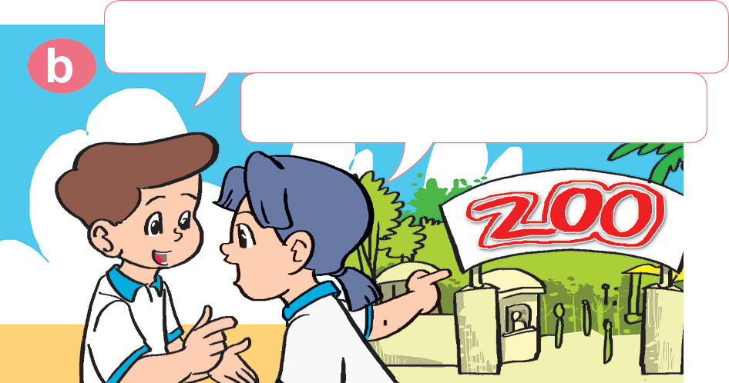
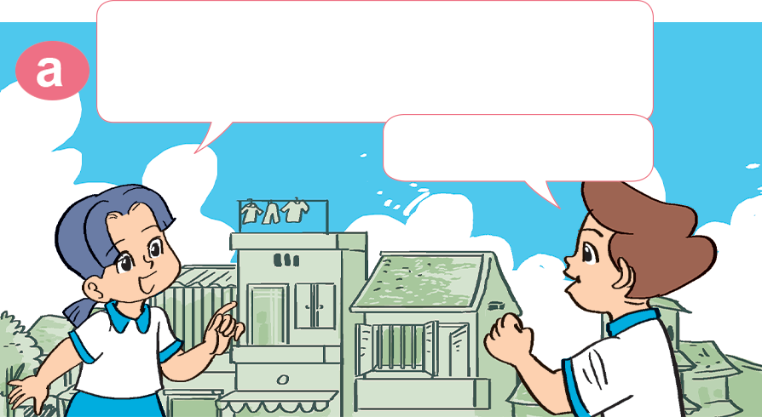

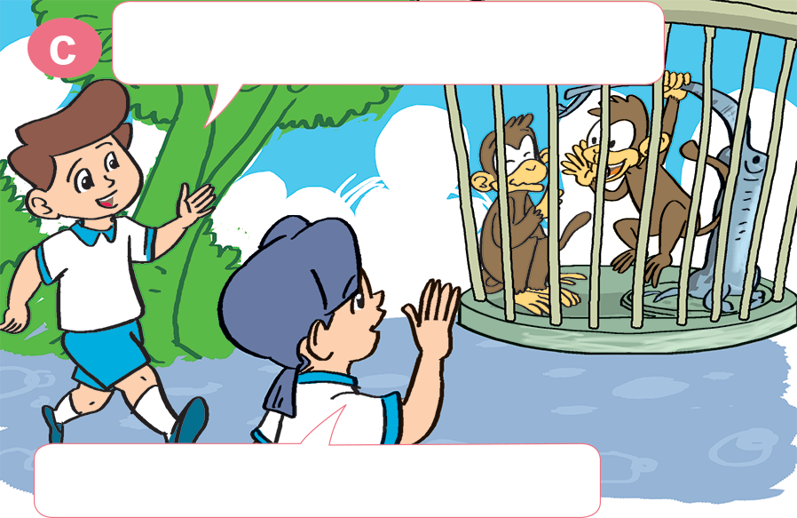
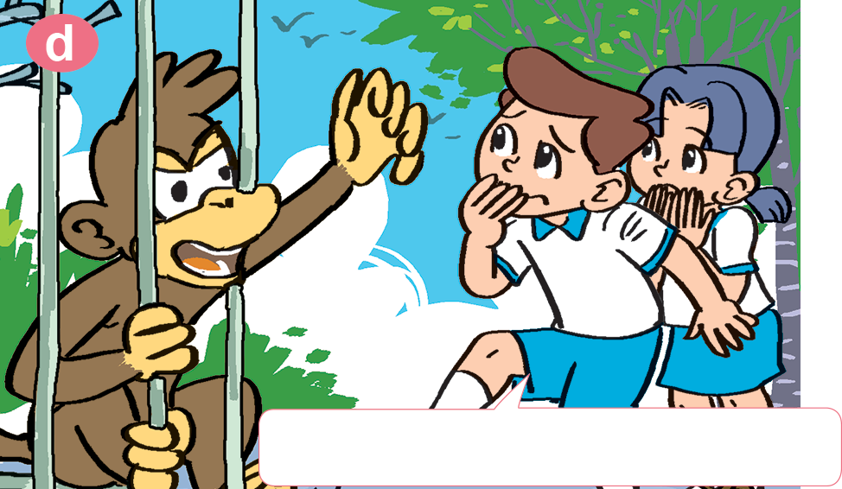
1. Look, listen and repeat.
What animal do you want to see?
The weather's wonderful. Let's go to the zoo.
I want to see monkeys.
Great idea!
Me too. I like monkeys.
OK. Let's go over there.
Oh! Now I don't like them.

Slide 20
2. Point and say.
What animal do you want to see?
I want to see _____________.
kangaroos

Slide 21
2. Point and say.
What animal do you want to see?
I want to see _____________.
kangaroos

Slide 22
2. Point and say.
What animal do you want to see?
I want to see _____________.
kangaroos

Slide 23
2. Point and say.
What animal do you want to see?
I want to see _____________.
kangaroos

Slide 24



Unit 19
What animal do you/they want to see?
I/they want to see ______.
tigers
crocodiles
kangaroos
elephants
Ms. Huyền Phạm

Slide 25
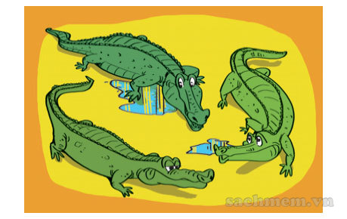
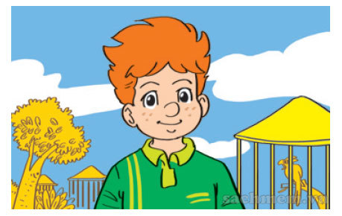
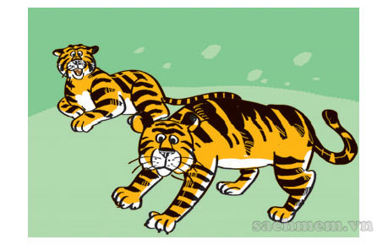
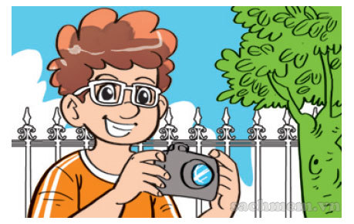
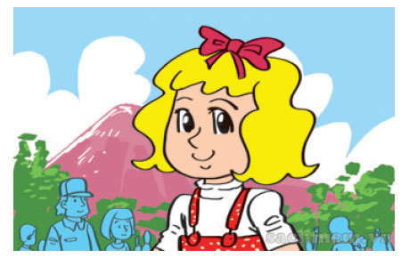
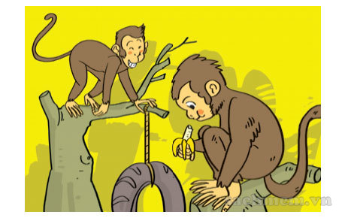
3. Listen and match
a
1
b
2
3
c

Slide 26
Unit 19
What animal does he/she want to see?
He/she wants to see _____.
tigers
crocodiles
kangaroos
elephants
Ms. Huyền Phạm

Slide 27
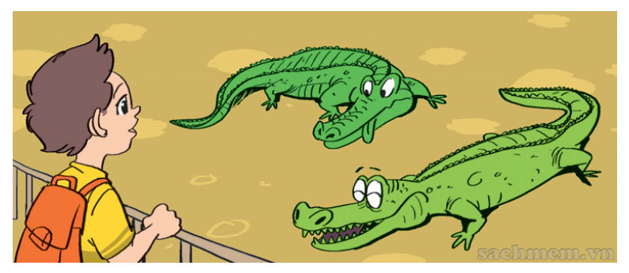
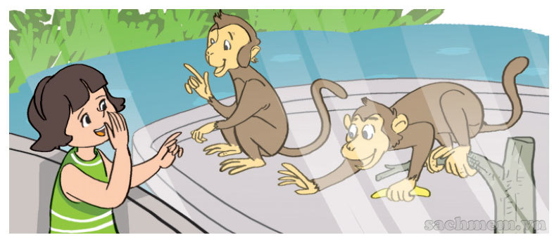
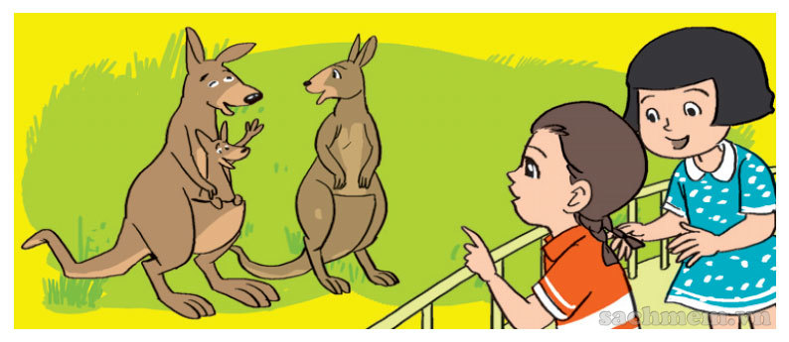
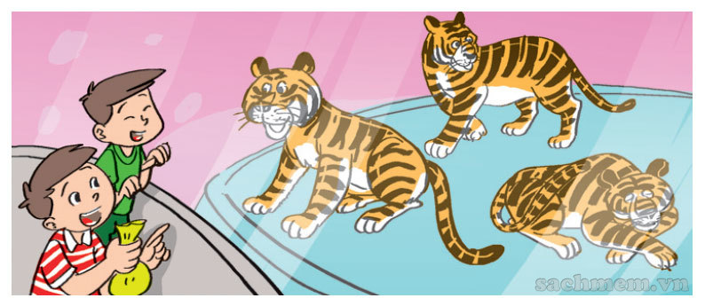
4. Look and write.
1. What animal does he want to see? _____________________________.
2. What animal does she want to see?
_____________________________.
3. What animal do they want to see? _____________________________.
4. What animal do they want to see? _____________________________.
He wants to see crocodiles.
She wants to see monkeys.
They want to see kangaroos.
They want to see tigers.

Slide 28
5. Let's play

Slide 29


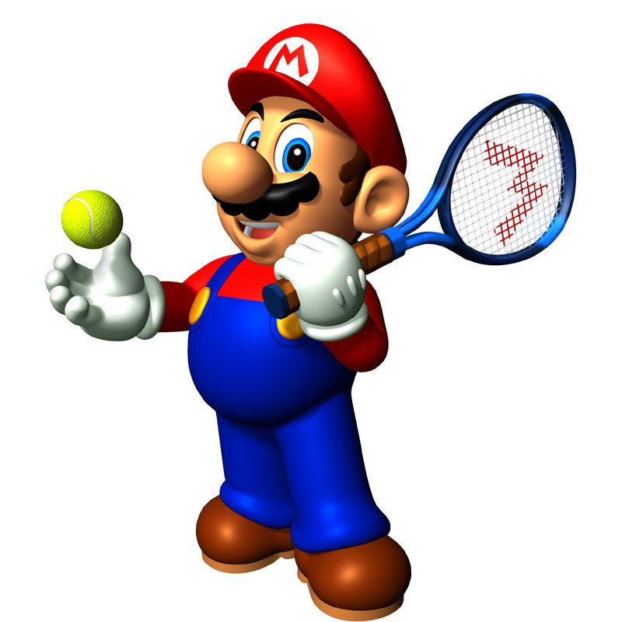





Slide 30
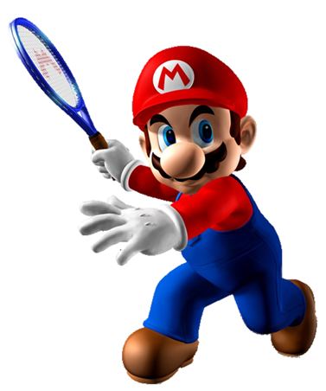
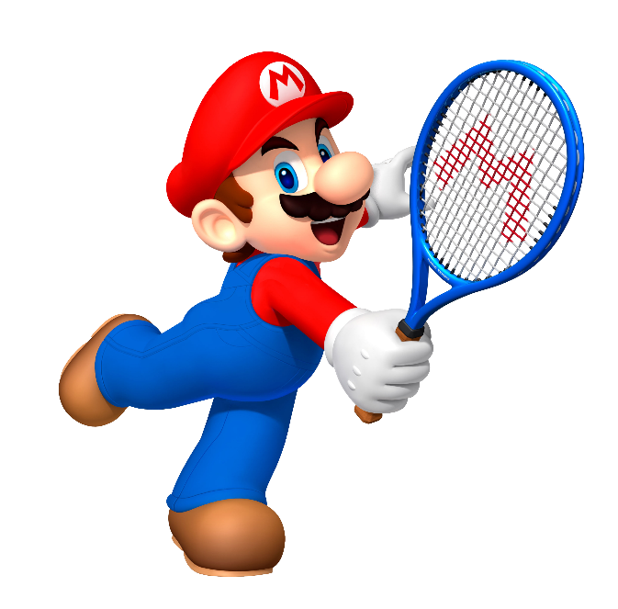



does
What animal ___ he want to see?
He wants to see crocodiles.
do
I wants

Slide 31
do
What animal ___ they want to see?
They want to see kangaroos.
does
Intelligent

Slide 32
Next
do
What animal ___ she want to see?
She wants to see monkeys.
does

Slide 33
do
What animal ___ they want to see?
She wants to see tigers.
does
do

Slide 34
do
What animal ___ you want to see?
I want to see elephants.
does
cat

Slide 35
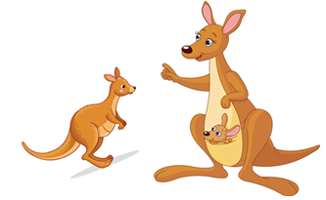
She
He
What animal do ____ want to see?
I want to see kangaroos.
You

Slide 36
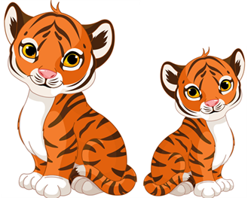
wants
want
What animal does she ___ to see?
She wants to see monkeys.
wanted

Slide 37
wants
wanted
What animal does he want to see?
He ___ to see crocodiles.
wants

Slide 38
He
I
What animal do they want to see?
___ want to see monkeys.
They

Slide 39
Time’s up!

Slide 40



THANK YOU!
Welcome to join with me!
MsPham Powerpoint
Mspham

