Slide 1


Unit
19
What animal do
you want to see?
Lesson 3

Slide 2
WARM-UP

Slide 3

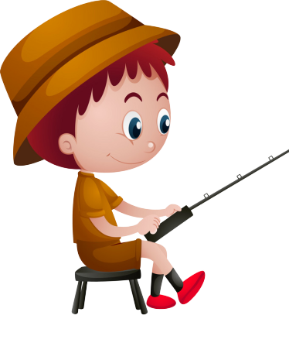


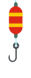

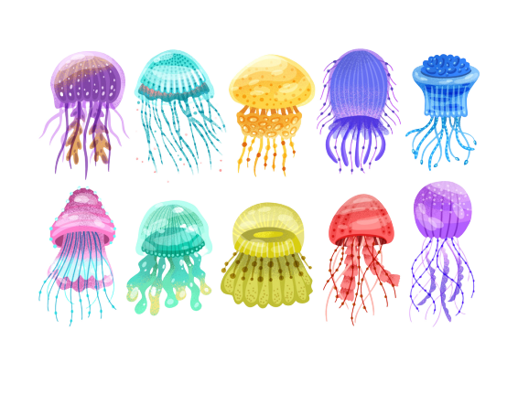




GO FISHING
Game
PLAY
EXIT
Notes:
Ms Huyền Phạm - 0936.082.789 – YOUTUBE: MsPham. Facebook: Dạy và học cùng công nghệ.

Slide 4












0
Score:
EXIT
7
8
6
9
2
4
1
10
5
3
13
12
11
14
15
Notes:
Ms Huyền Phạm - 0936.082.789 – YOUTUBE: MsPham. Facebook: Dạy và học cùng công nghệ.

Slide 5

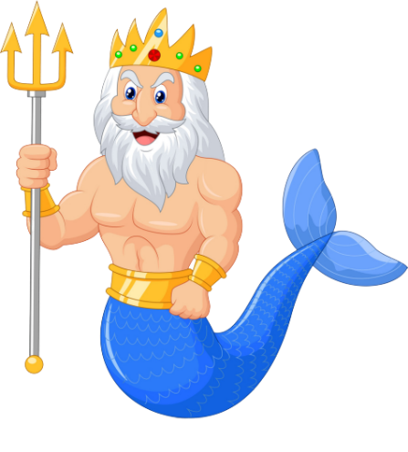



What animal do you
want to see?
A
I want to see crocodiles.
B
I wants to see crocodiles.
C
I want to see crocodile.
D
STOVE
Notes:
Ms Huyền Phạm - 0936.082.789 – YOUTUBE: MsPham. Facebook: Dạy và học cùng công nghệ.

Slide 6
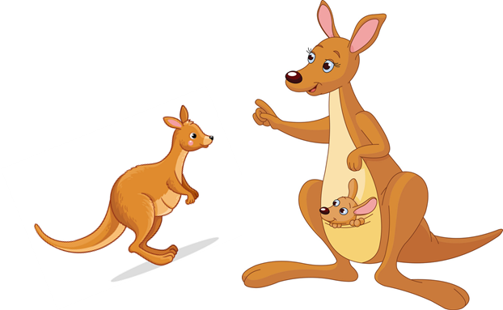
What animal does he
want to see?
A
She wants to see kangaroos.
B
He wants to see kangaroos.
C
I want to see kangaroos.
D
Climb
Notes:
Ms Huyền Phạm - 0936.082.789 – YOUTUBE: MsPham. Facebook: Dạy và học cùng công nghệ.

Slide 7
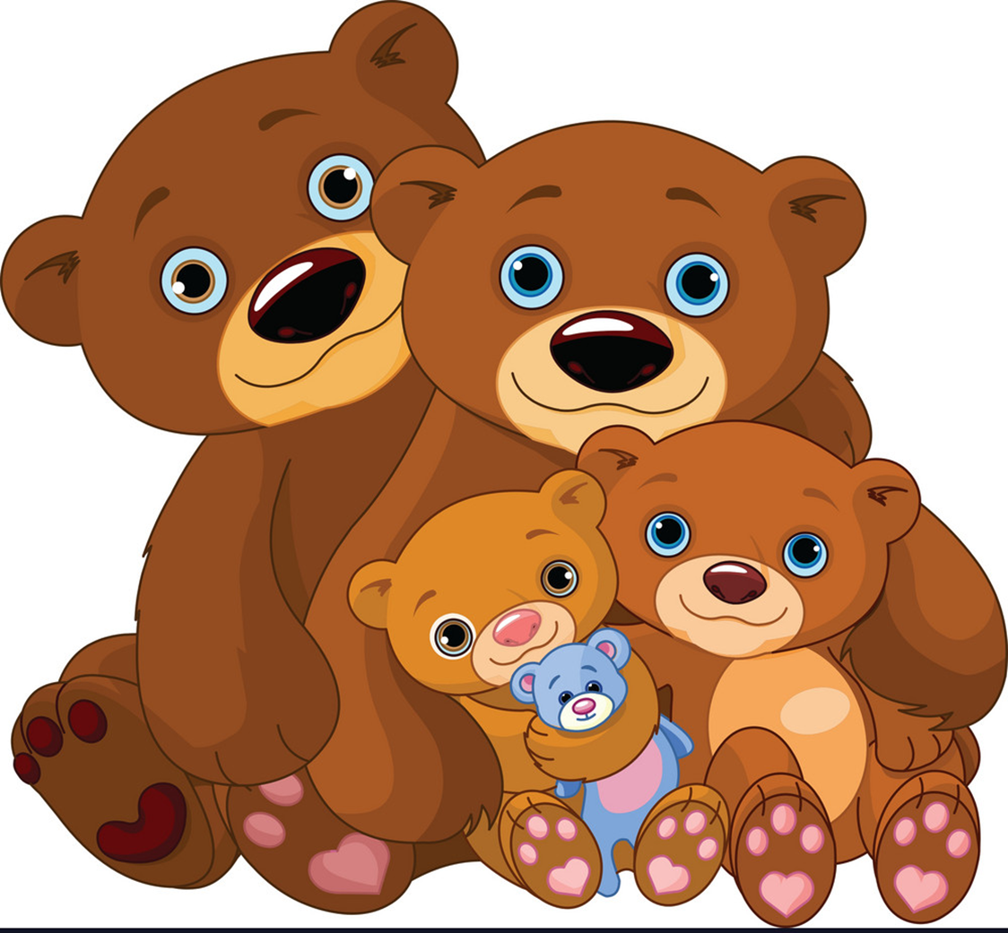
What animal do they
want to see?
A
They want to see kangaroos.
B
They wants to see kangaroos.
C
They wants to see kangaroo.
D
May
Notes:
Ms Huyền Phạm - 0936.082.789 – YOUTUBE: MsPham. Facebook: Dạy và học cùng công nghệ.

Slide 8
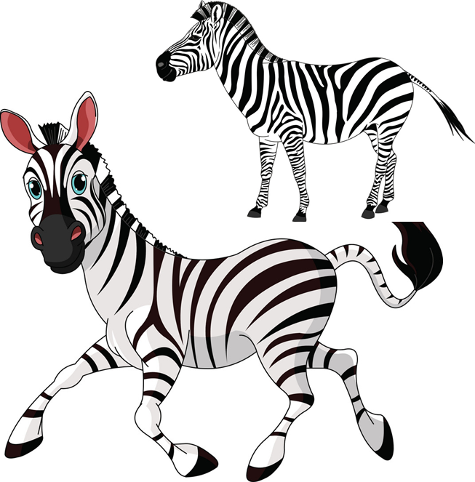
What animal does your sister want to see?
A
She wants to see kangaroos.
B
She wants to see zebras.
C
She wants to see bears.
D
Watch
Notes:
Ms Huyền Phạm - 0936.082.789 – YOUTUBE: MsPham. Facebook: Dạy và học cùng công nghệ.

Slide 9
I want to see mokeys.
A
What animal do they
want to see?
B
What animal does she
want to see?
C
What animal do you
want to see?
D
Next to
Notes:
Ms Huyền Phạm - 0936.082.789 – YOUTUBE: MsPham. Facebook: Dạy và học cùng công nghệ.

Slide 10
I don’t like tigers
__________.
A
Because they’re scary.
B
And they’re scary.
C
But they’re scary.
D
Next to
Notes:
Ms Huyền Phạm - 0936.082.789 – YOUTUBE: MsPham. Facebook: Dạy và học cùng công nghệ.

Slide 11
I like cats
__________.
A
Because they’re cute.
B
Because it’re cute.
C
Because it’s cute.
D
She plays chess
in his free time.
Notes:
Ms Huyền Phạm - 0936.082.789 – YOUTUBE: MsPham. Facebook: Dạy và học cùng công nghệ.

Slide 12
____________
Because they’re big.
A
He don’t like dogs.
B
He doesn’t likes dogs.
C
He doesn’t like dogs.
D
They likes sport.
Notes:
Ms Huyền Phạm - 0936.082.789 – YOUTUBE: MsPham. Facebook: Dạy và học cùng công nghệ.

Slide 13
____________
Because they’re beautiful.
A
They like kangaroos.
B
They likes kangaroos.
C
They don’t like kangaroo.
D
She should take some warm water.
Notes:
Ms Huyền Phạm - 0936.082.789 – YOUTUBE: MsPham. Facebook: Dạy và học cùng công nghệ.

Slide 14
She likes monkeys
______________.
A
because they’re
scary.
B
because they’re
big.
C
because they’re funny.
D
He shouldn’t watch much TV.
Notes:
Ms Huyền Phạm - 0936.082.789 – YOUTUBE: MsPham. Facebook: Dạy và học cùng công nghệ.

Slide 15
PRONUNCIATION

Slide 16

1. Listen and repeat.
'crocodile | I want to see 'crocodiles.
'elephant | 'Elephants are enormous.
'wonderful | The weather's 'wonderful.
'beautiful | Some zoo animals are 'beautiful.

Slide 17
2. Listen and circle.
1. I want to go to the zoo because I want to see ______.
a. animals b. elephants
2. My brother does not like ______ because they are scary.
a. elephants b. crocodiles
3. The monkeys are ______.
a. beautiful b. wonderful
4. Some zoo animals are ______.
a. beautiful b. wonderful

Slide 18
PRACTISE

Slide 19

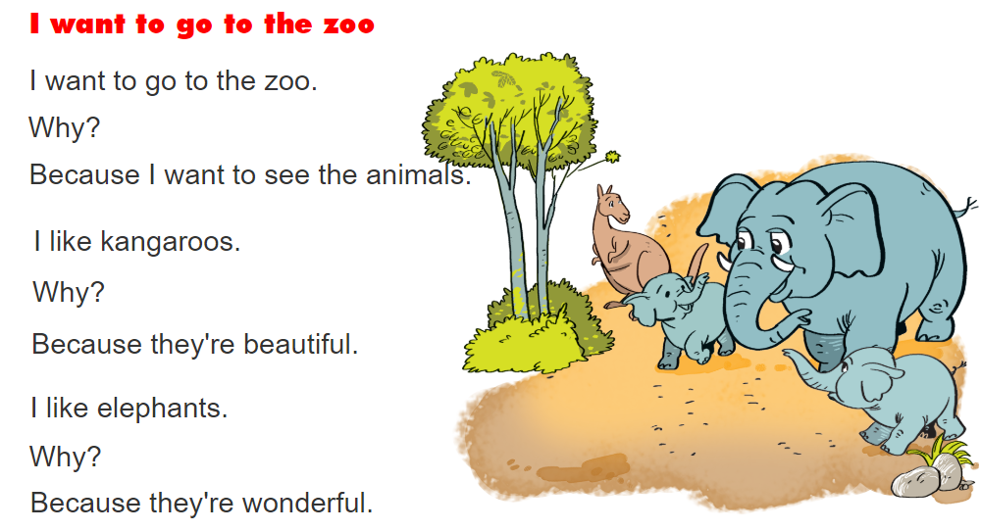
3. Let's chant.

Slide 20
4. Read and complete.
The weather is wonderful today. Mai and Nam are visiting Thu Le Zoo. There are a lot of animals and some of them are very beautiful. Some are friendly but some are scary. Mai does not like the elephants because they are big and perhaps dangerous. Nam likes the monkeys because they are funny.
Nam and Mai are at the zoo. There are many (1) ________ there. Some animals are (2) _________. Mai does not like the elephants because they are (3) ______. Nam likes the (4) ________ because they are (5) ______.
animals
beautiful
big
monkeys
funny

Slide 21
5. Let's write.
Why do you want to go to the zoo?
• What animal(s) do you like? And why?
• What animal(s) don't you like? And why not?
I want to go to the zoo because __________________

Slide 22
6. Project

Slide 23



THANK YOU!
Welcome to join with me!
MsPham Powerpoint
Mspham

