Slide 1

UNIT 20 – LESSON1

Slide 2
VOCABULARY

Slide 3
Vocabulary
Learn
Stay
Summer
Have to
Month
/lɜːrn/
/steɪ/
/ˈsʌmər/
/hæv tu/
/mʌnθ/
: Học
: Ở
: Mùa hè
: Phải
: Tháng

Slide 4
Vocabulary
Summer
Mùa hè
Phải
Have to
Phải
Học
Learn
Học
Tháng
Month
Tháng
Ở
Stay
Ở
Mùa hè

Slide 5
GRAMMAR

Slide 6
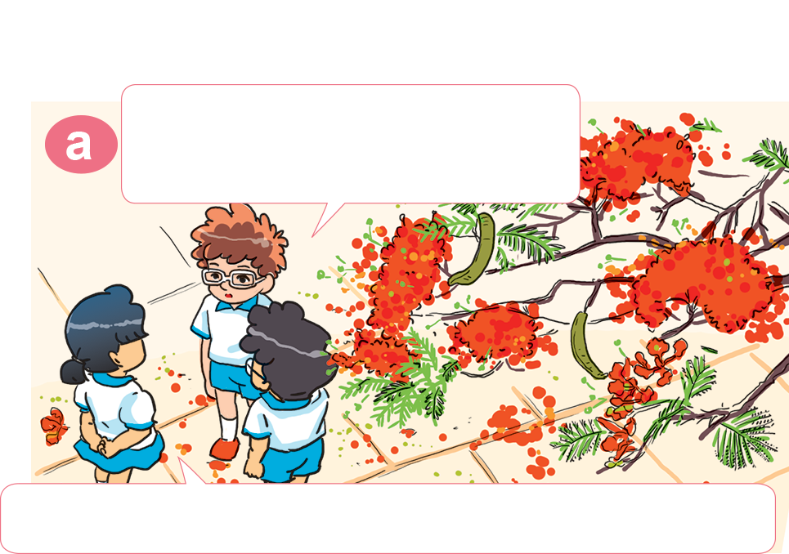
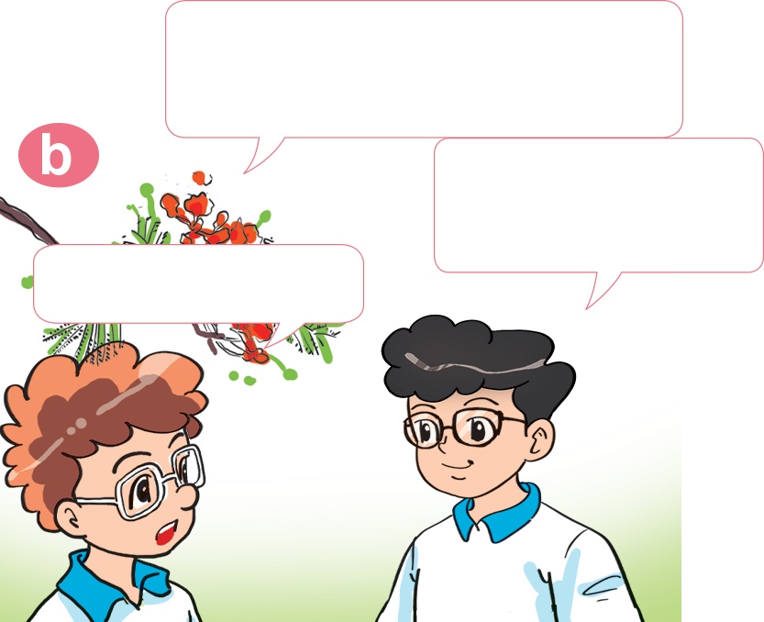

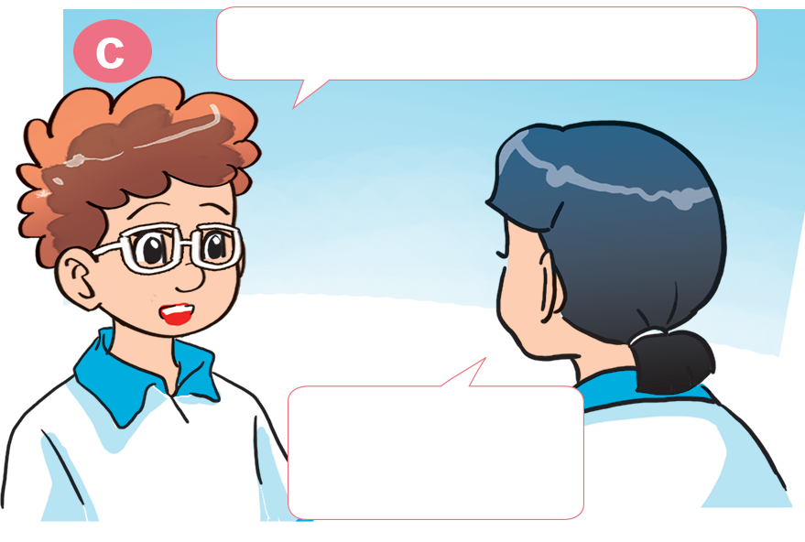

1. Look, listen and repeat.
Where are you going this summer, Phong?
Only one month until our summer holidays!
I'm going to Ha Long Bay.
That's great!
Yes! I love summer. It's a great time.
What about you, Mai?
What about you, Tom?
What are you going to do?
I'm going to stay at home.
Why?
I'm going to Phu Quoc.
Because I have to learn Vietnamese.

Slide 7



2. Point and say
Where are you going this summer?
I'm going to _________________.
Phu Quoc

Slide 8


2. Point and say
Where are you going this summer?
I'm going to _________________.
Ha Long Bay

Slide 9


2. Point and say
Where are you going this summer?
I'm going to _________________.
Nha Trang

Slide 10

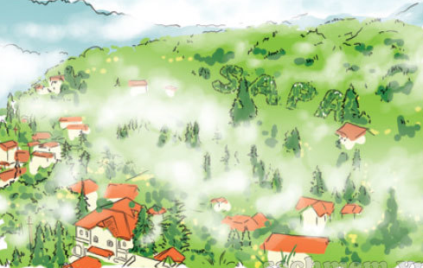
2. Point and say
Where are you going this summer?
I'm going to _________________.
Sa Pa

Slide 11

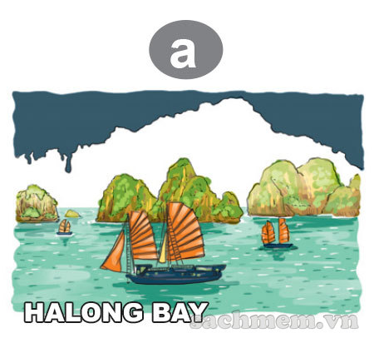

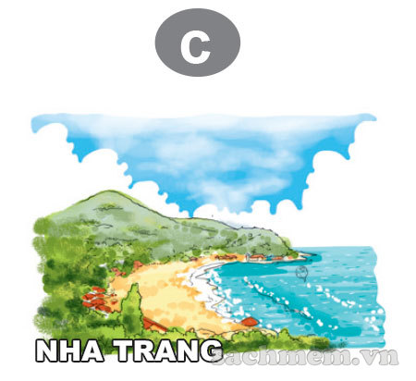

3. Listen and tick.
1.Tony is going to ______.
2.Nam is going to ______.
3.Linda is going to ______.

Slide 12



4. Look and write.
Where are you going this summer?
I'm ________________________.
going to Da Nang
1
2
Where is he going next month?
He's ____________________.
going to Hoi An
Where are they going in December?
They're ______________________.
3
going to Hue

Slide 13

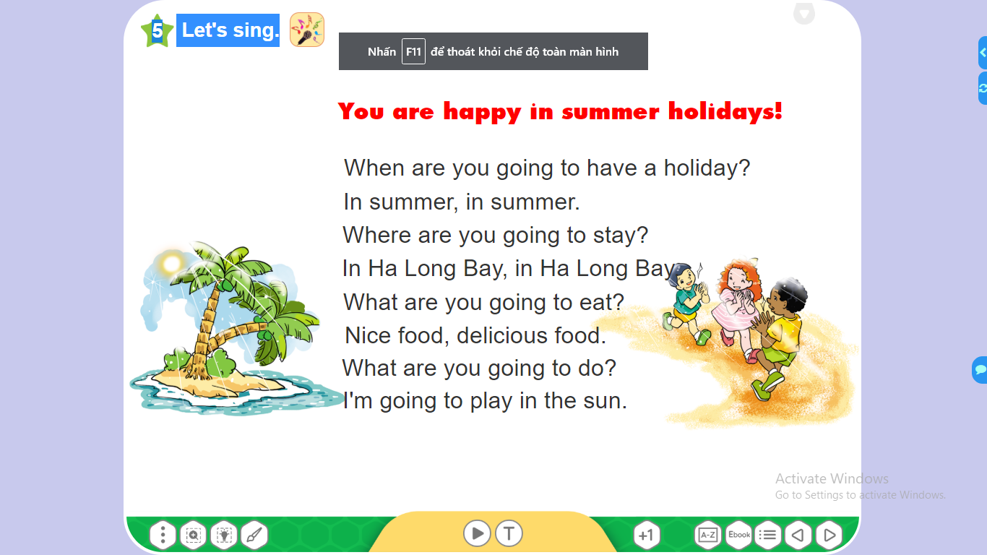
5. Let's sing.

Slide 14








Hoa Mặt Trời
Notes:
Ms Huyền Phạm - 0936.082.789 – YOUTUBE: MsPham. Facebook: Dạy và học cùng công nghệ.

Slide 15


I'm go to Hue this summer.
A
B
True
False
Notes:
Ms Huyền Phạm - 0936.082.789 – YOUTUBE: MsPham. Facebook: Dạy và học cùng công nghệ.

Slide 16

He is going to Da Nang next summer.
A
B
True
False
Notes:
Ms Huyền Phạm - 0936.082.789 – YOUTUBE: MsPham. Facebook: Dạy và học cùng công nghệ.

Slide 17
I’m going to Hoi An this summer.
A
B
True
False
Notes:
Ms Huyền Phạm - 0936.082.789 – YOUTUBE: MsPham. Facebook: Dạy và học cùng công nghệ.

Slide 18
She are going to Ha Long Bay this summer.
A
B
True
False
Notes:
Ms Huyền Phạm - 0936.082.789 – YOUTUBE: MsPham. Facebook: Dạy và học cùng công nghệ.

Slide 19

He going to Nha Trang this summer.
A
B
True
False
Notes:
Ms Huyền Phạm - 0936.082.789 – YOUTUBE: MsPham. Facebook: Dạy và học cùng công nghệ.

Slide 20
She is going to Sa Pa this summer.
A
B
True
False
Notes:
Ms Huyền Phạm - 0936.082.789 – YOUTUBE: MsPham. Facebook: Dạy và học cùng công nghệ.

Slide 21
Where are you going this summner?
A
B
C
D
He’s going to Nha Trang.
She’s going to Nha Trang.
I’m going to Nha Trang.
They’re going to Nha Trang.
Notes:
Ms Huyền Phạm - 0936.082.789 – YOUTUBE: MsPham. Facebook: Dạy và học cùng công nghệ.

Slide 22
Where is she going next summner?
A
B
C
D
She going to Hoi An.
He going to Ha Noi.
They’re going to Da Nang.
She’s going to Sa Pa.
Notes:
Ms Huyền Phạm - 0936.082.789 – YOUTUBE: MsPham. Facebook: Dạy và học cùng công nghệ.

Slide 23
Where is he going this summner?
A
B
C
D
He’s going to Ha Long Bay.
She’s going to Ha Long Bay.
I am going to Ha Long Bay.
They are going to Ha Long Bay.
Notes:
Ms Huyền Phạm - 0936.082.789 – YOUTUBE: MsPham. Facebook: Dạy và học cùng công nghệ.

Slide 24
She is going to Phu Quoc.
A
B
C
D
Where does she going this summner?
Where are she go this summner?
Where do she going this summner?
Where is she going this summner?
Notes:
Ms Huyền Phạm - 0936.082.789 – YOUTUBE: MsPham. Facebook: Dạy và học cùng công nghệ.

Slide 25
I’m going to Cat Ba Island.
A
B
C
D
Where is she going this summner?
Where are you going this summner?
Where is he going this summner?
Where are they going this summner?
Notes:
Ms Huyền Phạm - 0936.082.789 – YOUTUBE: MsPham. Facebook: Dạy và học cùng công nghệ.

Slide 26
He is going to Sam Son beach.
A
B
C
D
Where are you going next summer?
Where is she going next summer?
Where is he going next summer?
Where are they going next summer?
Notes:
Ms Huyền Phạm - 0936.082.789 – YOUTUBE: MsPham. Facebook: Dạy và học cùng công nghệ.

Slide 27


Notes:
Ms Huyền Phạm - 0936.082.789 – YOUTUBE: MsPham. Facebook: Dạy và học cùng công nghệ.

Slide 28



THANK YOU!
Welcome to join with me!
MsPham Powerpoint
Mspham

