Slide 1

UNIT 20 – LESSON 3

Slide 2
Warm-up

Slide 3


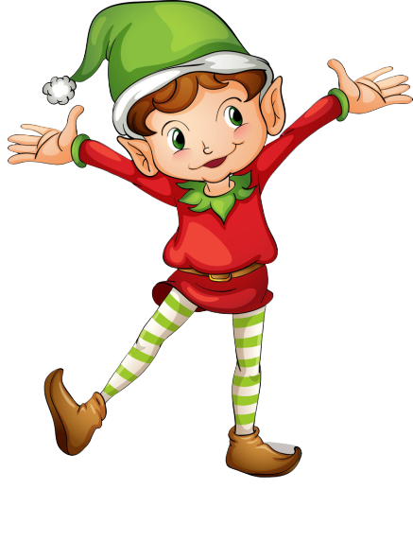
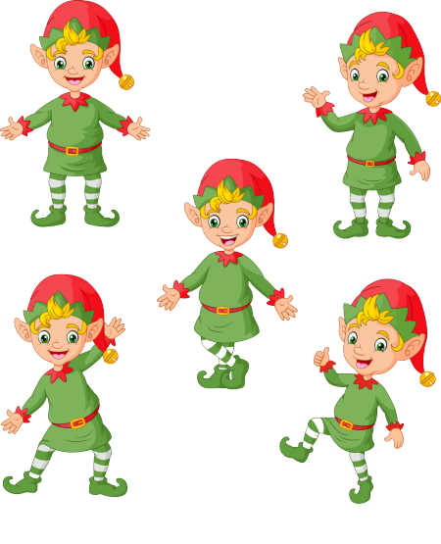
RING THE GOLDEN BELL
Notes:
Ms Huyền Phạm - 0936.082.789 – YOUTUBE: MsPham. Facebook: Dạy và học cùng công nghệ.

Slide 4



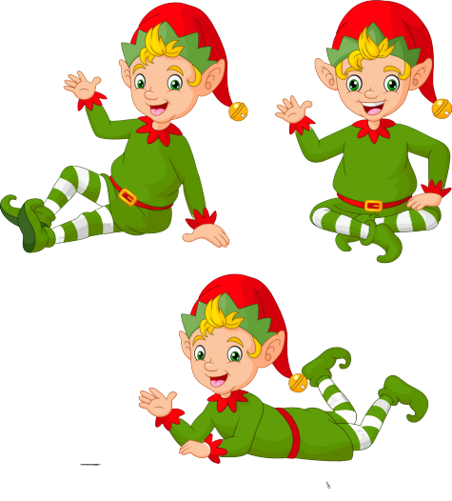
Ring The Golden Bell
Question 1
Answer
STAY IN A
HOTEL
1
2
3
4
5
6
7
8
9
10
Next
Notes:
Ms Huyền Phạm - 0936.082.789 – YOUTUBE: MsPham. Facebook: Dạy và học cùng công nghệ.

Slide 5
Ring The Golden Bell
Question 1
Answer
____ IN THE SEA
SWIM
1
2
3
4
5
6
7
8
9
10
Next
Notes:
Ms Huyền Phạm - 0936.082.789 – YOUTUBE: MsPham. Facebook: Dạy và học cùng công nghệ.

Slide 6
Ring The Golden Bell
Question 1
Answer
BUILD
SAND
CASTLES
1
2
3
4
5
6
7
8
9
10
Next
Notes:
Ms Huyền Phạm - 0936.082.789 – YOUTUBE: MsPham. Facebook: Dạy và học cùng công nghệ.

Slide 7
Ring The Golden Bell
Question 1
Answer
_____ SEAFOOD
EAT
1
2
3
4
5
6
7
8
9
10
Next
Notes:
Ms Huyền Phạm - 0936.082.789 – YOUTUBE: MsPham. Facebook: Dạy và học cùng công nghệ.

Slide 8
Ring The Golden Bell
Question 1
Answer
_____ A
BOAT CRUISE
GO ON
1
2
3
4
5
6
7
8
9
10
Next
Notes:
Ms Huyền Phạm - 0936.082.789 – YOUTUBE: MsPham. Facebook: Dạy và học cùng công nghệ.

Slide 9
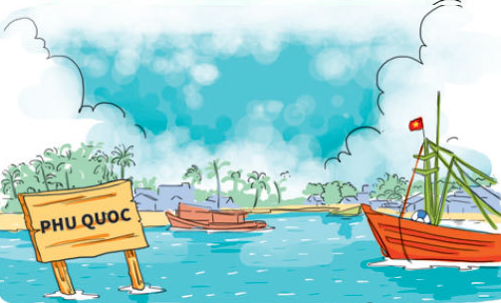
Ring The Golden Bell
Question 1
Answer
Where are you going this summer?
I’m going to Phu Quoc.
1
2
3
4
5
6
7
8
9
10
Next
Notes:
Ms Huyền Phạm - 0936.082.789 – YOUTUBE: MsPham. Facebook: Dạy và học cùng công nghệ.

Slide 10
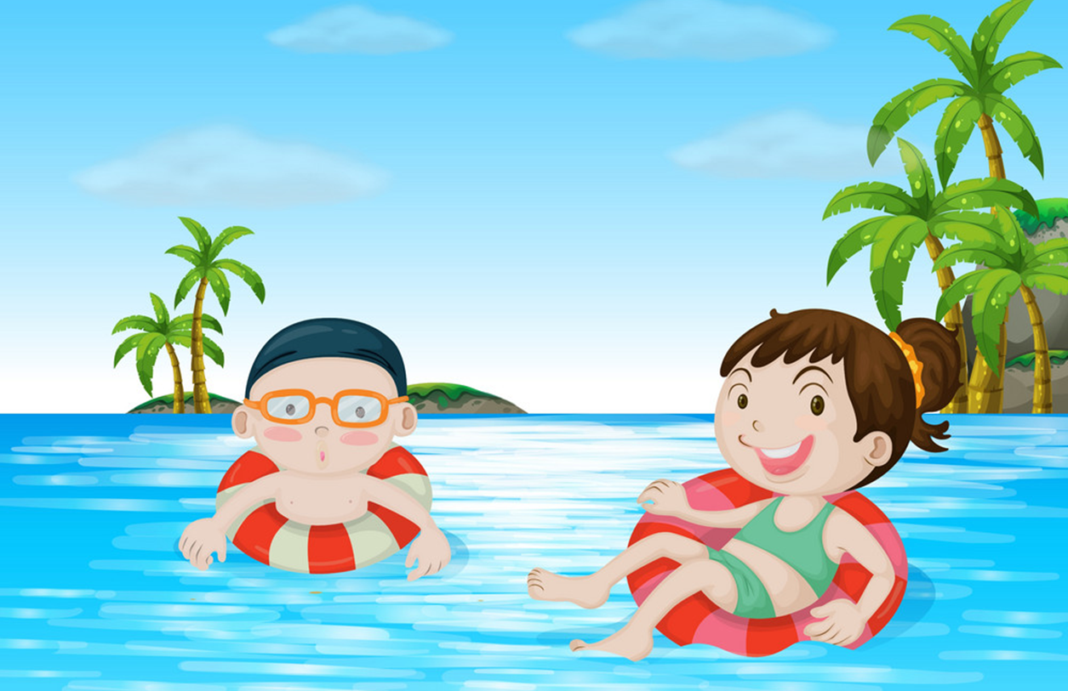
Ring The Golden Bell
Question 1
Answer
What are you going to do?
I’m/ we are going to swim in the sea.
1
2
3
4
5
6
7
8
9
10
Next
Notes:
Ms Huyền Phạm - 0936.082.789 – YOUTUBE: MsPham. Facebook: Dạy và học cùng công nghệ.

Slide 11
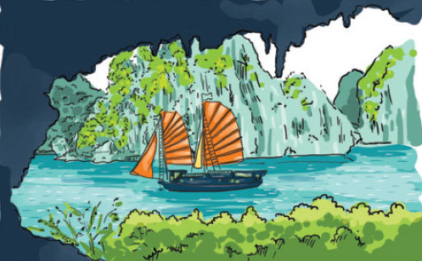
Ring The Golden Bell
Question 1
Answer
Where are your friends going this summer?
They’re going to Ha Long Bay.
1
2
3
4
5
6
7
8
9
10
Next
Notes:
Ms Huyền Phạm - 0936.082.789 – YOUTUBE: MsPham. Facebook: Dạy và học cùng công nghệ.

Slide 12
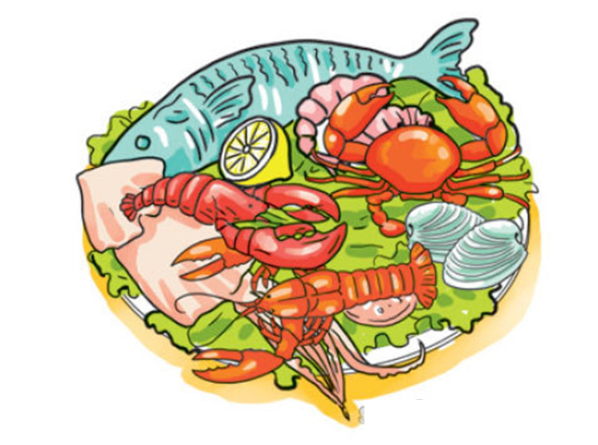
Ring The Golden Bell
Question 1
Answer
What are they going to do?
They’re going to eat seafood.
1
2
3
4
5
6
7
8
9
10
Next
Notes:
Ms Huyền Phạm - 0936.082.789 – YOUTUBE: MsPham. Facebook: Dạy và học cùng công nghệ.

Slide 13
Ring The Golden Bell
Question 1
Answer
Where ____ going next summer?
My brother is going to Ho Chi Minh city.
is your brother
1
2
3
4
5
6
7
8
9
10
Next
Notes:
Ms Huyền Phạm - 0936.082.789 – YOUTUBE: MsPham. Facebook: Dạy và học cùng công nghệ.

Slide 15
PRONUNCIATION

Slide 16

1. Listen and repeat.
de'licious | Seafood is de'licious.
e'normous | The hotel by the sea is e'normous.
No'vember | He is going to visit Sa Pa in No'vember.
De'cember | Linda is going to London this

Slide 17
2. Listen, circle and write.
1. Seafood is ___________.
a. delicious b. expensive
2. We stay in an ___________ hotel.
a. expensive b. enormous
3. We are going to Ho Chi Minh City this ___________.
a. November b. December
4. Is your holiday in ___________?
a. September b. December

Slide 18

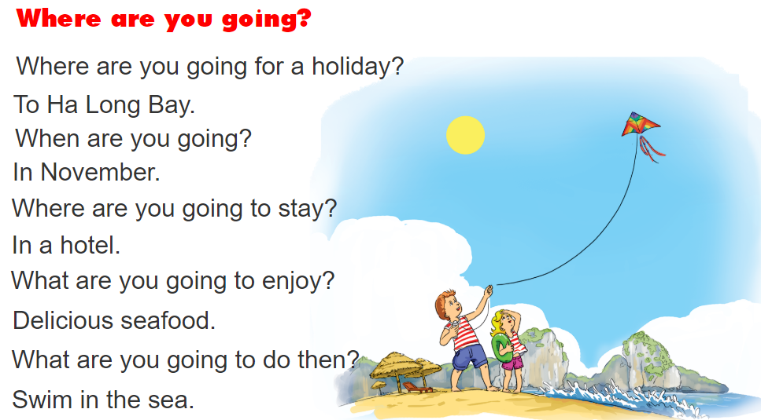
3. Let's chant.

Slide 19
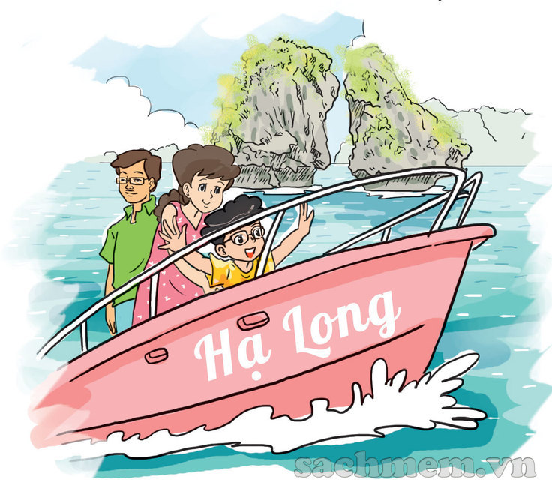
4. Read and complete.
My parents and I are going to have a holiday in Ha Long Bay next Saturday. We are going to stay in a nice hotel by the sea. In the morning, we are going to swim in the sea. In the afternoon, we are going to have a boat cruise around the bay. We are going to have delicious seafood in Tuan Chau in the evening. We are going to have a lot of fun there!
1. They are going to have a holiday in ________________.
2. They are going to stay in _________________.
3. In the morning, they are going to _________________.
Ha Long Bay
a nice hotel
swim in the sea

Slide 20
5. Write about the plan for your summer holidays.
Where are you going?
I'm going to __________________________.
When are you going?
___________________________________.
Who are you going with?
___________________________________.
Where are you going to stay?
___________________________________.
What are you going to do?
___________________________________.

Slide 21
6. Project

Slide 22



THANK YOU!
Welcome to join with me!
MsPham Powerpoint
Mspham

