Slide 1


Slide 2






Unit
1. Listen and repeat.
2. Point and say.

Slide 3

Warm-up

Slide 4
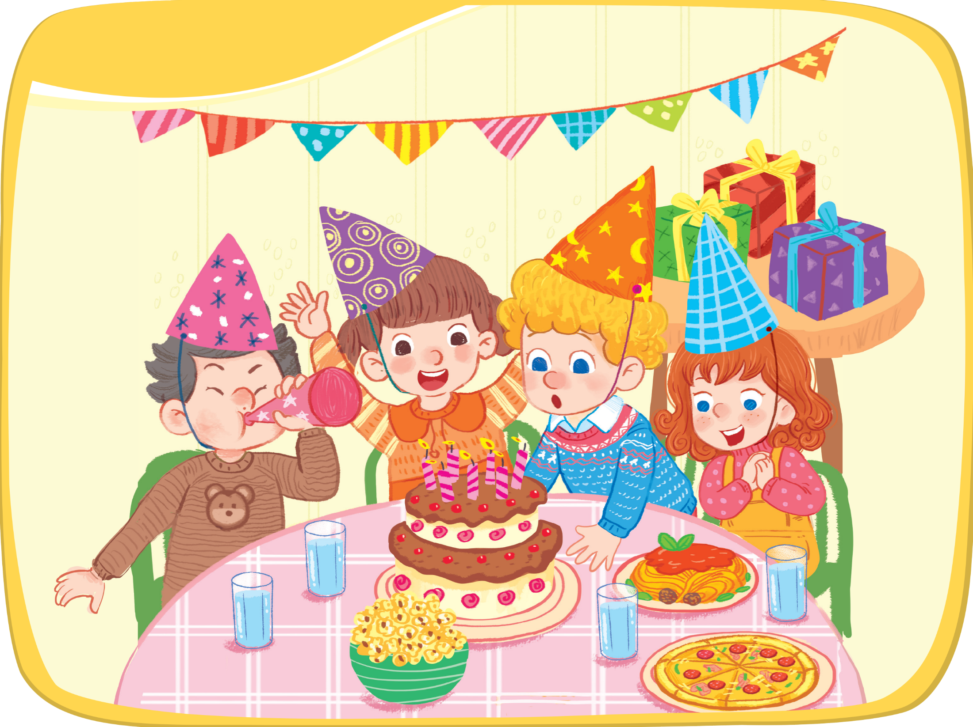




Listen and repeat.
pasta
popcorn
pizza

Slide 5

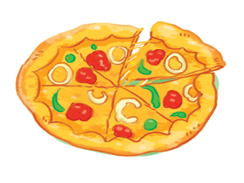
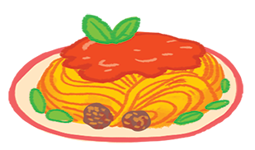
popcorn
pizza
pasta
p

Slide 6


Point and say.
pasta
popcorn
pizza

Slide 7
Time to say goodbye!
p

Slide 8





