Slide 1
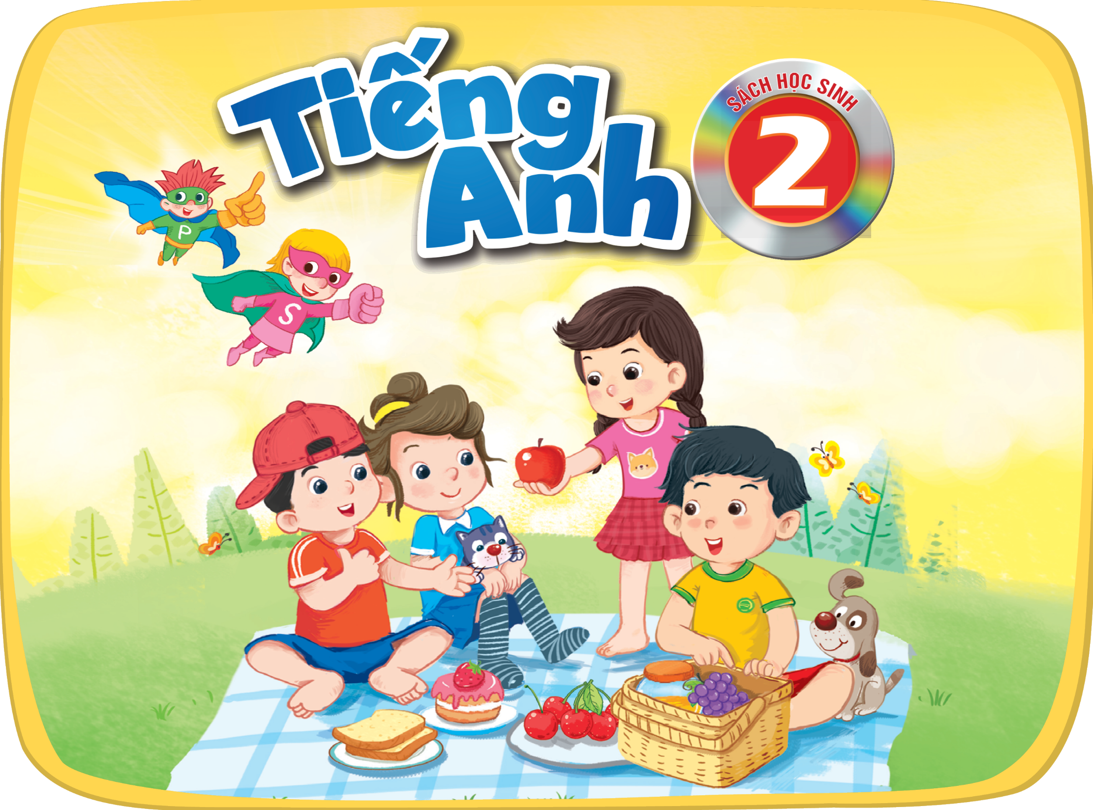

Slide 2







Unit
3. Listen and chant.
4.Listen and circle.
5. Look and write.

Slide 3

Warm-up

Slide 4
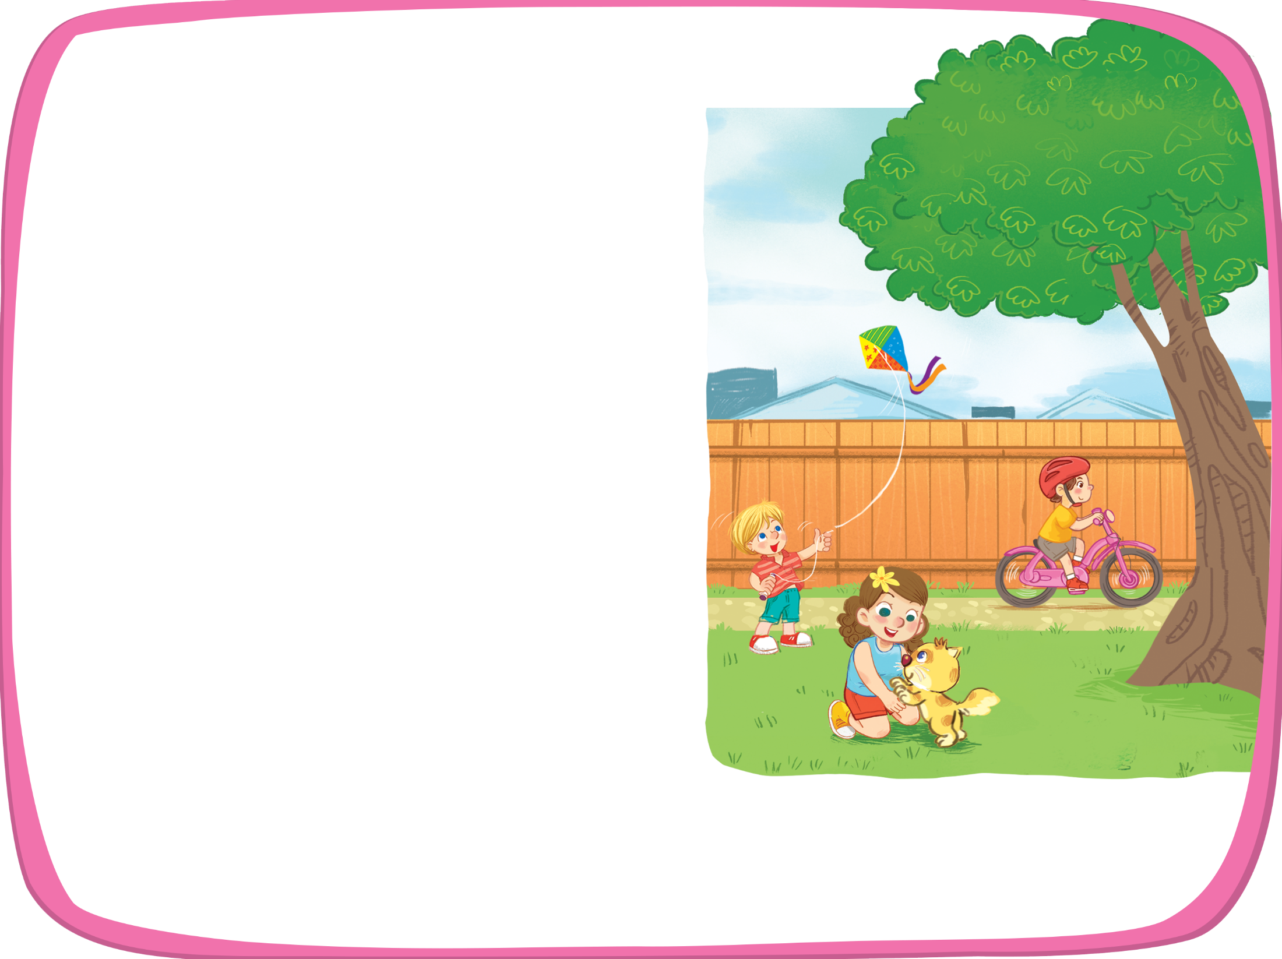



Listen and chant.
K, k, kite.
K, k, kite.
K, k, kite.
K, k, kite.
He’s flying a kite.
He’s flying a kite.
He’s flying a kite.
He’s flying a kite.
K, k, bike.
K, k, bike.
K, k, bike.
K, k, bike.
He’s riding a bike.
He’s riding a bike.
He’s riding a bike.
He’s riding a bike.
K, k, kitten.
K, k, kitten.
K, k, kitten.
K, k, kitten.
She’s playing with a kitten.
She’s playing with a kitten.
She’s playing with a kitten.
She’s playing with a kitten.

Slide 5


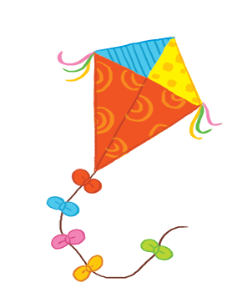
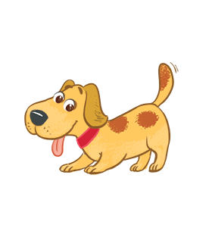
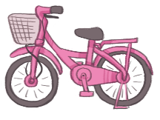
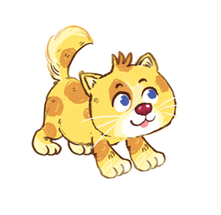


Listen and circle.
1
2

Slide 6
Listen and circle.
1

Slide 7
Listen and circle.
2

Slide 8


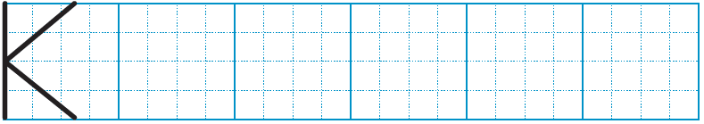
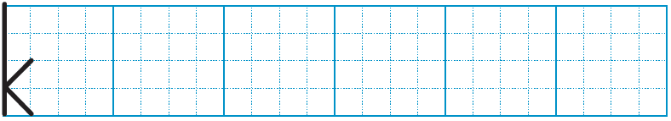
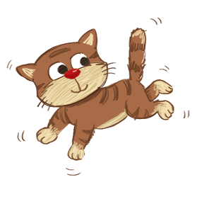
Look and write.
k
k
ite
k
itten
bi e

Slide 9
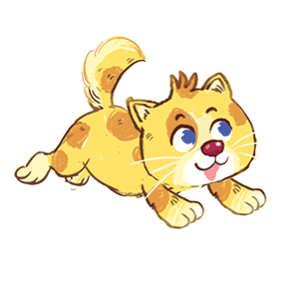
Time to say goodbye!
k

Slide 10





