Slide 1

Dong Hoa Primary School
WELCOME TO
OUR CLASS 3
Teacher: Nguyễn Thị Khang
Notes:
Made by Facebook: TRAN THI THANH TAM

Slide 2

UNIT 4: OUR BODIES
LESSON 3 (1, 2, 3)
Notes:
MADE BY FACEBOOK :TRAN THI THANH TAM

Slide 3
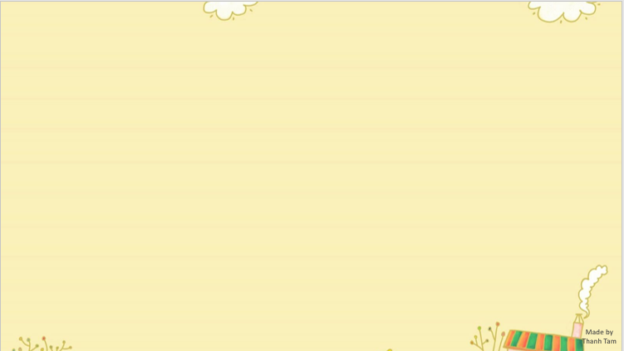

CONTENTS
1
WARM -UP
2
LISTEN AND REPEAT
3
LISTEN AND CIRCLE
4
LET’S CHANT
5
PLAY GAME
Notes:
MADE BY FACEBOOK :TRAN THI THANH TAM

Slide 4
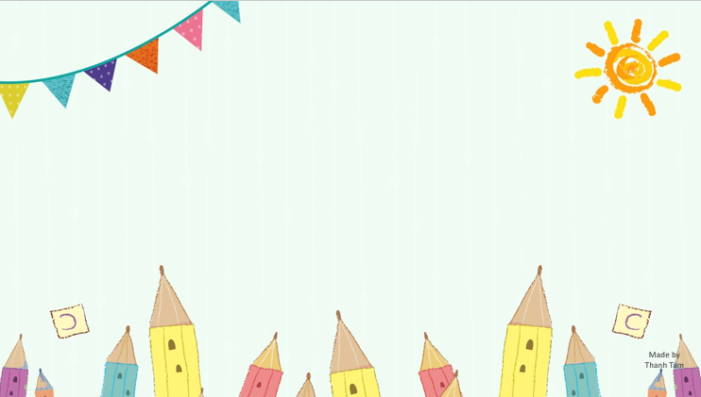
Warm - up
Notes:
MADE BY FACEBOOK :TRAN THI THANH TAM

Slide 5


Let's play
Made by Thanh Tam
Notes:
MADE BY FACEBOOK :TRAN THI THANH TAM

Slide 6



RING THE GOLDEN BELL
Notes:
MADE BY FACEBOOK :TRAN THI THANH TAM

Slide 7

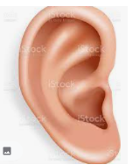
10
2
3
4
7
8
5
6
9
0
1
Game
RINGING THE GOLDEN BELL
What’s this?
It’s an …………...
ear
Notes:
MADE BY FACEBOOK :TRAN THI THANH TAM

Slide 8

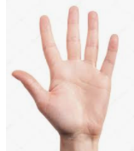
10
2
3
4
7
8
5
6
9
0
1
Game
RINGING THE GOLDEN BELL
What’s this?
It’s a …………...
hand
Notes:
MADE BY FACEBOOK :TRAN THI THANH TAM

Slide 9

10
2
3
4
7
8
5
6
9
0
1
Game
RINGING THE GOLDEN BELL
What’s this?
It’s a …………...
nose
Notes:
MADE BY FACEBOOK :TRAN THI THANH TAM

Slide 10
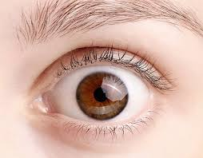
10
2
3
4
7
8
5
6
9
0
1
Game
RINGING THE GOLDEN BELL
What’s this?
It’s an …………...
eye
Notes:
MADE BY FACEBOOK :TRAN THI THANH TAM

Slide 11

10
2
3
4
7
8
5
6
9
0
1
Game
RINGING THE GOLDEN BELL
What’s this?
It’s a …………...
face
Notes:
MADE BY FACEBOOK :TRAN THI THANH TAM

Slide 12

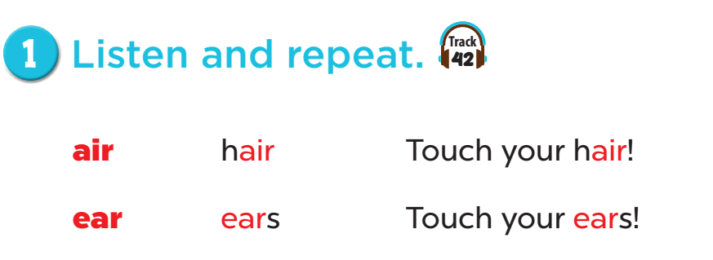
Notes:
MADE BY FACEBOOK :TRAN THI THANH TAM

Slide 13
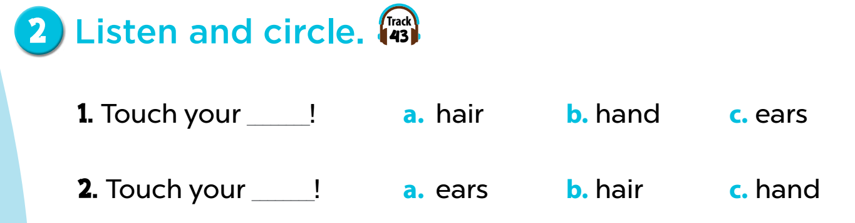
Notes:
MADE BY FACEBOOK :TRAN THI THANH TAM

Slide 14
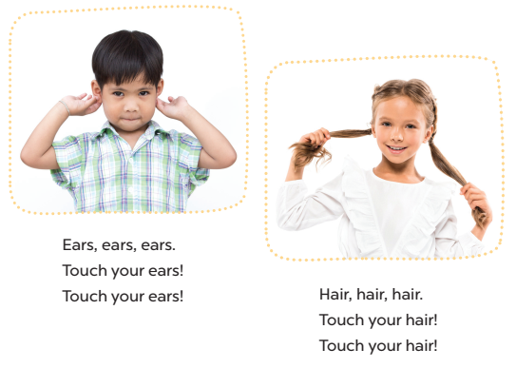
3. Let’s chant.
Notes:
MADE BY FACEBOOK :TRAN THI THANH TAM

Slide 15

Let's play
Who’s a millionaire?
Notes:
MADE BY FACEBOOK :TRAN THI THANH TAM

Slide 16


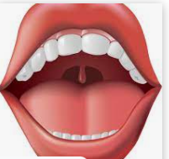


Who's a millionaire?
50:50
A. face
B. nose
C. mouth
C. mouth
D. eye
Notes:
MADE BY FACEBOOK :TRAN THI THANH TAM

Slide 17
Who's a millionaire?
50:50
A. face
B. ear
B. ear
C. mouth
D. eye
Notes:
MADE BY FACEBOOK :TRAN THI THANH TAM

Slide 18
Who's a millionaire?
50:50
A. hand
A. hand
B. nose
C. mouth
D. eye
Notes:
MADE BY FACEBOOK :TRAN THI THANH TAM

Slide 19
Who's a millionaire?
50:50
A. face
B. nose
B. nose
C. mouth
D. eye
Notes:
MADE BY FACEBOOK :TRAN THI THANH TAM

Slide 20
Who's a millionaire?
50:50
A. face
B. nose
C. mouth
D. eye
D. eye
Notes:
MADE BY FACEBOOK :TRAN THI THANH TAM

Slide 21
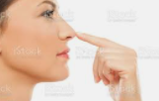
Who's a millionaire?
50:50
A. touch
B. open
A. touch
C. ear
D. hand
Notes:
MADE BY FACEBOOK :TRAN THI THANH TAM

Slide 22
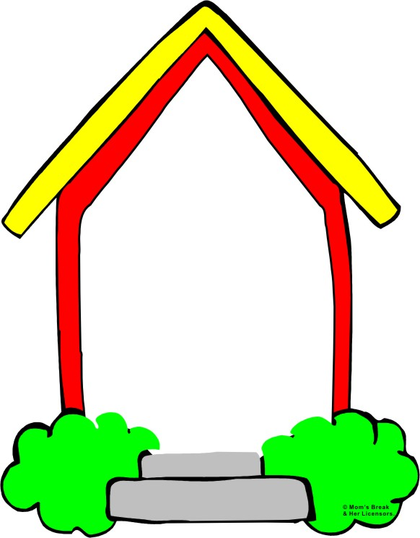
Homework:
- Practice more at home
- Prepare Unit 4- Lesson 3 ( 4, 5, 6)
Made by
Thanh Tam
Notes:
MADE BY FACEBOOK :TRAN THI THANH TAM

Slide 23

Notes:
MADE BY FACEBOOK :TRAN THI THANH TAM

Slide 24
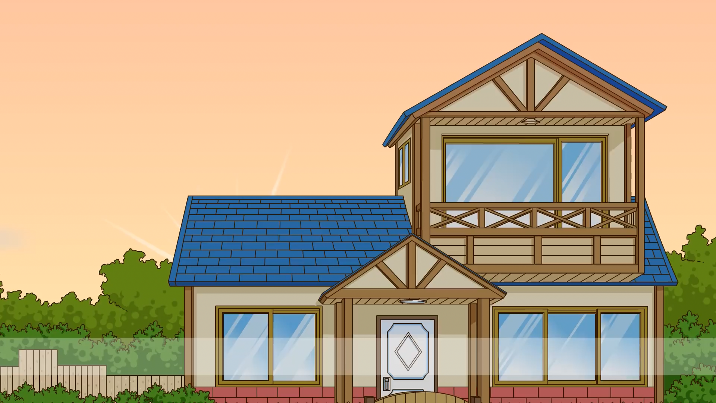
Dong Hoa Primary School
WELCOME TO
OUR CLASS 3
Teacher: Nguyễn Thị Khang
Notes:
MADE BY FACEBOOK :TRAN THI THANH TAM

Slide 25
UNIT 4: OUR BODIES
LESSON 3 (4, 5, 6)

Slide 26
CONTENTS
1
WARM -UP
2
READ AND MATCH
3
LET’S WRITE
4
PROJECT
5
PLAY GAME
Notes:
MADE BY FACEBOOK :TRAN THI THANH TAM

Slide 27
Warm - up
Notes:
MADE BY FACEBOOK :TRAN THI THANH TAM

Slide 28

LET’S PLAY

Slide 29
 REORDER WORDS
1
E
E
Y
E
Y
E
2
N
S
E
O
N
O
S
E
3
R
E
A
E
A
R
4
H
U
O
T
C
T
O
U
C
H

Slide 30
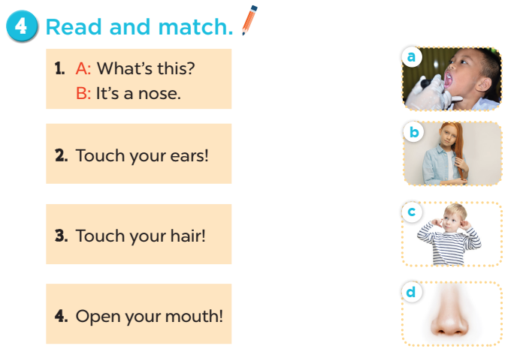
Notes:
MADE BY FACEBOOK :TRAN THI THANH TAM

Slide 31
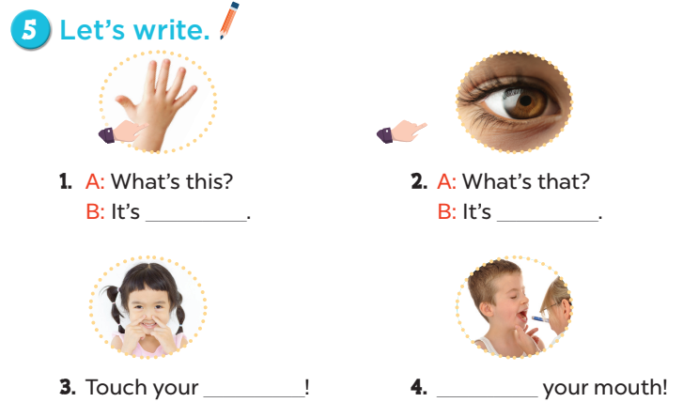
5.Let’s write.
a hand
an eye
nose
Open
Notes:
MADE BY FACEBOOK :TRAN THI THANH TAM

Slide 32
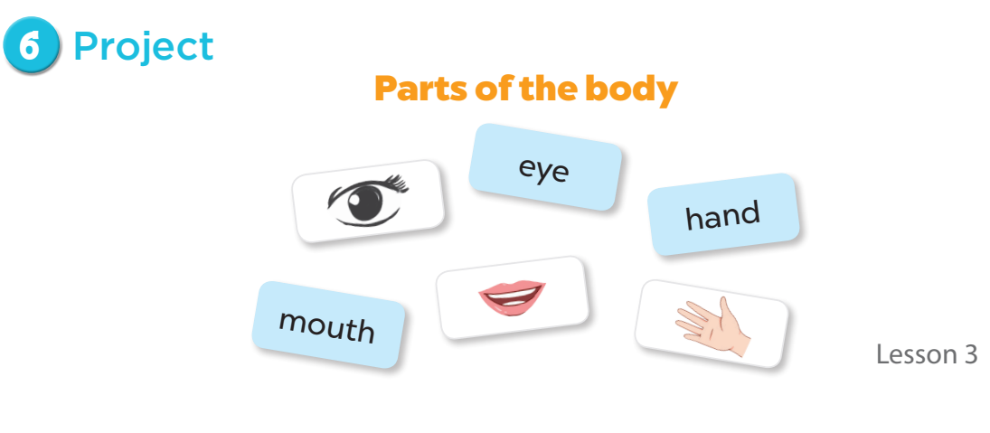
Notes:
MADE BY FACEBOOK :TRAN THI THANH TAM

Slide 33

Let's play
Reoder the words
Notes:
Made by Facebook: TRAN THI THANH TAM

Slide 34
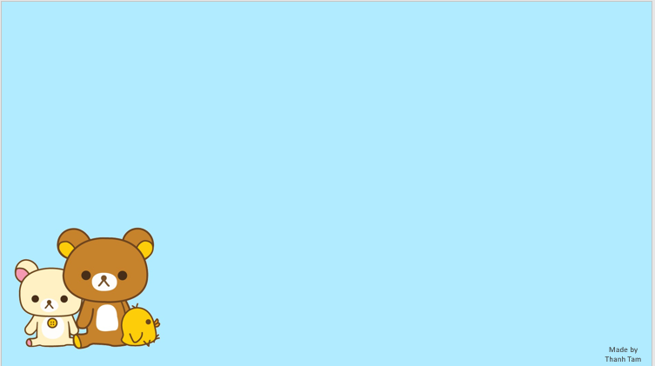
REODER THE WORDS
1. an/ It’s/ ear/ .
2. your/ touch/eyes/ !
3. mouth/ open/ ! /your
4. a/and/ ear/ an/ hand/ .
Notes:
MADE BY FACEBOOK :TRAN THI THANH TAM

Slide 35
1. an/ It’s/ ear/.
It’s an ear.
Notes:
MADE BY FACEBOOK :TRAN THI THANH TAM

Slide 36

2. your/ touch/ eyes/ !
Touch your eyes !
Notes:
MADE BY FACEBOOK :TRAN THI THANH TAM

Slide 37
3. mouth/ open/ ! / your
Open your mouth!
Notes:
MADE BY FACEBOOK :TRAN THI THANH TAM

Slide 38
4. a/and/ ear/An/ hand/.
A ear and a hand.
Notes:
MADE BY FACEBOOK :TRAN THI THANH TAM

Slide 39
Homework:
- Practice more at home
- Prepare Unit 5- Lesson 1 ( 1, 2, 3)
Notes:
MADE BY FACEBOOK :TRAN THI THANH TAM

Slide 40




The bye bye song
Bye, bye.
See you tomorrow.
Bye, bye.
See you tomorrow.
Bye, bye.
See you tomorrow.
Bye, bye. Bye, bye.
The bye bye song
Made by Thanh Tam

Slide 41

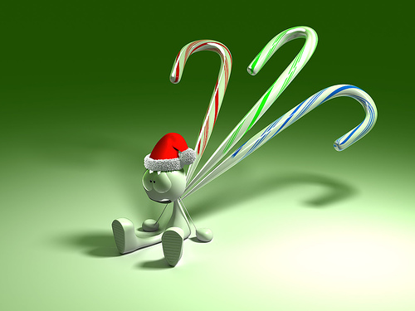

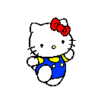
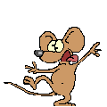


GOODBYE,
SEE YOU AGAIN !

