Slide 1
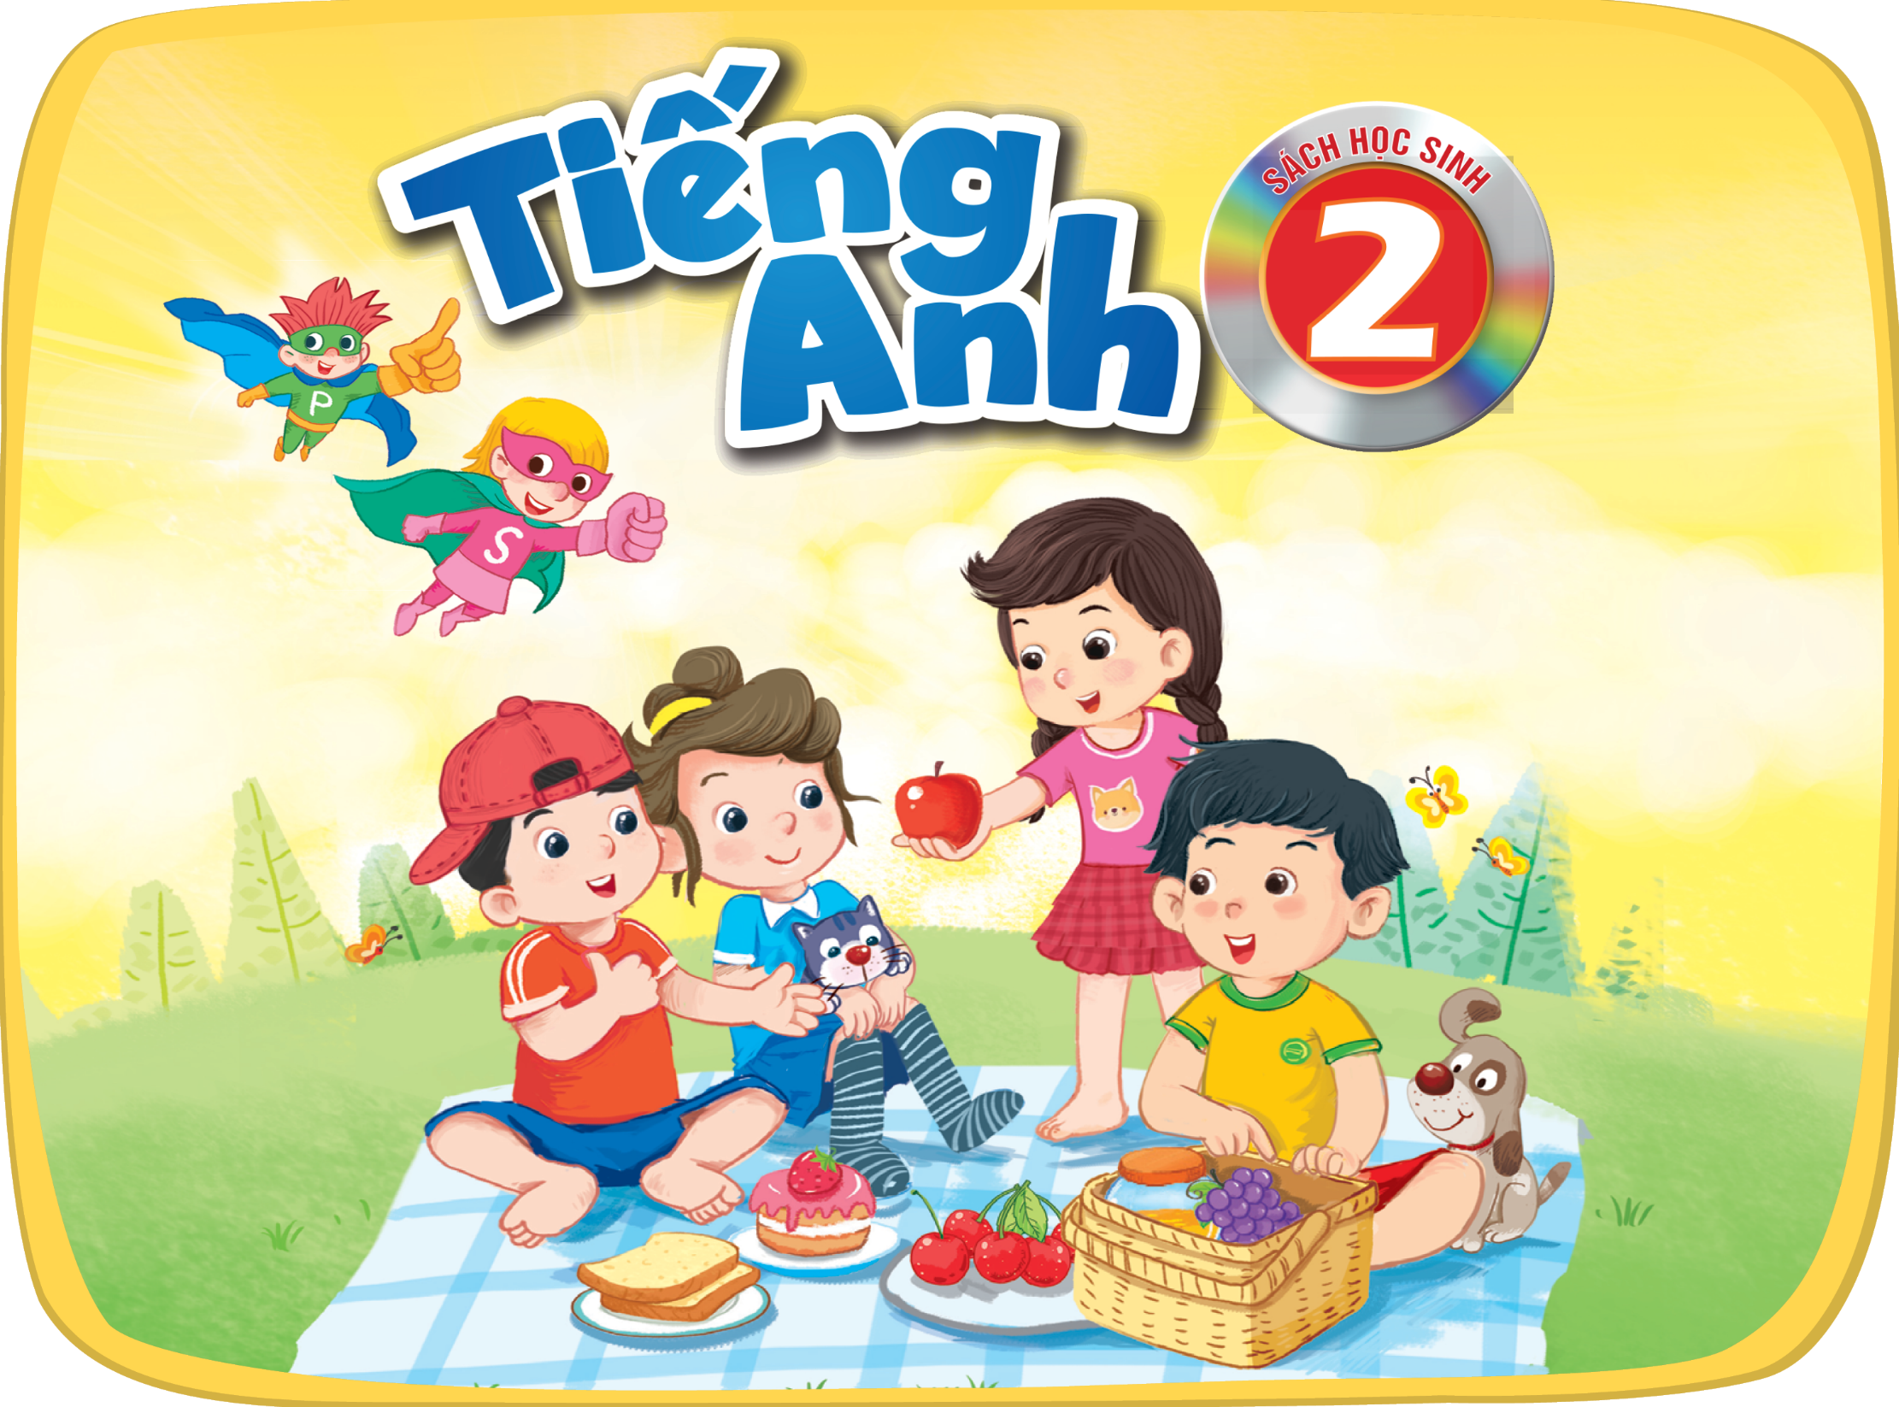

Slide 2







Unit
6. Listen and repeat.
7. Let’s talk.
8. Let’s sing.

Slide 3

Warm-up

Slide 4



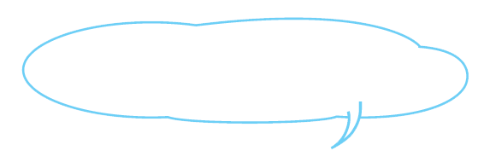
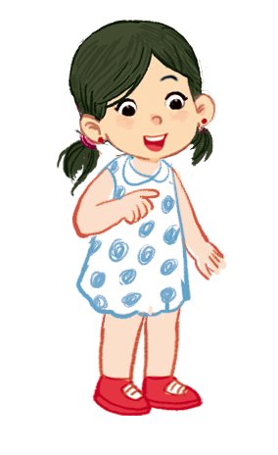

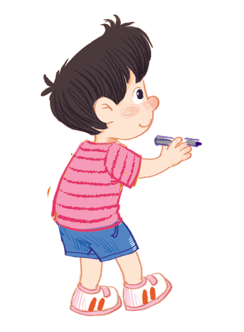
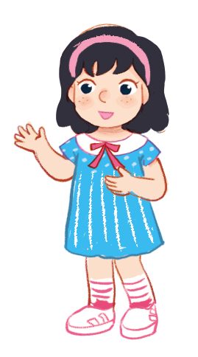
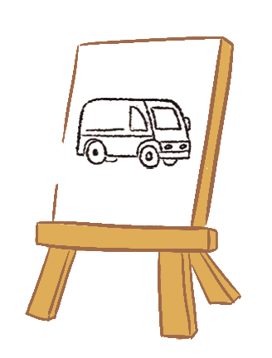

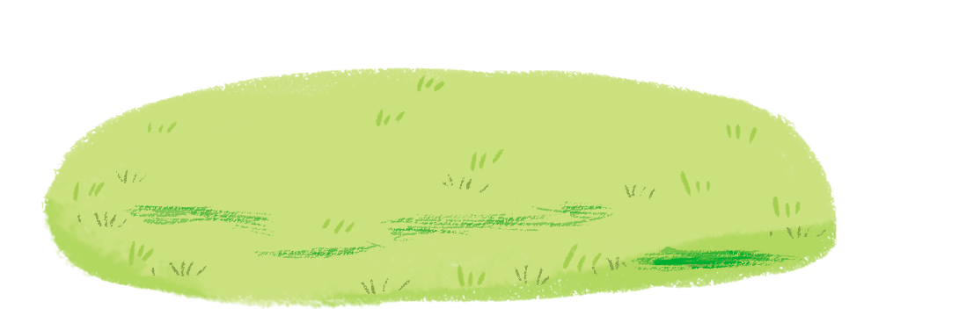
Listen and repeat.
Can you draw a van?
Can you draw a van?
Can you draw a van?
Can you draw a van?
No, I can’t.
No, I can’t.
No, I can’t.
No, I can’t.
Yes, I can.
Yes, I can.
Yes, I can.
Yes, I can.

Slide 5



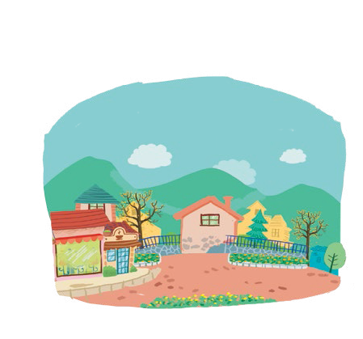
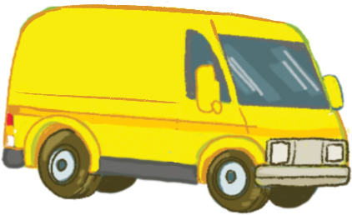


Let’s talk.
What can you see?
I .
I .
a
b
c
d

Slide 6
What can you see?
I .
I .
a

Slide 7

What can you see?
I .
I .
b

Slide 8
What can you see?
I .
I .
c

Slide 9
What can you see?
I .
I .
d

Slide 10
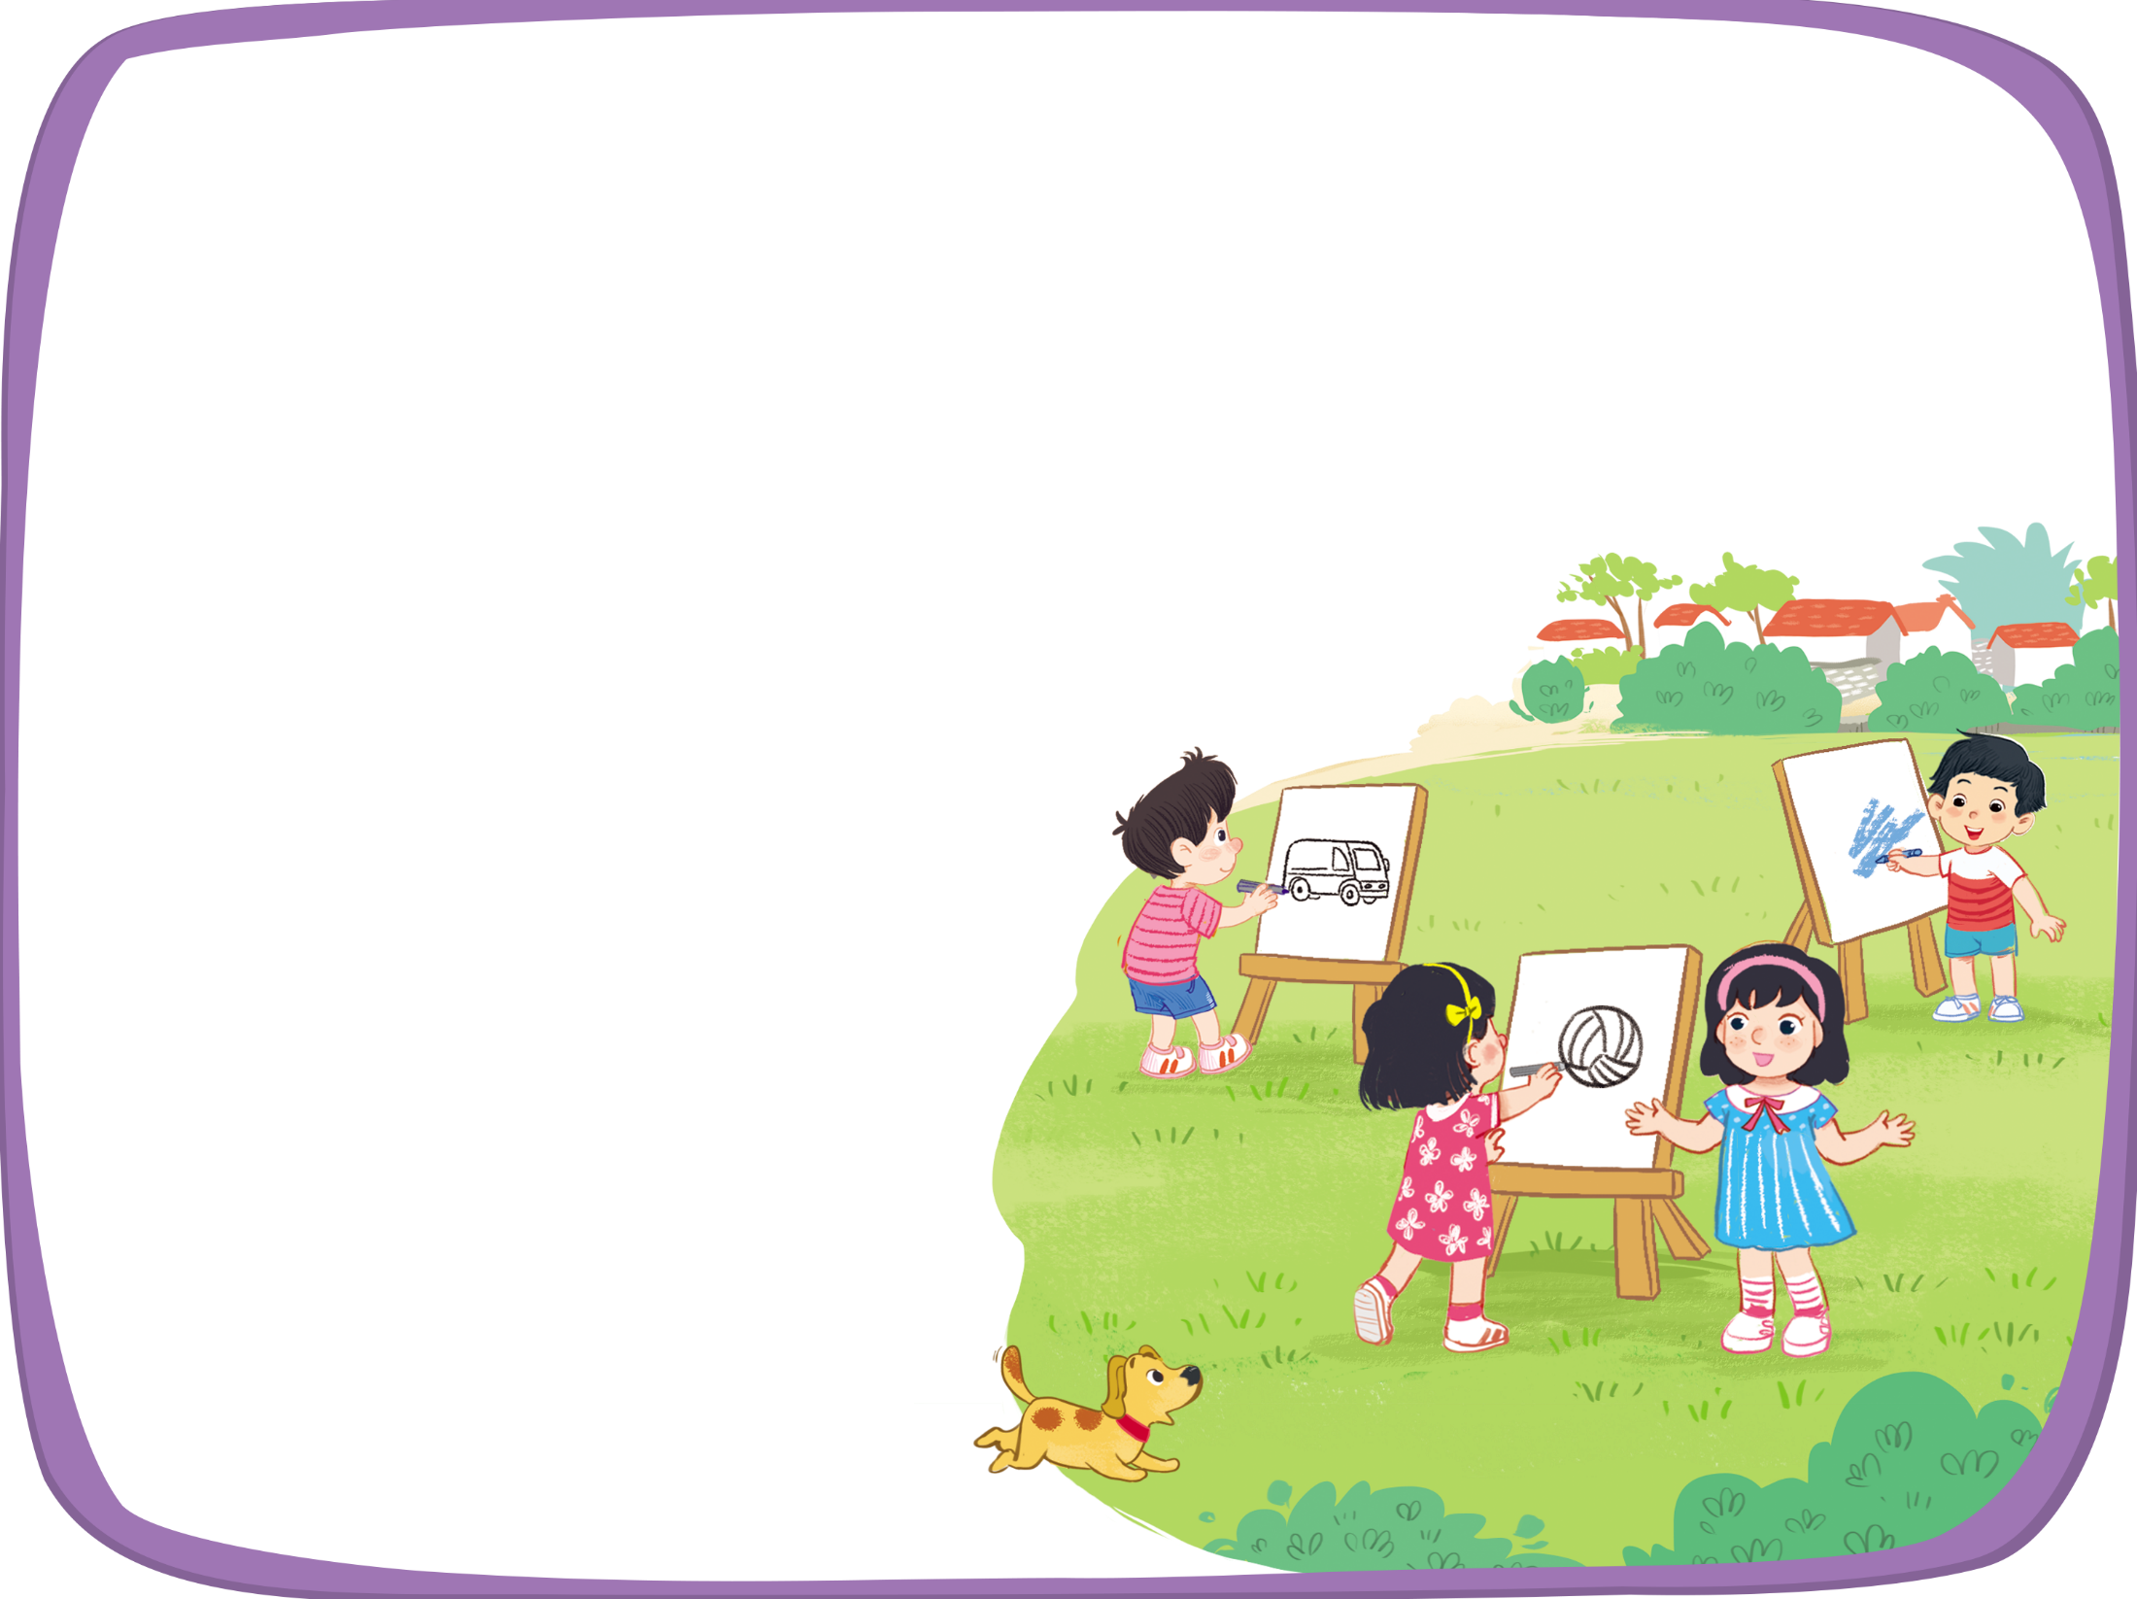


Let’s sing!
Can you draw a van?
Can you draw a van?
Can you draw a van?
Can you draw a van?
Yes, I can.
Yes, I can.
Yes, I can.
Yes, I can.
Can you draw a volleyball?
Can you draw a volleyball?
Can you draw a volleyball?
Can you draw a volleyball?
Yes, I can.
Yes, I can.
Yes, I can.
Yes, I can.
Can you draw a village?
Can you draw a village?
Can you draw a village?
Can you draw a village?
No, I can’t.
No, I can’t.
No, I can’t.
No, I can’t.

Slide 11
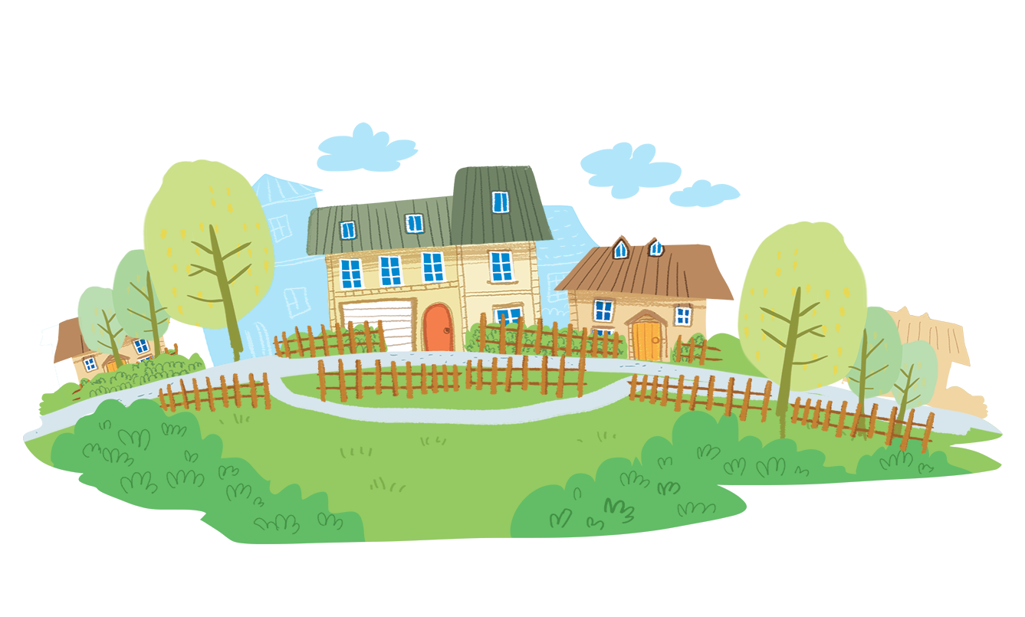
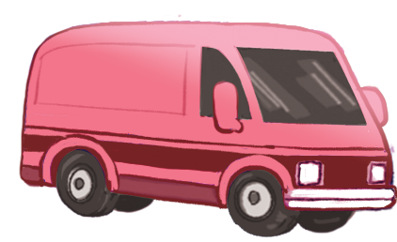
Time to say goodbye!
v

Slide 12





