Slide 1

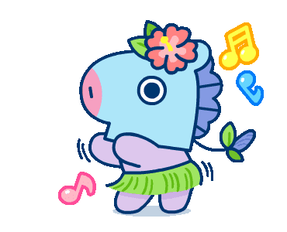
English lesson

Slide 2

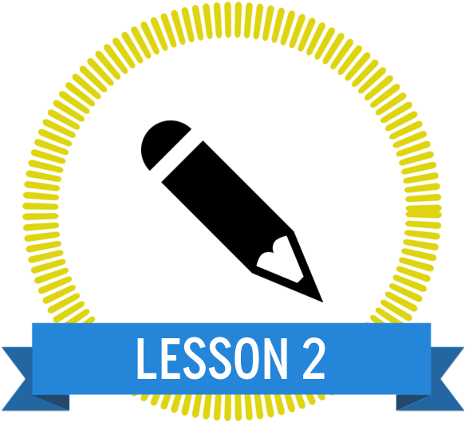
Unit 14:what happened in the story?

Slide 3

Nội dung bài học
1
Vocabulary

Slide 4



- intelligent: thông minh
- hard – working: chăm chỉ
- kind: tốt bụng
- greedy: tham lam
- hard – working: chăm chỉ
- Golden star fruit trees : cây khế vàng
- think: nghĩ
- younger: trẻ hơn>< older: gìa hơn

Slide 5
Nội dung bài học
1
Vocabulary
2
Look, listen and repeat

Slide 6

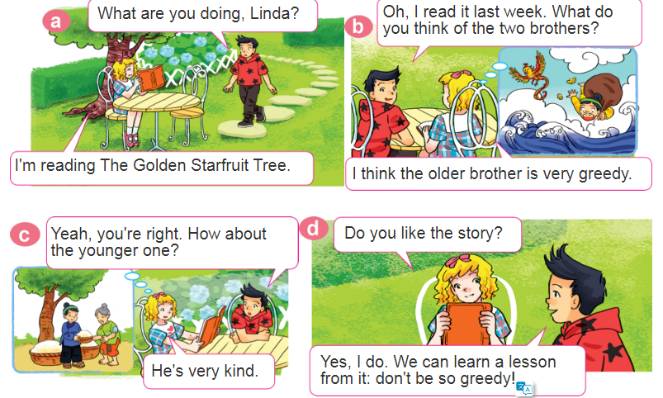
2. Look, listen and repeat

Slide 7
t
Nội dung bài học
1
Vocabulary
2
Look, listen and repeat
3
Point and say

Slide 8
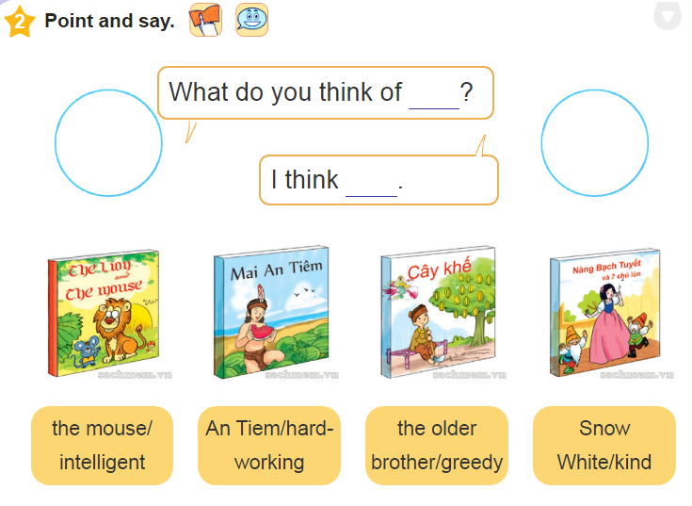
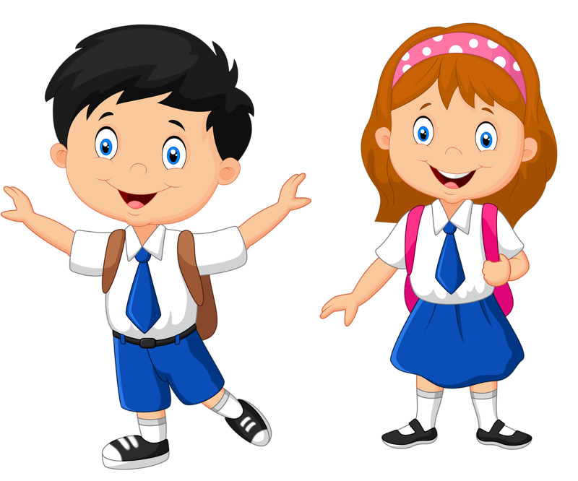
3. Point and say

Slide 9
Nội dung bài học
4
Let’ s talk

Slide 10
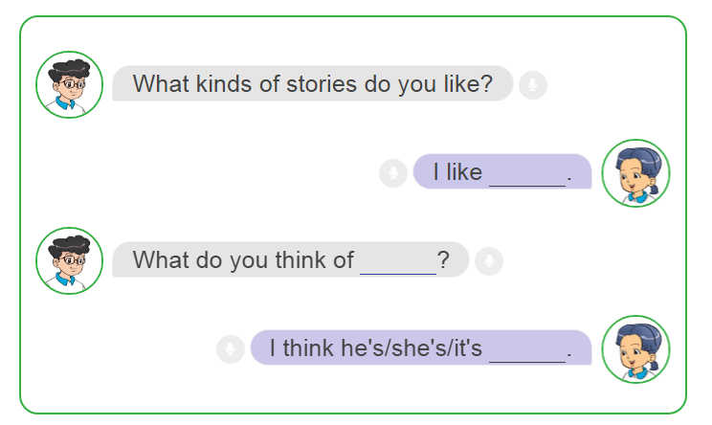
4
Let’ s talk

Slide 11
Nội dung bài học
4
Let’ s talk
5
Listen and tick

Slide 12
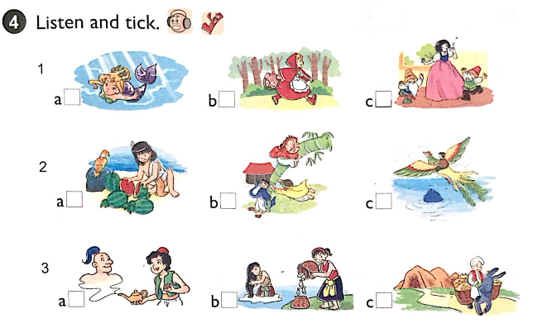

5
Listen and tick

Slide 13
Nội dung bài học
4
Let’ s talk
5
Listen and tick
6
Write bout your favourite book

Slide 14
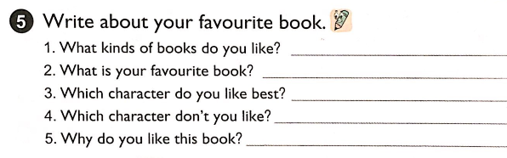
Write bout your favourite book
6
1. I like fairy tales.
2. My favourite book is The story of Tam and Cam.
3. I like Tam.
4. I don't like Cam.
5. Because each of them gives me a lesson in life.

Slide 15


