Slide 1
Unit 7
What do you
like doing?
Lesson 1

Slide 2
VOCABULARY

Slide 3
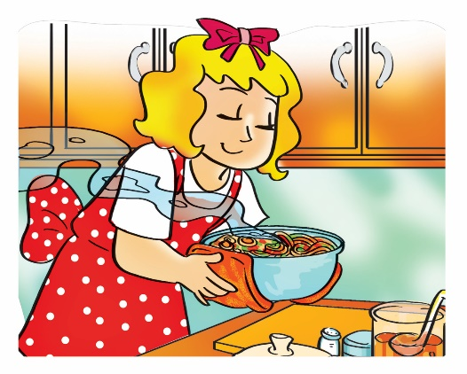
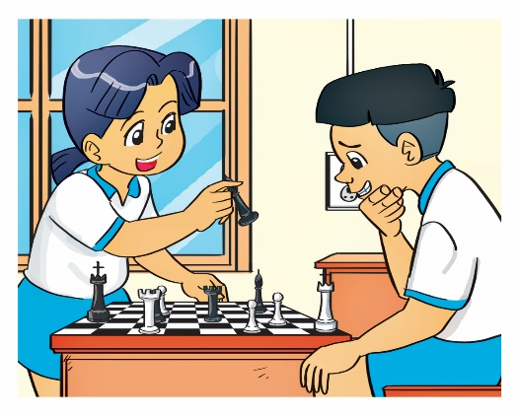
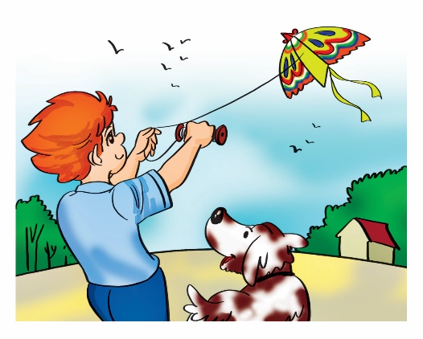
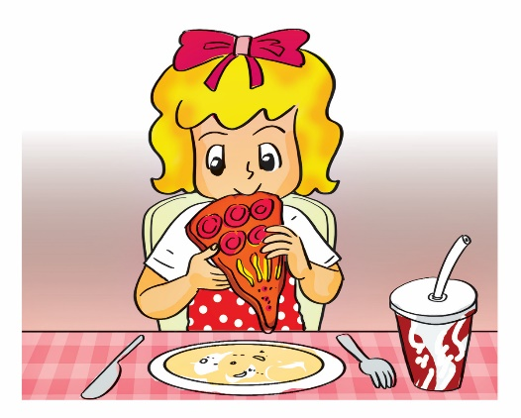
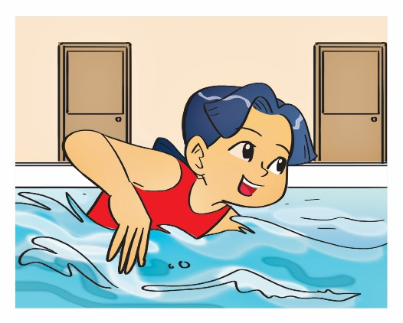
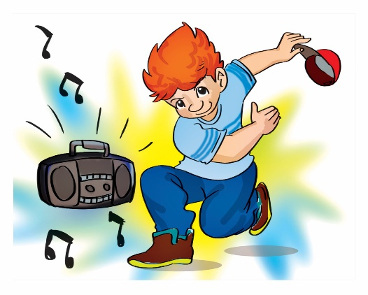
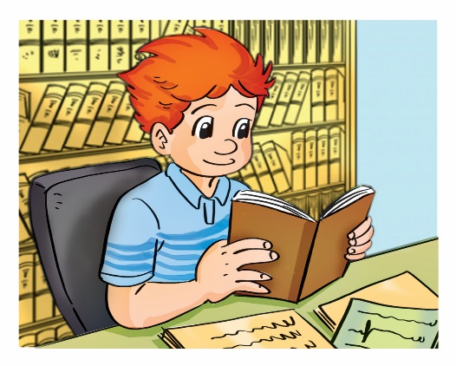
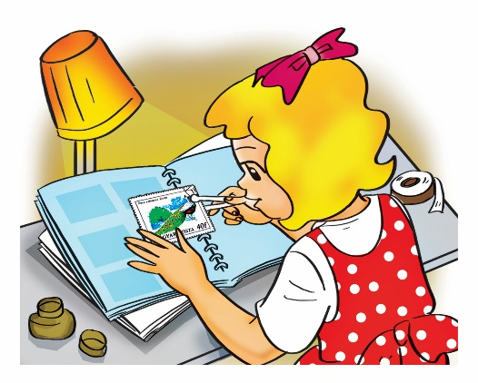
MsPham-0936082789
A. Vocabulary
Verb (v)
cook
play
fly
eat
/kʊk/
/pleɪ/
/flaɪ/
/iːt/
Nấu ăn
Chơi
Thả, bay
Ăn
swim
dance
read
collect
/swɪm/
/dæns/
/riːd/
/kəˈlekt/
Bơi
Nhảy
Đọc
Sưu tầm

Slide 4
MsPham-0936082789
A. Vocabulary
Verb (v)
V-ing
cooking
playing
flying
eating
cook
play
fly
eat
swimming
dancing
reading
collecting
swim
dance
read
collect

Slide 5
GRAMMAR

Slide 6
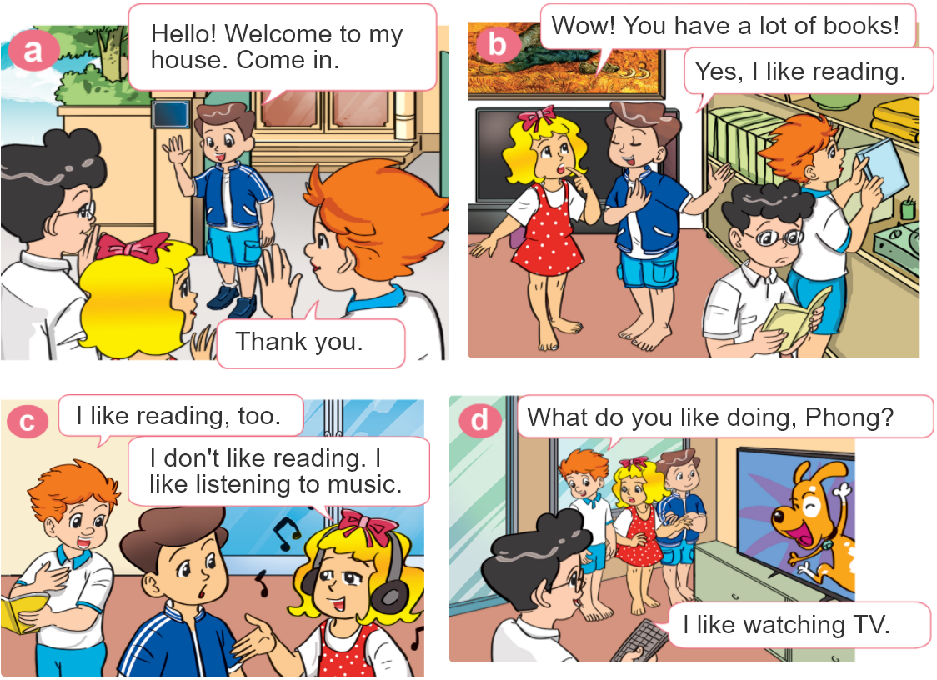

1. Look, listen and repeat.

Slide 7


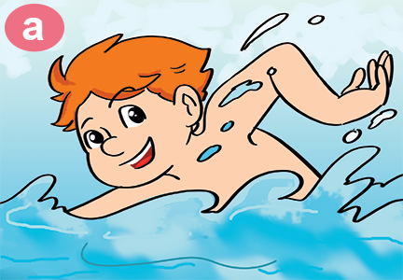
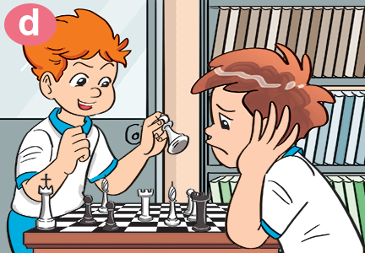
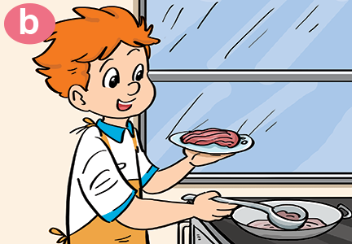
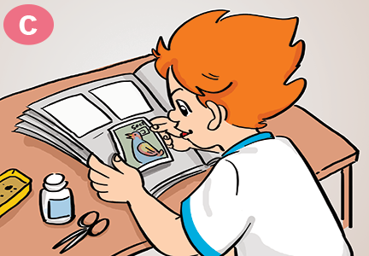
2. Point and say
What do you like doing?
I like ___________.
swimming
playing
chess
cooking
collecting
stamps

Slide 8

B. Structures:
Hỏi và trả lời bạn THÍCH làm gì:
What do you like doing?
(Bạn thích làm gì?)
I like ______.
V-ing
(Tớ thích___.)

Slide 9






Slide 10




What ___ you like doing?
are
do

Slide 11

What do you like _____?
doing
eating

Slide 12

What do you like doing?
I’m collecting stamps.
I like collecting stamps.

Slide 13
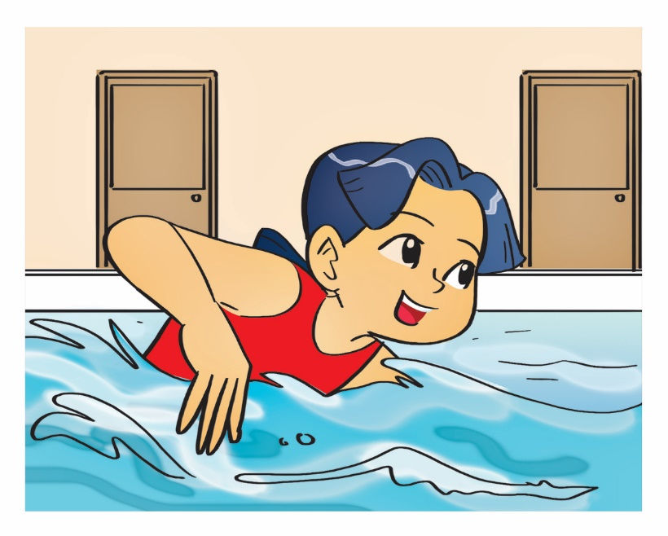
What do you like doing?
I like swimming.
She likes swimming.

Slide 14

What do you like doing?
I like dancing.
I like singsing.

Slide 15
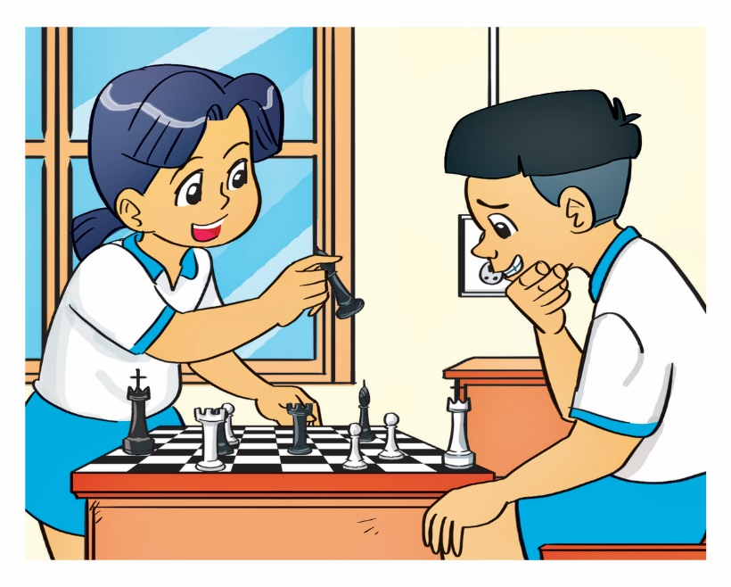
What do you like doing?
They like playing chess.
I like playing chess.

Slide 16

What do you like doing?
I like reading books.
I like read a book.

Slide 17

I like flying a kite.
What do you like doing?
What do you like going?

Slide 18
What do you like _____?
doing
eating

Slide 19
What ___ you like doing?
are
do

Slide 20


Slide 21
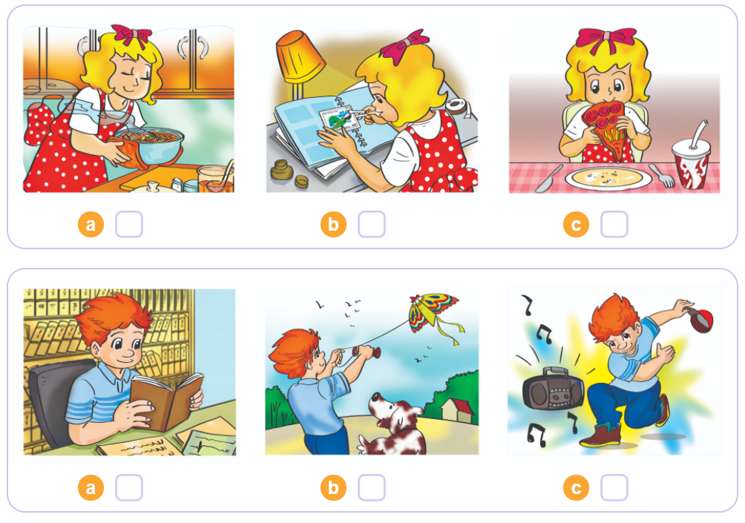


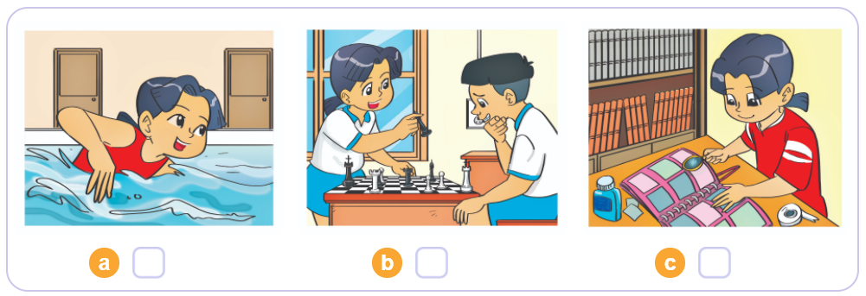
4. Listen and tick
1
2
3

Slide 22
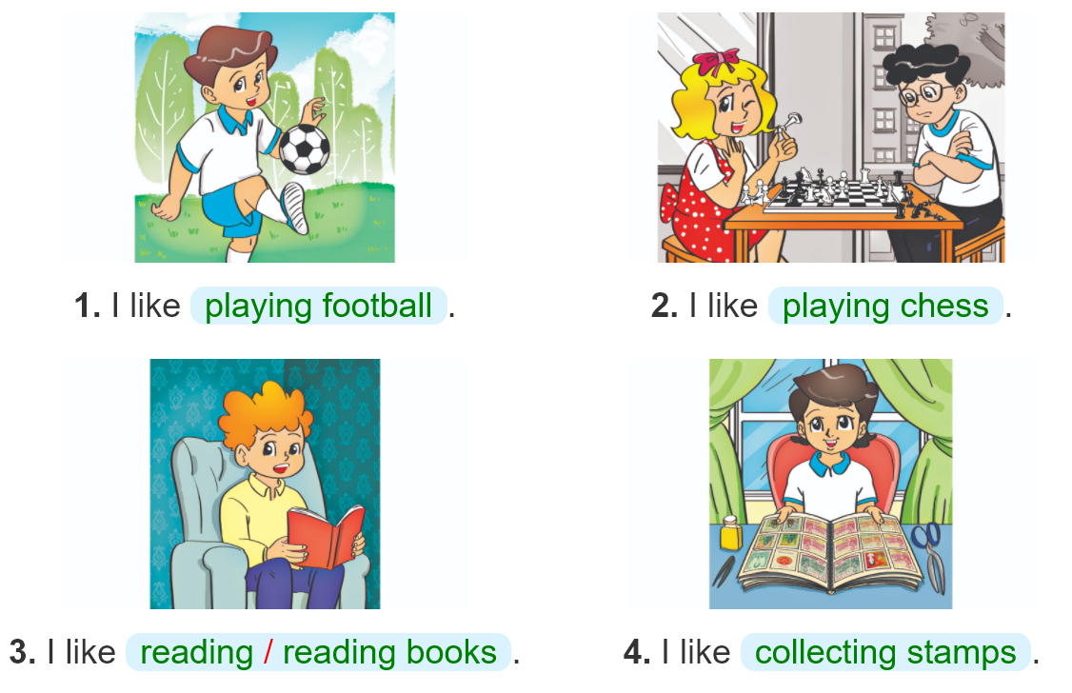

5. Look and write

Slide 23
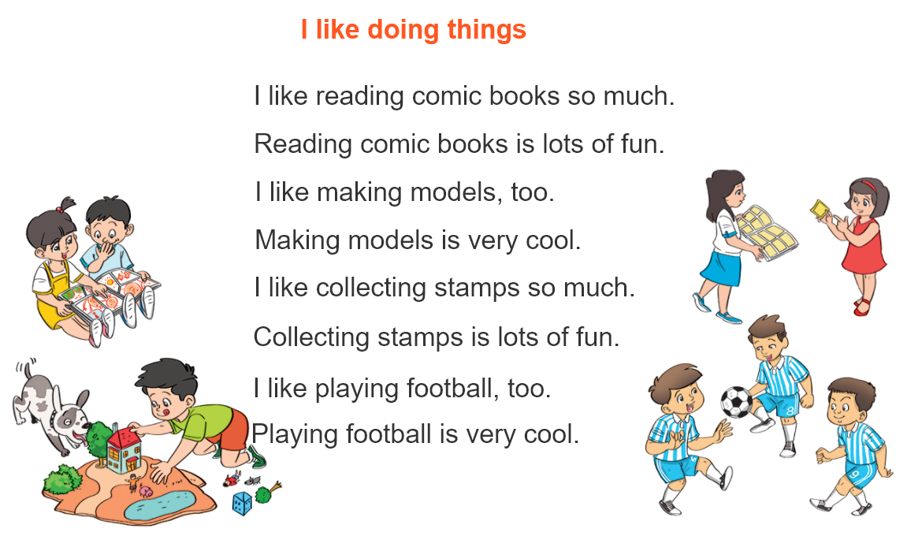


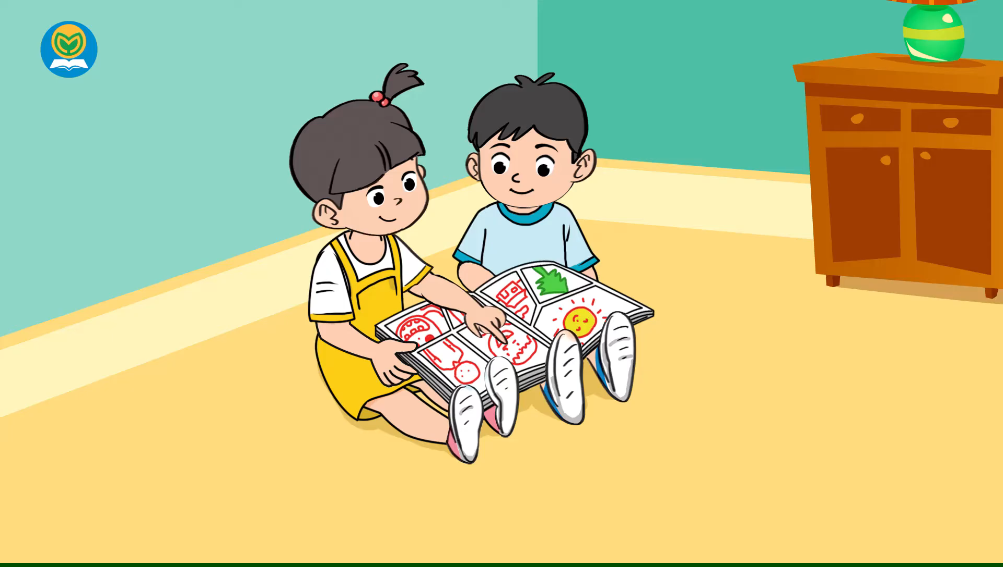
6. Let’s sing

