Slide 1







Unit
6. Listen and repeat.
7. Let’s talk.
8. Let’s sing.

Slide 2

Warm-up

Slide 3

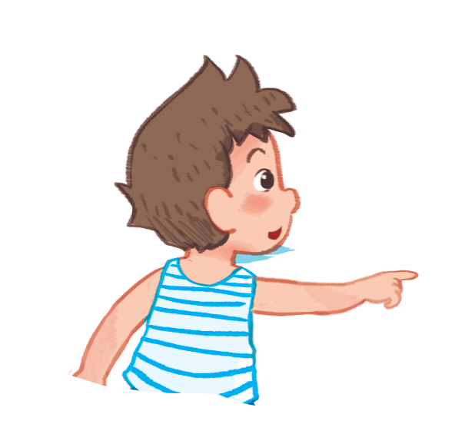
Who are you ?
I’m
Let’s look at Bill

Slide 4



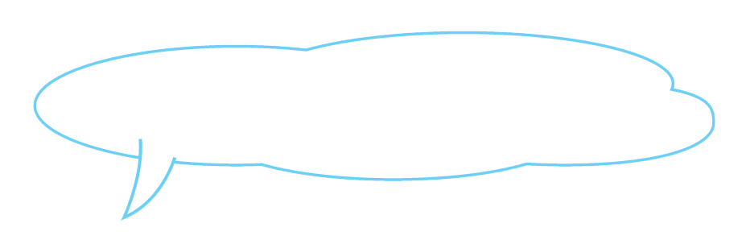
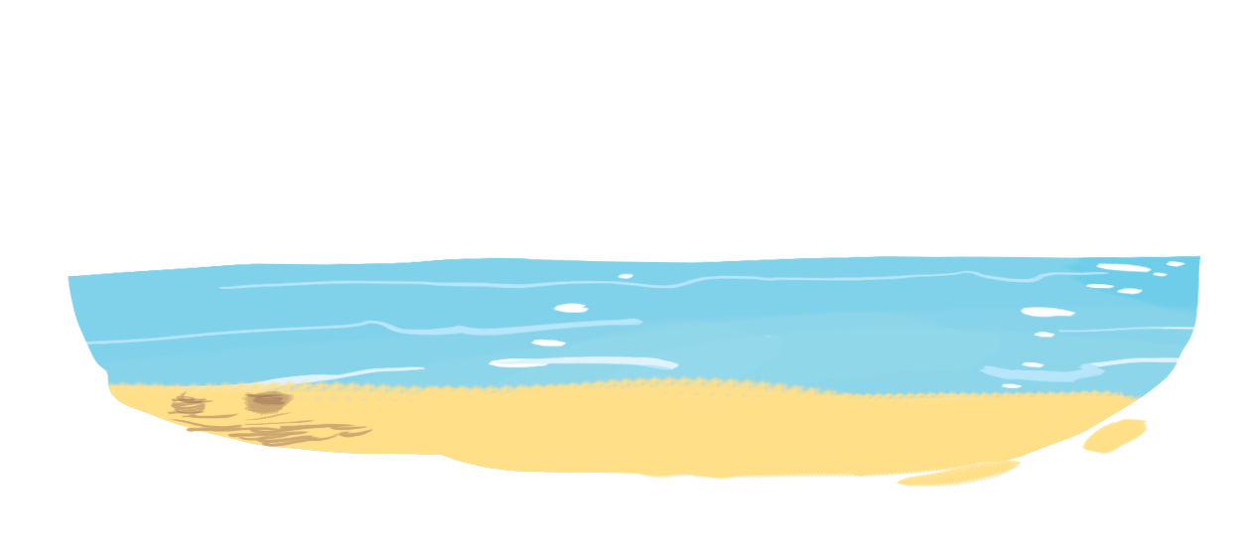
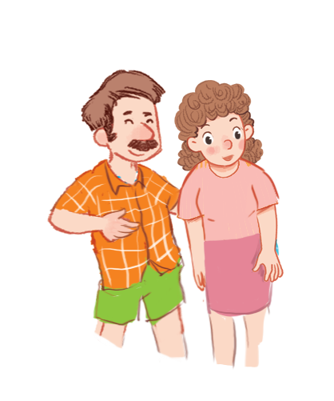
Listen and repeat.
Let’s look at the sea!
Let’s look at the sea!
Let’s look at the sea!
Let’s look at the sea!

Slide 5
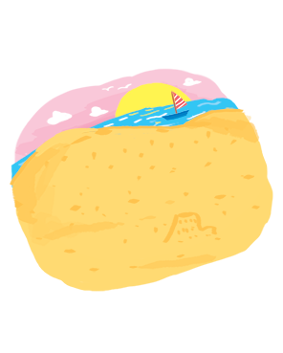
Listen and repeat.
Let’s look at the sea!
sand
Let’s look at the sea!
Let’s look at the sea!
c

Slide 6
Listen and repeat.
Let’s look at the sea!
sand
Let’s look at the sea!
Let’s look at the sea!

Slide 7



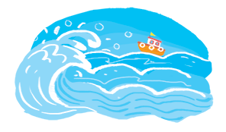
Let’s talk.
Let’s look at the sea!
Sand
Sea
Sail
a
b
c

Slide 8
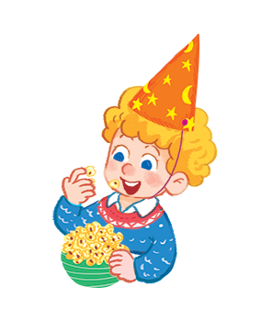
Let’s look at the sea!
a
Let’s look at the sail
b
Let’s look at the sand
c
Let’s look at Peter

Slide 9
a
Sea
Let’s look at the …………!
Sail
Sand
b
c

Slide 10
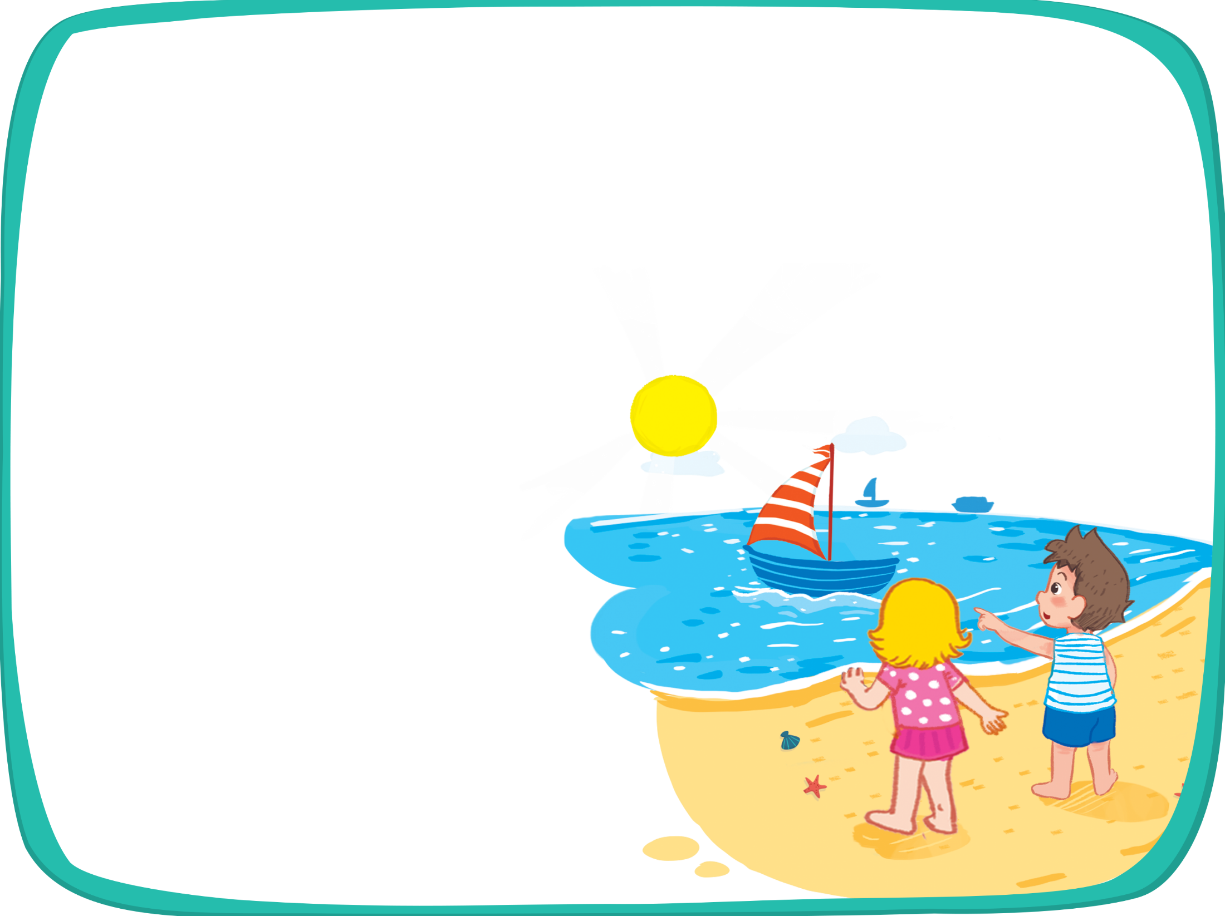


Let’s sing!
It’s Saturday.
It’s Saturday.
It’s Saturday.
It’s Saturday.
It’s a sunny day.
It’s a sunny day.
It’s a sunny day.
It’s a sunny day.
We’re at the seaside.
We’re at the seaside.
We’re at the seaside.
We’re at the seaside.
Let’s look at the sail!
Let’s look at the sail!
Let’s look at the sail!
Let’s look at the sail!
It’s Sunday.
It’s Sunday.
It’s Sunday.
It’s Sunday.
It’s a sunny day.
It’s a sunny day.
It’s a sunny day.
It’s a sunny day.
We’re at the seaside.
We’re at the seaside.
We’re at the seaside.
We’re at the seaside.
Let’s look at the sand!
Let’s look at the sand!
Let’s look at the sand!
Let’s look at the sand!

