Slide 1
UNIT 3. MY WEEK
( lesson 2/ p1,2,3 )

Slide 2
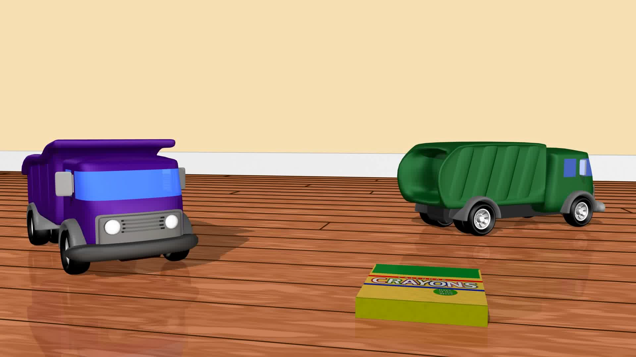
01
Warm-up
Sing The day of week .

Slide 3
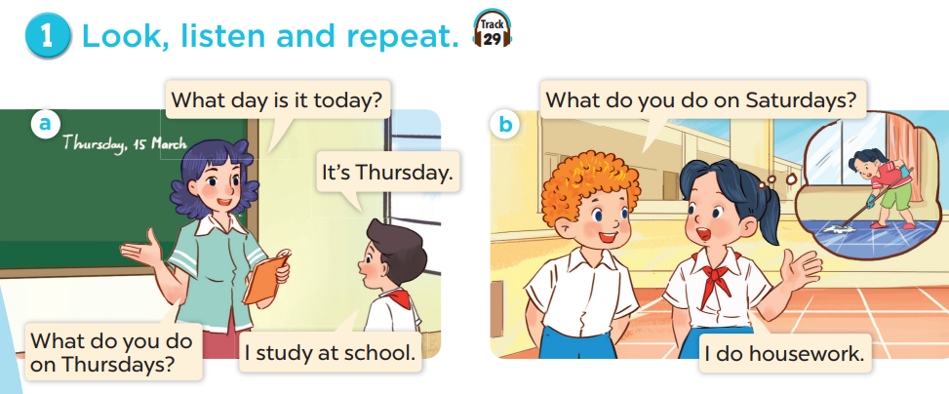


Slide 4
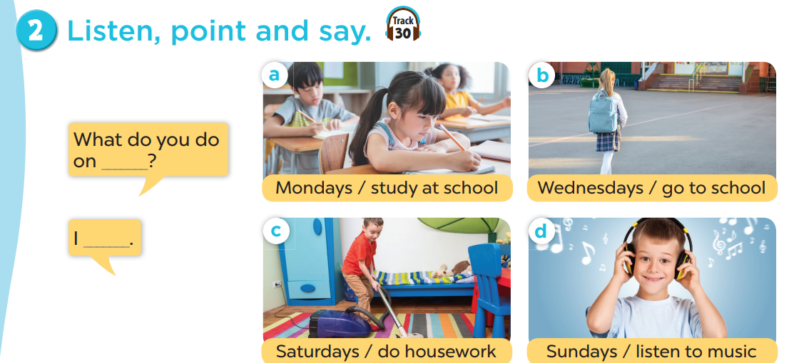

Slide 5
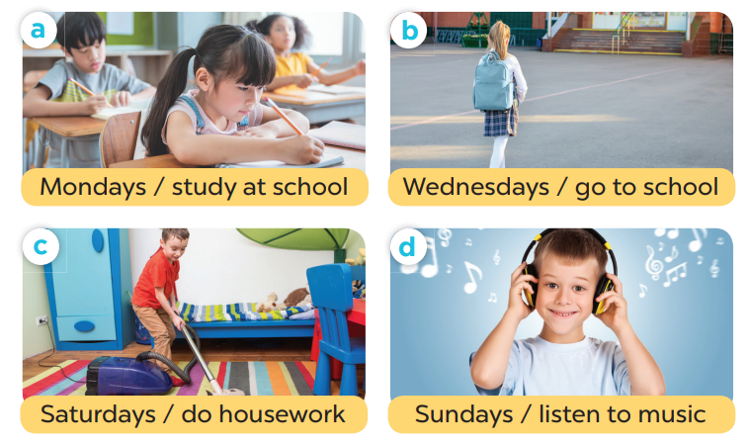
A: What do you do on (days )?
B: I ( act).
Notes:
EXPLORE PICTURES

Slide 6
A: What do you do on Mondays ?
B: I study at school.
Notes:
EXPLORE PICTURES

Slide 7
A: What do you do on Saturdays ?
B: I do housework.
Notes:
EXPLORE PICTURES

Slide 8
A: What do you do on Wednesdays ?
B: I go to school.
Notes:
EXPLORE PICTURES

Slide 9
A: What do you do on sundays ?
B: I listen to music.
Notes:
EXPLORE PICTURES

Slide 10
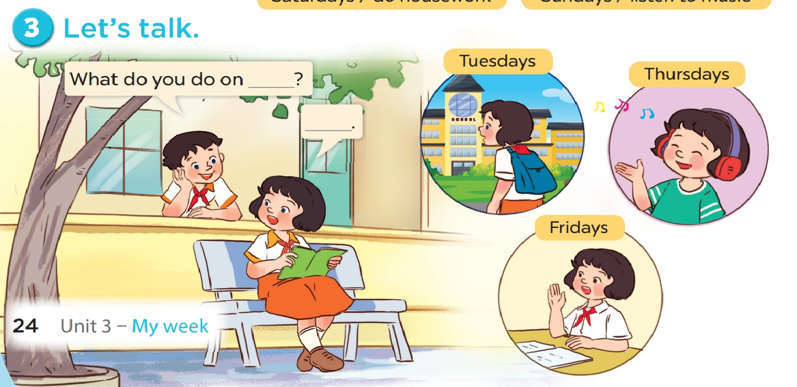

Slide 11
Monday Tuesday Wednesday Thursday Friday Saturday Sunday
Play football Play chess Go swimming Watch TV Read books Do homework Do house work
Freetalk
( game: passing ball)
A: What do you do on ____?
B: I _______.

Slide 12

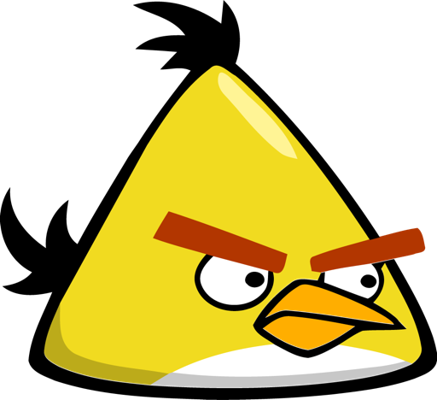
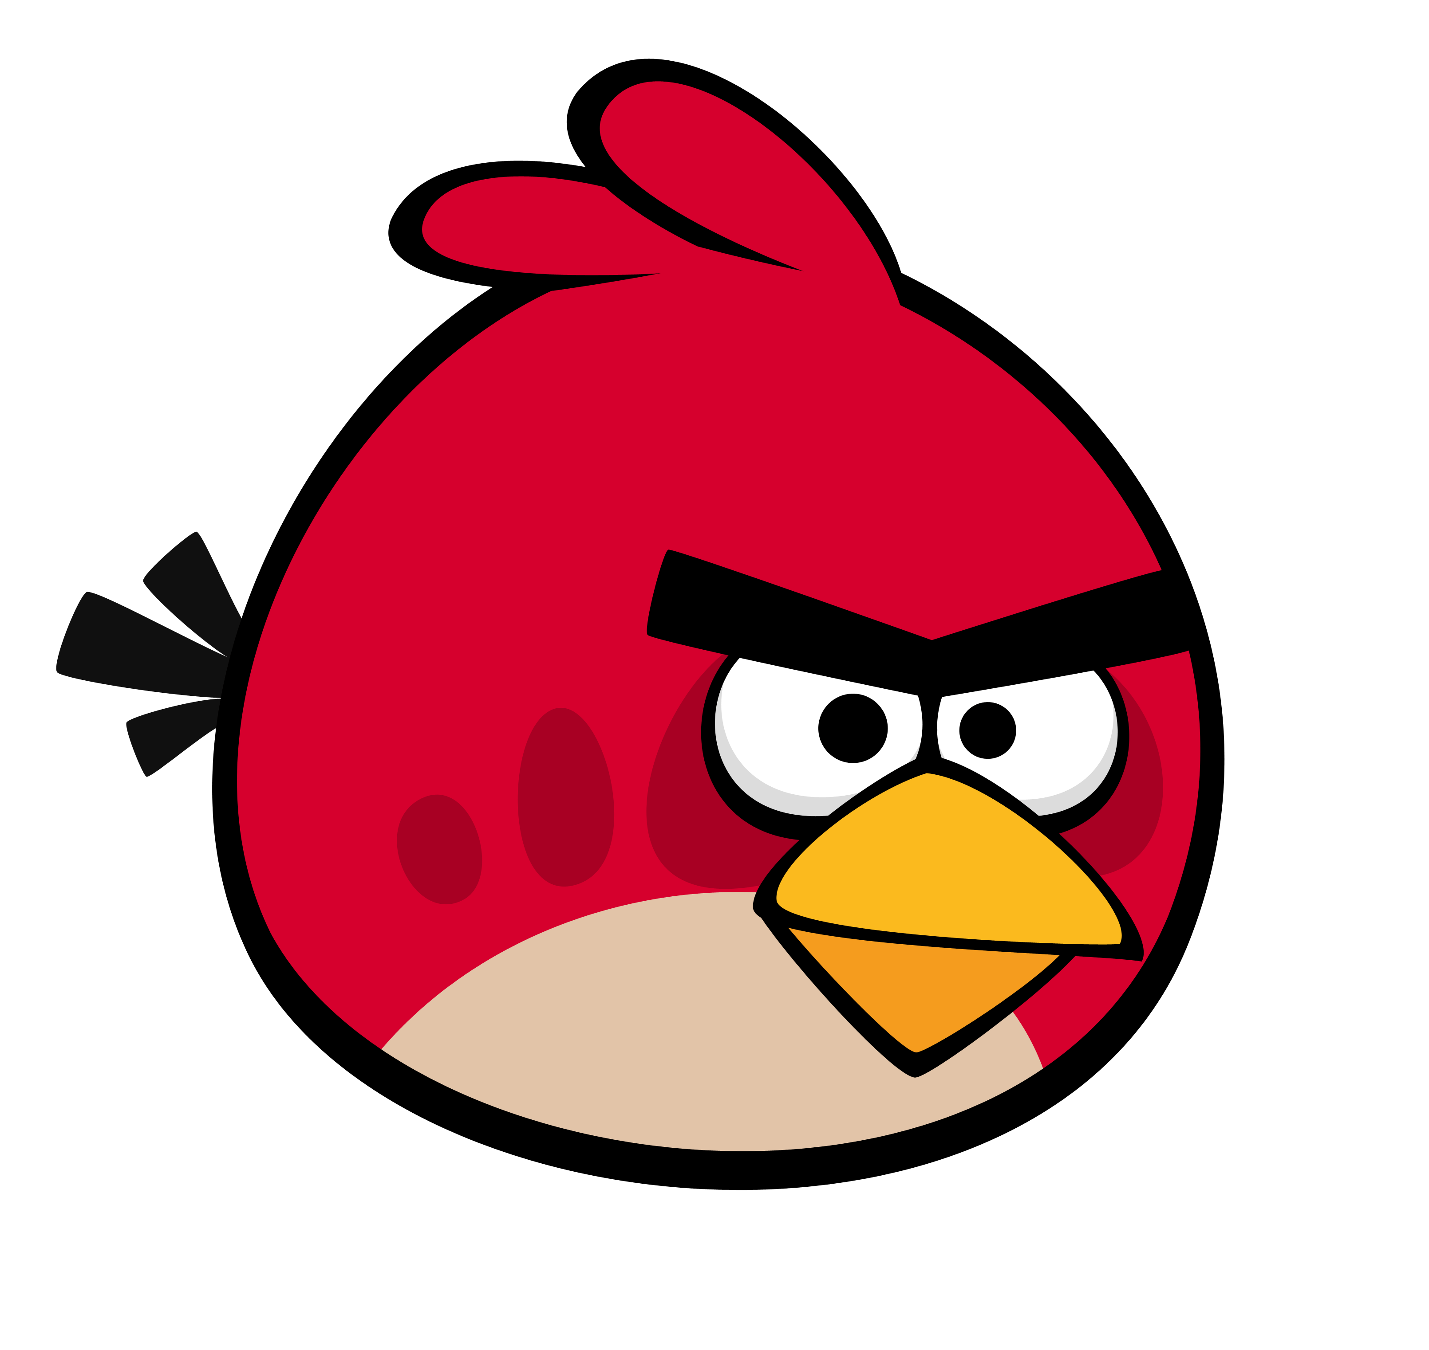



Slide 13

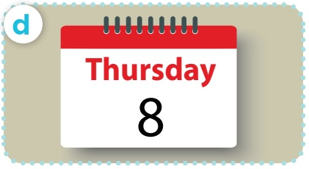



A. Thứ 3
B. Thứ 6
+5
-1
-1
-1
C. Chủ nhật
D. Thứ 5

Slide 14
A. What day it is today?
B. Where day is it today ?
+5
-1
-1
-1
C. How day is it today ?
D. What day is it today?

Slide 15
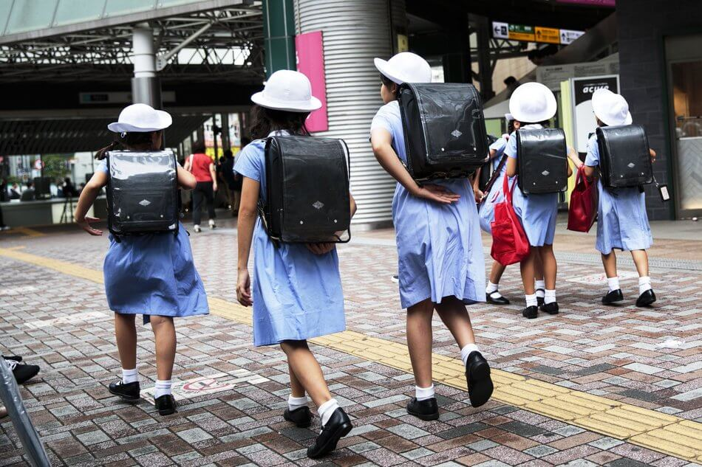

Câu hỏi 2
A. get up
B. have breakfast
+7
-1
-1
-1
C. go to school
D. go to bed

Slide 16
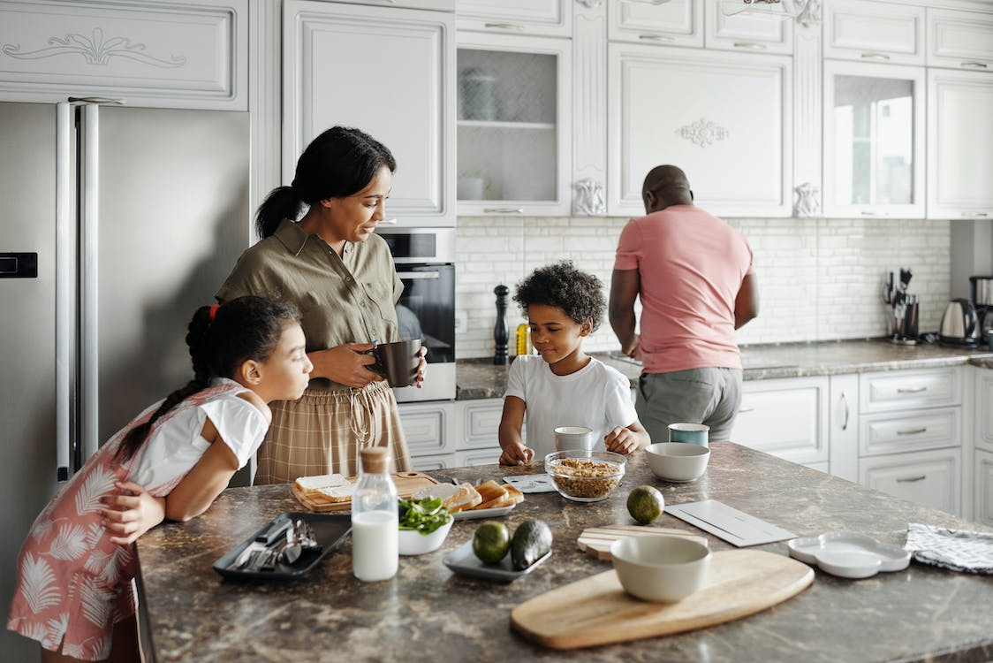
Câu hỏi 1
A. have breakfast
B. go to school
+5
-1
-1
-1
C. go to bed
D. get up

Slide 17
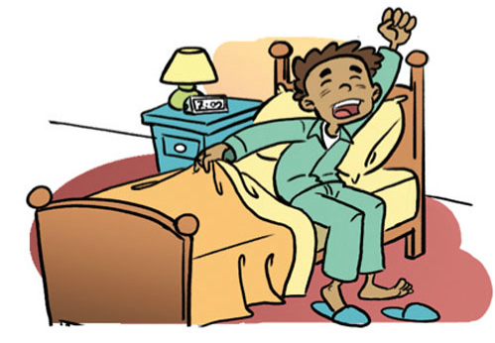
What time do you …… ?
Câu hỏi 4
A. have breakfast
B. go to school
+6
-1
-1
-1
C. go to bed
D. get up

Slide 18
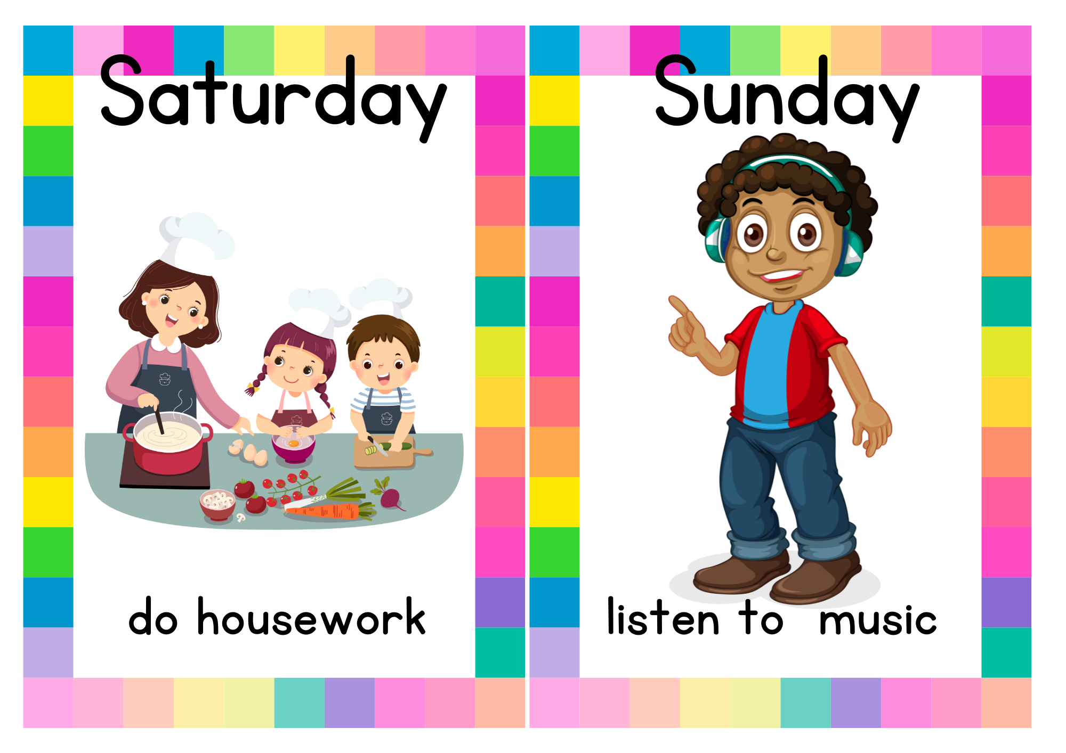
I do homework
on saturday
B. I do house work on Saturday
+8
-1
-1
-1
C. I go swimming sunday
B. I go swimming on Sunday

Slide 19
Câu hỏi 2
A. get up
B. have breakfast
+7
-1
-1
-1
C. go to school
D. go to bed

