Slide 1



Kim Dong Primary School
Welcome to our class
Teacher: Pham Thi Lan Huong

Slide 2


My birthday party
4
Lesson 2 – Part 1,2,3

Slide 3
01
Let’s sing.

Slide 4
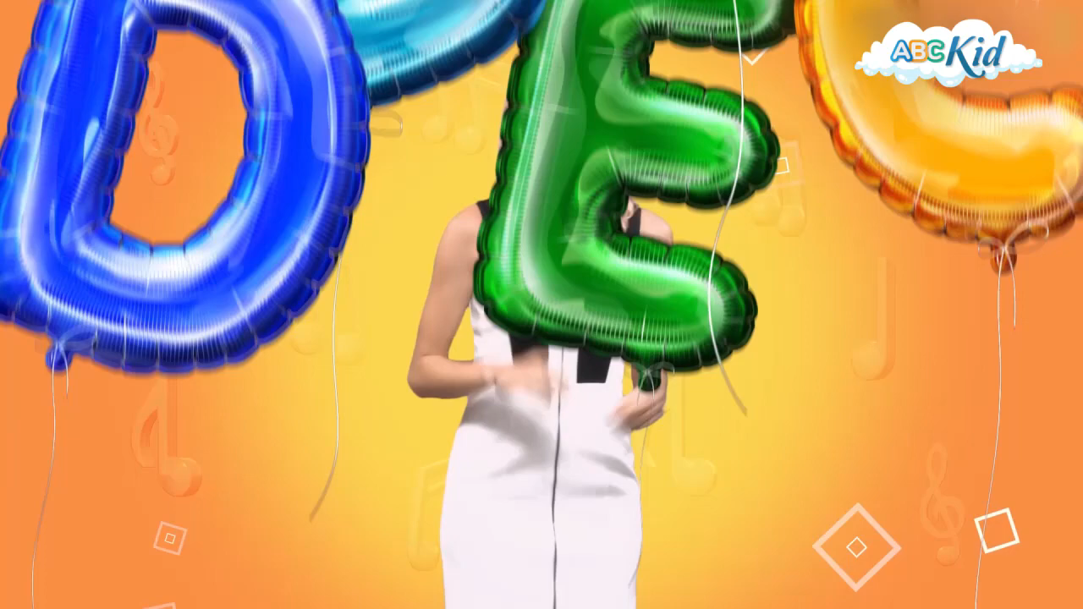

Slide 5

lemonade

Slide 6

chips

Slide 7

grapes

Slide 8
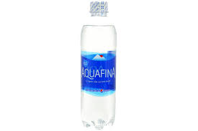
water

Slide 9
What do you want to eat? I want ……… What do you want to drink? I want……….
a. some chips
b. some grapes
c.some lemonade
d. some water

Slide 10
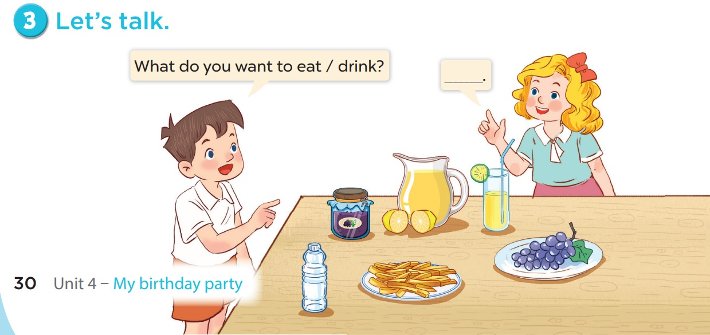

Slide 11


Thank you very much!
Good bye! See you later!

