Slide 1

My Duc II Primary School
WELCOME TO
OUR CLASS 4B
Teacher: Nguyen Thi Hong Diep

Slide 2








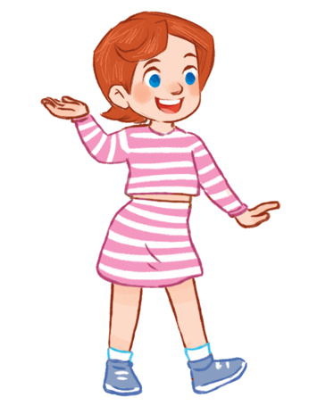

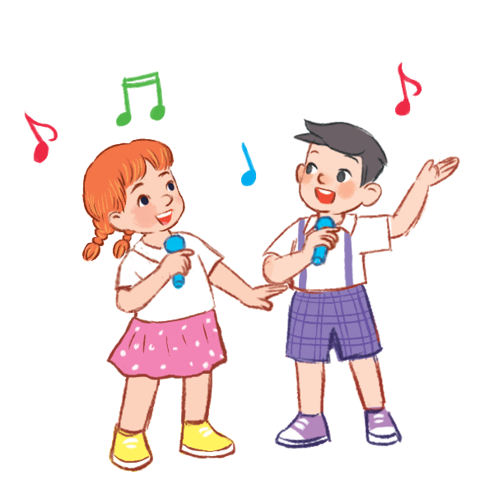
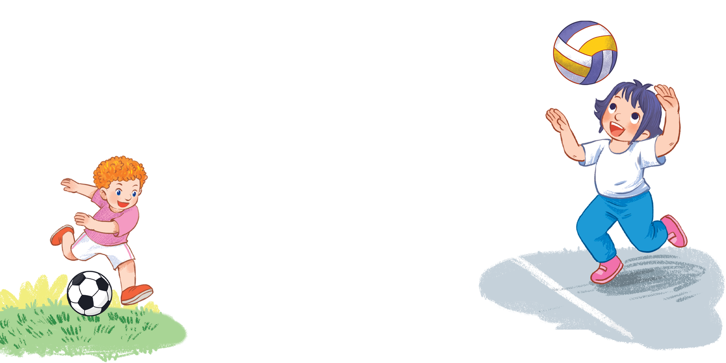



MsPham
0936082789
Unit 5
Things
we can do
Lesson 1 – Period 1

Slide 3




Warm-up
MsPham
0936082789

Slide 4


Slide 5


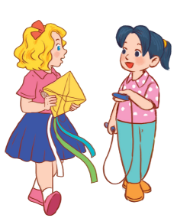

MsPham
0936082789
Vocabulary

Slide 6
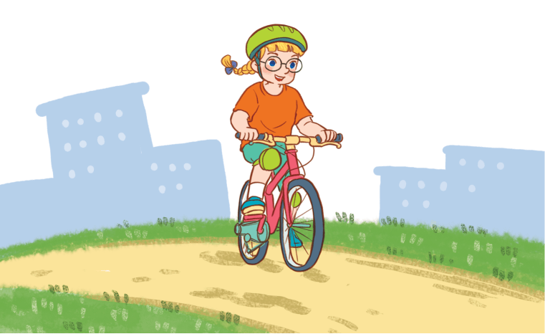
ride a bike
/raɪd ə baɪk/
MsPham
0936082789
Đạp xe

Slide 7
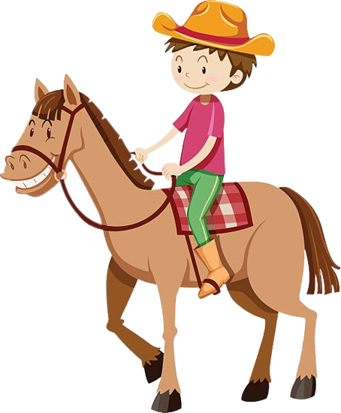
ride a horse
/raɪd ə hɔːs/
MsPham
0936082789
Cưỡi ngựa

Slide 8
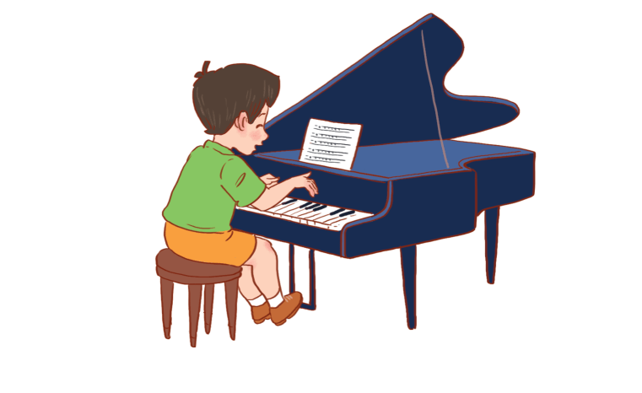
play the piano
/pleɪ ðə pɪˈænəʊ/
MsPham
0936082789
Chơi đàn piano

Slide 9
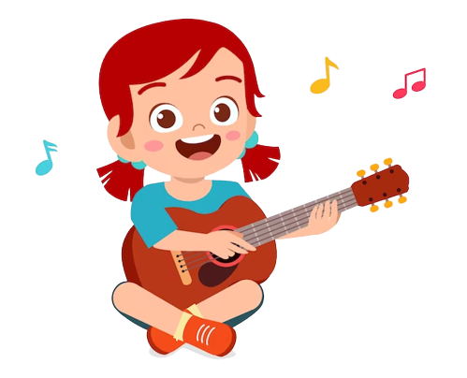
play the guitar
/pleɪ ðə ɡɪˈtɑː/
MsPham
0936082789
Chơi đàn ghita

Slide 10
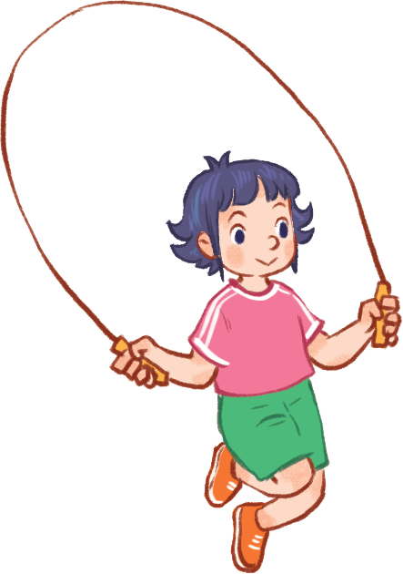
skip
/skɪp/
MsPham
0936082789
Nhảy dây

Slide 11
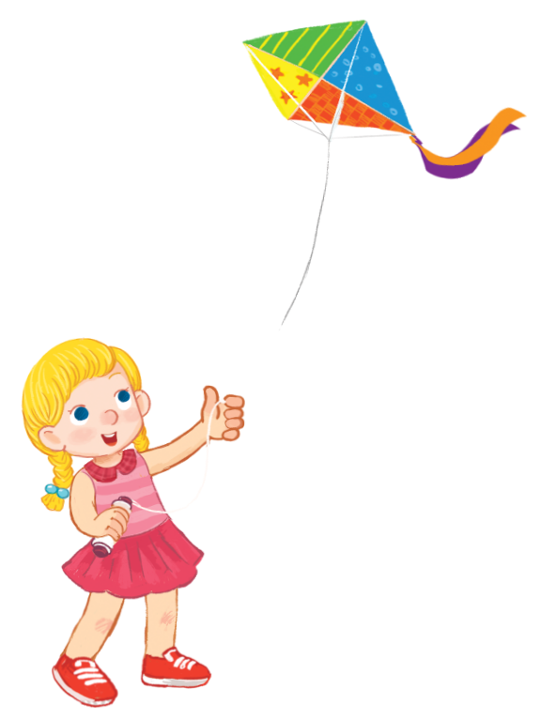
fly a kite
/flaɪ ə kaɪt/
MsPham
0936082789
Thả diều

Slide 12
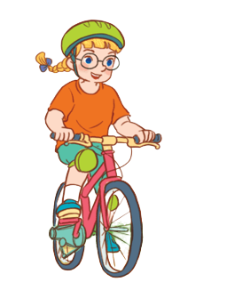

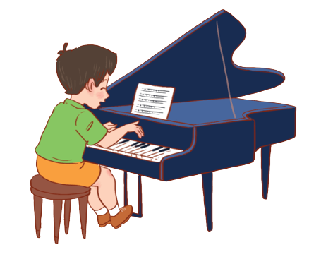
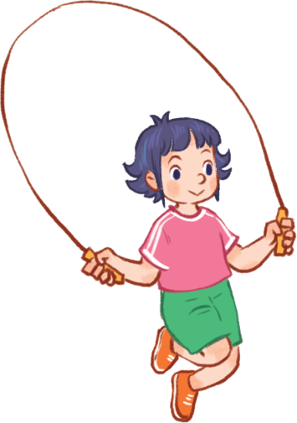
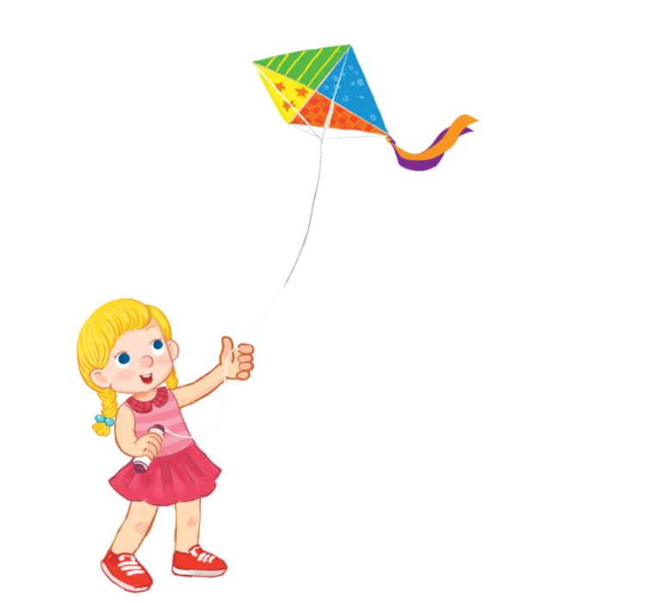
Vocabulary
ride a bike
: Đạp xe
ride a horse
MsPham
0936082789
: Cưỡi ngựa
play the piano
: Chơi đàn piano
play the guitar
: Chơi đàn ghita
skip
: Nhảy dây
fly a kite
: Thả diều

Slide 13
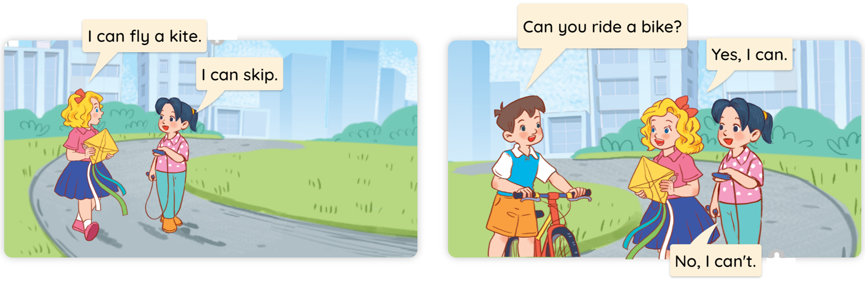

1
Look, listen and read.

Slide 14
MsPham
0936082789
Structure

Slide 15


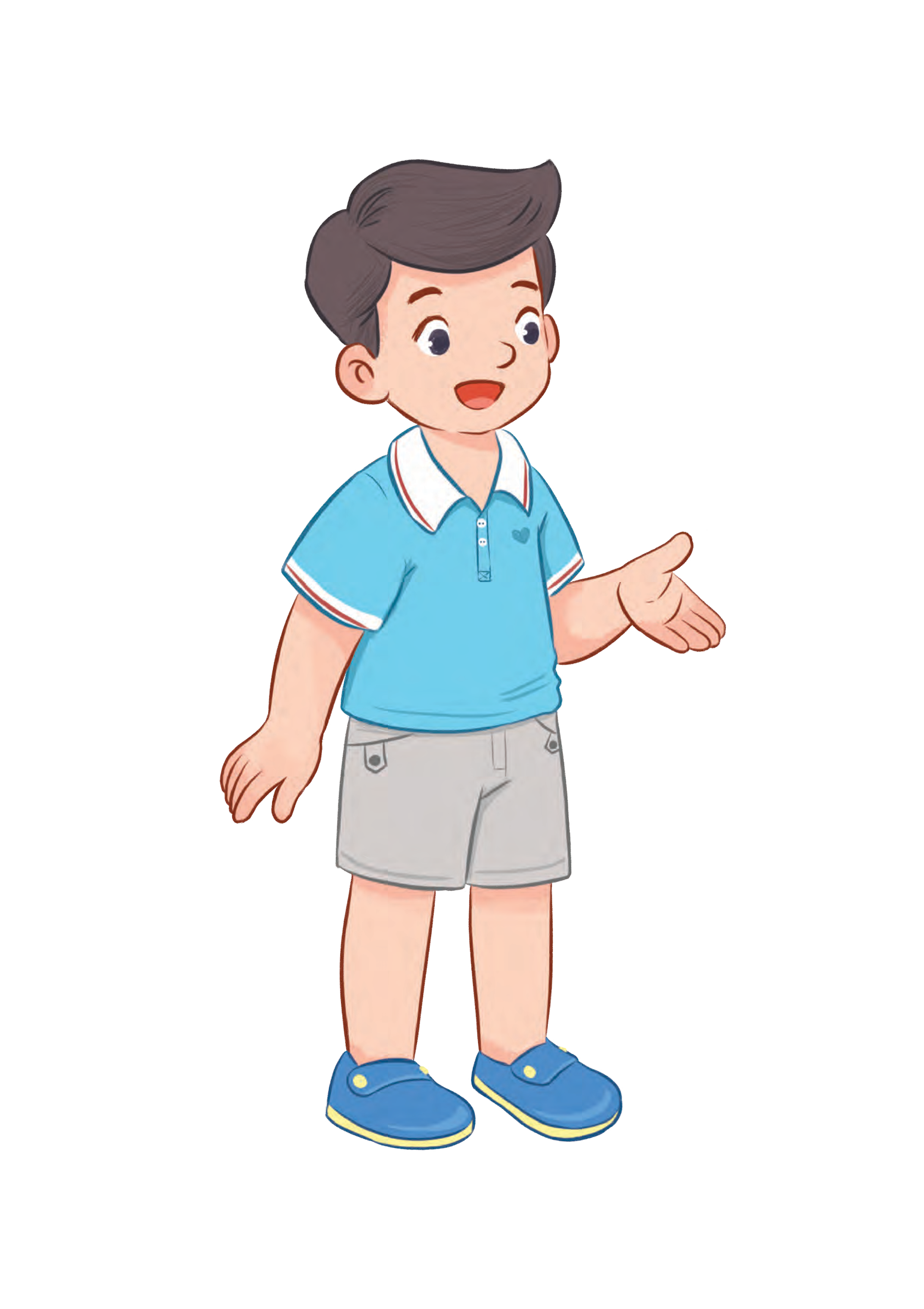
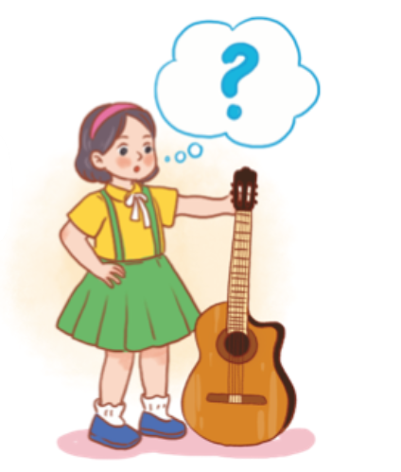
1
Cách hỏi bạn có thể làm gì hay không:
Yes, I can.
Can you + (hoạt động)?
No, I can’t.
(Bạn có thể _________ không?)
Ex:
Can you ride a bike?
Yes, I can.
MsPham
0936082789
Can you play the guitar?
No, I can’t.

Slide 16
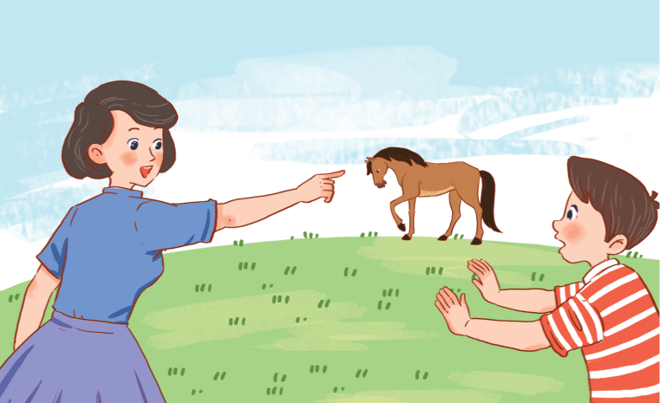
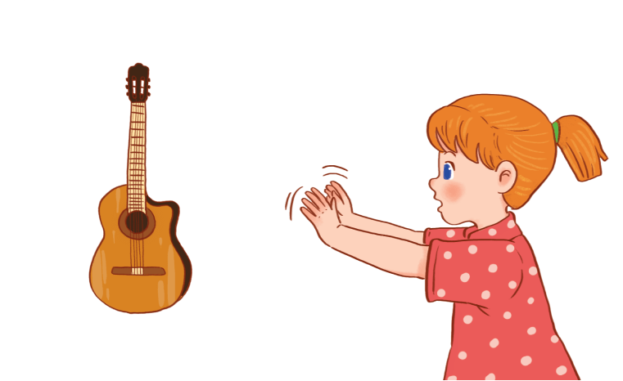
Yes, I can.
2
Listen, point and say.
Can you + ______?
No, I can’t.
a
b
ride a bike
ride a horse
c
d
play the piano
play the guitar

Slide 17

2
Listen, point and say.
a
MsPham
0936082789
ride a bike
Can you ride a bike?
Yes, I can.

Slide 18
2
Listen, point and say.
b
MsPham
0936082789
ride a horse
Can you ride a horse?
No, I can’t.

Slide 19
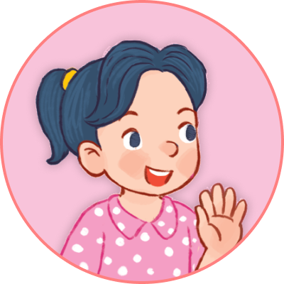
2
Listen, point and say.
c
MsPham
0936082789
play the piano
Can you play the piano?
Yes, I can.

Slide 20
2
Listen, point and say.
d
MsPham
0936082789
play the guitar
Can you play the guitar?
No, I can’t.

Slide 21
Yes, I can.
2
Listen, point and say.
Can you + ______?
No, I can’t.
a
b
ride a bike
ride a horse
c
d
play the piano
play the guitar

Slide 22







Start

Slide 23






Start
Can you play the piano?
No, I can’t.
Click one number!

Slide 24
Start
Can you ride a bike?
Yes, I can.
Click one number!

Slide 25
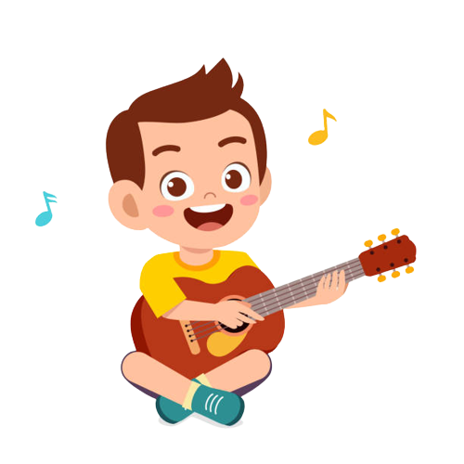
Start
Can you ride a horse?
Yes, I can.
Click one number!

Slide 26
Start
Can you play the guitar?
No, I can’t.
Click one number!

Slide 27
Start
Can you skip?
No, I can’t.
Click one number!

Slide 28
Start
Can you fly a kite?
Yes, I can.
Click one number!

Slide 29
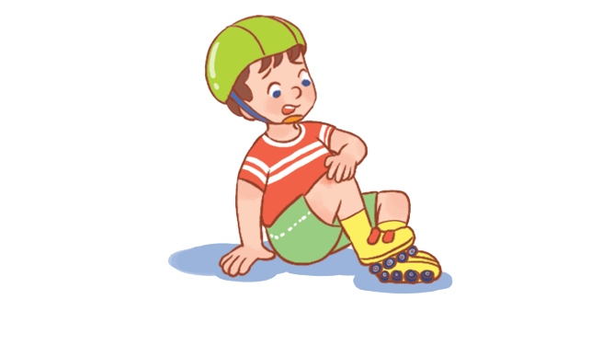

Start
Can you ______________?
Yes, I can.
fly a kite
Click one number!

Slide 30
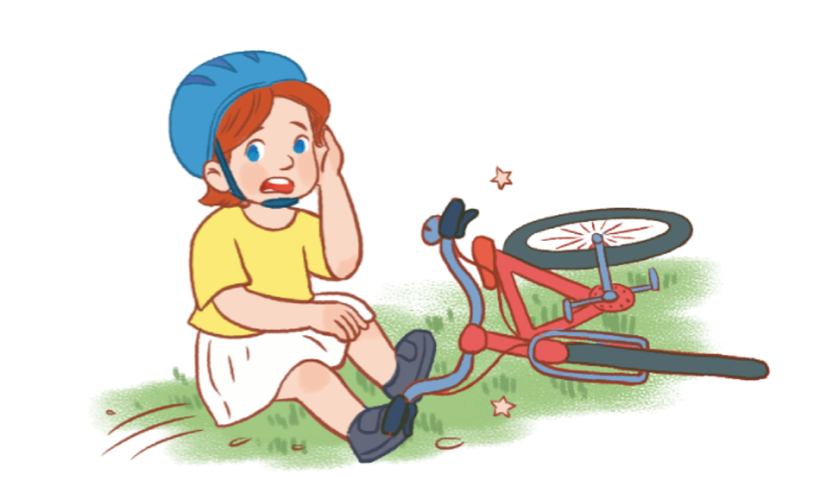
Start
Can you______________?
Yes, I can.
skip
Click one number!

Slide 31
Start
Can you______________?
No, I can’t.
ride a bike
Click one number!

Slide 32
Start
Can you______________?
Yes, I can.
play the guitar
Click one number!

Slide 33
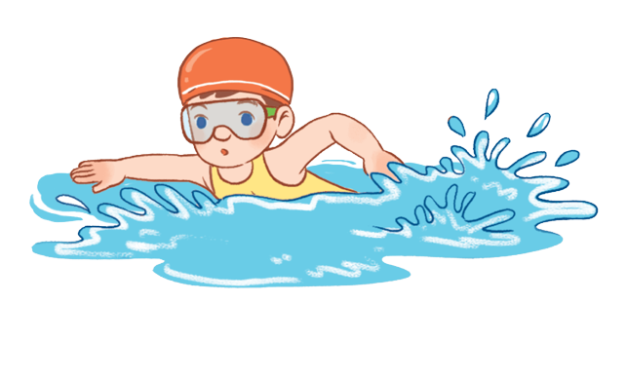
Start
Can you ______________?
No, I can’t.
play the piano
Click one number!

Slide 34
Start
Can you _______________?
No, I can’t.
ride a horse
Click one number!

Slide 35


Start

Slide 36


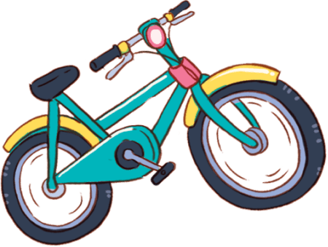
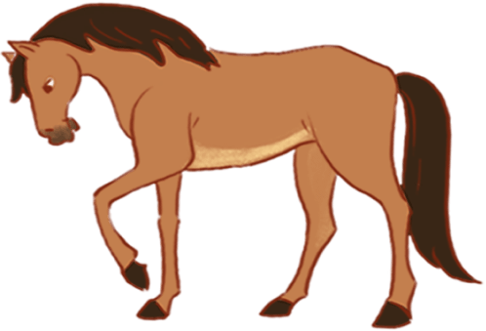
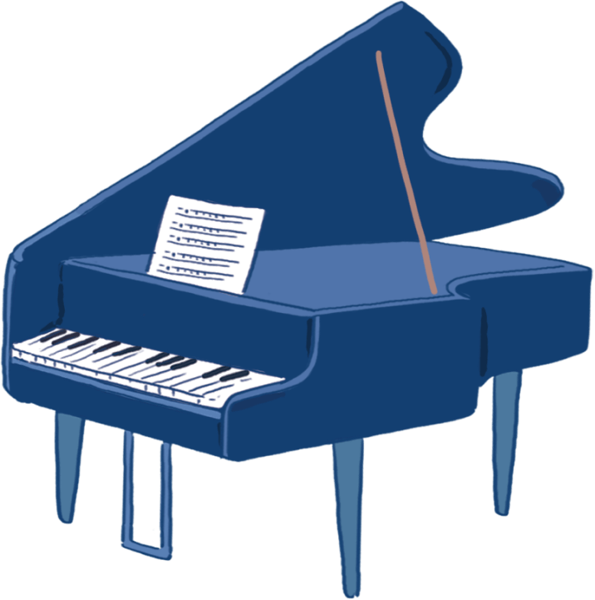
3
Let’s talk.
Yes, I can.
Can you + ______?
No, I can’t.

Slide 37
MsPham
0936082789
Review

Slide 38
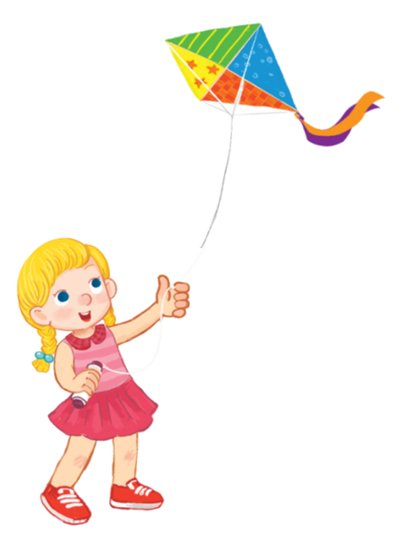
Yes, I can.
Can you + __________?
MsPham
0936082789
No, I can’t.
play the guitar
ride a bike
MsPham
0936082789
play the piano
ride a horse
skip
fly a kite

Slide 39
MsPham
0936082789
Thank you!

