Slide 1




WELCOME TO OUR CLASS
Mỹ Đức II PRIMARY SCHOOL
Teacher: Nguyễn Thị Hồng Điệp
Class: 5 C
Notes:
1

Slide 2


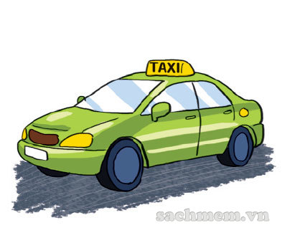










Ring golden bell
Question 1
01s
02s
03s
04s
05s
06s
07s
08s
09s
10s
How did you get to Do Son beach?
10 seconds
Time up
I went by____________.
A. taxi
B. train
C. bus

Slide 3
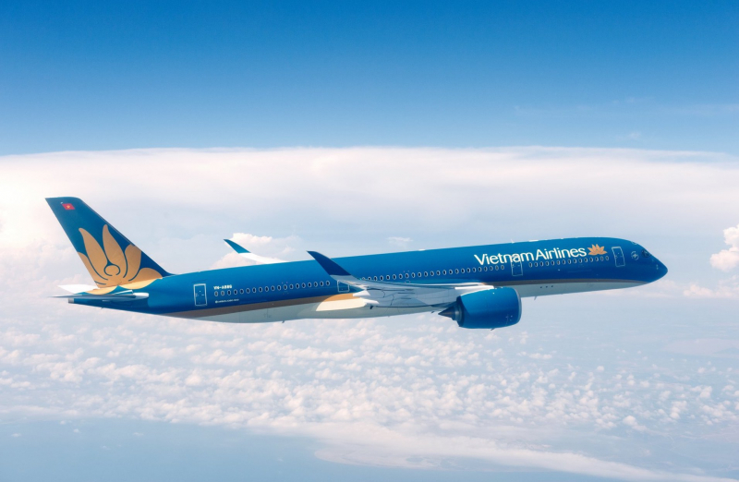
Ring golden bell
Question 2
01s
02s
03s
04s
05s
06s
07s
08s
09s
10s
How did you get to London?
10 seconds
Time up
I went by____________.
A. bus
B. train
C. plane

Slide 4
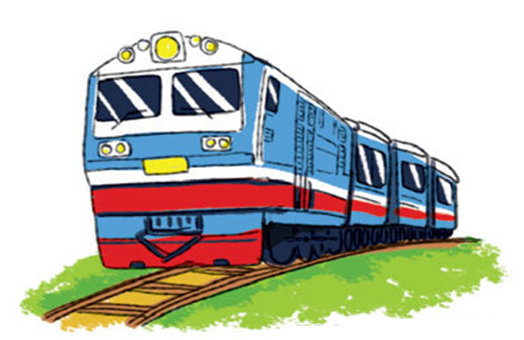
Ring golden bell
Question 3
01s
02s
03s
04s
05s
06s
07s
08s
09s
10s
How did you get to Sapa?
10 seconds
Time up
I went by____________.
A. motorbike
B. train
C.car

Slide 5
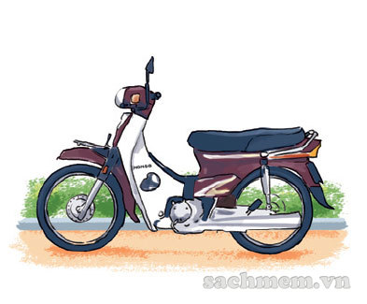
Ring golden bell
Question 4
01s
02s
03s
04s
05s
06s
07s
08s
09s
10s
How did you get to Do Son beach?
10 seconds
Time up
I went by_____________.
A. motorbike
B. plane
C. car

Slide 6


Thursday, March 22nd 2023
Unit 16: Where’s the post office?
Lesson 2 – 1,2,3/ p 42

Slide 7
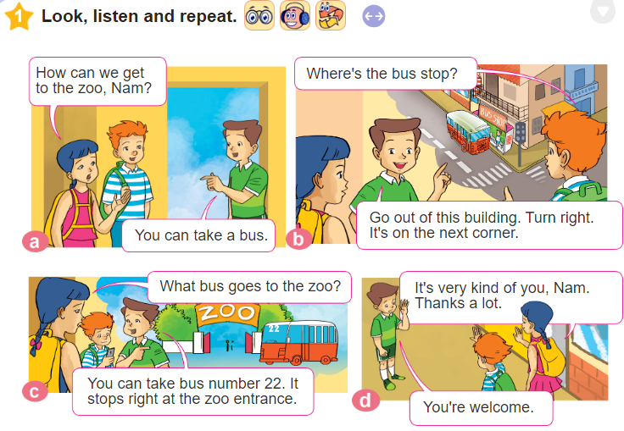


Slide 8

Vocabulary
take a boat
/teɪk ə bəʊt/

Slide 9

Vocabulary
take a coach
/teɪk ə kəʊtʃ/

Slide 10
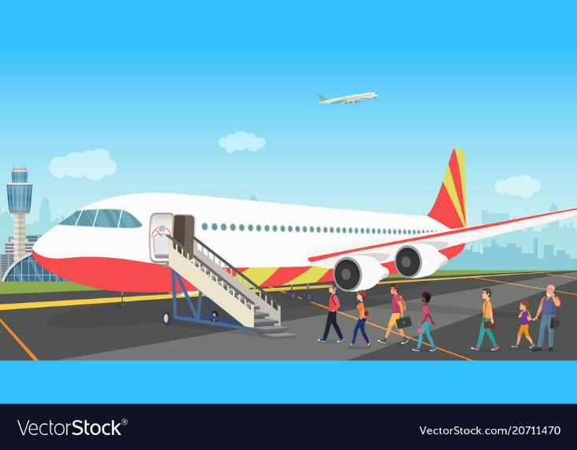
Vocabulary
go by plane
/ ɡəʊ baɪ pleɪn/

Slide 11

Vocabulary
walk
/wɔːk/

Slide 12
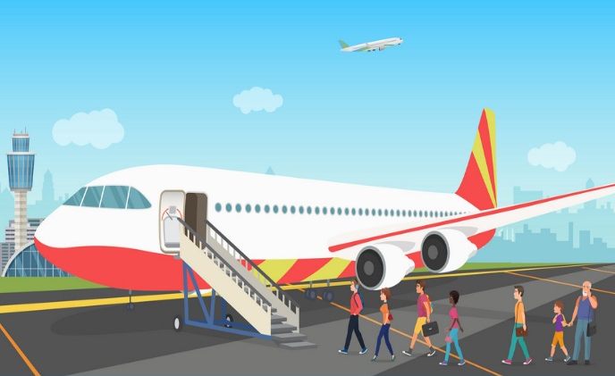
Vocabulary
1
2
take a boat
take a coach
3
4
go by plane
walk

Slide 13
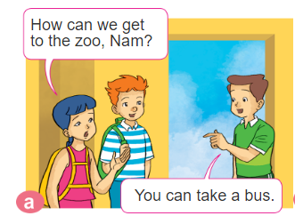

Slide 14
Model sentences
How can I get to _________ ?
=> You can ________

Slide 15


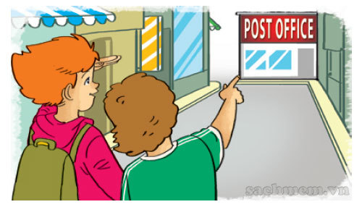
2. Point and say.
How can I get to _________________?
the post office
You can __________________.
walk for five minutes
Excuse me, where's the bus stop?
It's next to the stadium.

Slide 16
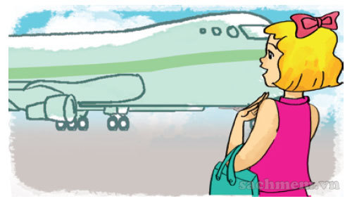
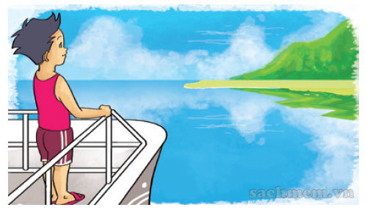
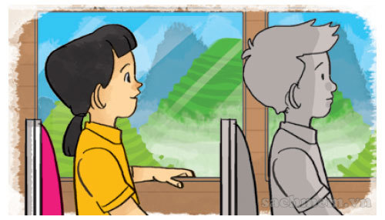
2. Point and say.
How can I get to _________________?
Phu Quoc Island
You can ______________.
take a boat
Excuse me, where's the bus stop?
It's next to the stadium.

Slide 17
2. Point and say.
How can I get to _________________?
Sa Pa
You can ______________.
take a coach
Excuse me, where's the bus stop?
It's next to the stadium.

Slide 18
2. Point and say.
How can I get to _________________?
Ho Chi Minh city
You can ______________.
go by plane
Excuse me, where's the bus stop?
It's next to the stadium.

Slide 19


Play a game

Slide 20


3. Let’s talk.
How can I get to _____________________?
You can _______________________.

Slide 21
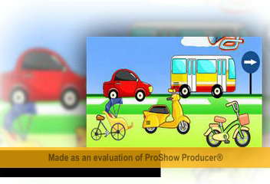

Slide 22

How can I get to the post office? How can I get to the post office?
You can walk for ten minutes - You can take a bus
Train, plane, boat and coach – motorbike , bike and bus
Train, plane, boat and coach – motorbike and bus
How can I get to the cinema? - How can I get to the cinema?
You can go by motorbike – You can take a bus
Train, plane, boat and coach – motorbike , bike and bus
Train, plane, boat and coach – motorbike and bus
I like motorbike… I like plane and coach… I like bike and bus…
I like all of them

