Slide 1








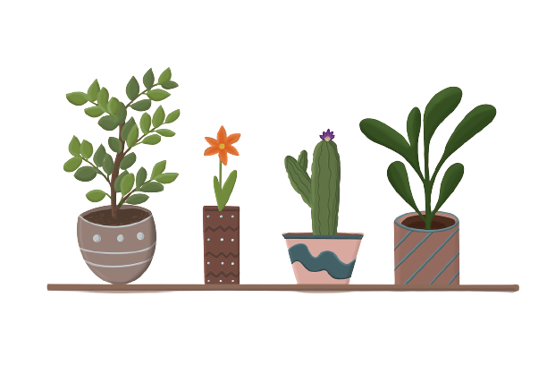




Slide 2


Friday, August 25th 2023
Welcome to join our
English lesson today!
My Duc II Primary school
Teacher: Nguyen Thi Mai Anh
Subject: English 4 Global success
Class: 4A

Slide 3


Unit 1 My friends
Lesson 1 - Period 1

Slide 4
Table of content
Warm-up
New words
Activity 1
Activity 2
Activity 3
Fun time
01
02
03
05
06
04

Slide 5

01
Warm-up

Slide 6
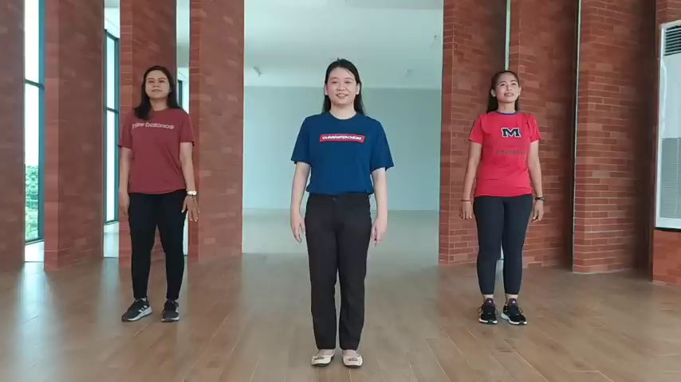

Slide 7

We live in many different countries in the world.

Slide 8

Can you name any country in the world?

Slide 9
Unit 1 My friends
Lesson 1 - Period 1

Slide 10

02
New words

Slide 11
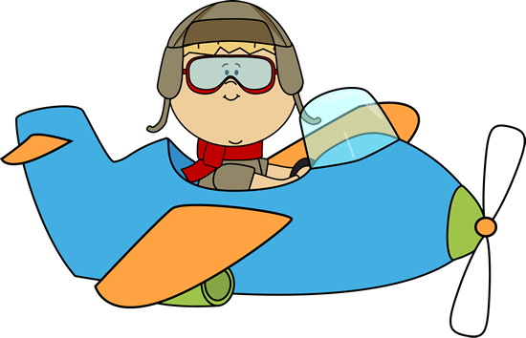
Hello. I'm Ben.
Let's visit some countries with me.
Look, guess, then learn.

Slide 12





Slide 13


Viet Nam

Slide 14









Slide 15

Britain

Slide 16





Slide 17

America

Slide 18

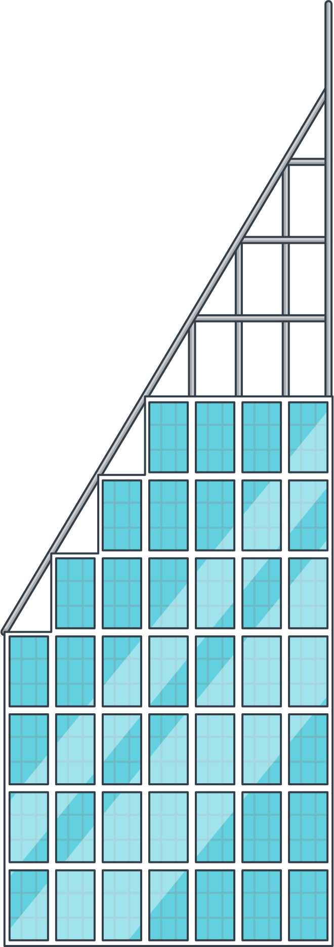







Slide 19

Australia

Slide 20

Review
America
Britain
Viet Nam
Australia

Slide 21

Look and say

Slide 22
Viet Nam

Slide 23
America

Slide 24
Australia

Slide 25

Britain

Slide 26

03
Activity 1
Look, listen and repeat.

Slide 27
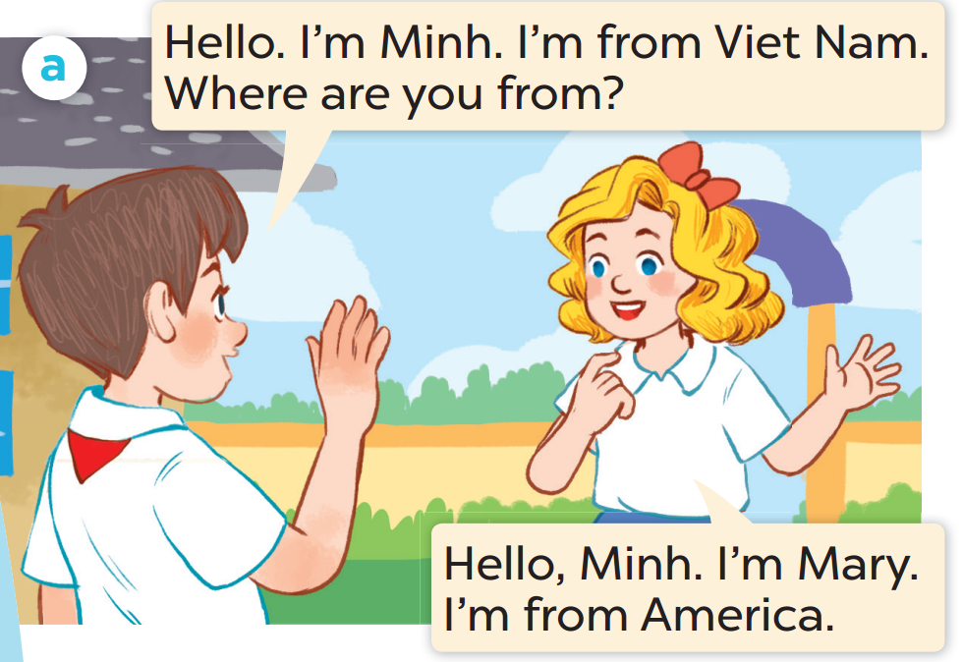
Who is the boy?
Who is the girl?

Slide 28
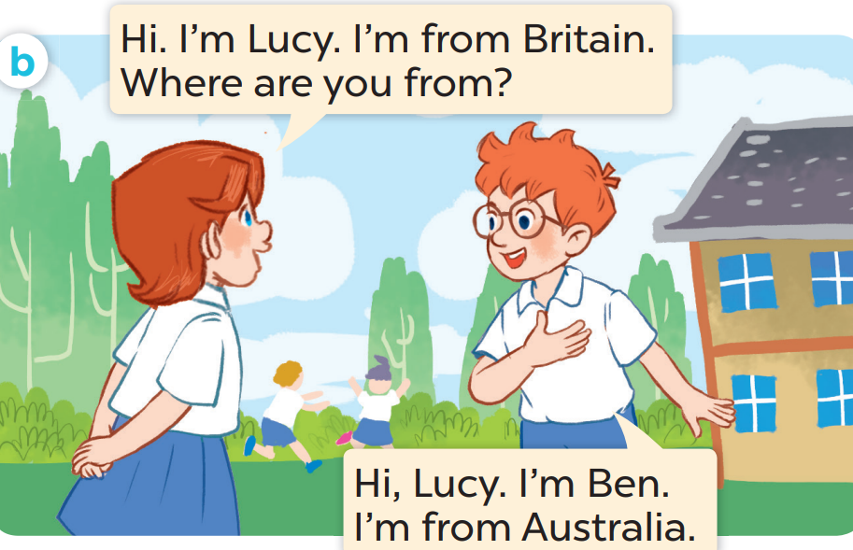
Who is the girl?
Who is the boy?

Slide 29
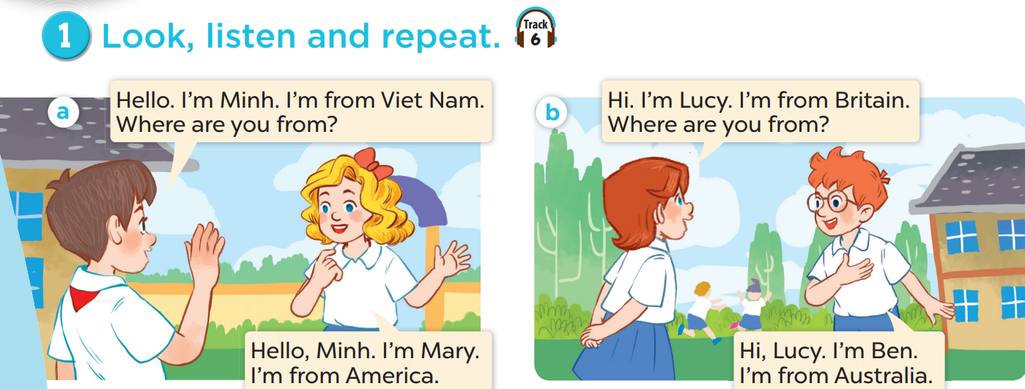
Look, listen and repeat
Act it out.

Slide 30
Look, listen and repeat.
Notes:
Click on the Speaker Icon to play the audio.

Slide 31
Look, listen and repeat
Notes:
Click on the Speaker Icon to play the audio.

Slide 32

Work in pairs
Act it out.

Slide 33
04
Activity 2
Listen, point and say.

Slide 34
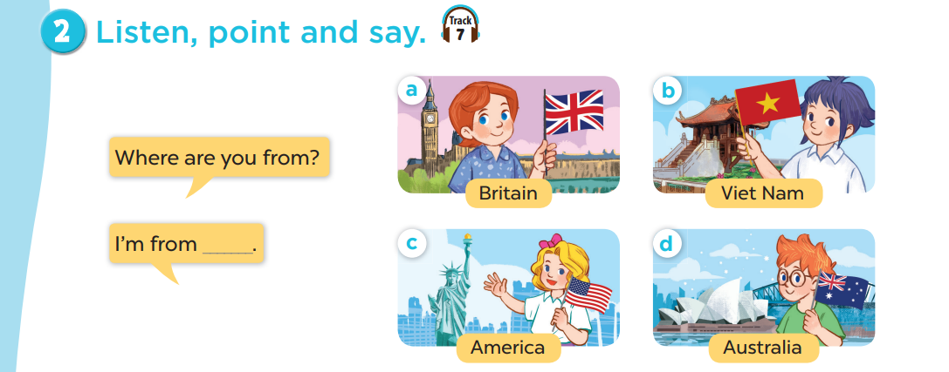
Notes:
Click on the Speaker Icon to play the audio.

Slide 35

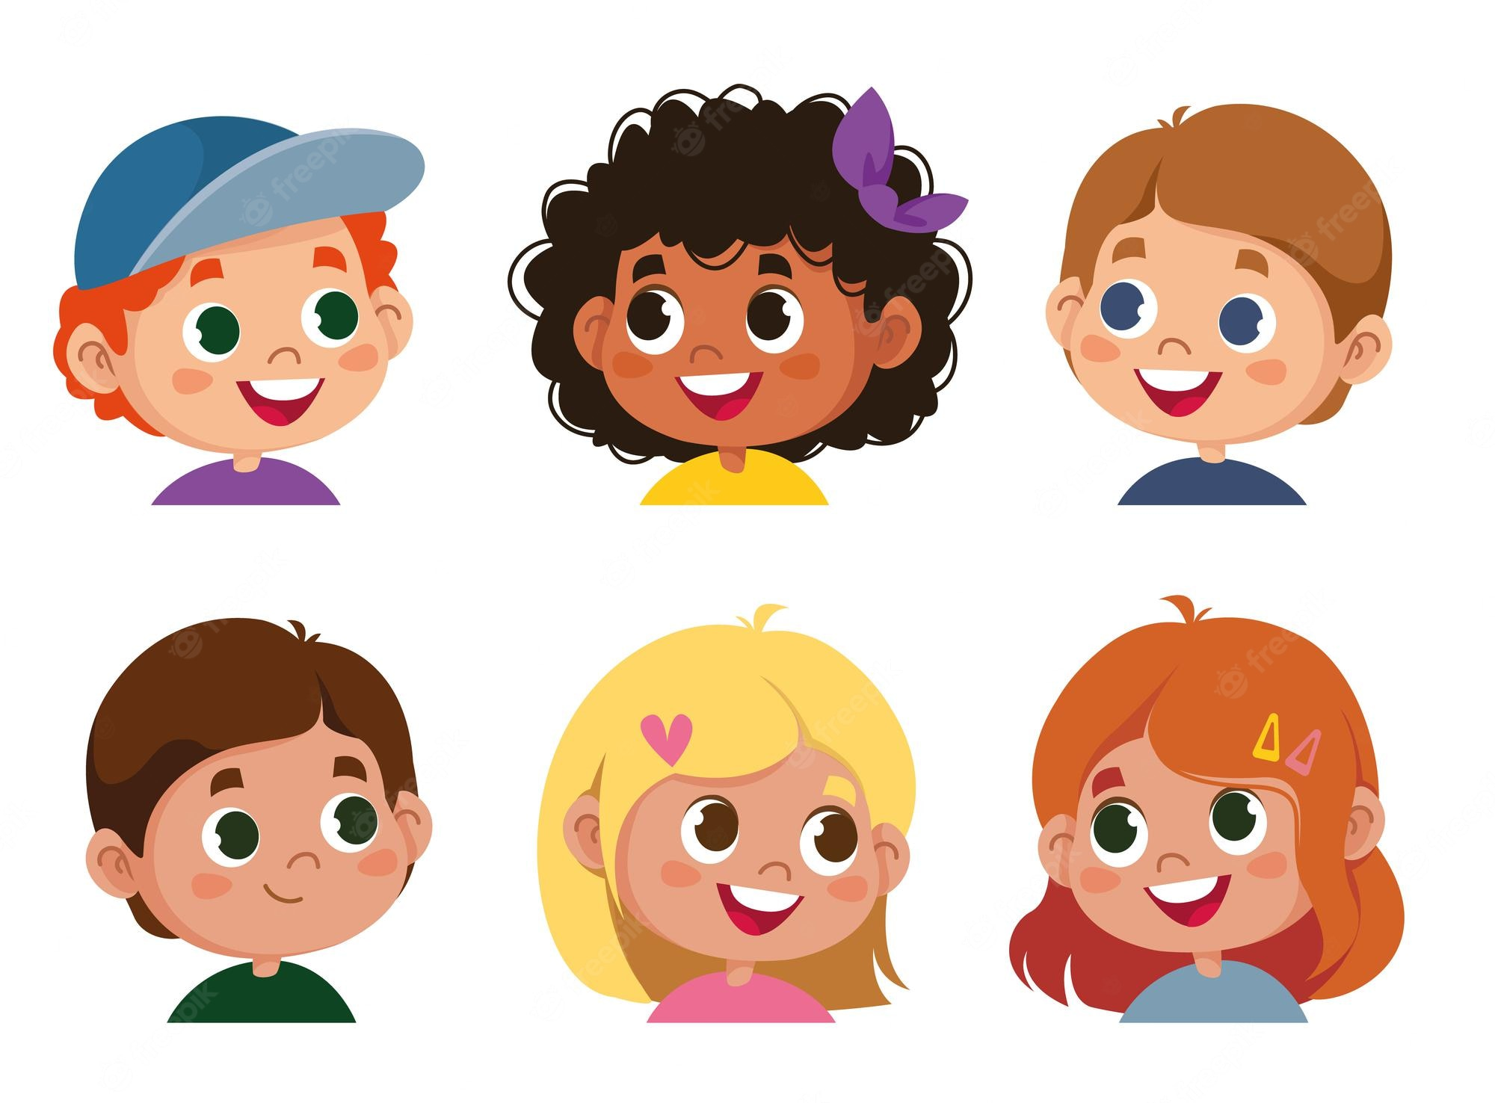
Where are you from?
I'm from Britain.

Slide 36

Where are you from?
I'm from Viet Nam.

Slide 37
Where are you from?
I'm from America.

Slide 38

Where are you from?
I'm from Australia.

Slide 39

Work in pairs

Slide 40
05
Activity 3
Let's talk.

Slide 41
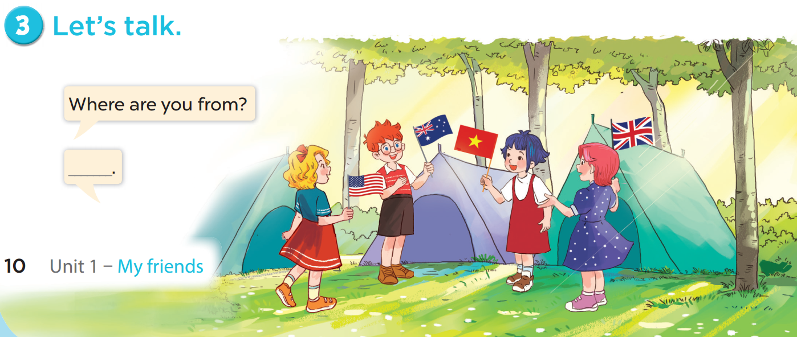


Slide 42
06
Fun time
Choose a number.
Ask, answer and have fun.

Slide 43




1
2
3
= + 1 star
4
5
6
= lose 2 stars
= rock, paper, scissors
(winner takes 2)
7
8
9

Slide 44



