Slide 1


Welcome to our class 4A
Teacher: Nguyễn Thị Phương Hồng
School: Nguyễn Văn Trỗi
2/2/2023
Võ Thị Thoa

Slide 2
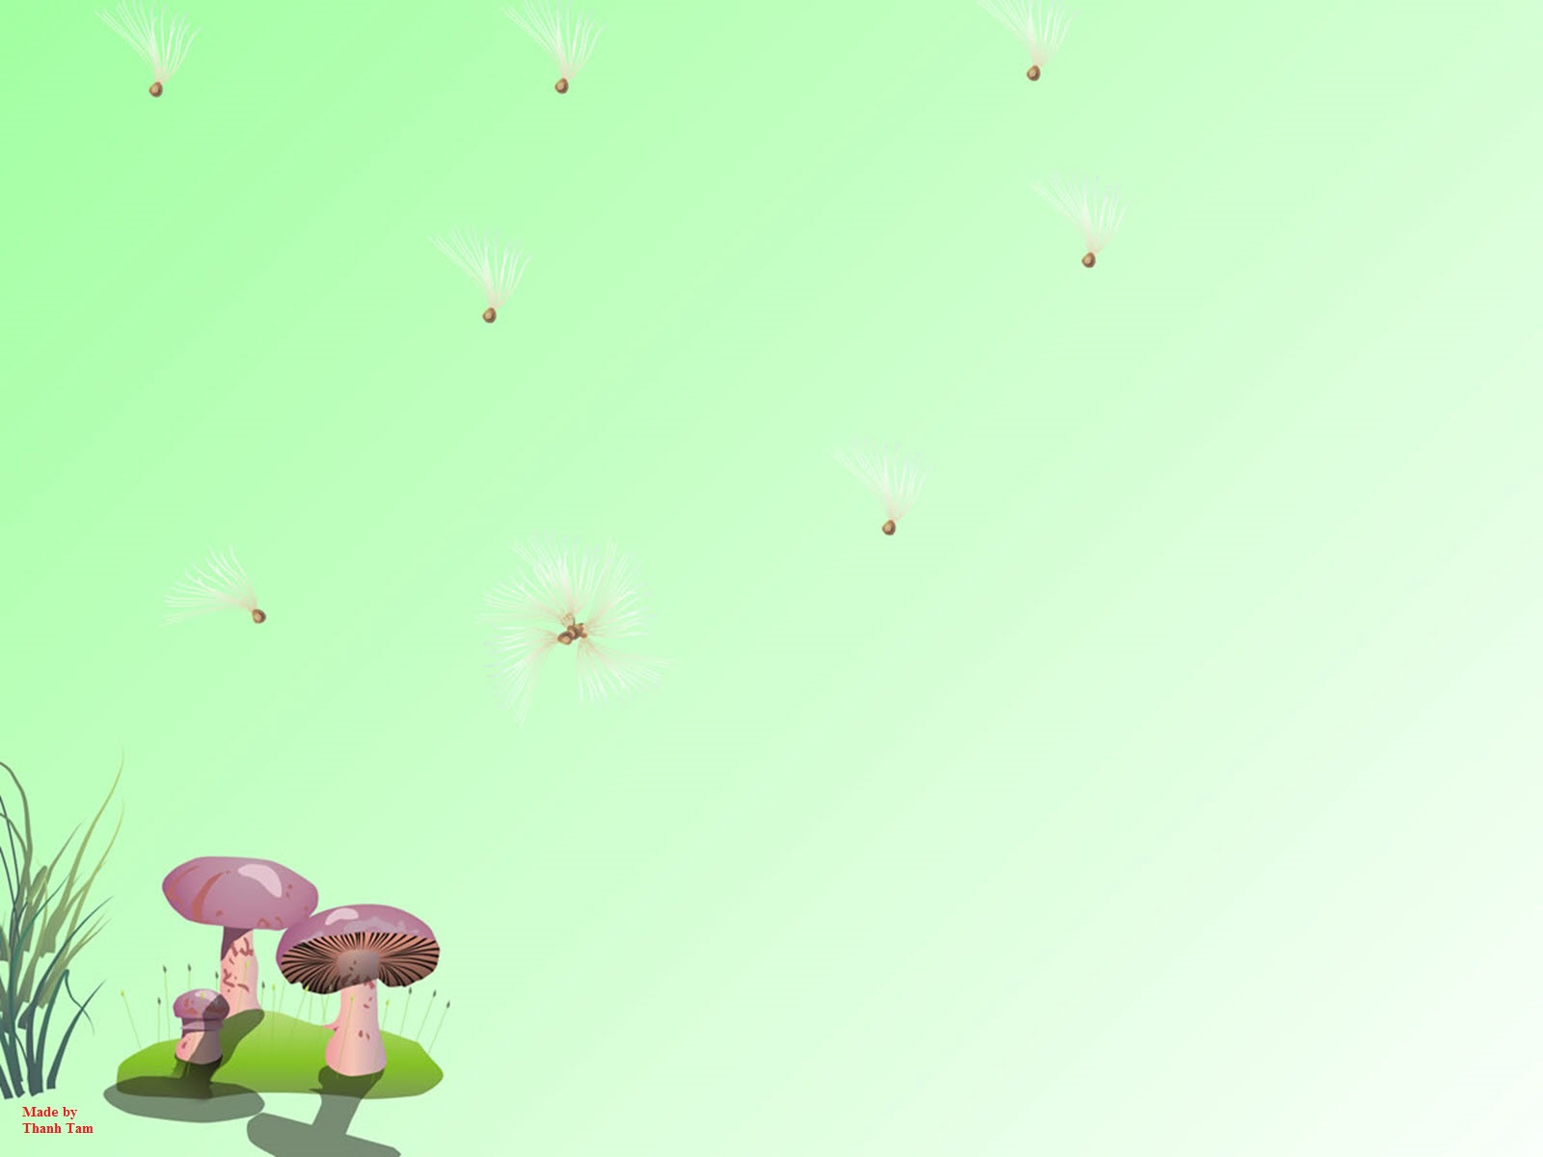
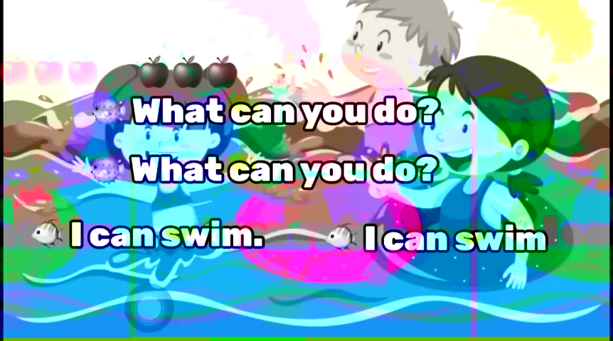


Sing a song

Slide 3
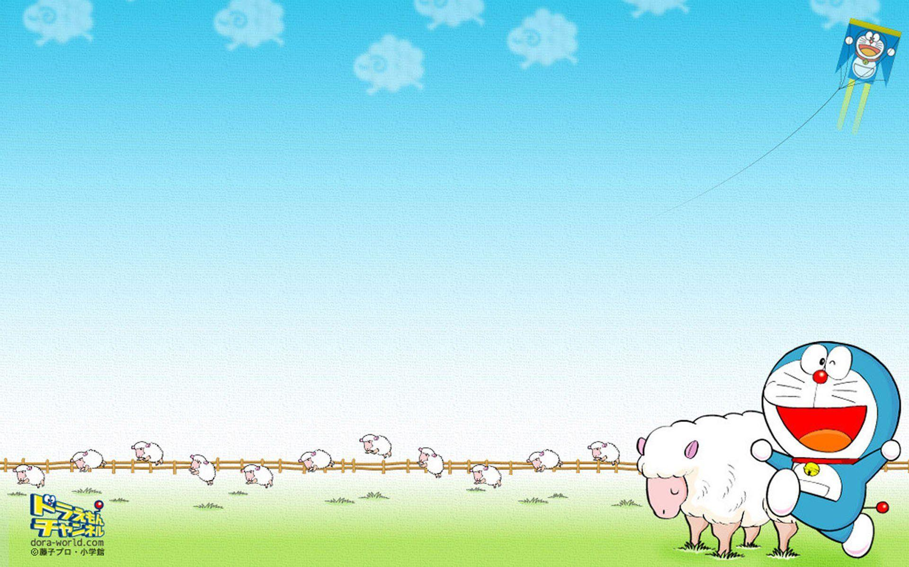
Monday, December 19th 2022
UNIT 10:
WHERE WERE YOU YESTERDAY?
Lesson 2,3: part 4, 5, 6 (P 67,69 )
4. Listen and number.(P67)
5. Read and tick. (P69)
6. Write about you.(P69)

Slide 4

THE GAME

Slide 5




Who's a milionaire?
1. Where were you yesterday?
A. I were at home.
B. I am at home
C. I was at home.
C. I was at home.
D. I am home .

Slide 6
Who's a milionaire?
2. He was at school yesterday.
50:50
A. When he was yesterday?
B. Where was he yesterday?
B. Where was he yesterday?
C. Where yesterday he was?
D. Where he was yesterday?

Slide 7
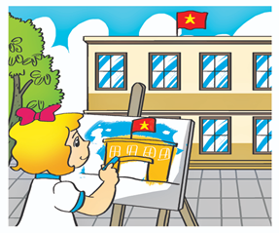
Who's a milionaire?
3. She …………….the picture last Monday.
50:50
A. is painting
B. were painting
D. painted
C. paints
D. painted

Slide 8
Who's a milionaire?
4. What did you do yesterday?
A. I play chess.
B. I am playing chess.
C. I played chess.
C. I played chess
D. I playing chess.

Slide 9
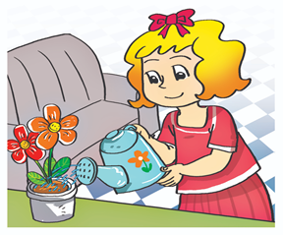
Who's a milionaire?
5. She …………….the flowers yesterday morning.
50:50
A. water
B. waters
C. is watering
D. watered
D. watered

Slide 10
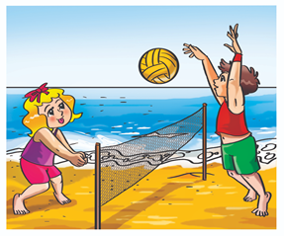
Who's a milionaire?
6. What did they do yesterday?
50:50
A. They are playing volleyball.
B. They play volleyball.
C. They plays volleyball.
D. They played volleyball.
D. They played volleyball.

Slide 11


Slide 12

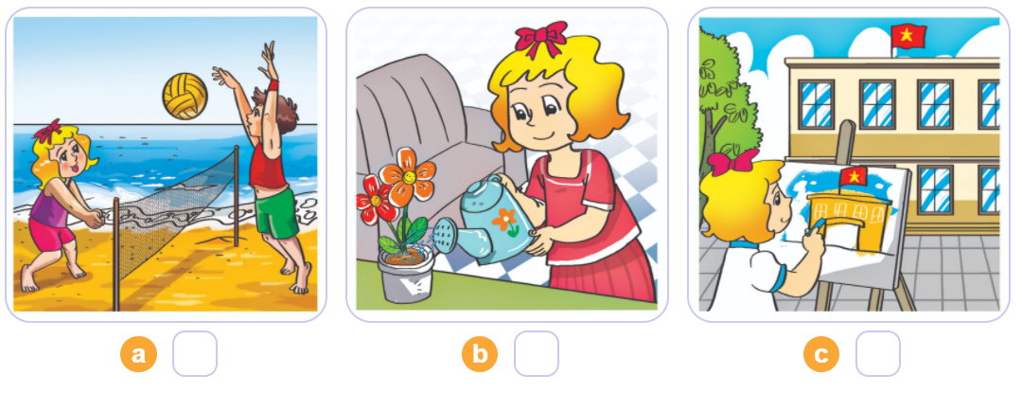
4. Listen and number (67)
1
2
3
3
1
2

Slide 13
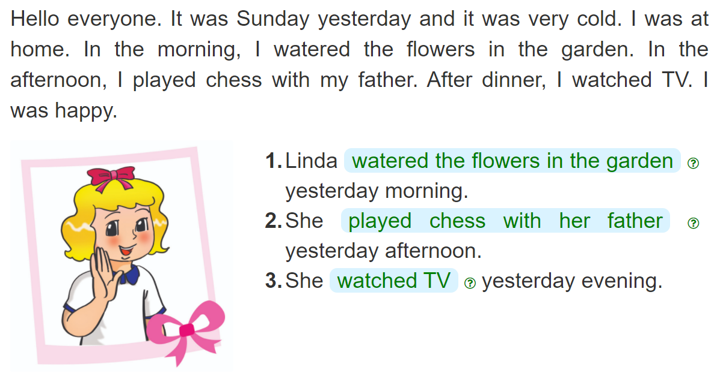
4. Read and complete
_______________________________________________
_______________________________________________
__________________

Slide 14
LET’S PRACTICE
Work in pairs:
- Asking and answering using structures : Where were you yesterday? I was……………
What did you do yesterday morning?
yesterday afternoon?
yesterday evening?
In the morning, I……………………………………
In the afternoon, I………………………………….
In the evening, I………………………………………..

Slide 15
5. Write about you
Yesterday, I was __________________.
In the morning, I__________________.
In the afternoon, I _________________.
In the evening, I___________________.

Slide 16


Slide 17




Let’s play
Game :Passing the ball

Slide 18



Thank you very much
Good bye! See you again!

