Slide 1


Welcome to our class
Teacher: Nguyễn Thị Phương Hồng
12/19/2022
Võ Thị Thoa

Slide 2

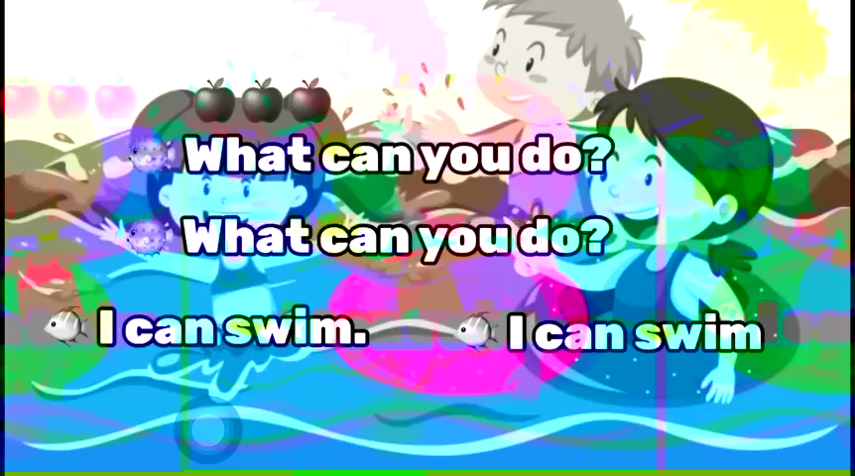


Sing a song

Slide 3
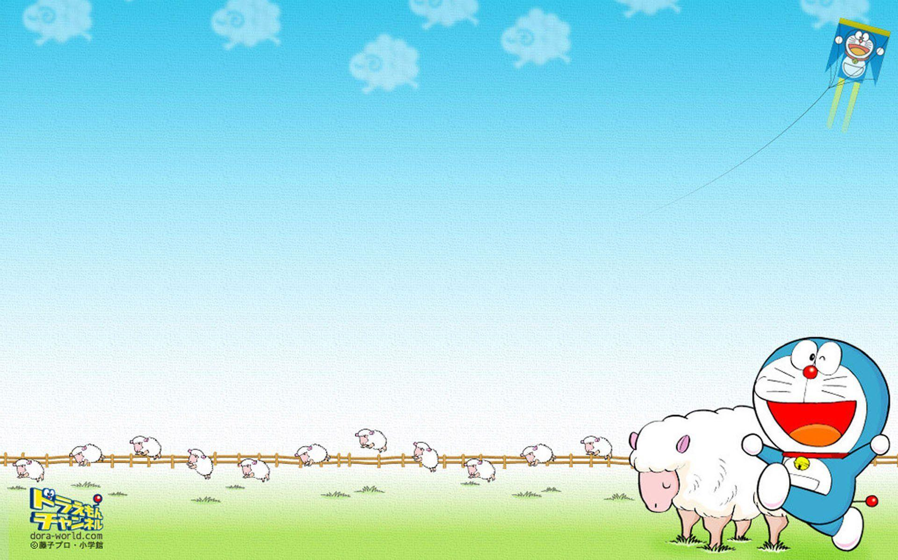
Monday, December 19th 2022
UNIT 10:
WHEN WILL SPORTS DAY BE?
Lesson 2,3: part 4, 4, 5 (P 67,69 )
4. Listen and number
5. Read and tick
5. Write about you

Slide 4

THE GAME

Slide 5





Who's a milionaire?
1.When/ Sports/ be/ day/will?
A. When will Day Sports be?
B. Sports Day will be When?
C. When will Sports Day be?
C. When will Sports Day be?
D. Day Sports will be When?

Slide 6

Who's a milionaire?
2. Teachers’ Day will be on …………
50:50
A. the twenty of November.
B. the twentieth of November.
B. the twentieth of November.
C. the twentieth of December.
D. the twentieth of December.

Slide 7
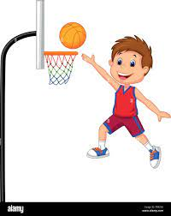
Who's a milionaire?
3. He is going to play …….on………….
50:50
A. basketball/ Christmas Day
B. Sports Day/ volleyball
C. volleyball/ Sports Day
D. basketball/ Sports Day
D. basketball/ Sports Day

Slide 8
Who's a milionaire?
3. He is going to play …….on………….
50:50
A. basketball/ Christmas Day
B. Sports Day/ volleyball
C. volleyball/ Sports Day
D. basketball/ Sports Day
D. basketball/ Sports Day

Slide 9
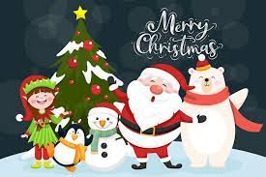
Who's a milionaire?
4. When ……….Christmas Day be?.
A. Is
B. are
C. will
C. will
D. does

Slide 10

Who's a milionaire?
5. When will New Year be?
50:50
A. It will be on the one of January?
B. It be on the first of January.
C. It’s fist of January
D. It will be on the first of January
D. It will be on the first of January

Slide 11


Slide 12

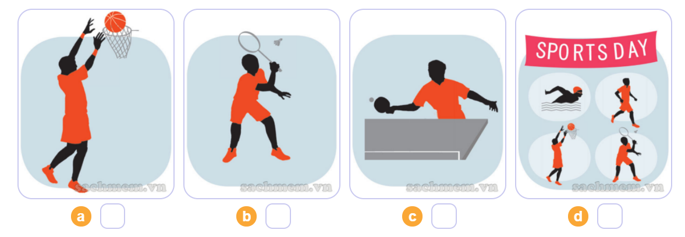
4. Listen and number.
4
2
3
1
1
2
3
4

Slide 13
4. Read and tick
Our school Sports Day will be next Saturday. Everyone in my class is going to take part in it. Mai and Linda are going to play table tennis. Tony's going to play basketball and Peter's going to play badminton. Phong and Nam are going to play in a football match. Tom's going to swim. My classmates are practising hard for the events. We hope that we will win the competitions.

Slide 14
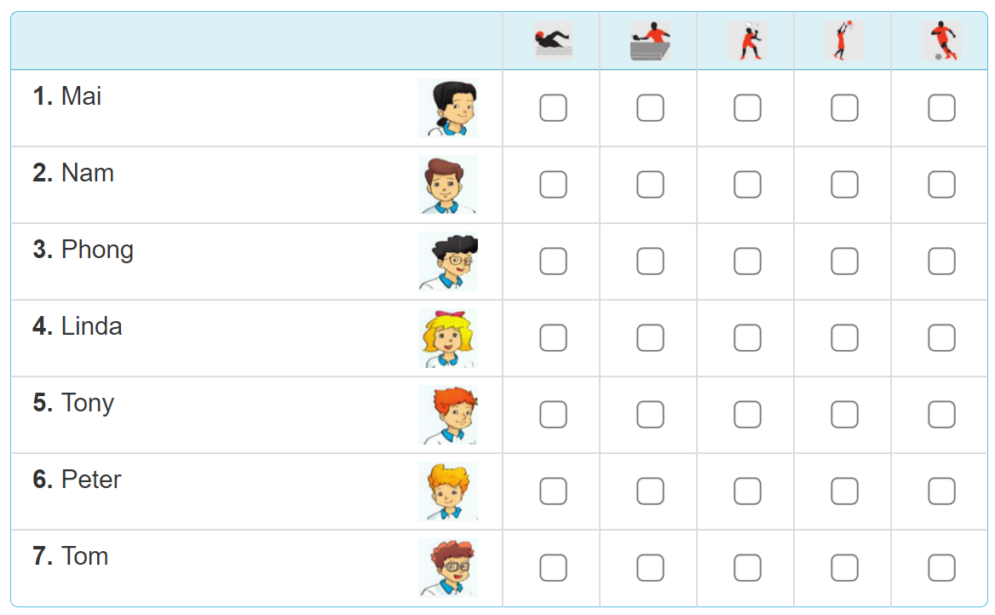
4. Read and tick

Slide 15

4. Read and tick

Slide 16
5. Write about Sport Day
Sports Day is going to be _______________.
Some of the boys are going to____________.
Some of the girls are going to_____________.
I am going to__________________________.
I hope that we will______________________.

Slide 17




Let’s play
Game :Passing the ball

Slide 18



Thank you very much
Good bye! See you again!

