Slide 1



Unit 1
What’s your address?
Lesson 1
Teacher: Pham Thi Thanh Van

Slide 2
Warm up
Sing a song!
Head, shoulder, knee and toes

Slide 3
VOCABULARY

Slide 4

Vocabulary
address
/əˈdres/
(n) địa chỉ

Slide 5
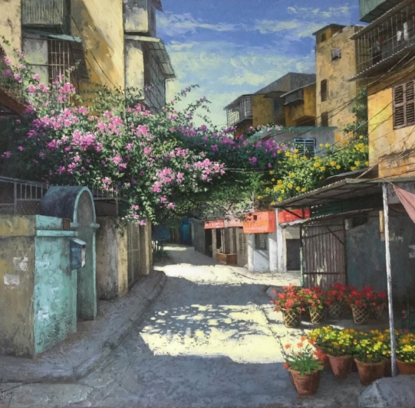

Vocabulary
lane
/leɪn/
(n) ngõ

Slide 6

Vocabulary
road
/rəʊd/
(n) đường

Slide 7

Vocabulary
street
/striːt/
(n) đường (phố)

Slide 8



Vocabulary
1
tower
2
/ˈtaʊər/
(n) Tòa nhà, tòa tháp
3

Slide 9

Vocabulary
11
10
9
8
floor
7
6
/flɔːr/
5
4
(n) tầng
3
2
1

Slide 10
Vocabulary
flat
/flæt/
(n) Căn hộ

Slide 11

Vocabulary
town
/taʊn/
(n) thị trấn

Slide 12
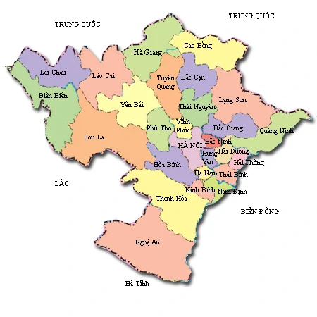
Vocabulary
province
/ˈprɒvɪns/
(n) tỉnh

Slide 13

Vocabulary
village
/ˈvɪlɪdʒ/
(n) làng

Slide 14

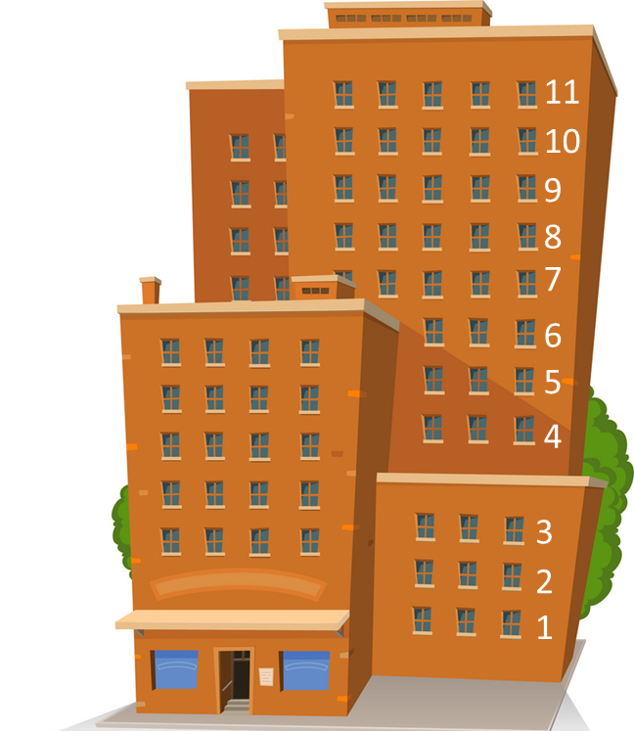
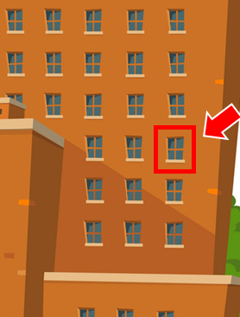
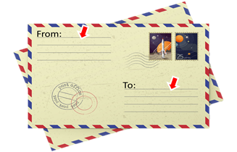

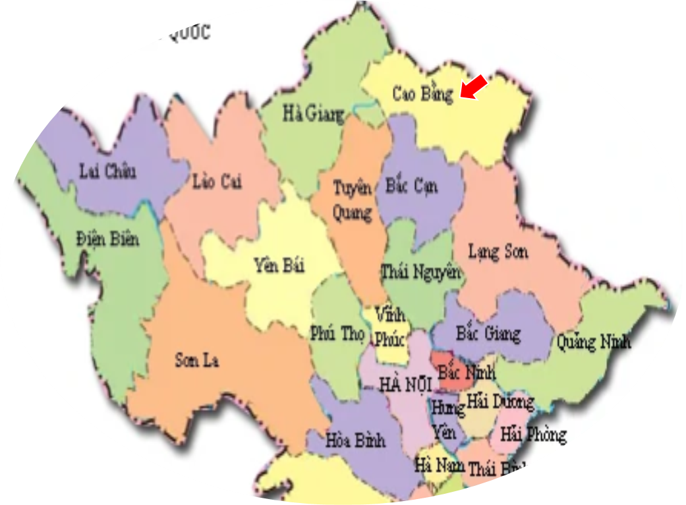
Vocabulary
1
2
3
4
5
village
town
tower
floor
flat
6
7
8
9
10
lane
address
street
province
road

Slide 15


START

Slide 16





Look!
Tower
Check
Next

Slide 17
Look!
Address
Check
Next

Slide 18
Look!
Floor
Check
Next

Slide 19
Look!
Lane
Check
Next

Slide 20
MsPham
Look!
Road
Check
Next

Slide 21
MsPham
Look!
Street
Check
Next

Slide 22
Look!
Province
Check
Next

Slide 23
MsPham
Look!
Village
Check
Next

Slide 24
MsPham
Look!
Flat
Check
Next

Slide 25
MsPham
Look!
Town
Check
Next

Slide 26
Good job!
End

Slide 27
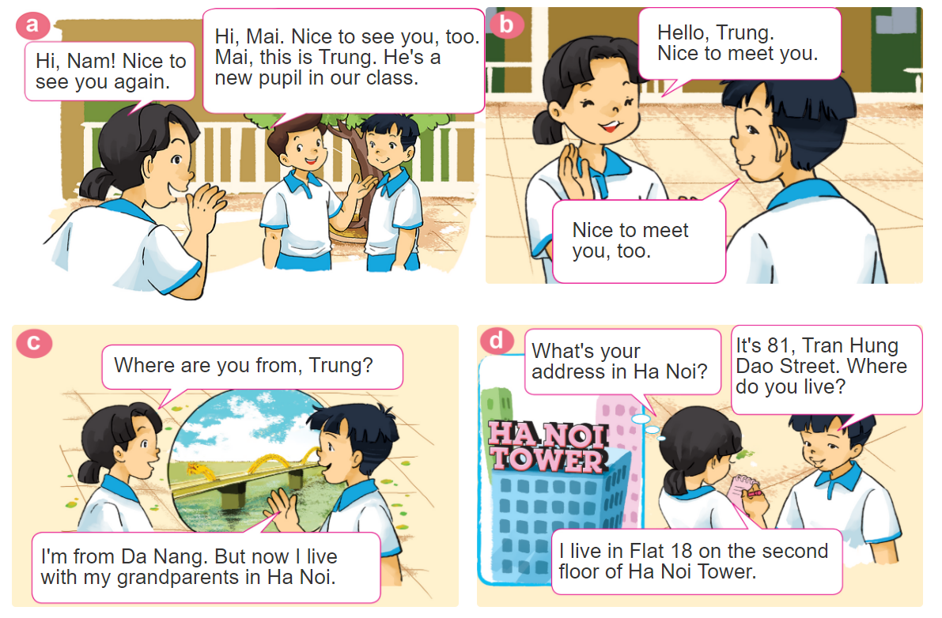

1. Look, listen and repeat.

Slide 28
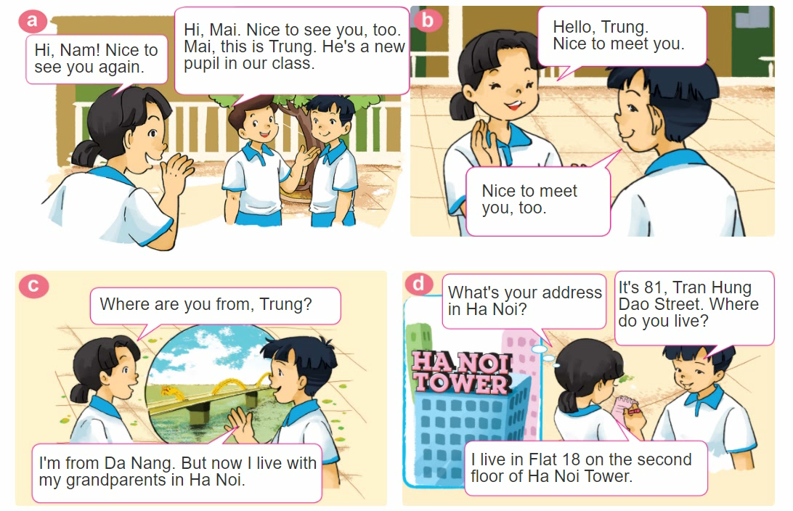
1. Look, listen and repeat.

Slide 29
GRAMMAR

Slide 30


GRAMMAR
Hỏi - đáp ai đó đến từ đâu:
Where are you from?
(Bạn đến từ đâu)
I’m from _____________.
+ address
(Tớ đến từ_________)
Hỏi - đáp về địa chỉ nhà:
What's your address?
It's _________.
+ address
(Địa chỉ của bạn là gì?)
(Đó là ___________.)

Slide 31
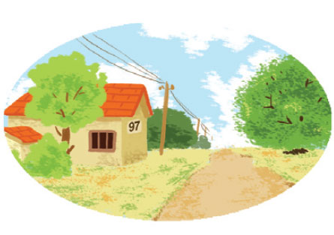

2. Point and say
97, Village Road
It's __________________.
What's your address?
97, Village Road

Slide 32
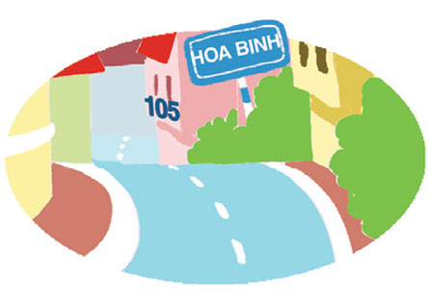
2. Point and say
75, Hai Ba Trung Street
It's __________________.
What's your address?
75, Hai Ba Trung Street

Slide 33

2. Point and say
flat 8, second floor, City Tower
It's ______________
_____________.
What's your address?
flat 8, second floor,
City Tower

Slide 34
3. Let’s talk
Where are you from?
I’m from _______.
What’s your address?
It’s _______.
Where do you live?
I live in/at/on _______.

Slide 35
GRAMMAR
Hỏi - đáp ai đó sống ở đâu:
Where do you live?
(Bạn sống ở đâu?)
I live in/on/at _____________.
+ address
(Tớ sống ở_________)

Slide 36




Slide 37



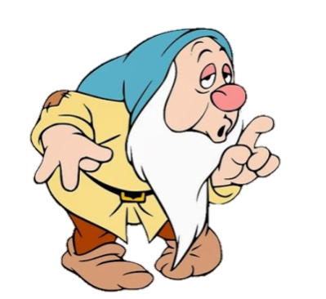


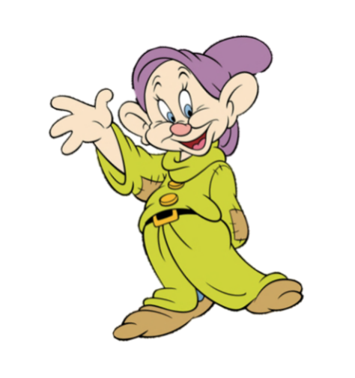

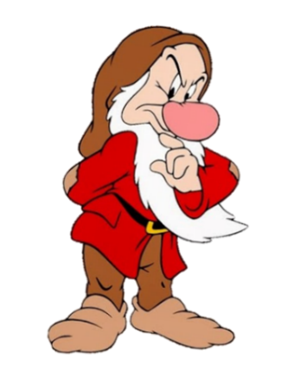


It’s flat 8, second floor,
City Tower
Where are you from?
What’s your address?

Slide 38
I’m from Hai Phong.
Where are you from?
What’s your address?

Slide 39
It’s 97, Village Road
What’s your address?
Where do you live?

Slide 40
Where do you live?
I live in Hai Phong.
I’m from Hai Phong.

Slide 41
I live in Flat 18 on the second floor of HaNoi Tower.
Where are you from?
Where do you live?

Slide 42
What’s your address?
It’s 75, Hai Ba Trung Street.
I live at 75, Hai Ba Trung Street.

Slide 43
Where are you from?
It’s in DaNang.
I’m from DaNang.

Slide 44
What’s your address?
____ 105, Hoa Binh Lane.
I live at
It’s

Slide 45
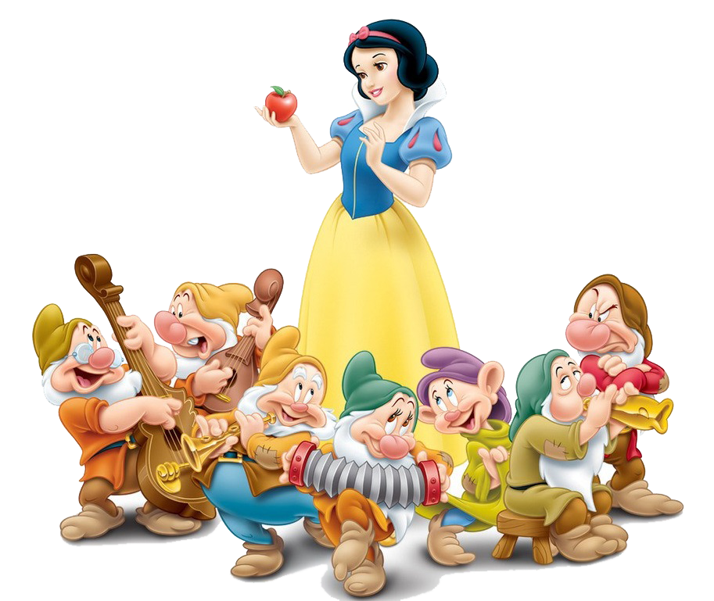
Good job!

Slide 46

THANK YOU!

