Slide 1




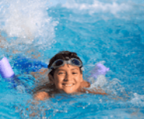
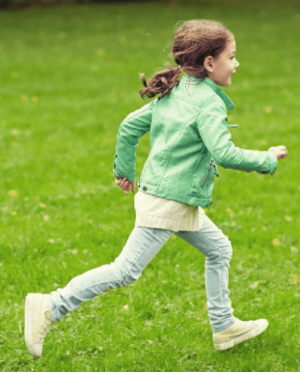


5
My hobbies
LESSON 1

Slide 2
1 Warm-up
Let’s SING A SONG.
Notes:
Review Numbers 1-10 and Alphabet

Slide 3
1. Look, listen and repeat

Slide 4
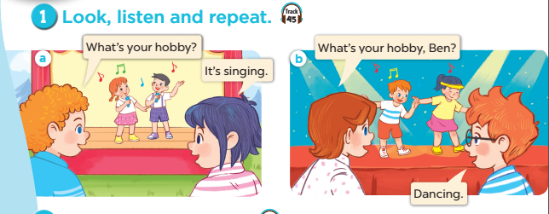
Notes:
Step 1: Ask pupils to look at context a. Play the recording for them to listen. Play the recording again, sentence by sentence, for them to listen and repeat. Correct pronunciation if necessary.
Step 2: Do the same with context b.
Step 4: Work in pair - role play.
Step 5: Invite few pairs to the front of the class and act.

Slide 6
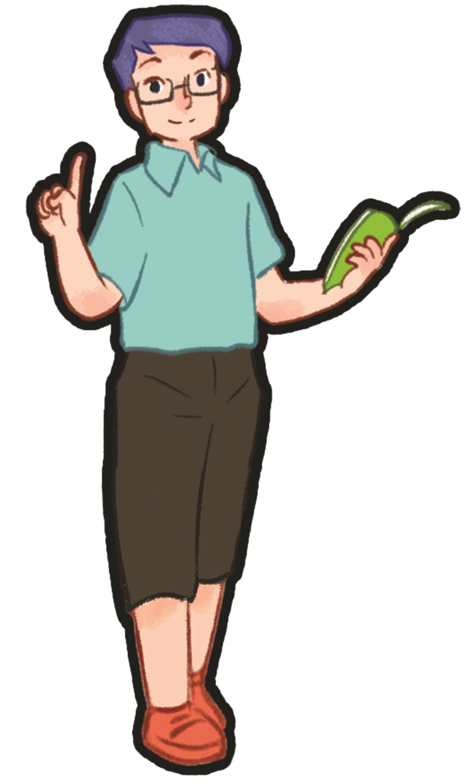
2. Look, point and say

Slide 7
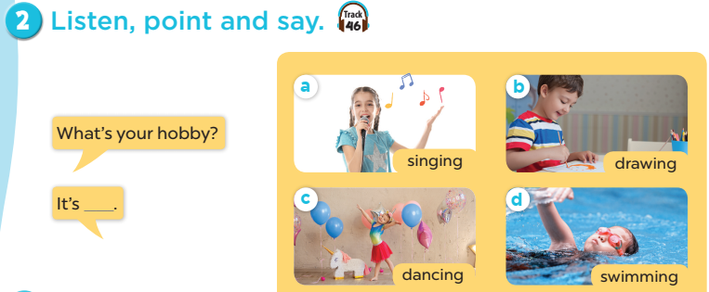
Notes:
Step 1: Have pupils look at the pictures and elicit the names of the pupils. Have the class repeat the words a few time.
Step 2: Ask 2 pupils to do as an example.
Step 4: Ask pupils to work in pairs, pointing to the questions and pictures and giving the answers.
Step 5: Invite few pairs to the front of the class and make questions and answers.

Slide 8

singing

Slide 9
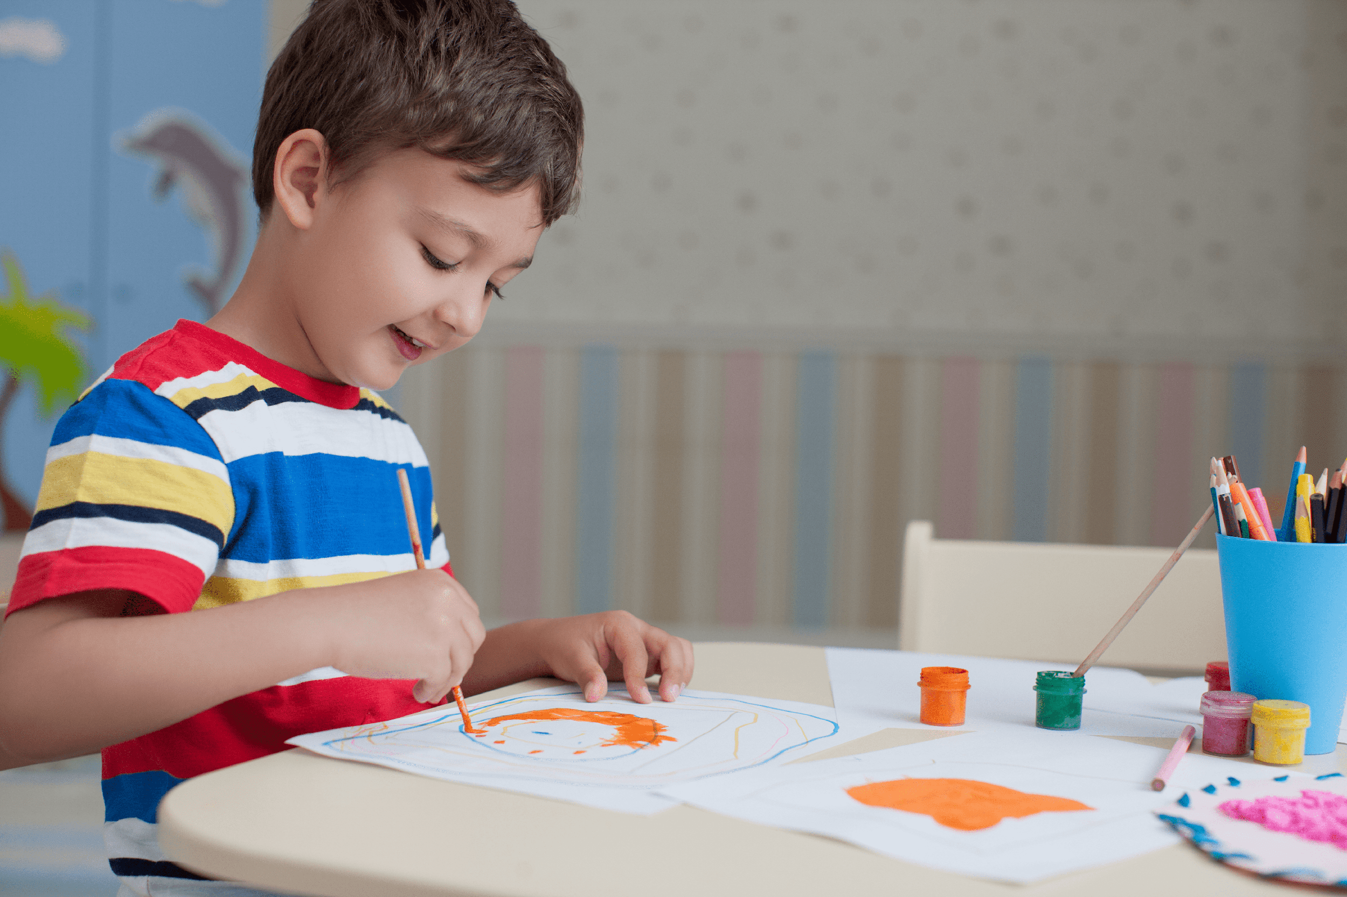
drawing

Slide 10
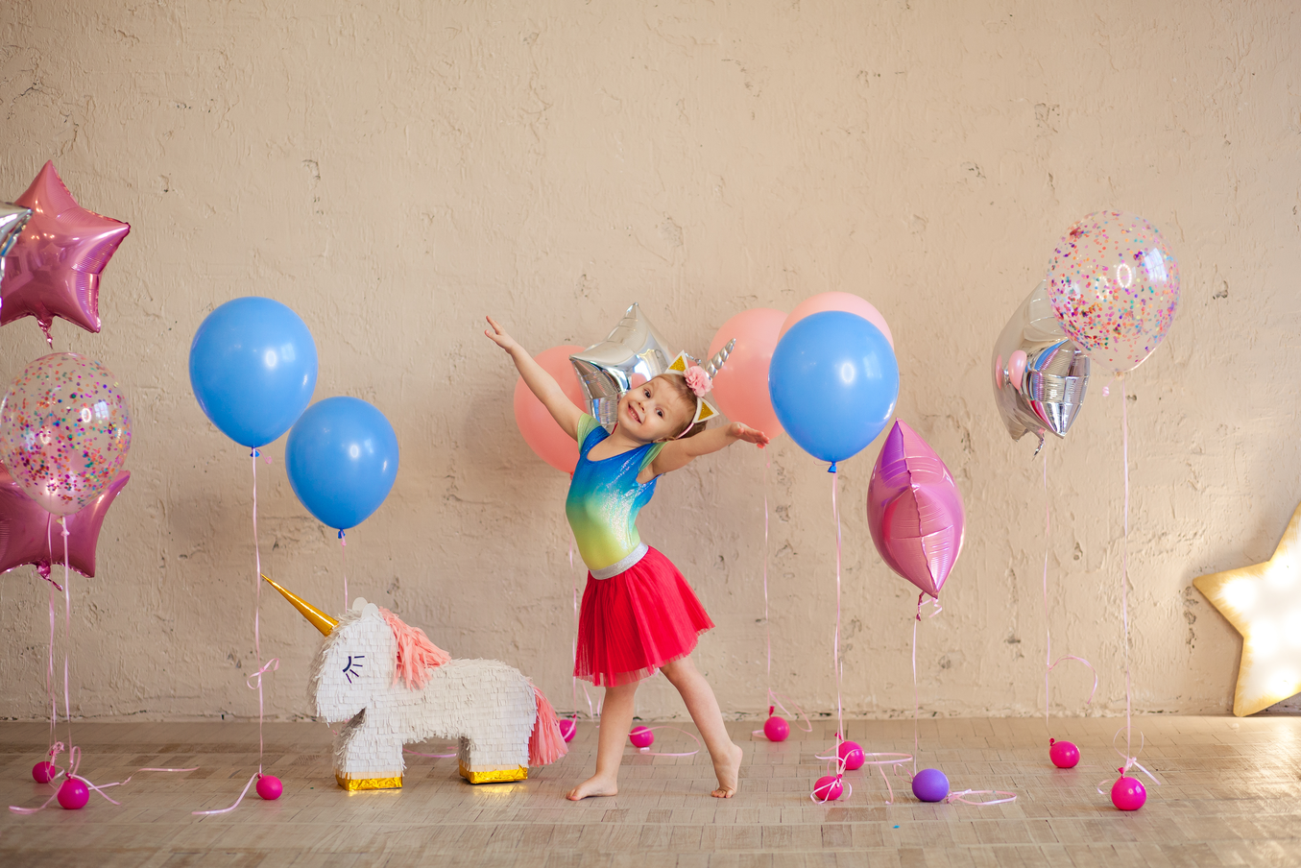
dancing

Slide 11
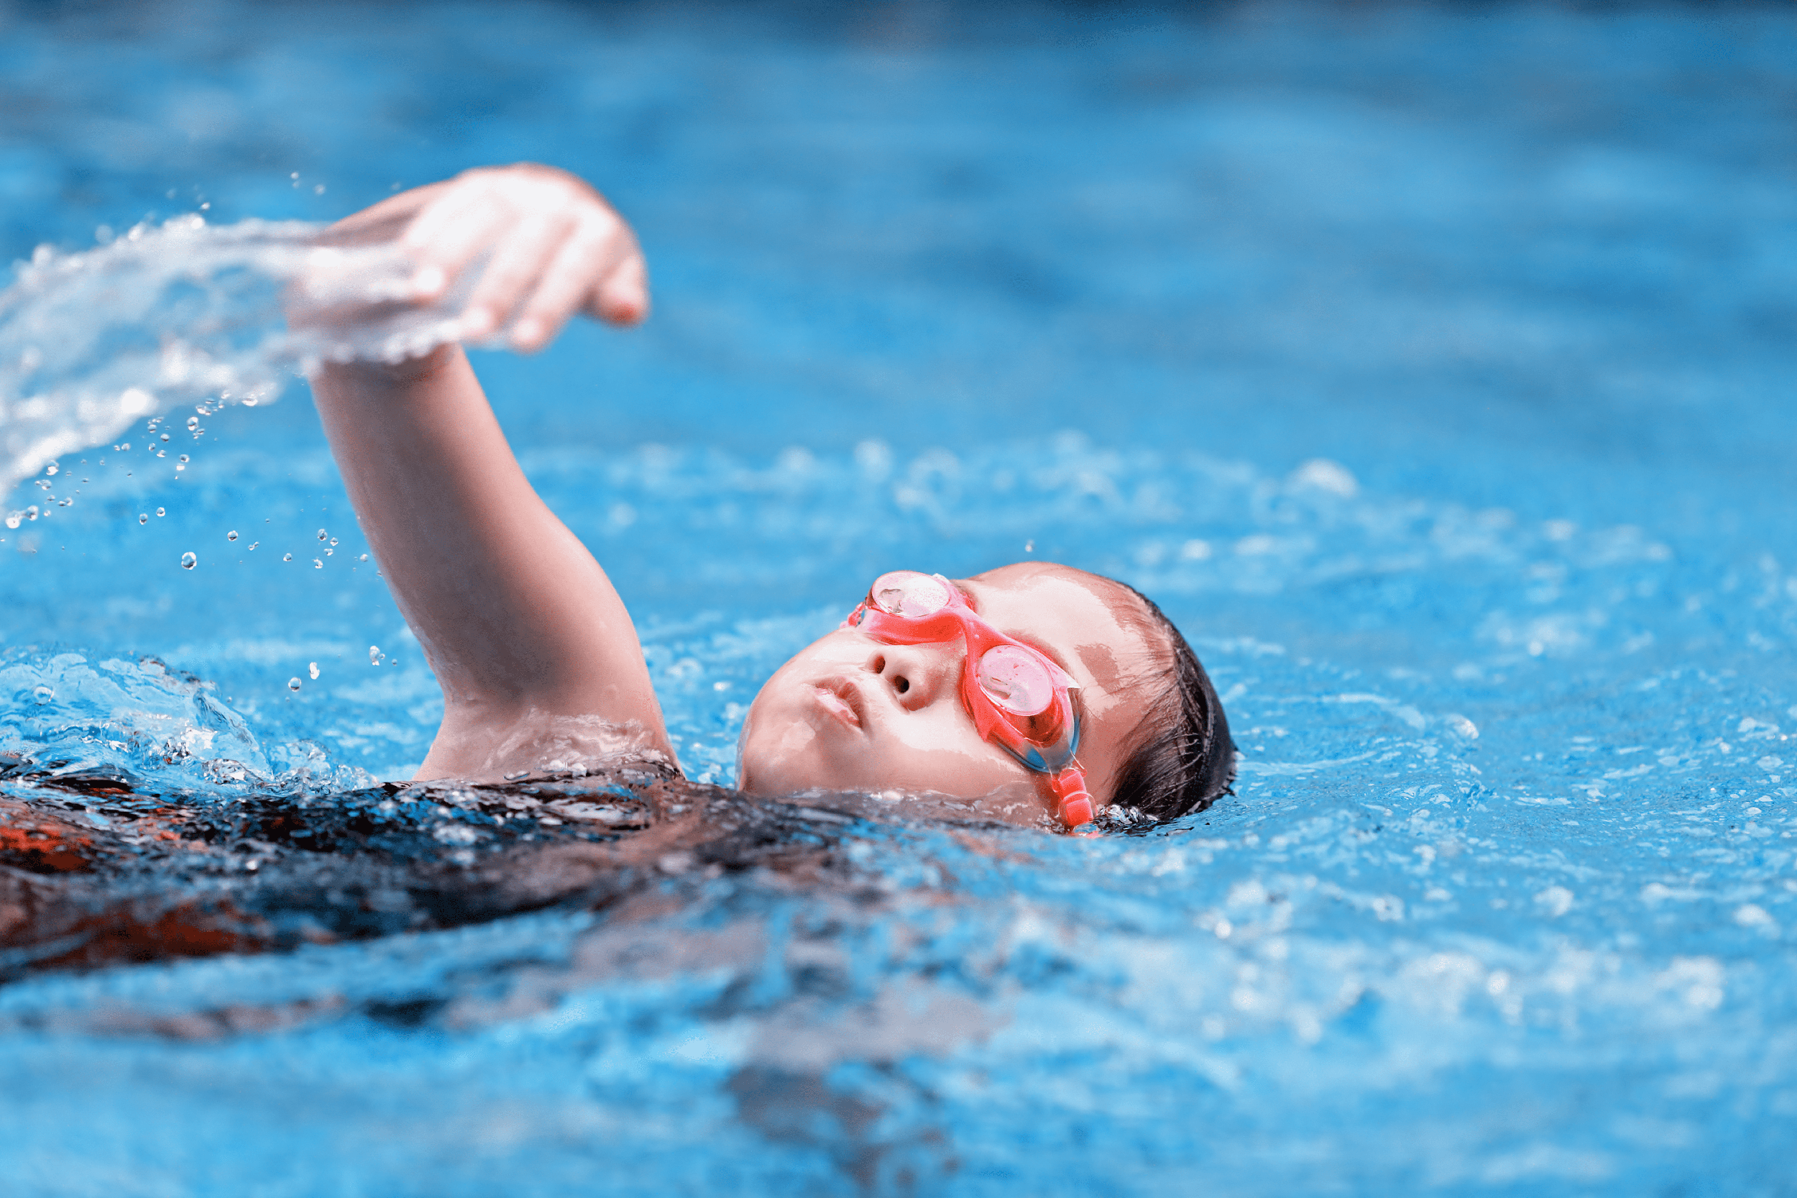
swimming

Slide 12
What’s missing?
Notes:
Game: What’s missing?
Divide the class into 4 groups.
A pupil from each group comes to the front, look at the pictures and say which is missing.
Who say it fast will get points.

Slide 13
What’s missing?

Slide 14
What’s missing?

Slide 15
What’s missing?

Slide 16
What’s missing?

Slide 17
What’s your hobby?
It’s singing

Slide 18
Notes:
Step 1: Have pupils look at the pictures and elicit the names of the pupils. Have the class repeat the words a few time.
Step 2: Ask 2 pupils to do as an example.
Step 4: Ask pupils to work in pairs, pointing to the questions and pictures and giving the answers.
Step 5: Invite few pairs to the front of the class and make questions and answers.

Slide 19

b

Slide 20
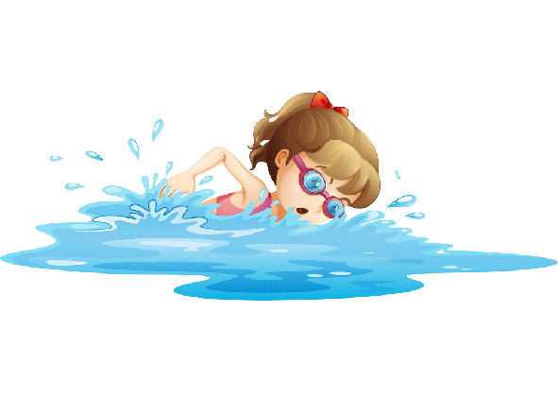

Slide 21


Slide 22
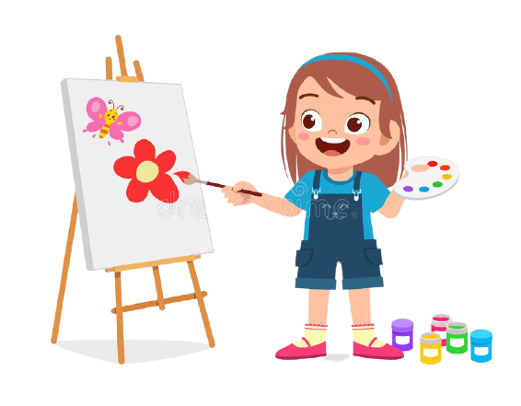

Slide 23
4 Let’s talk.

Slide 24
a
b
d
c

Slide 25
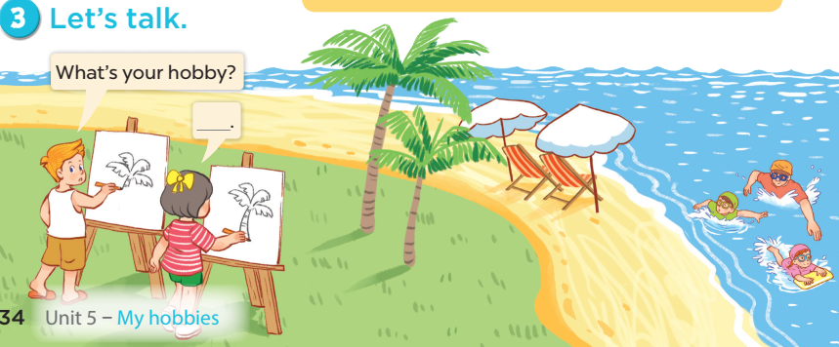

Slide 26
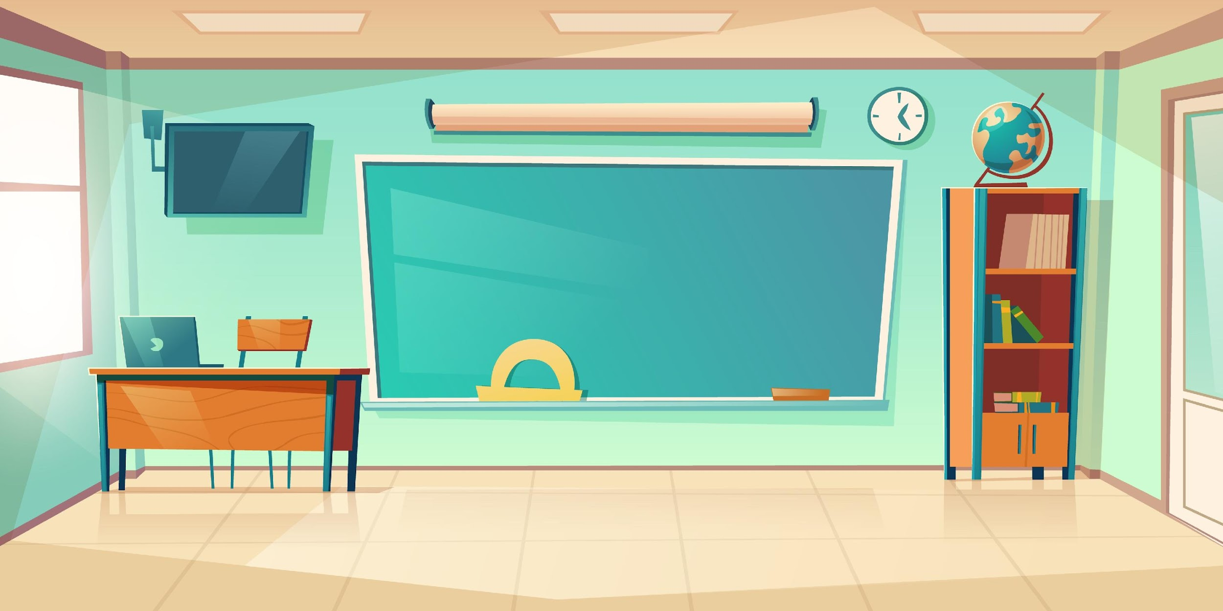

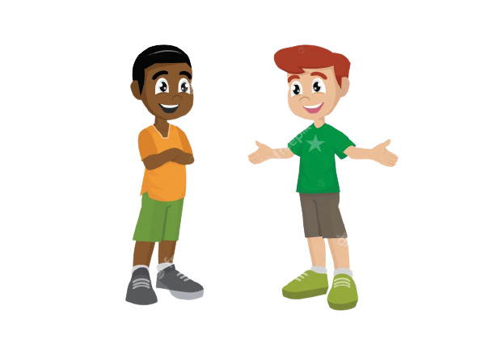
It’s ____.
What’s your hobby?
Notes:
- T asks pupils to practise in pairs asking and answering.
- T asks some pairs to present in front of class.

Slide 27
Matching game

Slide 28
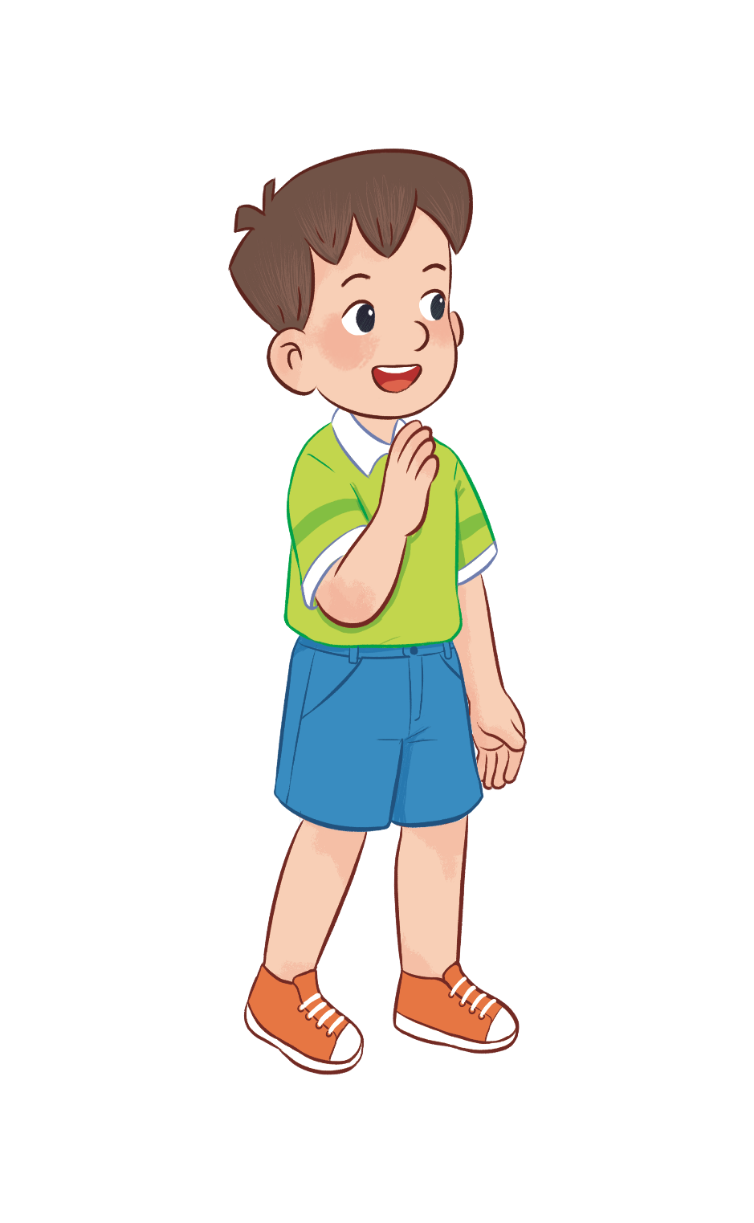
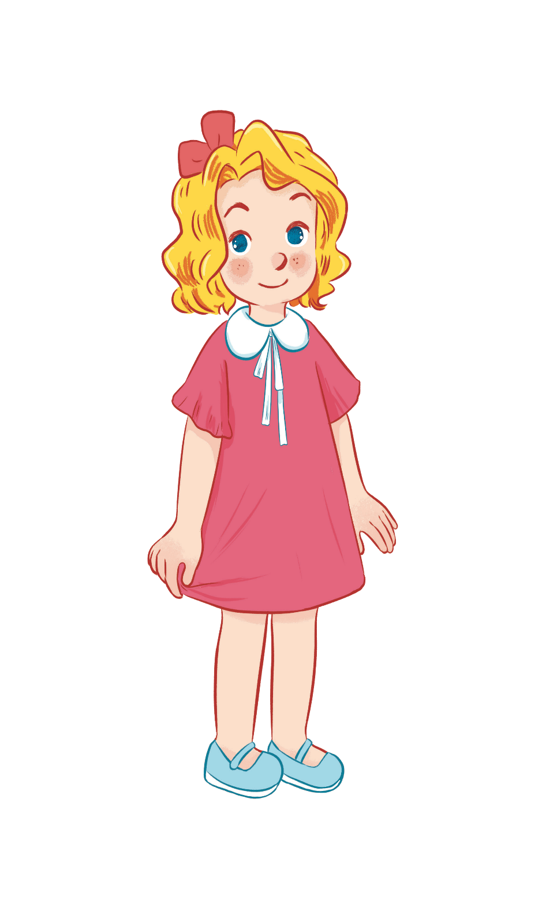
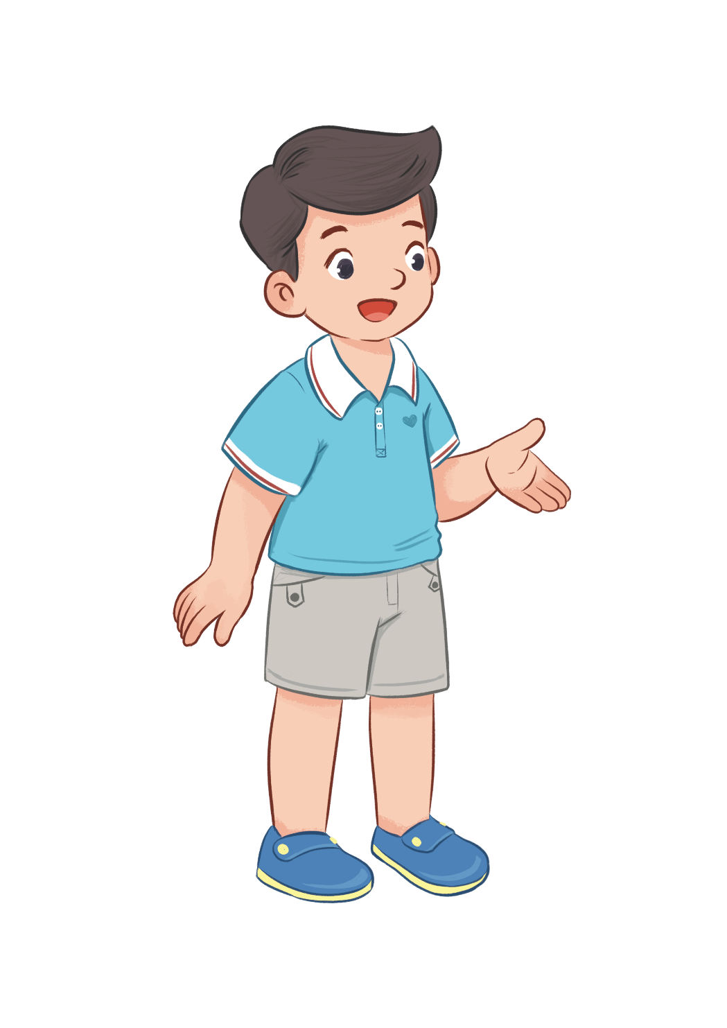
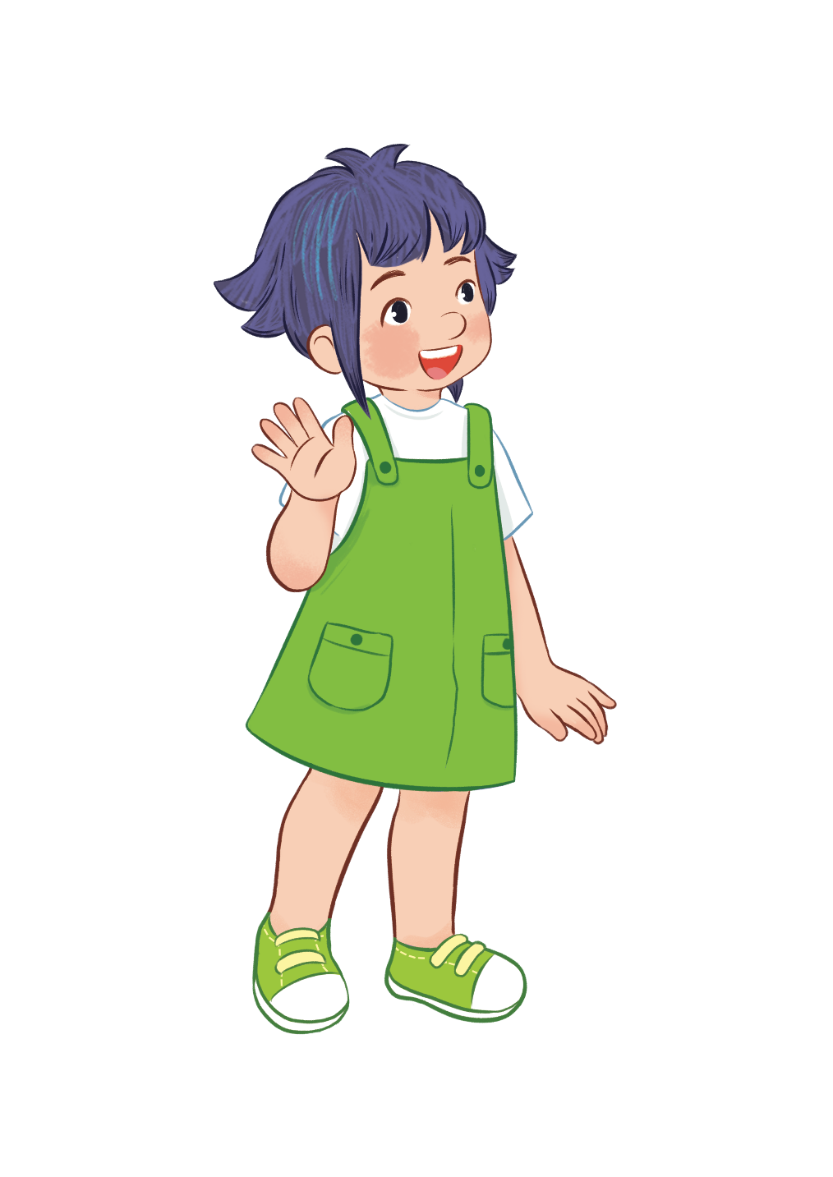
HOBBIES
drawing
swimming
dancing
singing
Notes:
- T writes 4 new words on the board and asks pupils to read (whole class).
- T asks 4 pupils to come to the board and write their hobbies in the pieces of paper and keep them in secret.

Slide 29


swimming/ drawing, ..?
dancing/ singing, ..?
dancing/ singing, ...?
swimming/ drawing, ...?
HOBBIES
drawing
swimming
dancing
singing
Notes:
T asks 1 pupil come to the board and guess their hobbies written in the paper (He has to write the answers in the small pieces of paper and stick to 4 pupils).

Slide 30
It’s swimming.
HOBBIES
drawing
swimming
dancing
singing
What’s your hobby?
swimming
singing
dancing
drawing
Notes:
T asks the pupil to ask the question to find the answers and gives him or her point if correct (repeat the activities depending the time).

Slide 31
5 Fun corner and Wrap-up

Slide 32


Notes:
- T asks 1 student come to the board and face to the class.
- T shows 1 picture of 4 hobbies and lets the others act so that the pupil on the board can guess the name of the hobby in the picture (1 pupil will guess 3 pictures).

Slide 33

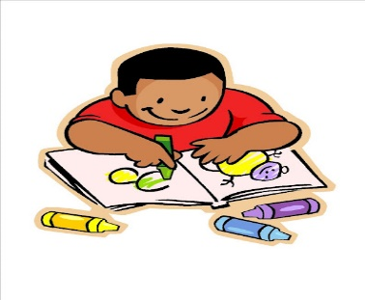

What’s your hobby?
Notes:
T shows 4 pictures on the board and asks pupils to repeat -> Wrap up.

