Slide 1



6
Our school
LESSON 1 PERIOD 1

Slide 2
Warm-up

Slide 3


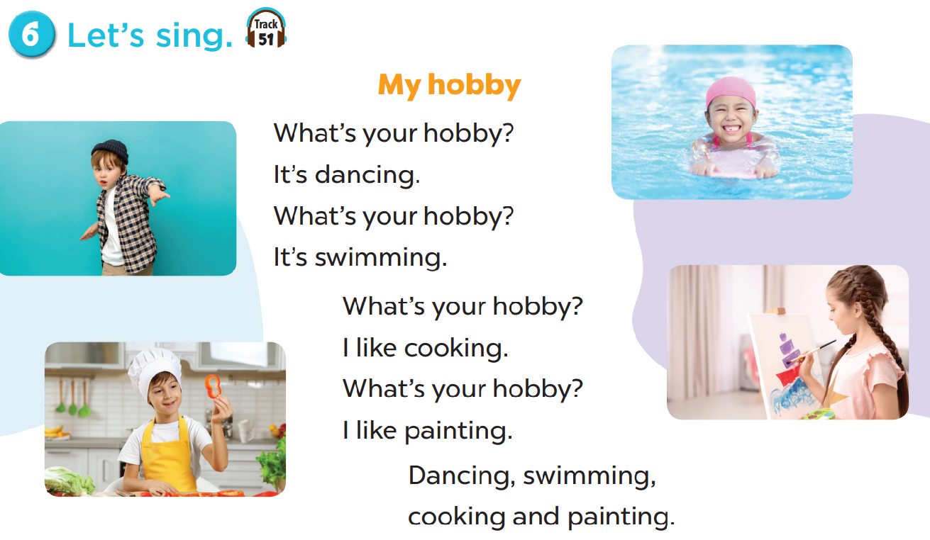
Let’s sing.

Slide 4
New words

Slide 5
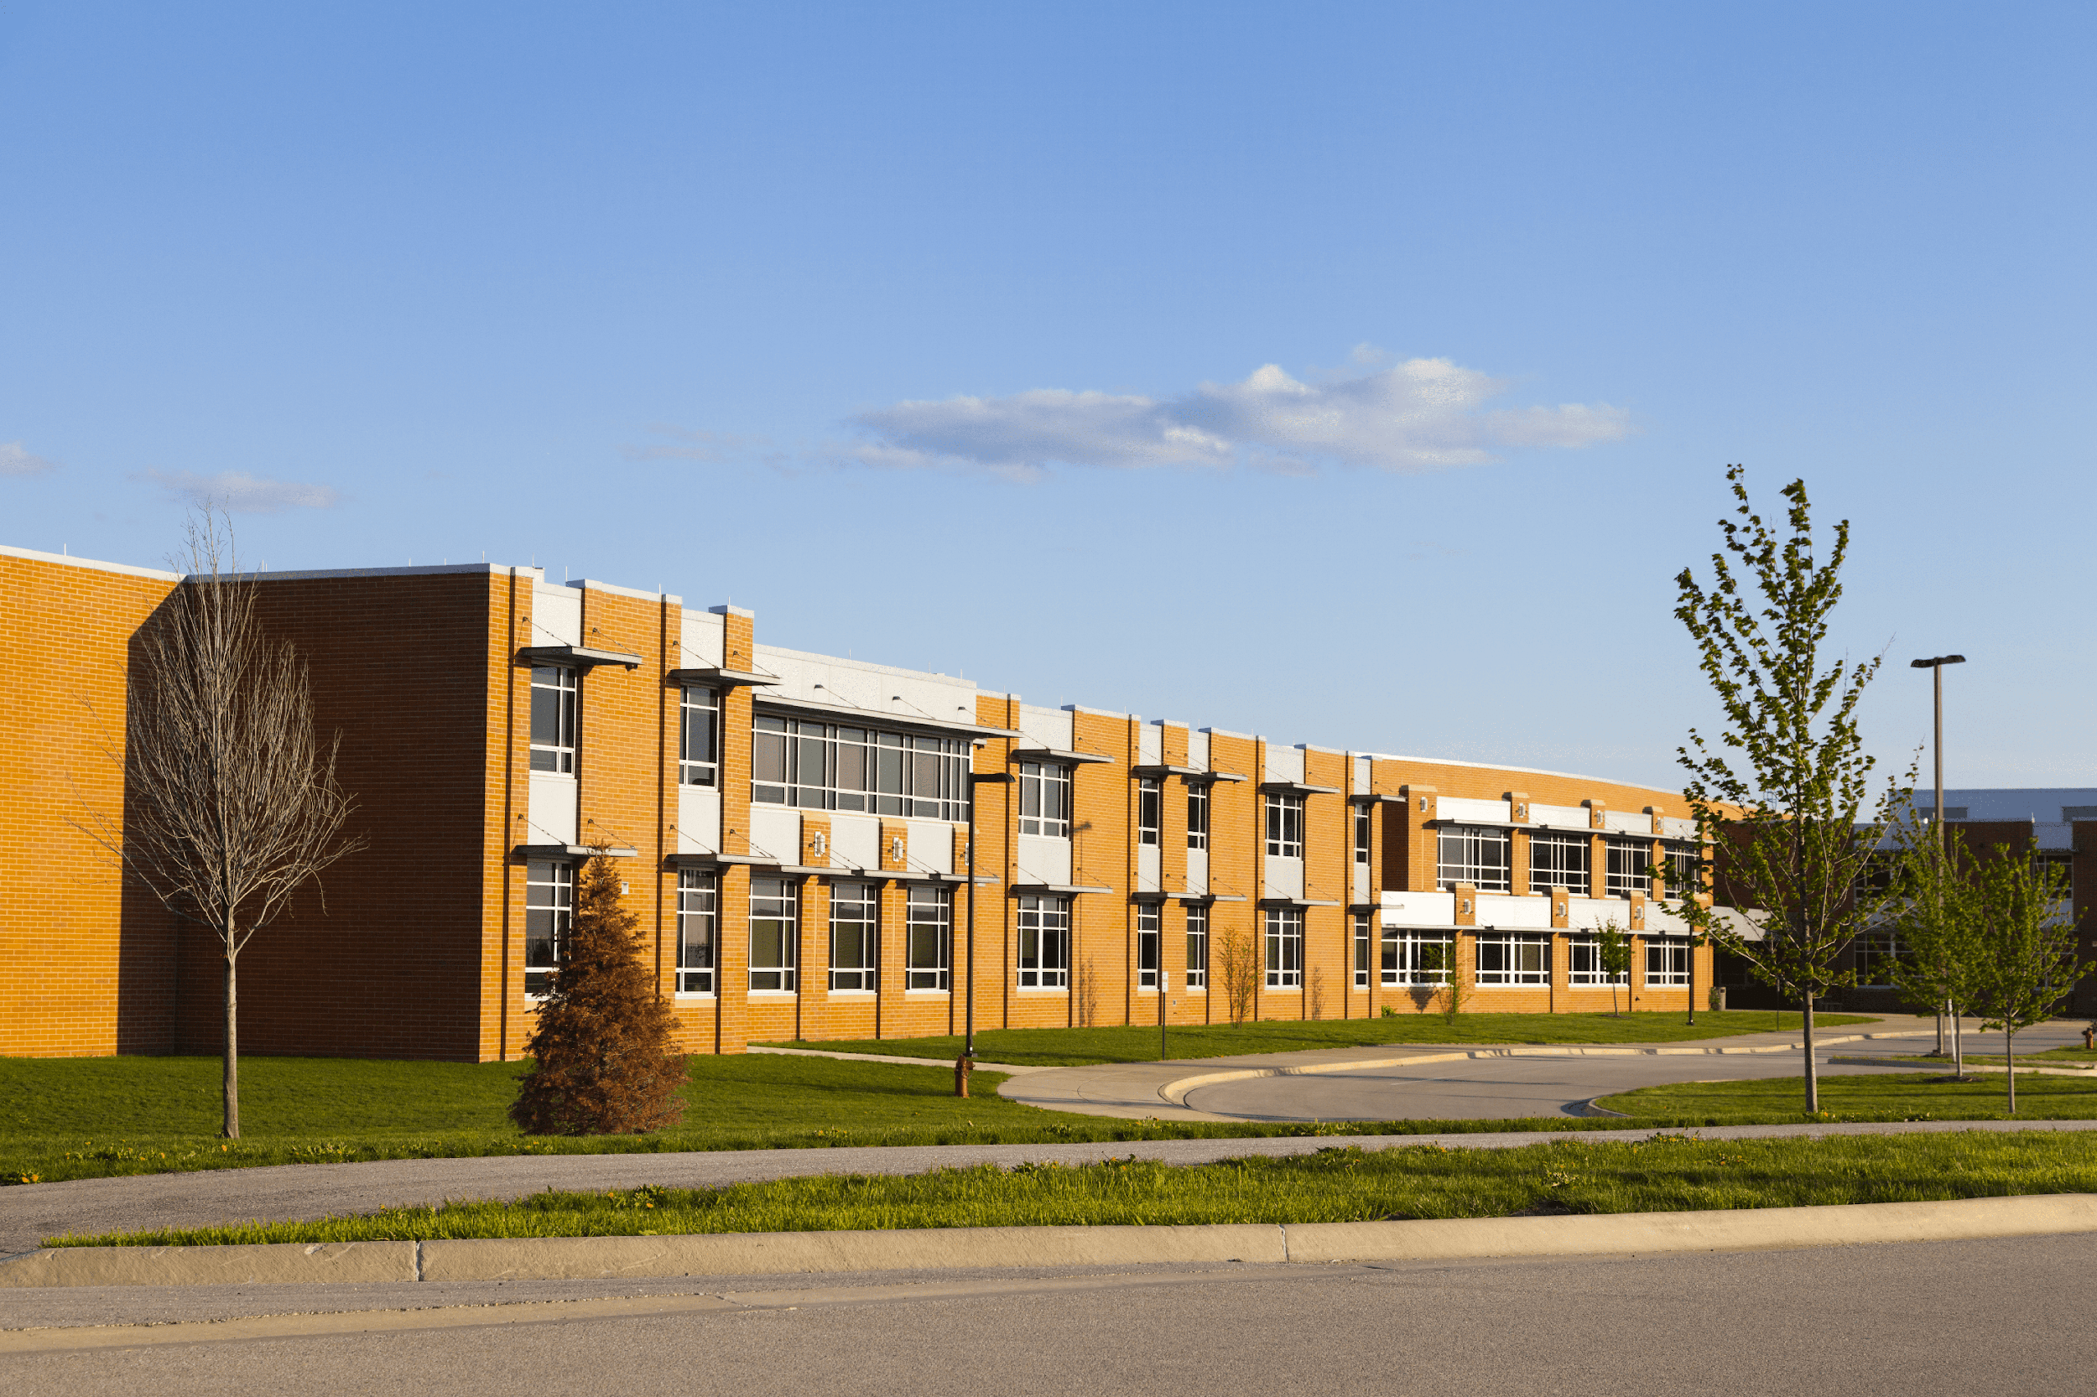
school

Slide 6
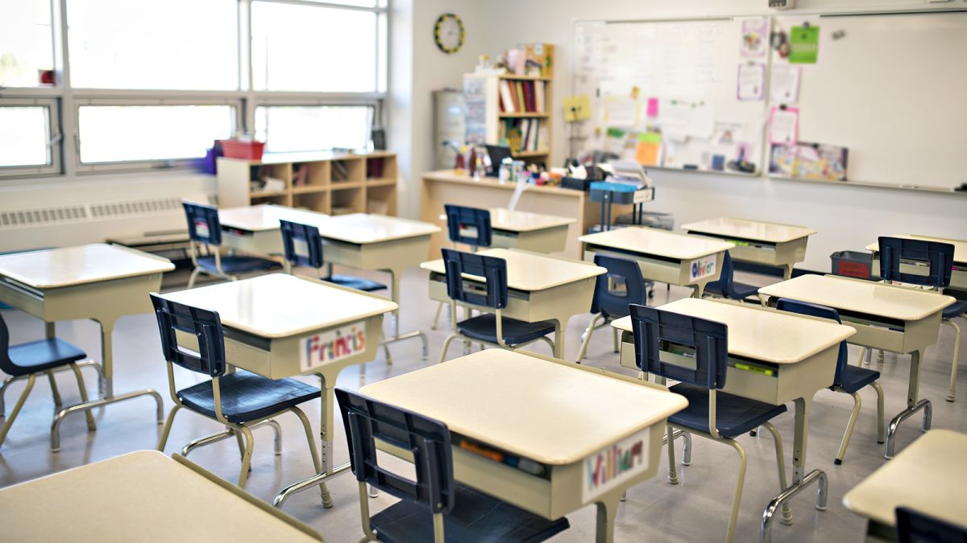
classroom

Slide 7
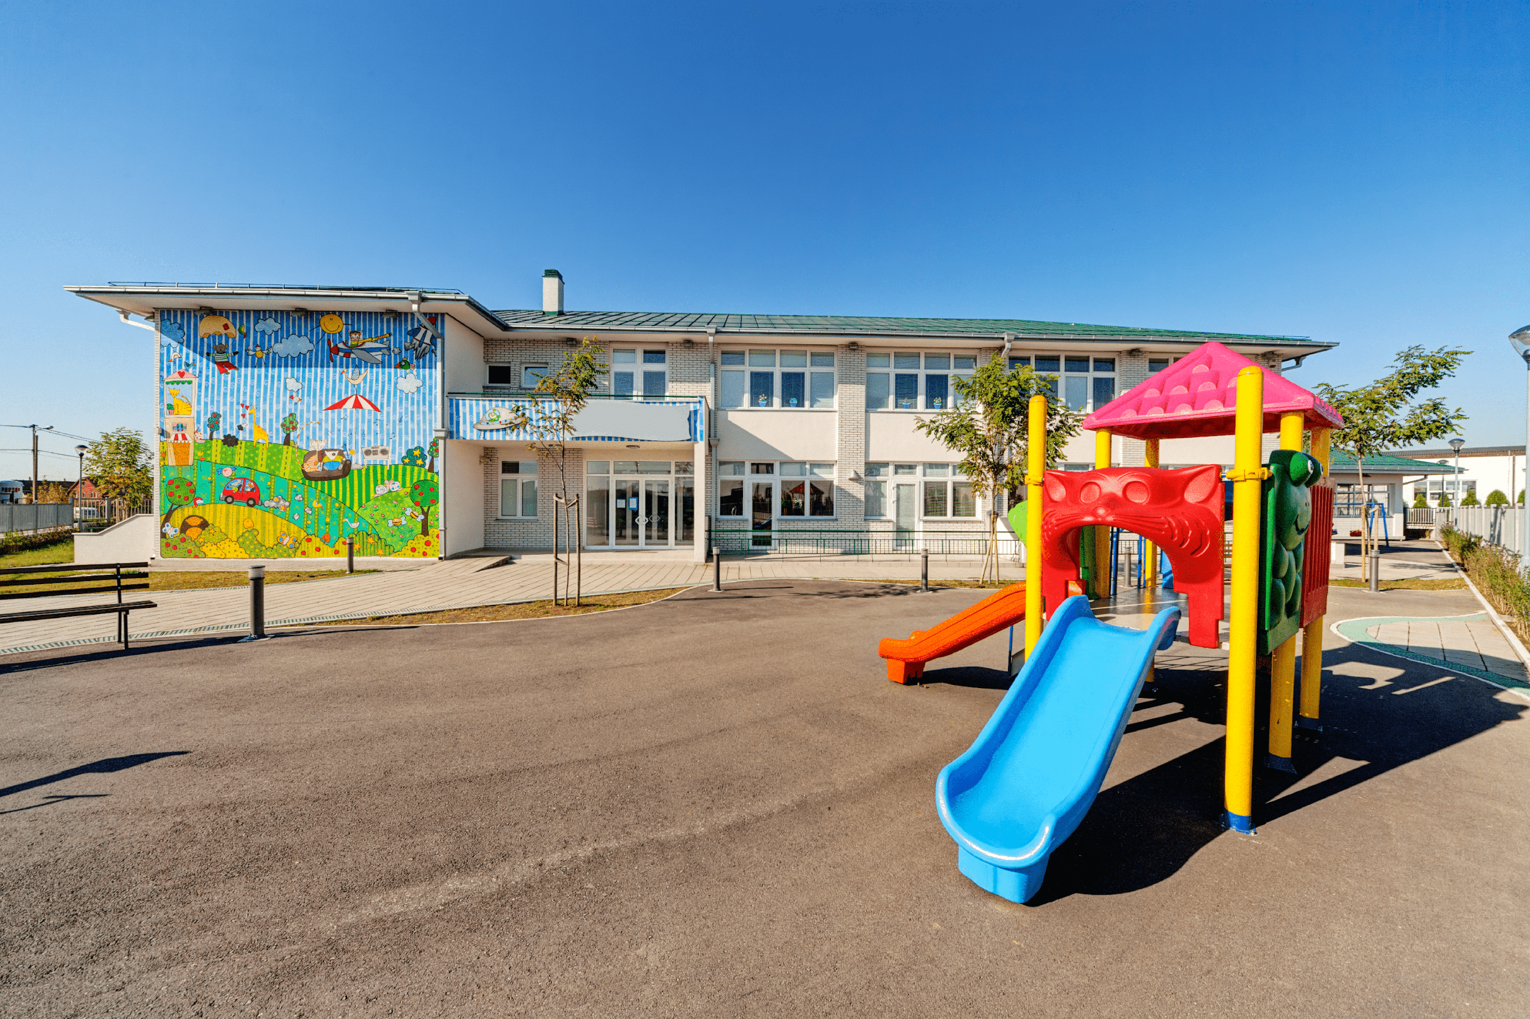
playground

Slide 8
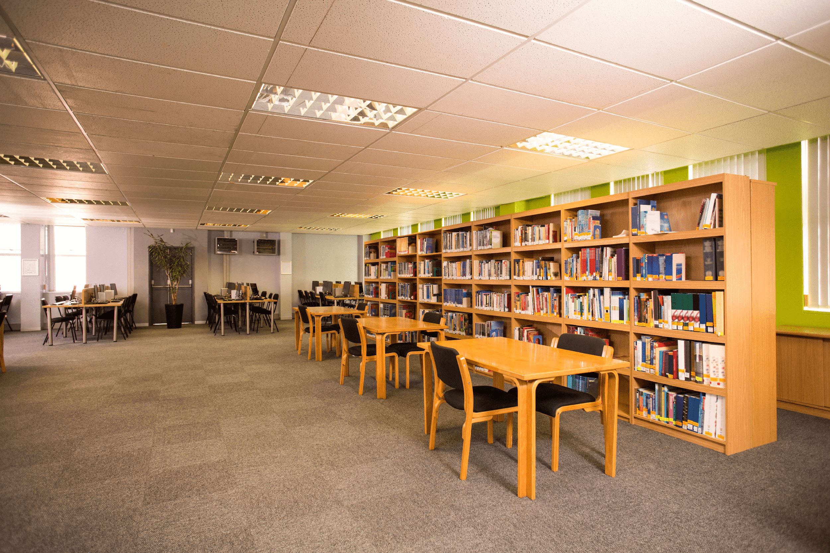
library

Slide 9
Look and guess.

Slide 10
playground

Slide 11
classroom

Slide 12
library

Slide 13
school

Slide 14

Look, listen and repeat.

Slide 15
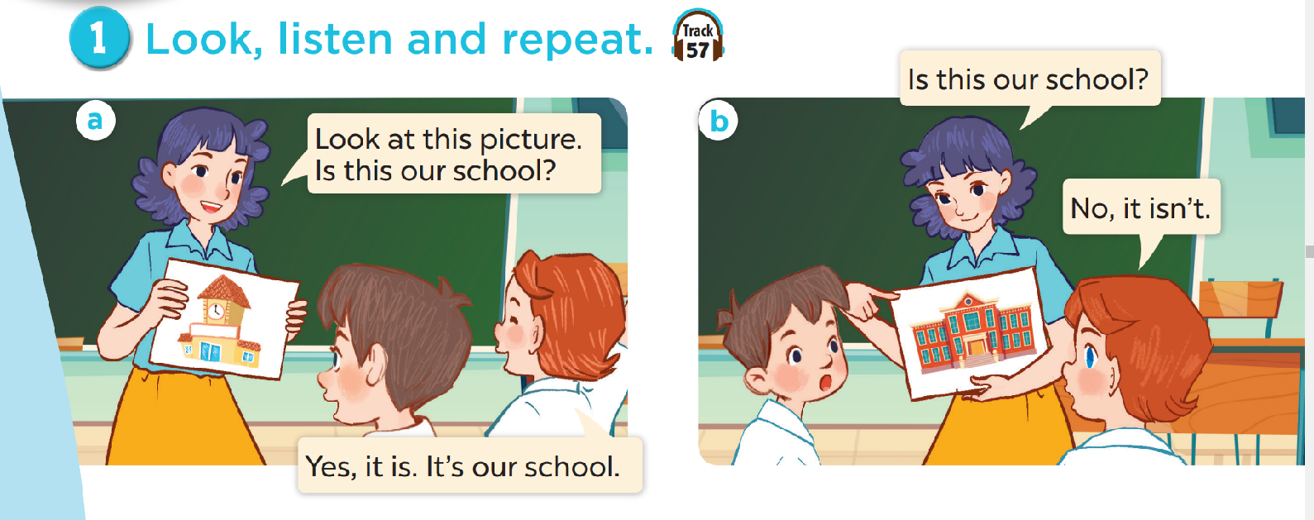
Look and answer the questions.
Where are they?
Who are they?
What are they doing?

Slide 16
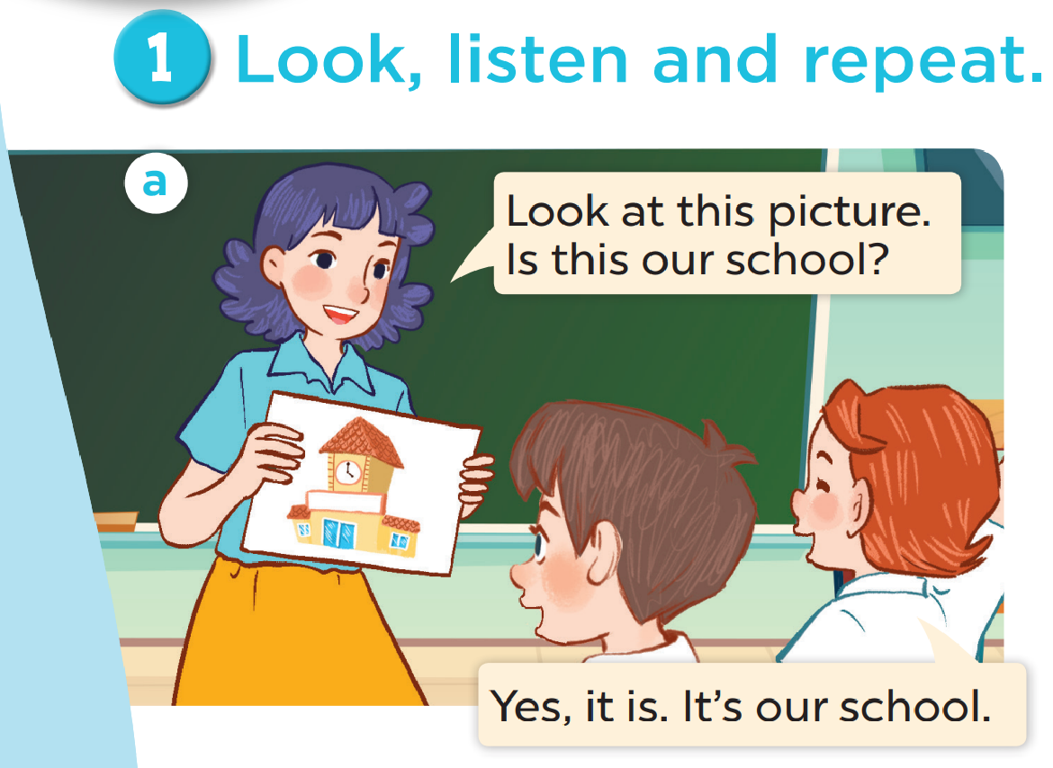

Slide 17
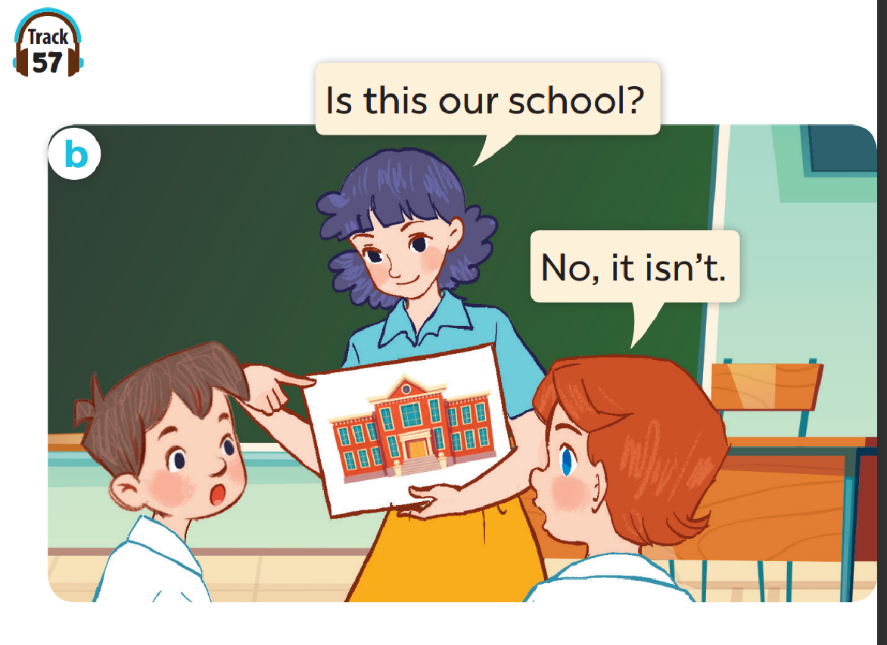

Slide 18
Work in pairs. Practise.
Listen and repeat.

Slide 19

Listen, point and say.

Slide 20


Is this our classroom?
Yes, it is.
No, it isn’t.

Slide 21
Is this our library?
Yes, it is.
No, it isn’t.

Slide 22
Is this our playground?
Yes, it is.
No, it isn’t.

Slide 23
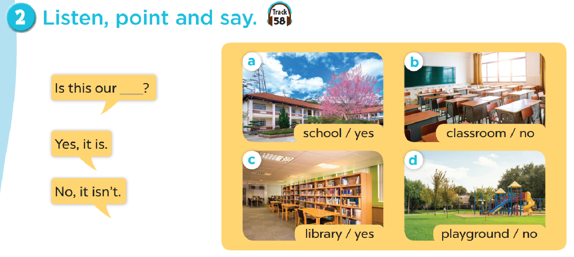
Work in pairs. Practise.

Slide 24

Let’s talk.

Slide 25
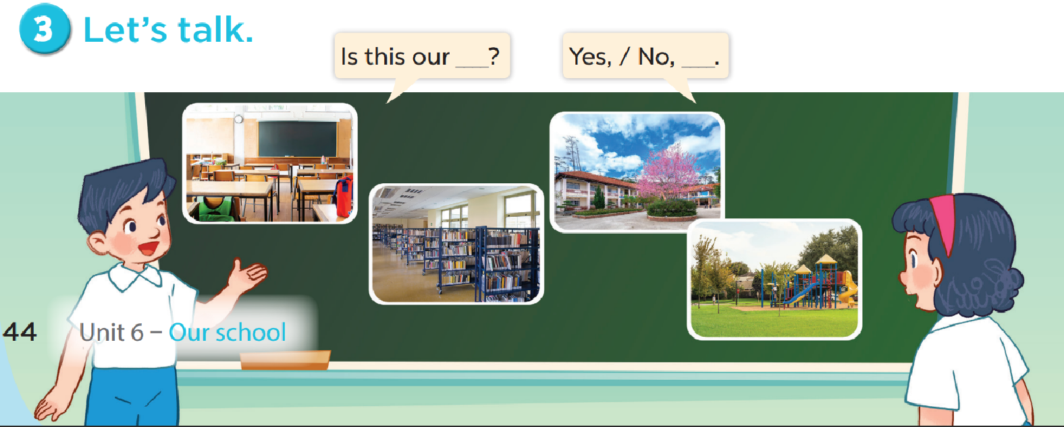

Slide 26

Fun corner

