Slide 1


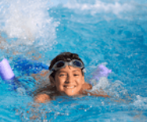
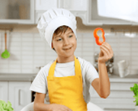
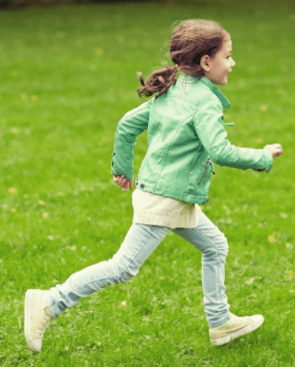


5
My hobbies
LESSON 3
Period 6

Slide 2
Content
1
5
Warm-up
Fun corner and Wrap-up
4
2
3
Project
Read and tick.
Let’s write.

Slide 3
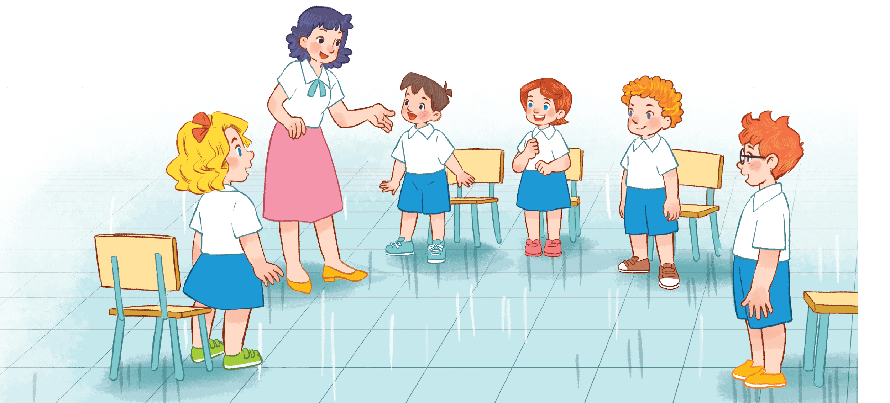
What’s your hobby?
- It’s _____________.
- I like ____________.
Notes:
- T calls 5 pupils come to the board and say their hobbies.
T asks: What’s your hobby?
Pupils answer: It’s _____. / I like ______.
- The others will listen and try to remember the hobbies of pupils on the board.
- T asks 1 pupil to come to the board and retell the hobbies

Slide 4
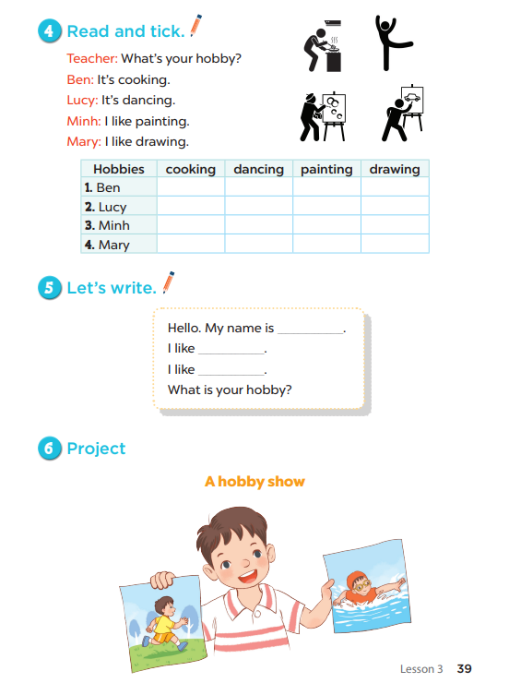
Notes:
T asks pupils to open their SB/ page 39.

Slide 5
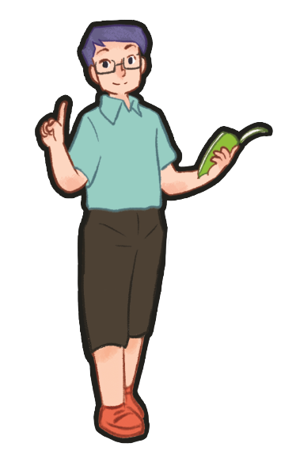
2
Read and tick.

Slide 6
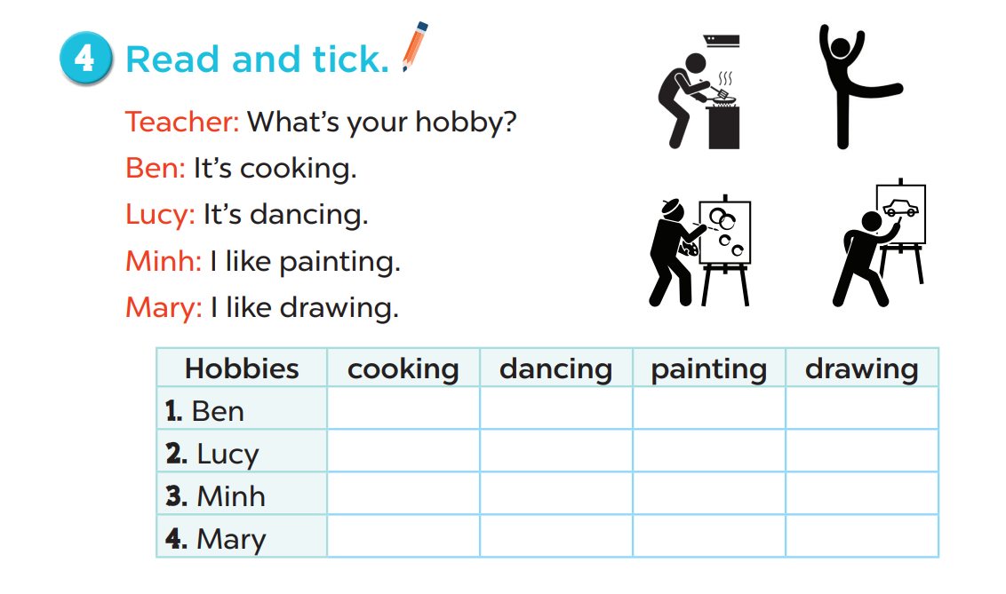
✔
✔
✔
✔
Notes:
Step 1: Tell pupils about the activity. Pupils should read the communicative context in silence,
pay attention to the sentences and complete the table by ticking the correct boxes.
Step 2: Give the class time to do the task. Circulate round the classroom during the activity and
offer help where necessary.
Step 3: Check the answers as a class. Get pupils to swap and correct their answers in pairs.

Slide 7
3
Let’s write.

Slide 8
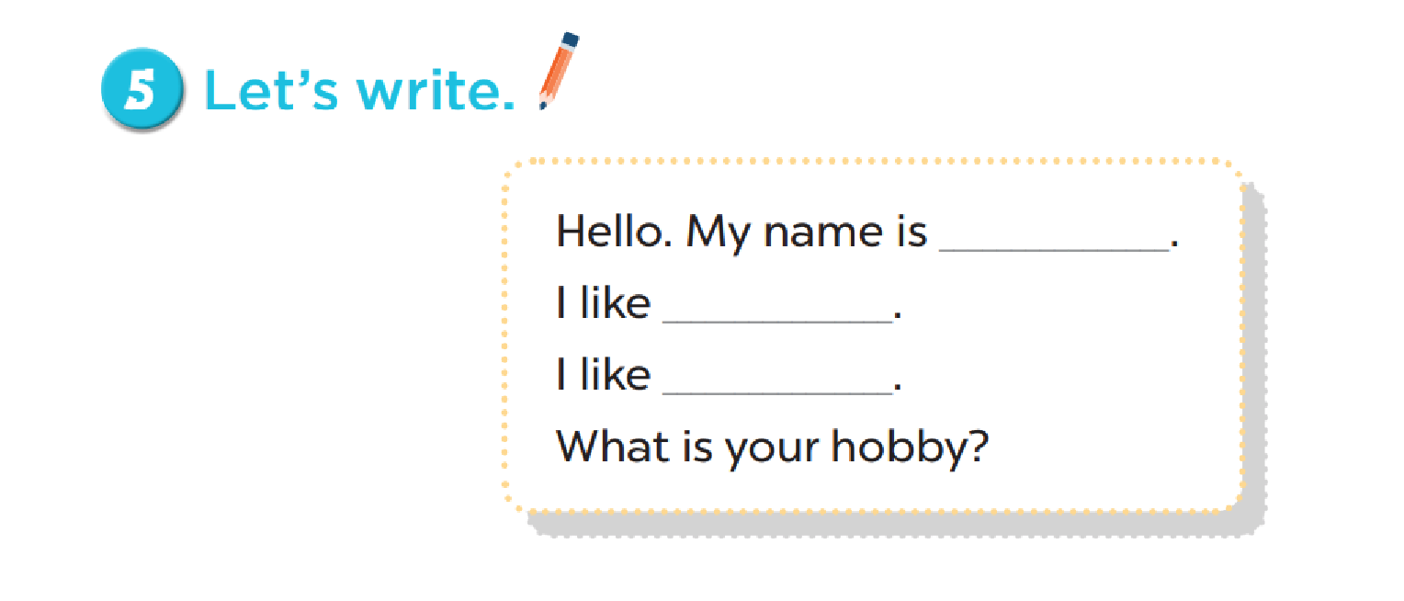
Notes:
Step 1: Explain to the class the goal of this activity. Show them how to complete the task. They
should read each gapped sentence, guess the missing information and complete the sentence
with their own personal information. Check comprehension and give feedback.
Step 2: Give pupils time to write their answers. Circulate round the classroom during the
activity and offer help where necessary.
Step 3: Ask pupils to swap and correct their answers in pairs. Check the answers as a class.
Extension: If time allows, invite a pupil to stand up and read his / her completed sentences.
The rest of the class listen, and cheer or clap their hands if the performers do a good job.

Slide 9
Game time

Slide 10
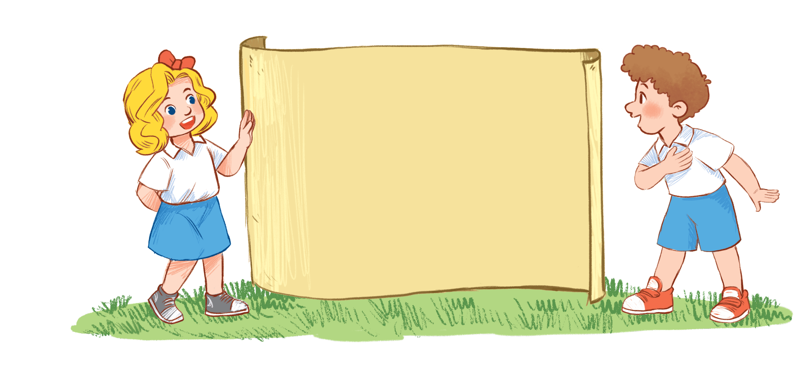
HOBBIES
…
Notes:
- T asks pupils to write their own information and hobbies.
- Pupils hand in the paper.
- T will get the 1st pieces of paper to come to the board and give the speaking of that.
- The pupils will take turn in circle.

Slide 11
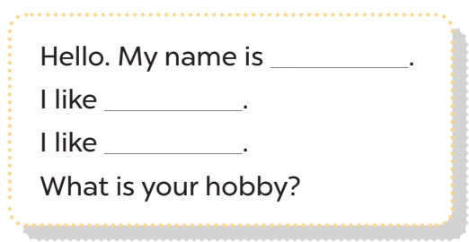
Notes:
- T asks pupils to write their own information and hobbies.
- Pupils hand in the paper.
- T will get the 1st pieces of paper to come to the board and give the speaking of that.
- The pupils will take turn in circle.

Slide 12
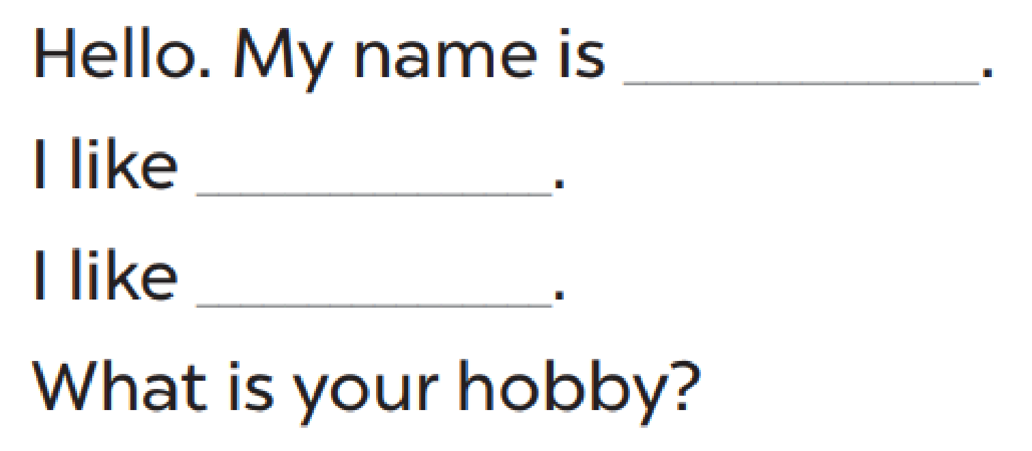
Notes:
- T asks pupils to write their own information and hobbies.
- Pupils hand in the paper.
- T will get the 1st pieces of paper to come to the board and give the speaking of that.
- The pupils will take turn in circle.

Slide 13
4
Project

Slide 14
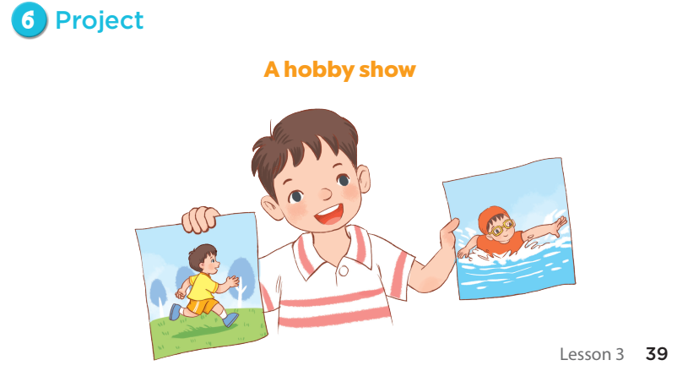
Notes:
Step 1: Explain the goal of this activity to pupils. Point at the picture and explain what they
should do to complete the project. Tell pupils to work in groups. Remind pupils to be friendly,
cooperative and supportive when working together.
Step 2: Give the class time to complete the project by drawing three pictures showing their
hobbies. Circulate round the classroom and offer help where necessary.
Extension: Have a class display of pupils’ projects and have them vote for the most interesting.
Give prizes like paper flowers, coloured stars or stickers to the best presenters.

Slide 15
5
Fun corner
and
Wrap-up
Notes:
Review Numbers 1-10 and Alphabet

Slide 16

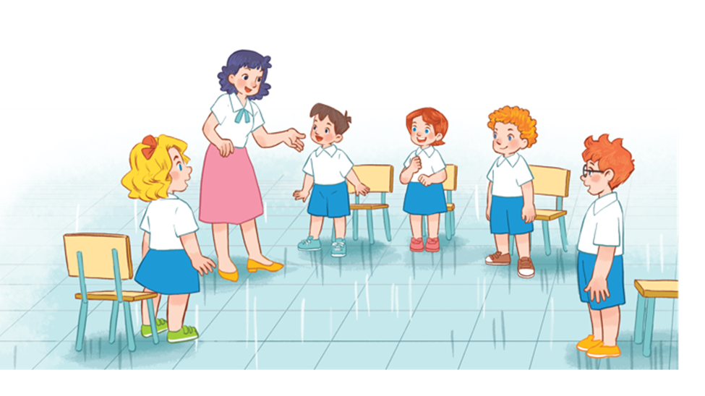

Notes:
Game: Passing the ball
- T lets the pupils sit in circle and turn on the music. When the music stops, the one with the ball will say 1 hobby using I like _____./ It’s ______.
- The next one are not allowed to say the same word before.

Slide 17




Spin the wheel!
30
20
40
10
SPIN
50
80
- What’s your hobby?
- I like ___________.
60
70
singing dancing dancing swimming
running walking painting cooking
Notes:
- T lets the pupils sit in circle and turn on the music. When the music stops, the one with the ball will spin the wheel get points when answer the question by his/ her own idea:
What’s your hobby?
I like ______________.

