Slide 1
GRADE 5: Unit 16
WHERE’S THE POST OFFICE?
Lesson 2 (p1,2,3)
Teacher: Phạm Thị Thanh Vân

Slide 2
VOCABULARY

Slide 3

Vocabulary
take a boat
/teɪk ə bəʊt/

Slide 4

Vocabulary
take a coach
/teɪk ə kəʊtʃ/

Slide 5

Vocabulary
go by plane
/ ɡəʊ baɪ pleɪn/

Slide 6

Vocabulary
on foot
/ ɒn fʊt /
walk
/wɔːk/

Slide 7

Vocabulary
1
2
3
take a boat
take a coach
on foot
4
5
go by plane
walk

Slide 8




take a boat
take a boat
A
B
C

Slide 9
go by plane
go by plane
A
B
C

Slide 10
take a coach
take a coach
A
B
C

Slide 11
on foot
on foot
A
B
C

Slide 12
walk
walk
A
B
C

Slide 13
GRAMMAR

Slide 14
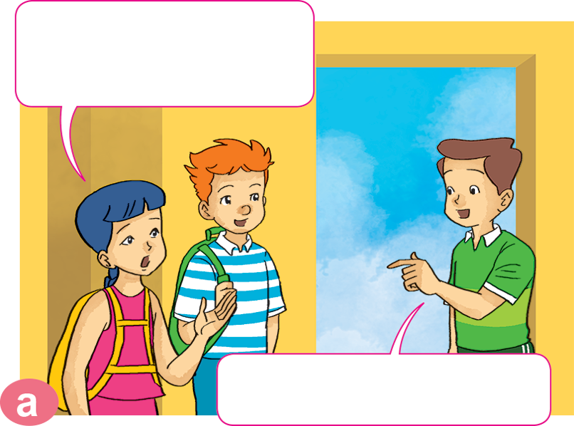
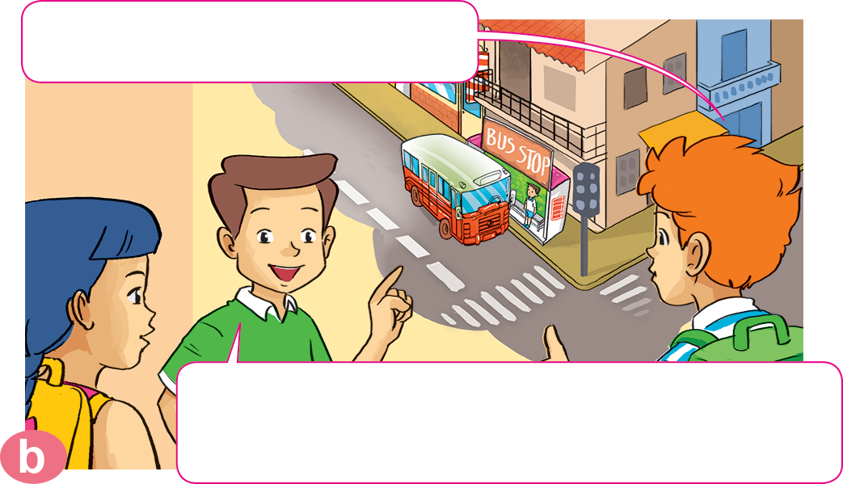

1. Look, listen and repeat.
How can we get to the zoo, Nam?
Where's the bus stop?
Go out of this building. Turn right. It's on the next corner.
You can take a bus.

Slide 15

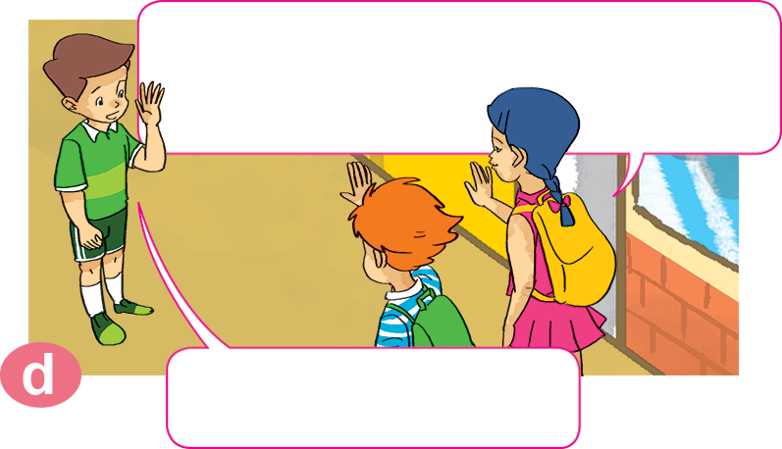
1. Look, listen and repeat.
What bus goes to the zoo?
It's very kind of you, Nam.
Thanks a lot.
You can take bus number 22. It stops right at the zoo entrance.
You're welcome.

Slide 16


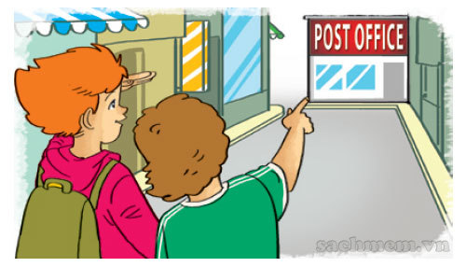
2. Point and say.
How can I get to _________________?
the post office
You can __________________.
walk for five minutes
Excuse me, where's the bus stop?
It's next to the stadium.

Slide 17



2. Point and say.
How can I get to _________________?
Phu Quoc Island
You can ______________.
take a boat
Excuse me, where's the bus stop?
It's next to the stadium.

Slide 18
2. Point and say.
How can I get to _________________?
Sa Pa
You can ______________.
take a coach
Excuse me, where's the bus stop?
It's next to the stadium.

Slide 19
2. Point and say.
How can I get to _________________?
Ho Chi Minh city
You can ______________.
go by plane
Excuse me, where's the bus stop?
It's next to the stadium.

Slide 20


3. Let’s talk.
the supermarket
How can I get to _____________________?
You can _______________________.

Slide 21
3. Let’s talk.
Ha Noi
How can I get to _____________________?
You can _______________________.

Slide 22
3. Let’s talk.
the cinema
How can I get to _____________________?
You can _______________________.

Slide 23
3. Let’s talk.
How can I get to _____________________?
Ho Chi Minh City
You can _______________________.

Slide 24
3. Let’s talk.
How can I get to _____________________?
the post office
You can _______________________.

Slide 25
3. Let’s talk.
Singapore
How can I get to _____________________?
You can _______________________.

Slide 26












Ms Huyền Phạm
0936.082.789
Ms Huyền Phạm
0936.082.789
Ms Huyền Phạm
0936.082.789
Ms Huyền Phạm - 0936.082.789 – YOUTUBE: MsPham. Facebook: Dạy và học cùng công nghệ.
Ms Huyền Phạm
0936.082.789
Notes:
Ms Huyền Phạm - 0936.082.789 – YOUTUBE: MsPham. Facebook: Dạy và học cùng công nghệ.

Slide 27






How can I get to the post office?
Next
You can walking.
I am walk.
I can walk.
You can walk.
Notes:
Ms Huyền Phạm - 0936.082.789 – YOUTUBE: MsPham. Facebook: Dạy và học cùng công nghệ.

Slide 28
How can I get to Ho Chi Minh city?
Next
You can go
on plane.
You can go
a plane.
You can go
by plane.
You can go
to plane.
Notes:
Ms Huyền Phạm - 0936.082.789 – YOUTUBE: MsPham. Facebook: Dạy và học cùng công nghệ.

Slide 29
How can I get to Ha Long Bay?
Next
You can
take a boat.
You can
take a walk.
You can
take on foot.
You can
take a plane.
Notes:
Ms Huyền Phạm - 0936.082.789 – YOUTUBE: MsPham. Facebook: Dạy và học cùng công nghệ.

Slide 30
How can I get to Hue?
Next
You can
go a coach.
You can
take a coach.
You can
take a plane.
You can
take on foot.
Notes:
Ms Huyền Phạm - 0936.082.789 – YOUTUBE: MsPham. Facebook: Dạy và học cùng công nghệ.

Slide 31
How can I get to England?
Next
You can
take a coach.
You can
take a boat.
You can
go on foot.
You can
go by plane.
Notes:
Ms Huyền Phạm - 0936.082.789 – YOUTUBE: MsPham. Facebook: Dạy và học cùng công nghệ.

Slide 32
You can take a bus.
Next
What can I get to school?
How can I get to school?
Why can I get to school?
When can I get to school?
Notes:
Ms Huyền Phạm - 0936.082.789 – YOUTUBE: MsPham. Facebook: Dạy và học cùng công nghệ.

Slide 33
You can go on foot.
Next
How can I get the museum?
How I get to the museum?
How can I get to the museum?
How can I to the museum?
Notes:
Ms Huyền Phạm - 0936.082.789 – YOUTUBE: MsPham. Facebook: Dạy và học cùng công nghệ.

Slide 34
How ___ I get to My Dinh stadium?
You can take a coach.
Next
can
do
am
are
Notes:
Ms Huyền Phạm - 0936.082.789 – YOUTUBE: MsPham. Facebook: Dạy và học cùng công nghệ.

Slide 35
How can I get ___ Phu Quoc Island?
You can take a boat.
Next
a
the
go
to
Notes:
Ms Huyền Phạm - 0936.082.789 – YOUTUBE: MsPham. Facebook: Dạy và học cùng công nghệ.

Slide 36
How can I get to Phu Quoc Island?
You can go ____ plane.
Next
a
with
by
the
Notes:
Ms Huyền Phạm - 0936.082.789 – YOUTUBE: MsPham. Facebook: Dạy và học cùng công nghệ.

Slide 37








Notes:
Ms Huyền Phạm - 0936.082.789 – YOUTUBE: MsPham. Facebook: Dạy và học cùng công nghệ.

Slide 38


THANK YOU!
Welcome to our class!

