Slide 1


Unit
19
What animal do
you want to see?
Lesson 1

Slide 2
VOCABULARY

Slide 3
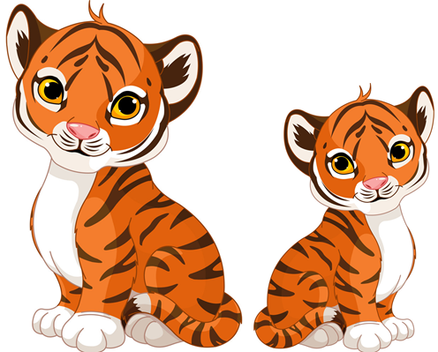
Vocabulary
a
tiger
tigers
/ˈtaɪɡər/
/ˈtaɪɡərz/

Slide 4
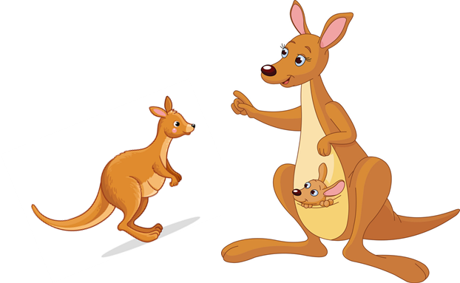
Vocabulary
a
kangaroo
kangaroos
/ˌkæŋɡəˈruː/
/ˌkæŋɡəˈruːz/

Slide 5
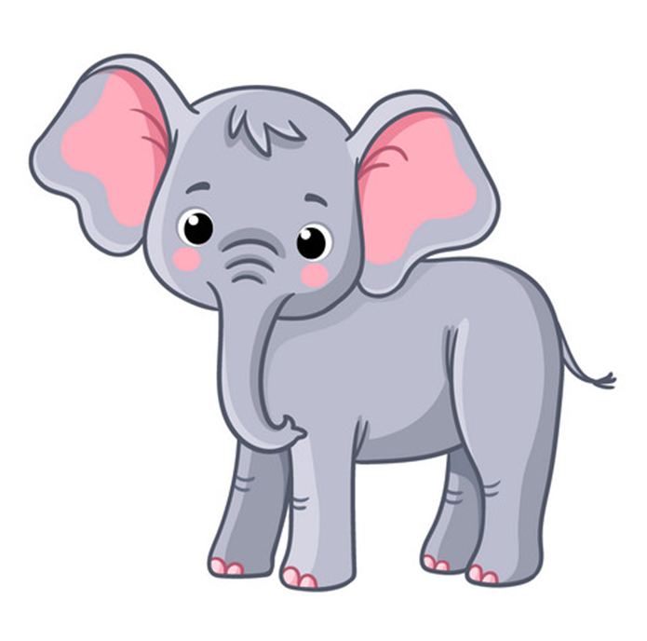
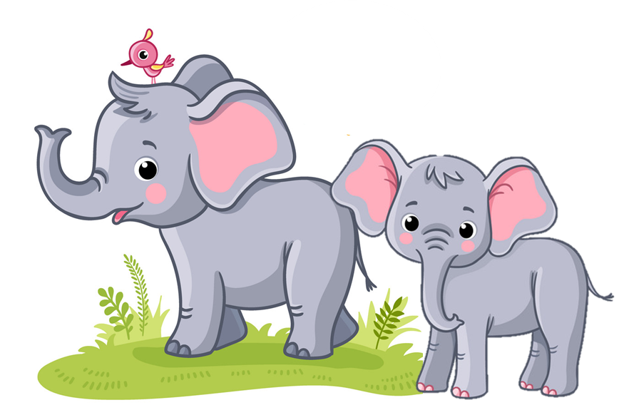
Vocabulary
elephant
elephants
an
/ˈelɪfənt/
/ˈelɪfənts/

Slide 6
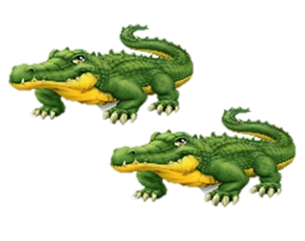
Vocabulary
a
crocodile
crocodiles
/ˈkrɑːkədaɪl/
/ˈkrɑːkədaɪlz/

Slide 7
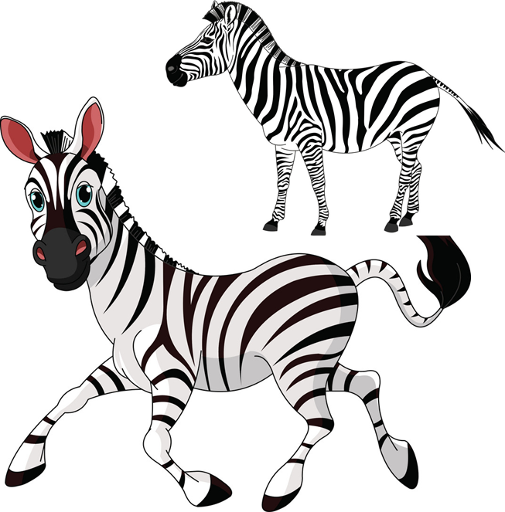
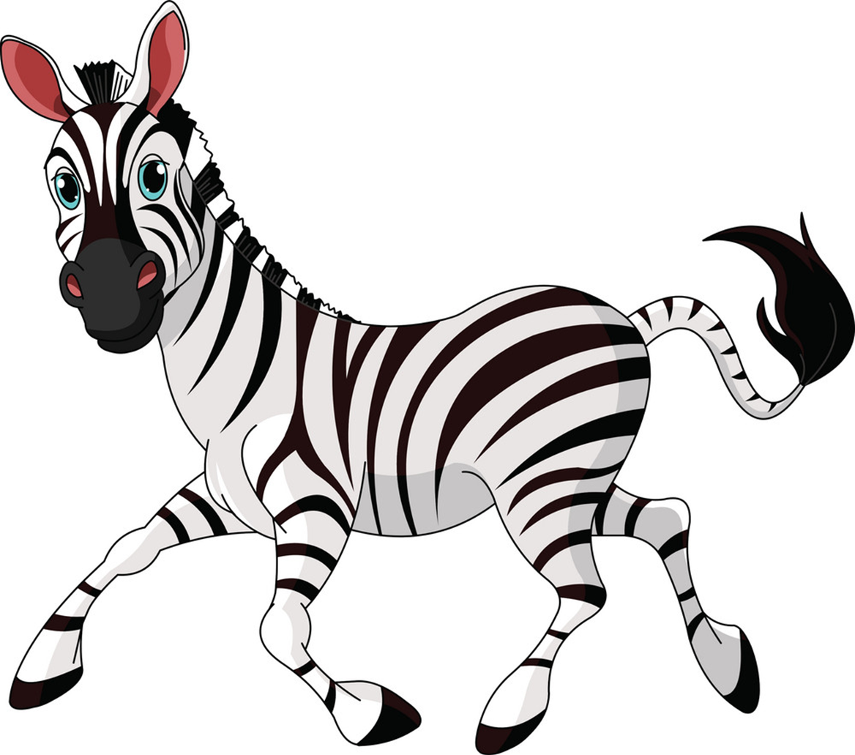
Vocabulary
zebra
zebras
a
/ˈziːbrə/
/ˈziːbrəz/

Slide 8
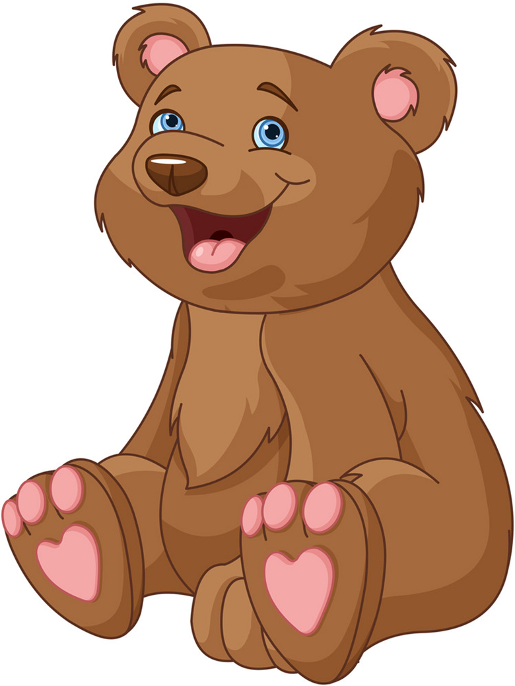
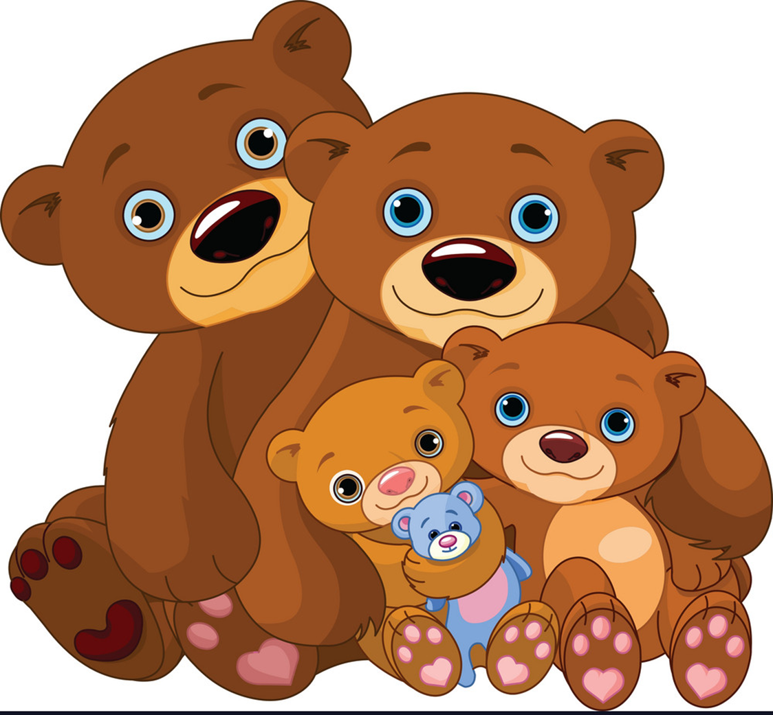
Vocabulary
bear
bears
a
/beər/
/beərz/

Slide 9
Vocabulary
kangaroos
crocodiles
bears
tigers
elephants
zebras

Slide 10
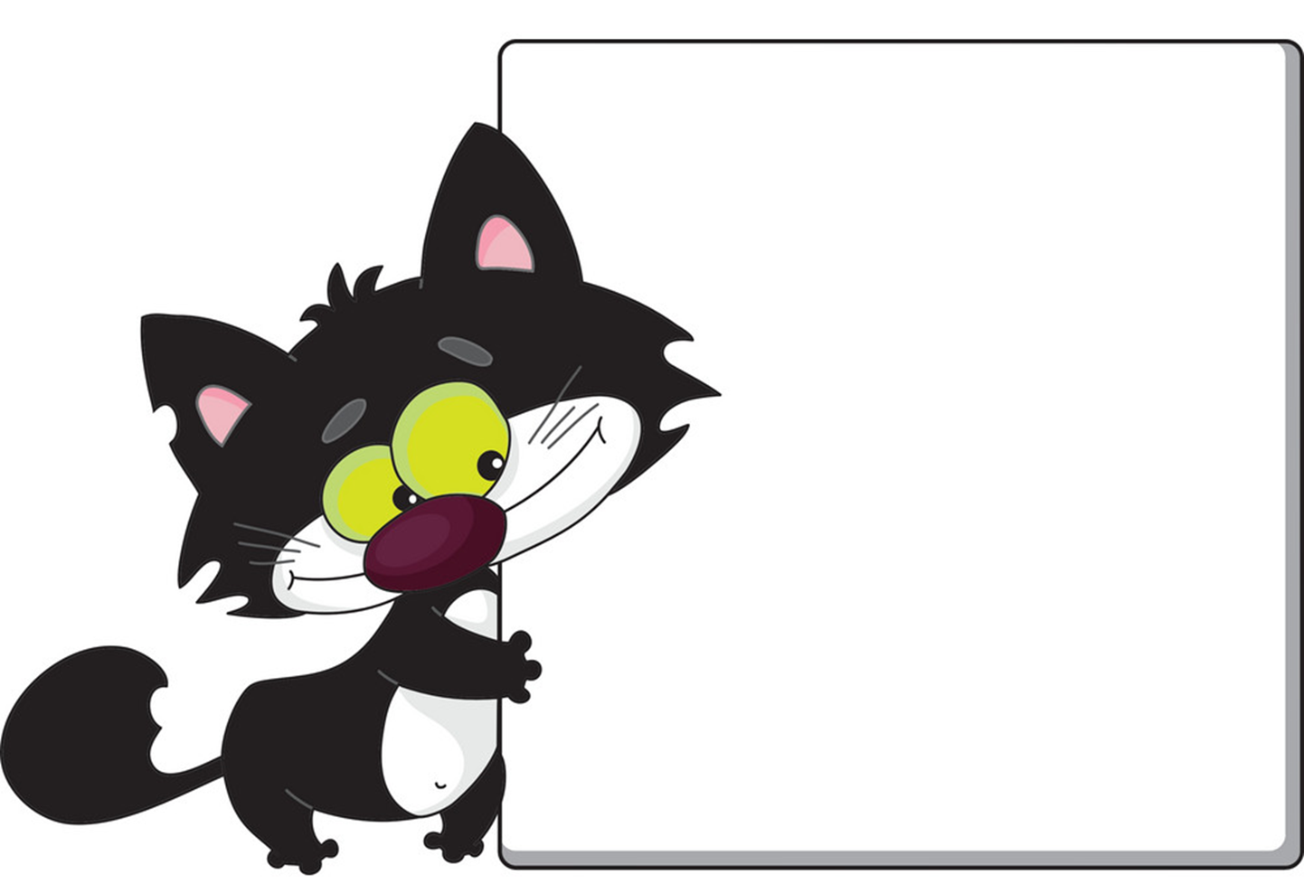
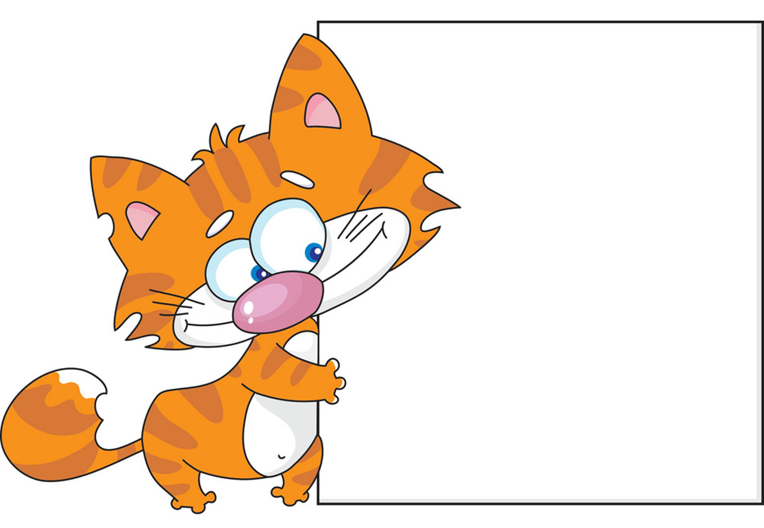
Black
cat
Yellow
cat
&

Slide 11


kangaroos

Slide 12
Crocodiles

Slide 13
Elephants

Slide 14
Bears

Slide 15
Tigers

Slide 16
Zebras

Slide 17
Well
Done

Slide 18
GRAMMAR

Slide 19
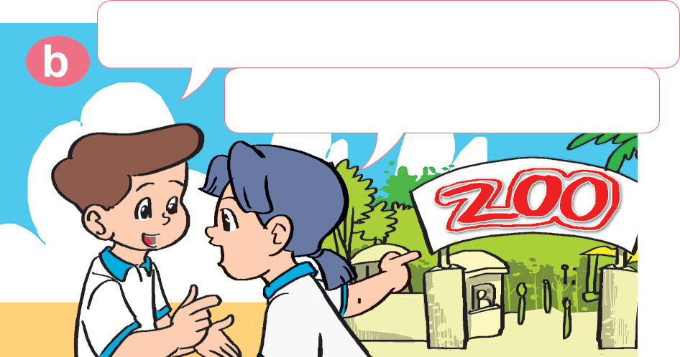
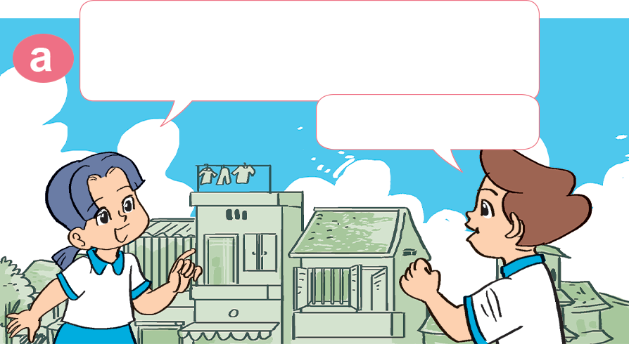

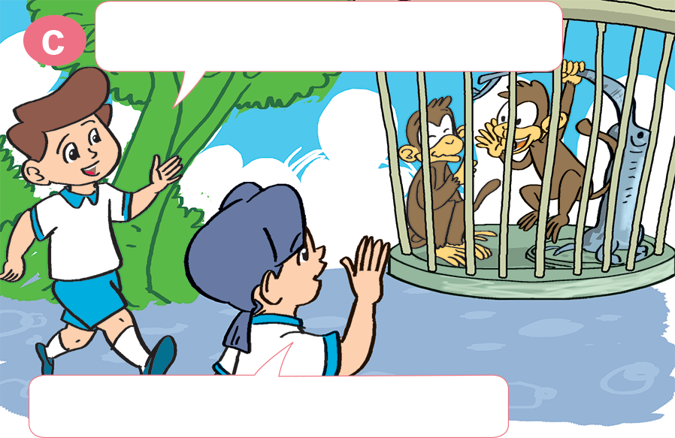
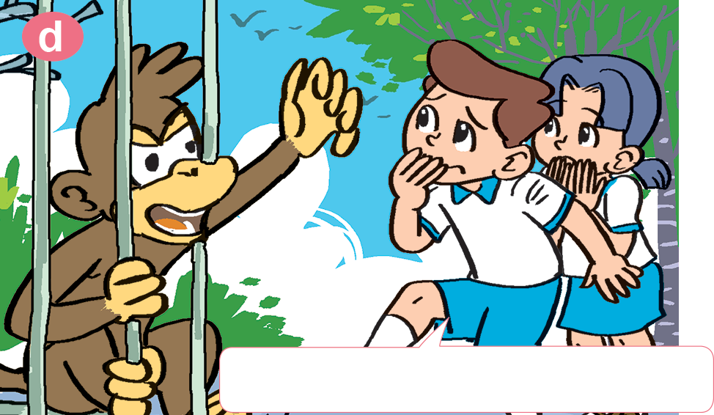
1. Look, listen and repeat.
What animal do you want to see?
The weather's wonderful. Let's go to the zoo.
I want to see monkeys.
Great idea!
Me too. I like monkeys.
OK. Let's go over there.
Oh! Now I don't like them.

Slide 20
2. Point and say.
What animal do you want to see?
I want to see _____________.
kangaroos

Slide 21
2. Point and say.
What animal do you want to see?
I want to see _____________.
tigers

Slide 22
2. Point and say.
What animal do you want to see?
I want to see _____________.
elephants

Slide 23
2. Point and say.
What animal do you want to see?
I want to see _____________.
crocodiles

Slide 24



Unit 19
What animal do you/they want to see?
I/they want to see ______.
tigers
crocodiles
kangaroos
elephants
Ms. Huyền Phạm

Slide 25
Unit 19
What animal does he/she want to see?
He/she wants to see _____.
tigers
crocodiles
kangaroos
elephants
Ms. Huyền Phạm

Slide 26
Game: pass the ball!!!!!

Slide 27


THANK YOU!
Welcome to join with me!

