Slide 1

All teachers and students To English 5
Did you go to
the party?
Unit 4
Lesson 2
Teacher :Bui Thi Hang
Quoc Tuan primary school

Slide 2
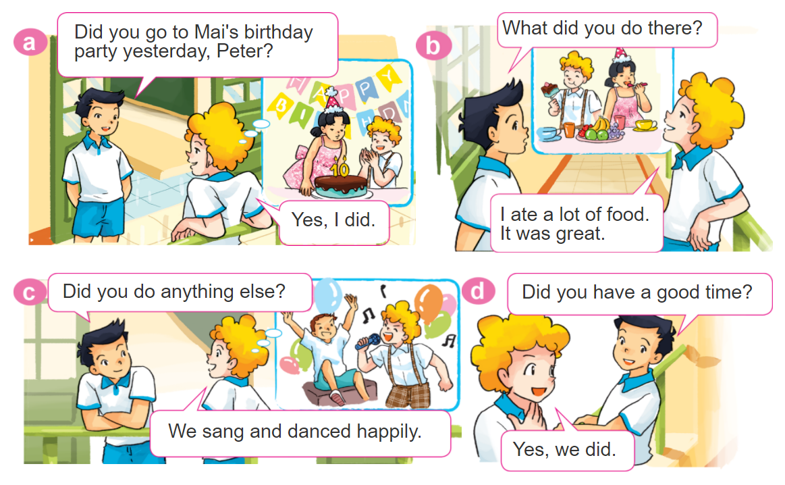

1. Look, listen and repeat.

Slide 3
VOCABULARY

Slide 4
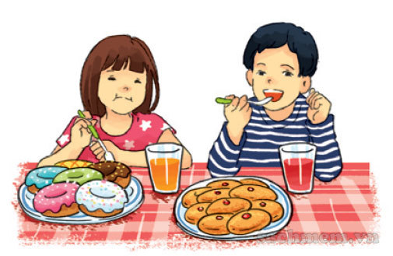
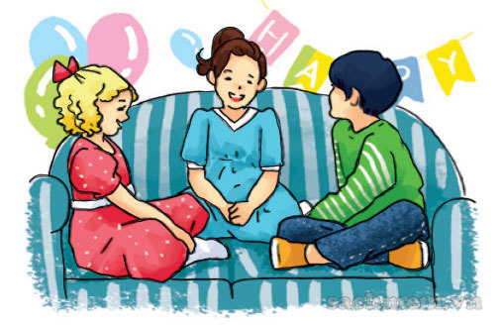
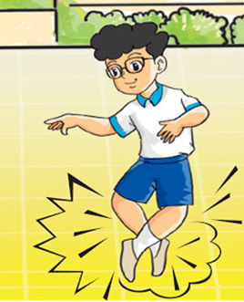
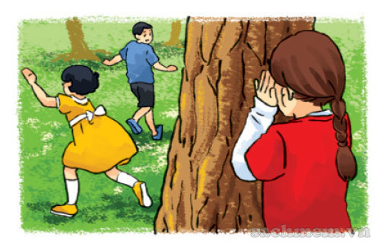
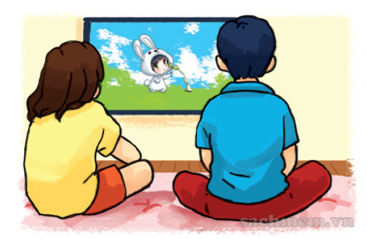
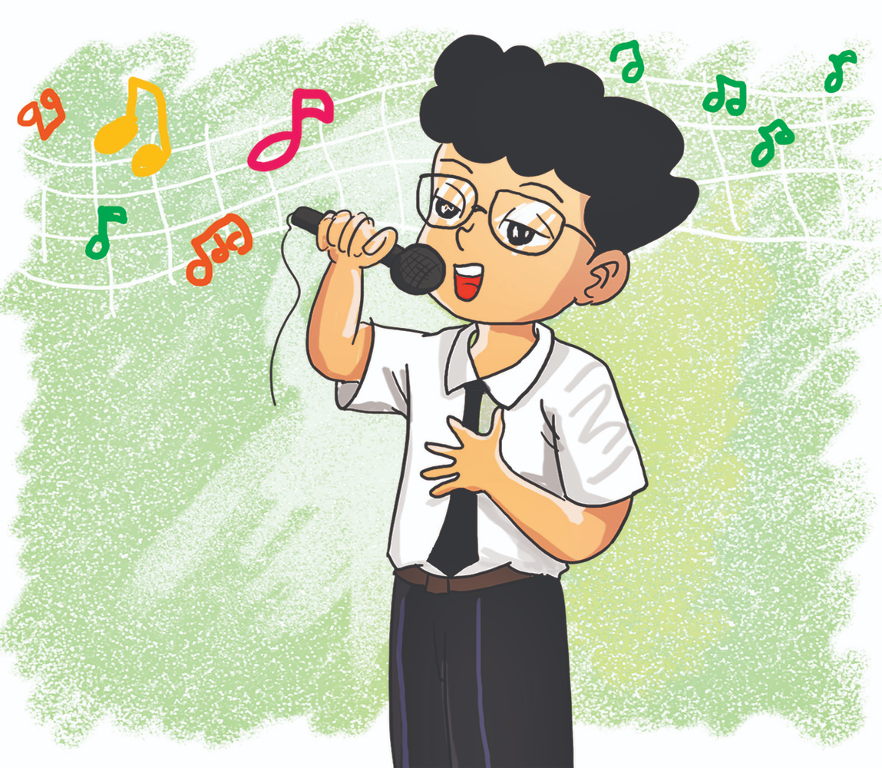
A. Vocabulary
Verd – (v)
eat
- have
chat
dance
ăn
nói chuyện
nhảy
play
watch
sing
chơi
xem
hát

Slide 5




B. Grammar
Cách nói đã làm một hoạt động (Ved/V2):
chat
play
watch
dance
eat / have
sing
nói chuyện
chơi
xem
Nhảy
ăn
Nhảy
chatted
played
watched
danced
ate / had
sang
Đã n.chuyện
đã chơi
Đã xem
Đã nhảy
Đã ăn
Đã hát

Slide 6
GRAMMAR

Slide 7
1. Look, listen and repeat.

Slide 8
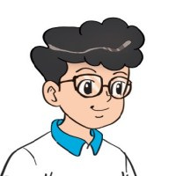
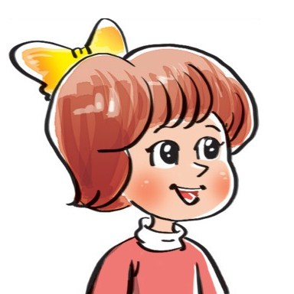
2. Point and say
What did you do at the party?
We ___________.
had nice
food and drink
watched cartoons
played
hide-and-seek
chatted
with friends

Slide 9


B. Grammar
Hỏi và đáp các bạn đã làm gì ở bữa tiệc:
What did you do at the party?
+ Ved/V2
We ________________.
Hỏi và đáp bữa tiệc đã như thế nào?
How was the party (it)?
It was _______.
+ adj

Slide 10


3. Let’s talk
Did you ________?
Yes. I did.
No, I didn't.
How was it?
It was________.
What did you do there?
I/We ____________.

Slide 11
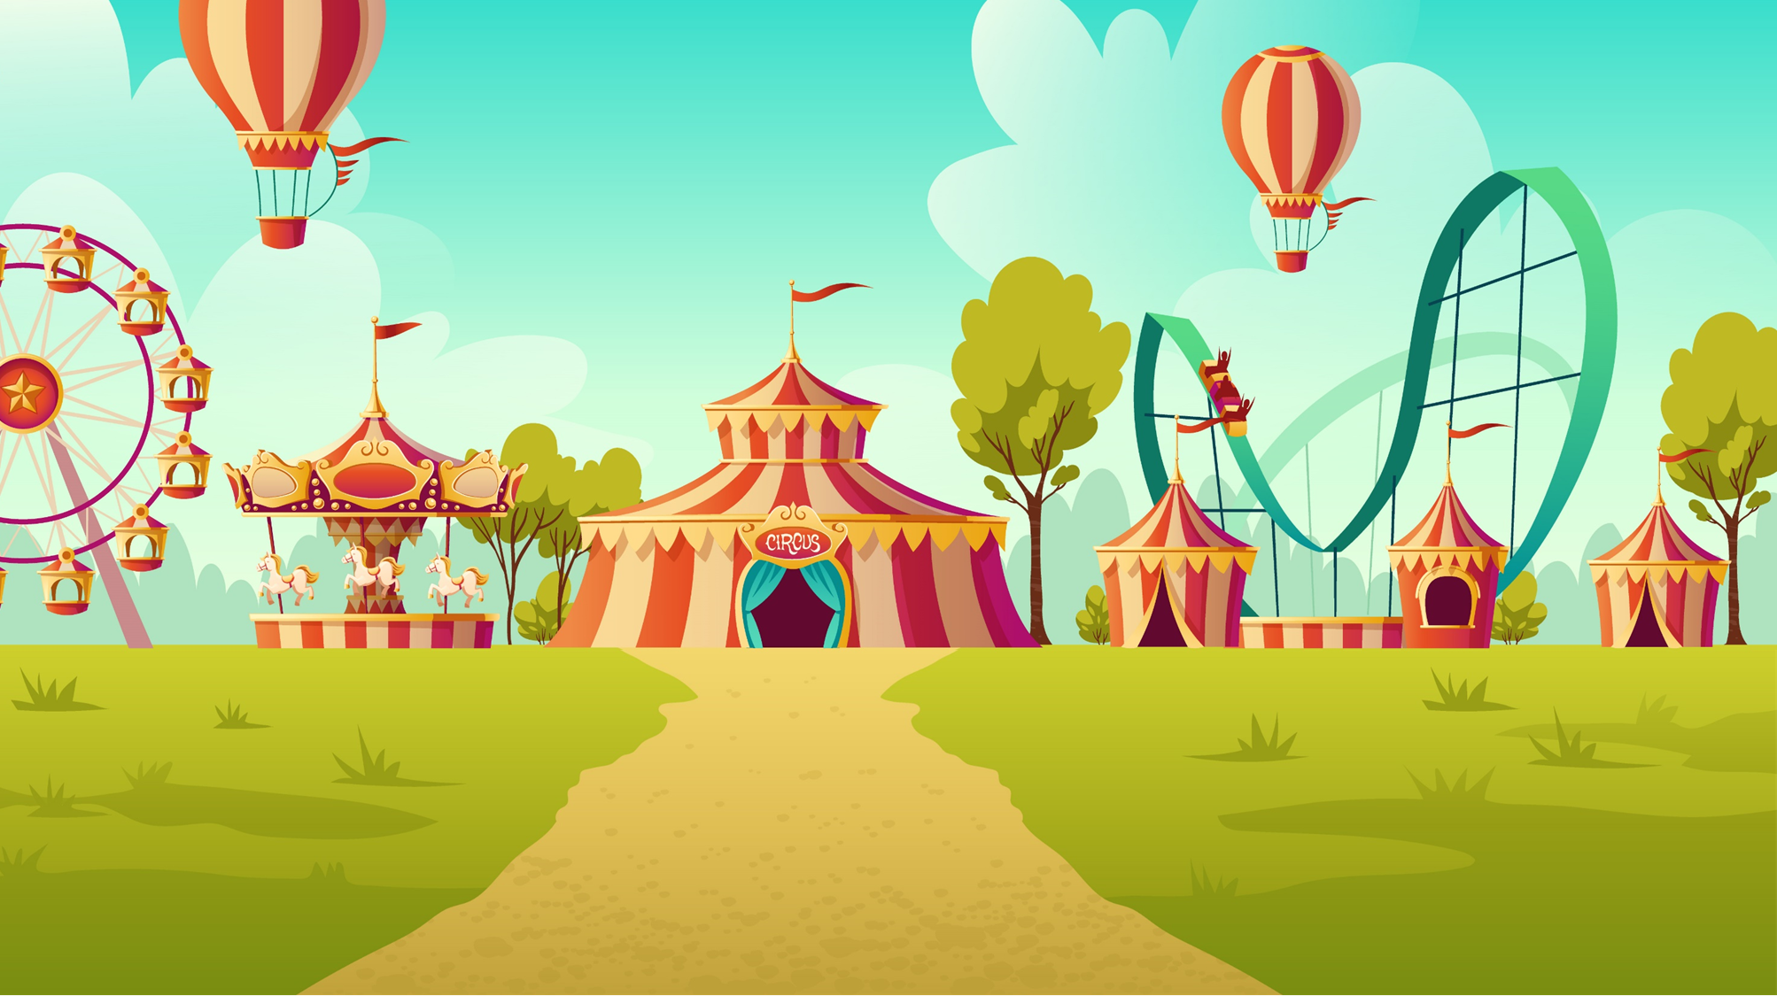
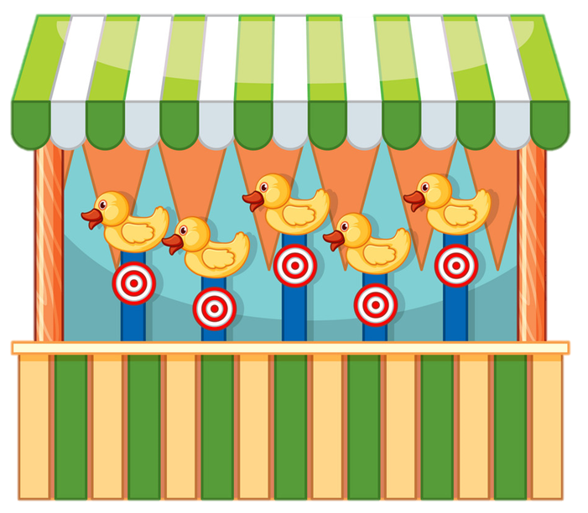

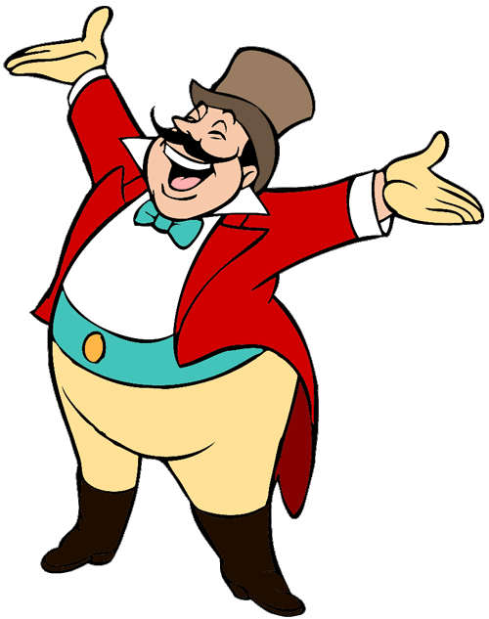
START

Slide 12





What did you do at the party?
We sing many songs.
We sang many songs.
We singed happily.

Slide 13
What did you do at the party?
We chat with my friends.
We chatted with my friends.
We chated with my friends.

Slide 14
What did you do at the party?
We play hide-and-seek.
We plays hide-and-seek.
We played hide-and-seek.

Slide 15
What did you do at the party?
We had nice food and drink.
We have nice food and drink.
We eat nice food and drink.
Next

Slide 16
What did you do at the party?
We dances happily.
We dance happily.
We danced happily.

Slide 17
What did you do at the party?
We watched cartoon.
We watch cartoon.
We watches cartoon.
Next

Slide 18
What ___ you do at the party?
We had nice food and drink.
do
did
was

Slide 19
What did you ____
at the party?
was
did
do

Slide 20


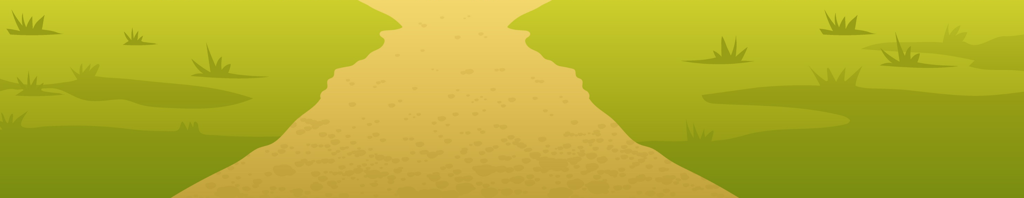

Ms Huyền Phạm
0936.082.789

Slide 21


THANK YOU!
Welcome to join with me!

