Slide 1


Welcome to our class
Quoc Tuan Primary School
Teacher: Dao Thi Lieu
English 3
5/10/2023
Võ Thị Thoa

Slide 2


Slide 3



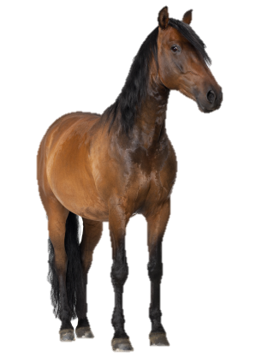
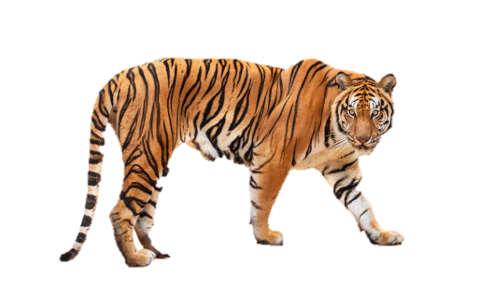


At the zoo
20
LESSON 1
Period 1

Slide 4












1
Warm-up and review

Slide 5
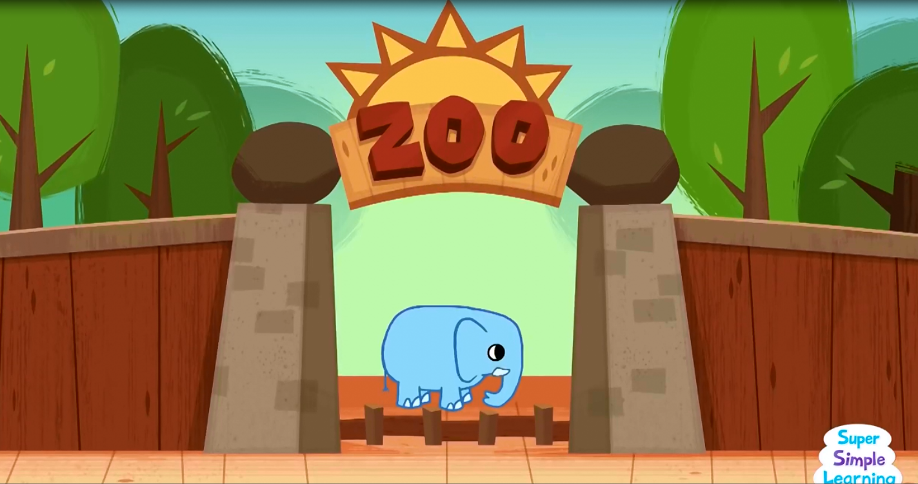
Notes:
Option 1: Sing a “At the zoo” song
https://www.youtube.com/watch?v=OwRmivbNgQk

Slide 6

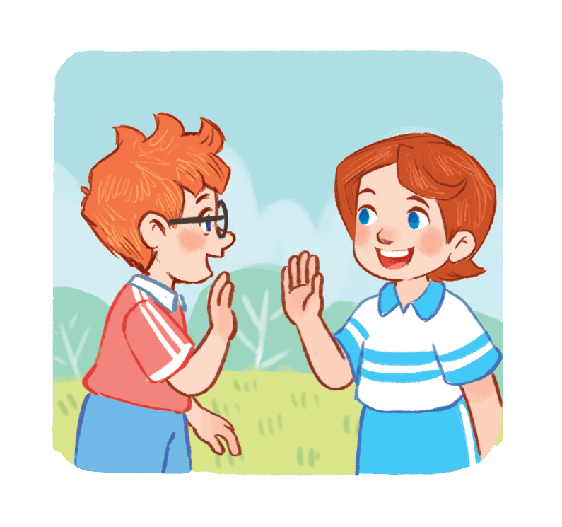
What’s your favourite animal?
I like....
Notes:
Option 2: Ask pupils if they have ever been to the zoo and what animals they saw. (Pupils can show their pictures at the zoo if they want). Then introduce the animal names and key expressions for the lesson.

Slide 7
2
Look,listen and repeat.

Slide 8
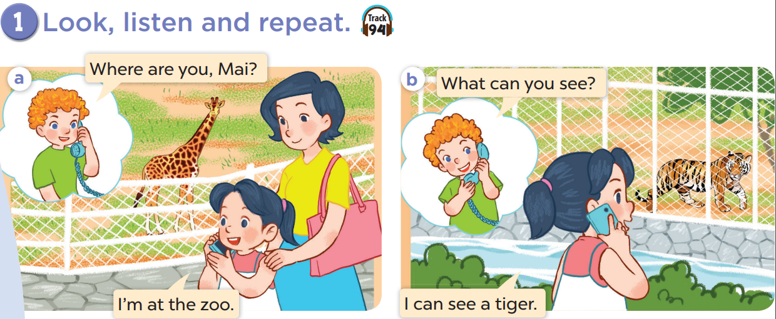


Slide 10
3
Listen, point and say.

Slide 11
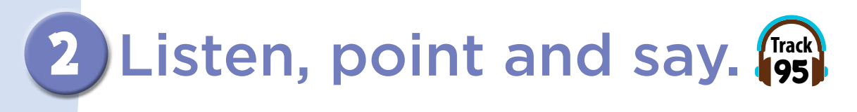
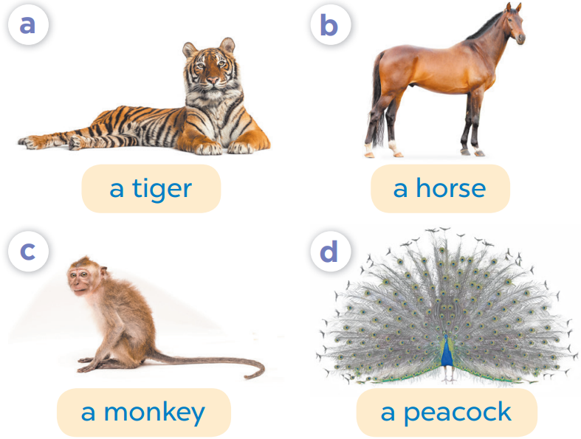
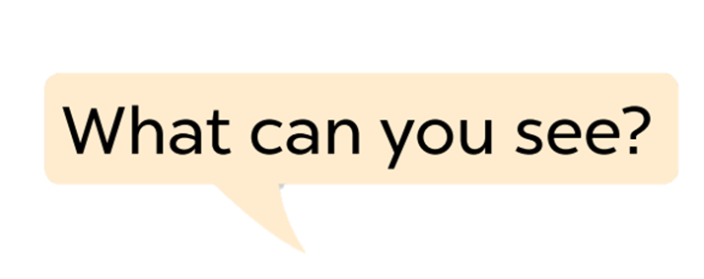

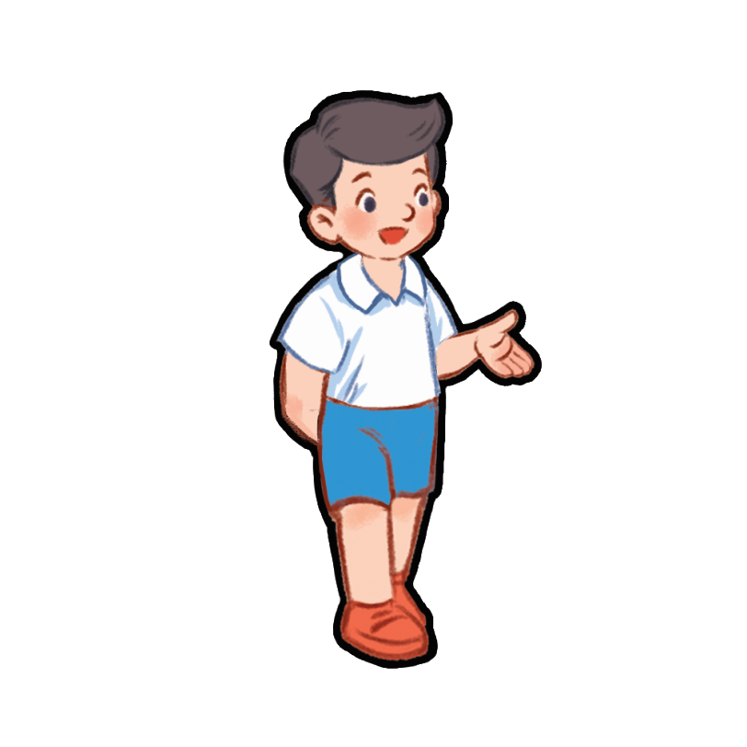
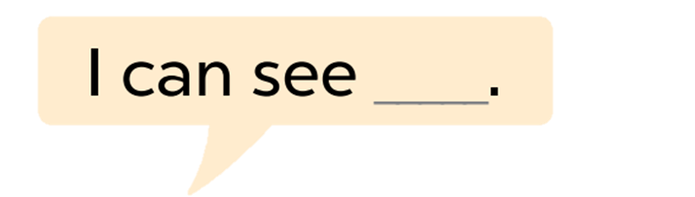

Slide 12
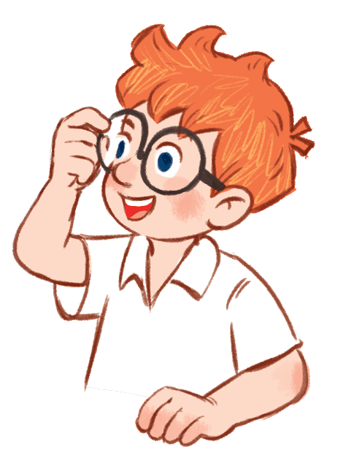
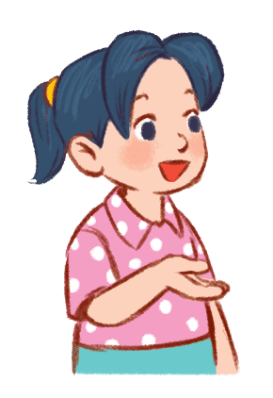
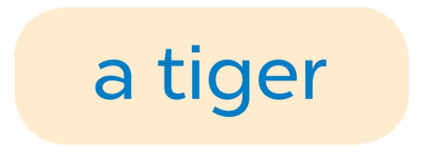

Slide 13
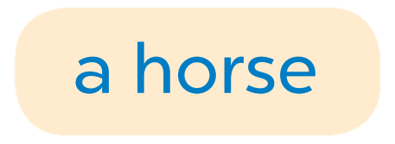

Slide 14
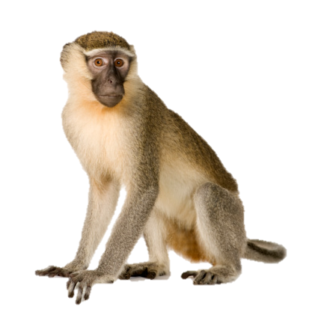
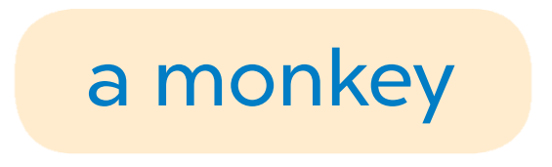

Slide 15
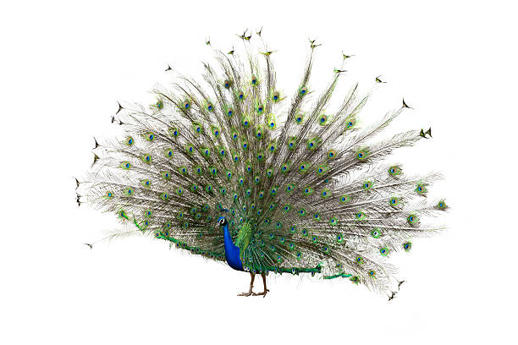


Slide 16
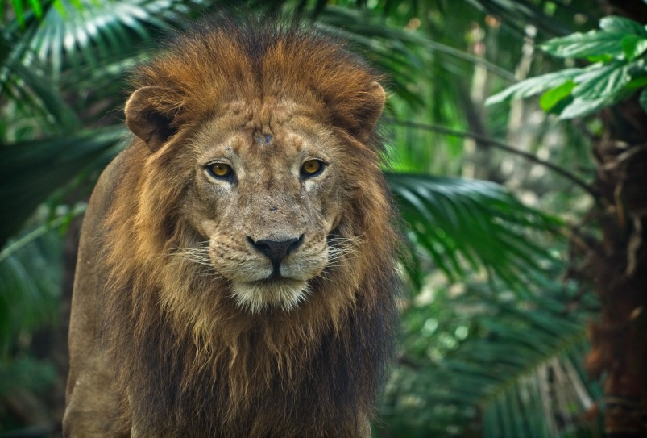
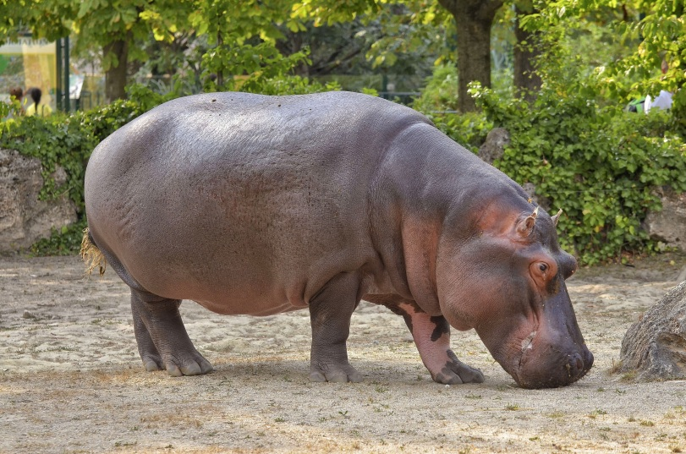
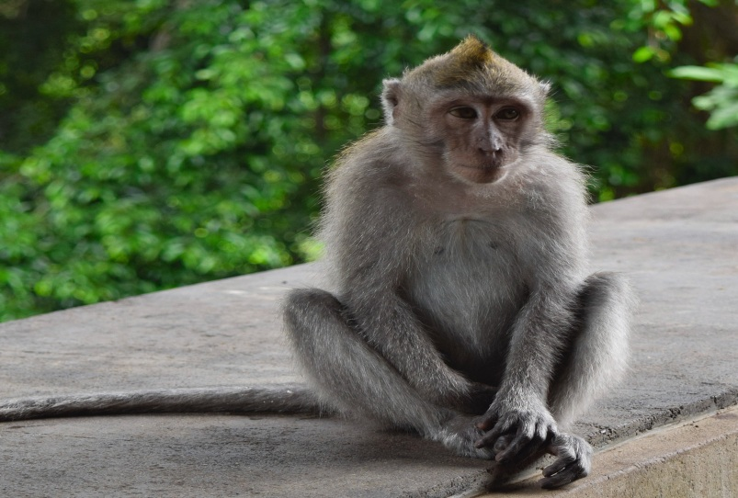
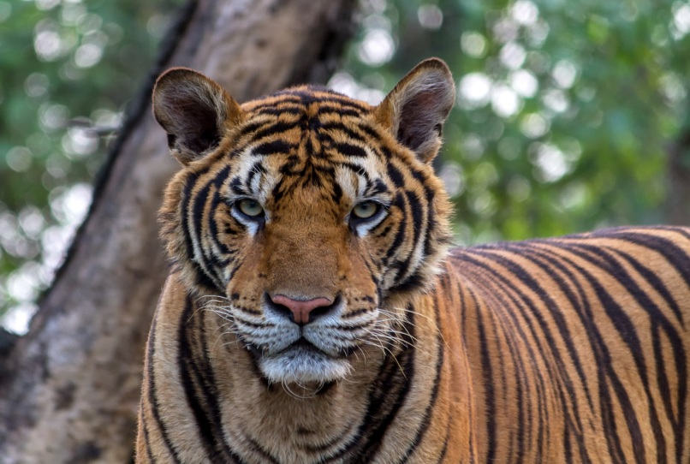
Listen and choose.
A
B
C
D
Notes:
Mini game: Listen and choose
Teacher asks pupils to listen carefully, then choose the correct answer. Write it on the board.
Key: D

Slide 17
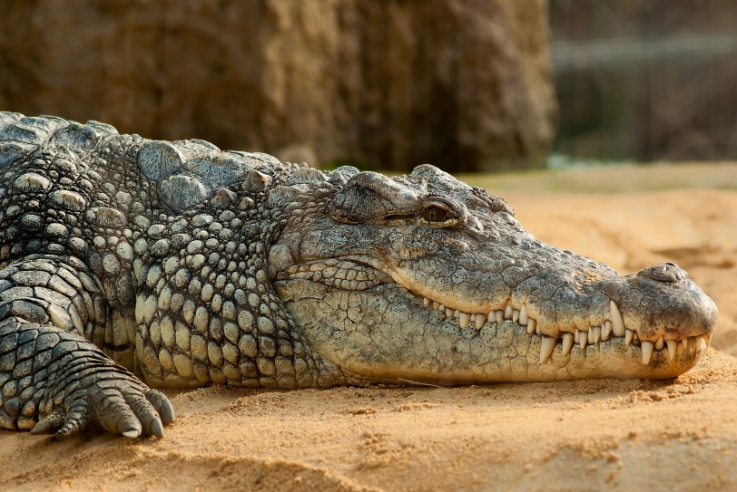
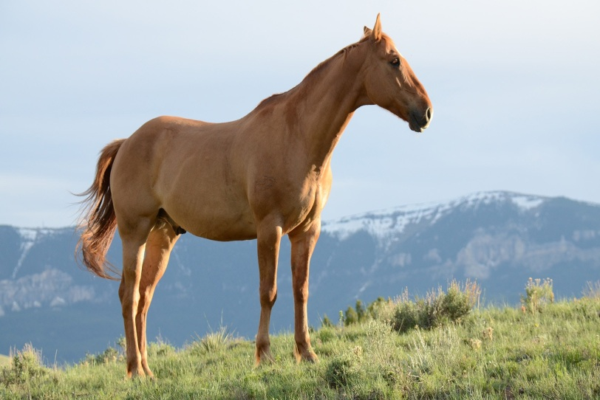
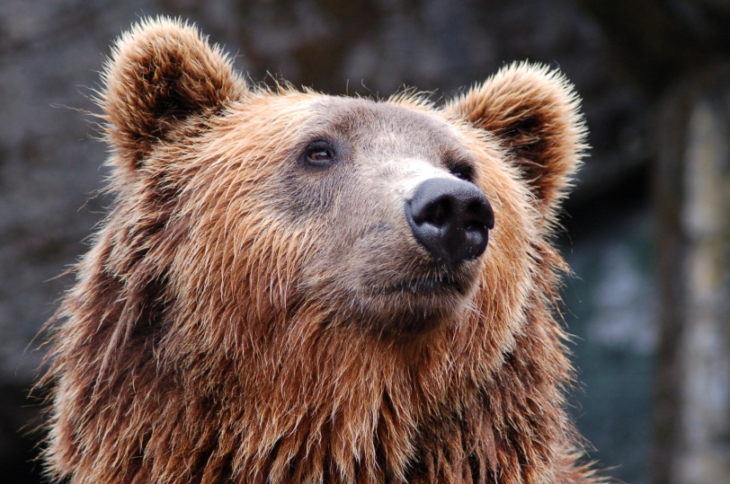
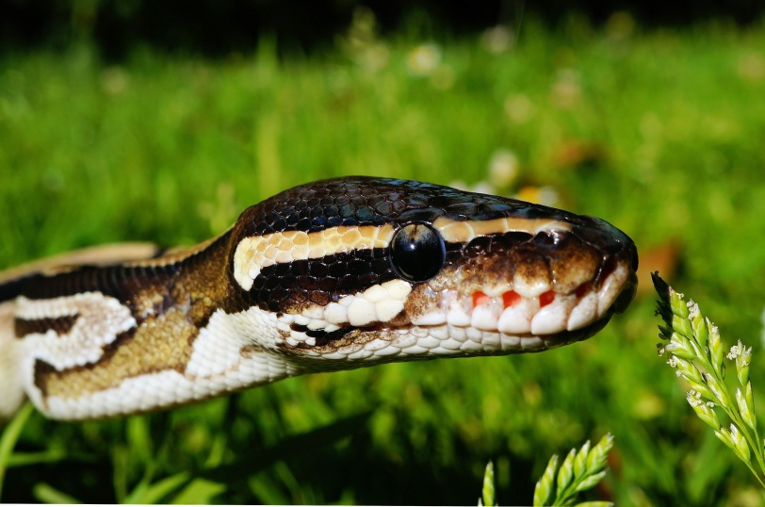
Listen and choose.
A
B
C
D
Notes:
Key: B

Slide 18
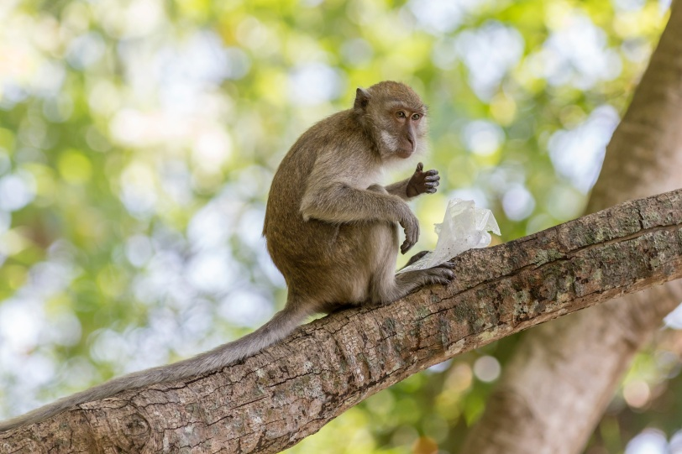
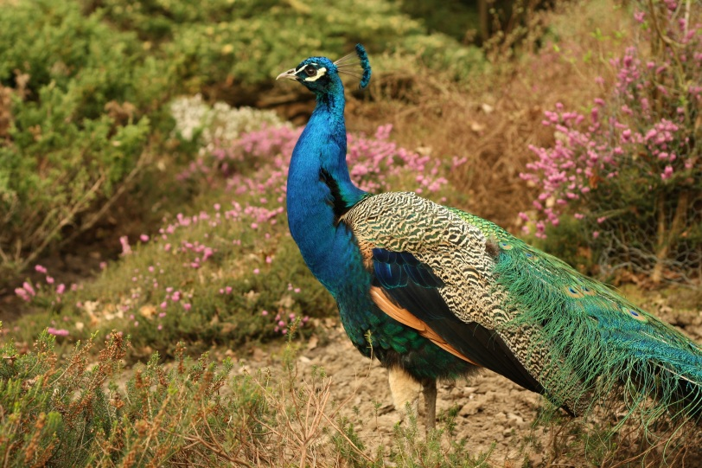
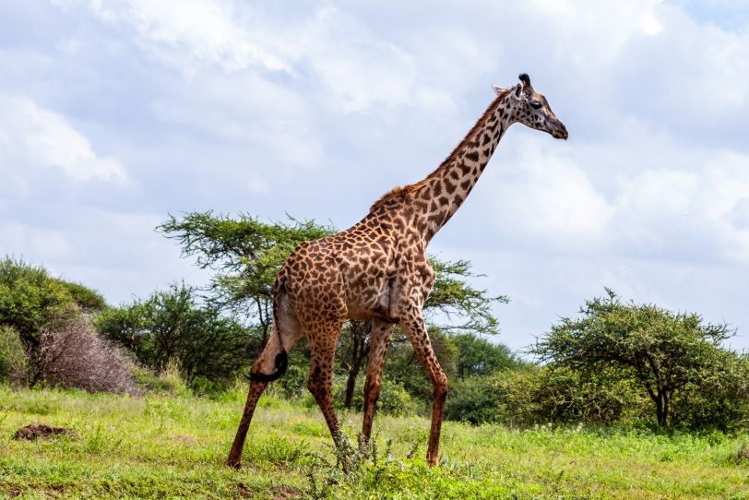
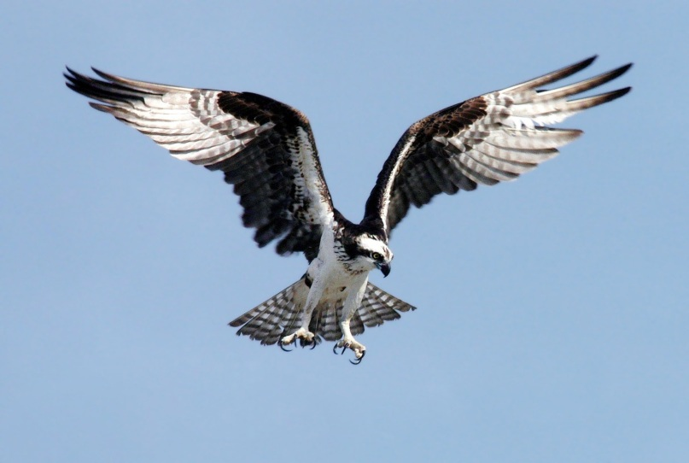
Listen and choose.
A
B
C
D
Notes:
Key: A

Slide 19
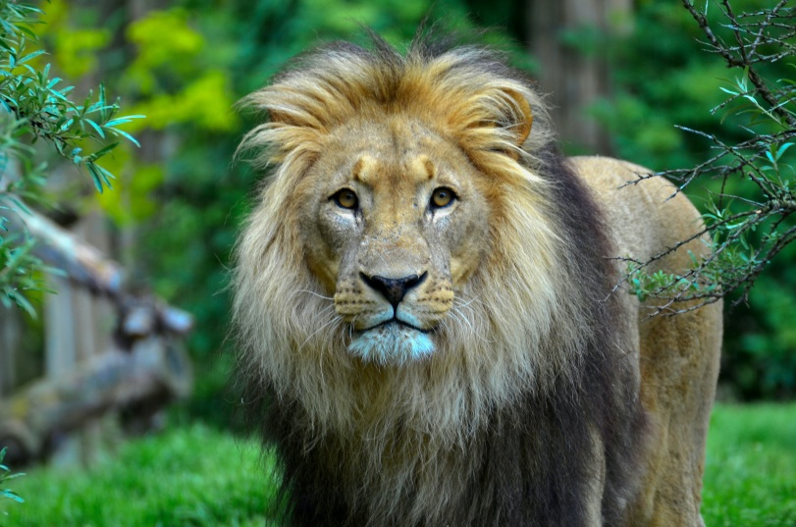
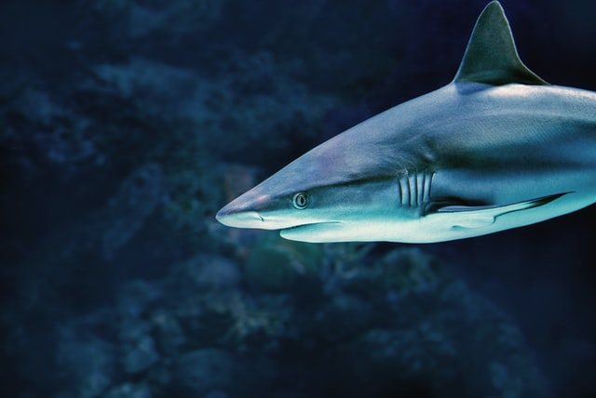
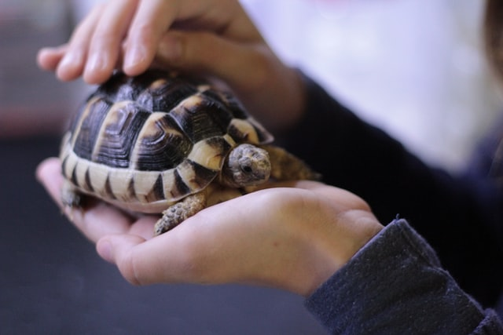
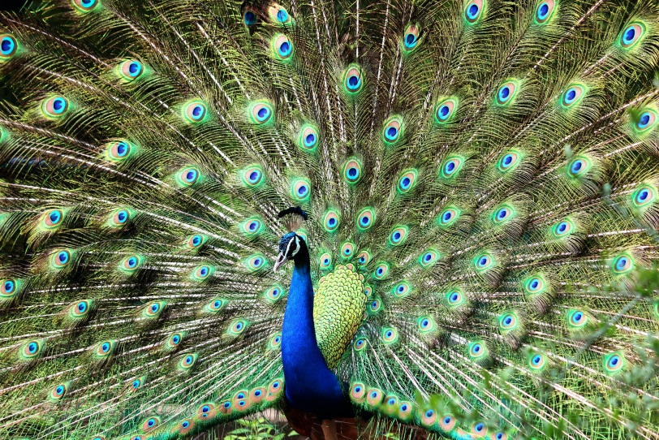
Listen and choose.
A
B
C
D
Notes:
Key: D

Slide 20
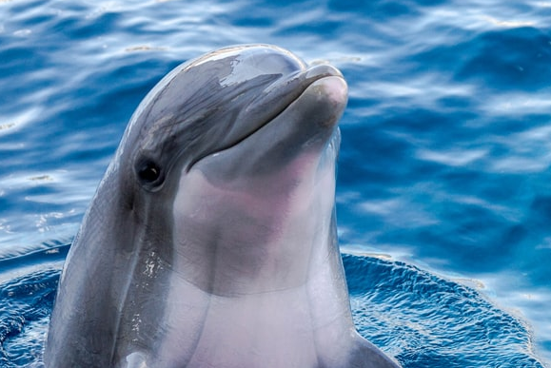
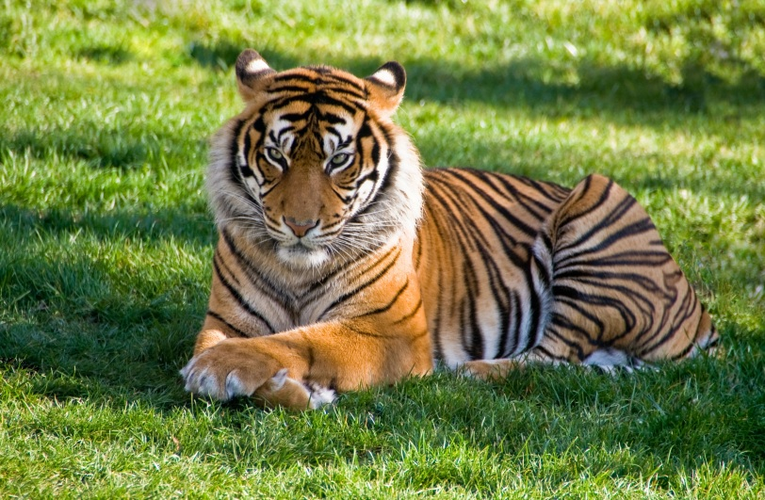
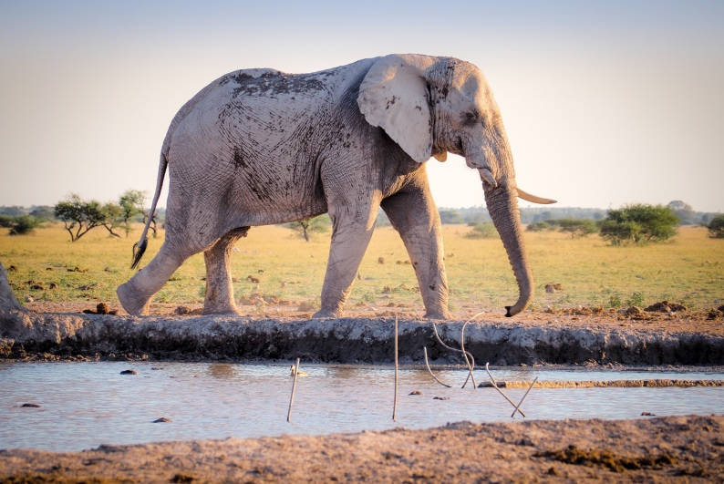
Listen and choose.
A
B
C
D
Notes:
Key: C

Slide 21
4
Let’s talk!

Slide 22

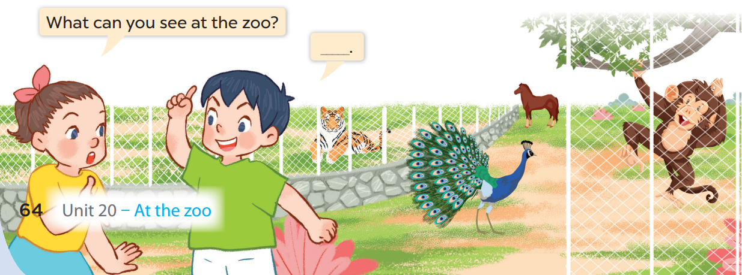




Slide 23
I can see a monkey and a tiger.

Slide 24
I can see a horse and a peacock.

Slide 25
5
Fun corner
and wrap-up

Slide 26



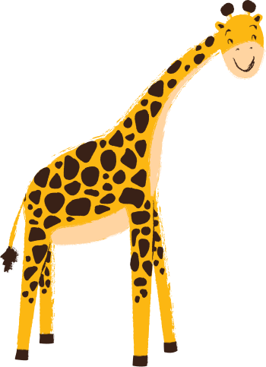










Notes:
Game: Animal sounds
Ask pupils to listen to the sound carefully, then guess the animal’s name.
Teacher: What do you hear?
Pupils: It’s a ______

Slide 27
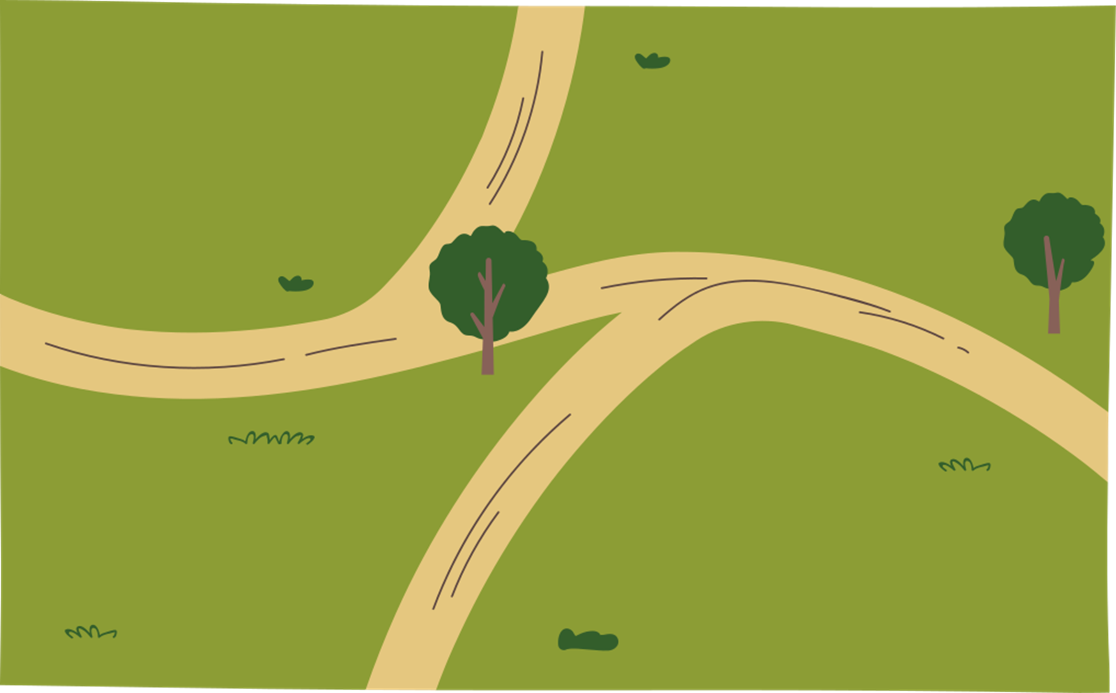

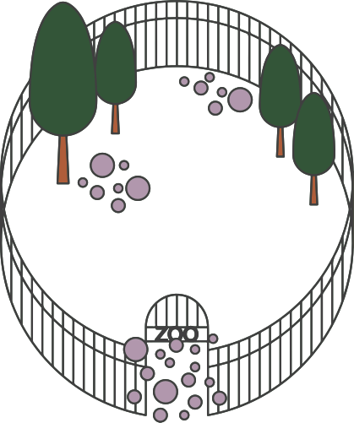



1
2
3
4

Slide 28

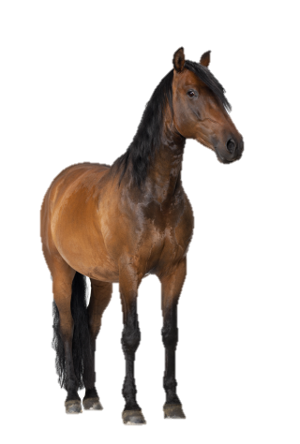
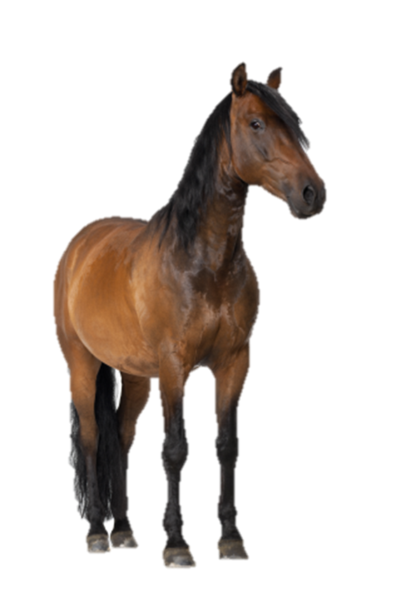

1
horse

Slide 29

2
tiger

Slide 30
3
monkey

Slide 31
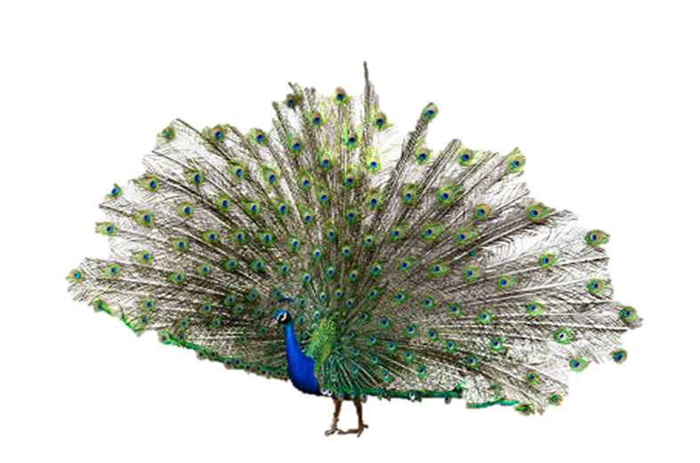
4
peacock

Slide 32



Thank you very much
Good bye! See you again!

