Slide 1


Welcome to our class
Quoc Tuan Primary School
Teacher: Dao Thi Lieu
English 3
5/13/2023
Võ Thị Thoa

Slide 2


Slide 3



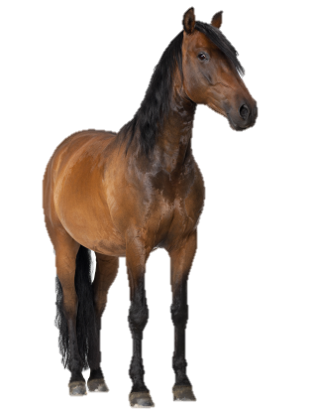
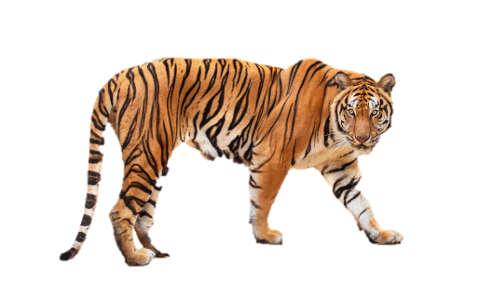


At the zoo
20
LESSON 1
Period 2

Slide 4












1
Warm-up and review

Slide 5
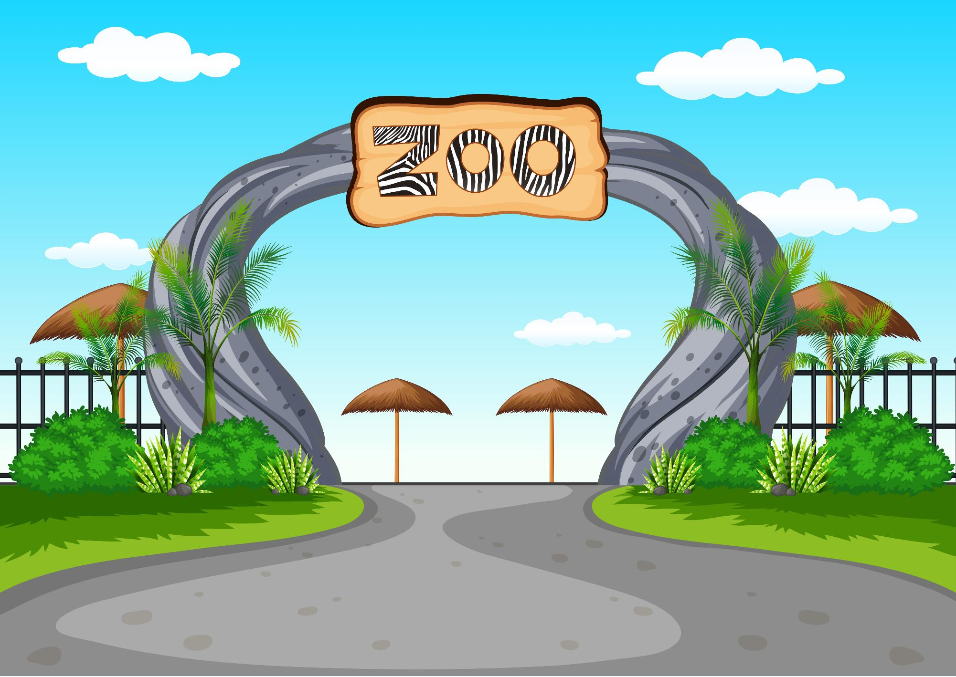

d
j
Excellent!
tiger
lion
a ___________
Notes:
Game: Choose the correct word.
- Ask pupils to look at the picture, then choose the correct name of the animals.
- Ask them to write the answer on their mini board.

Slide 6
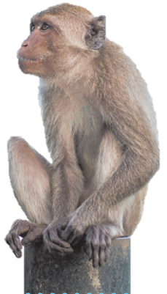
Excellent!
parrot
monkey
a ___________

Slide 7
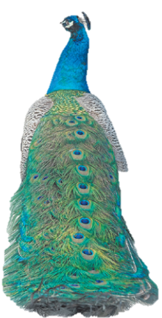
Excellent!
peacock
panda
a ____________

Slide 8
Excellent!
horse
chicken
a ___________

Slide 9
2
Listen and number.

Slide 10
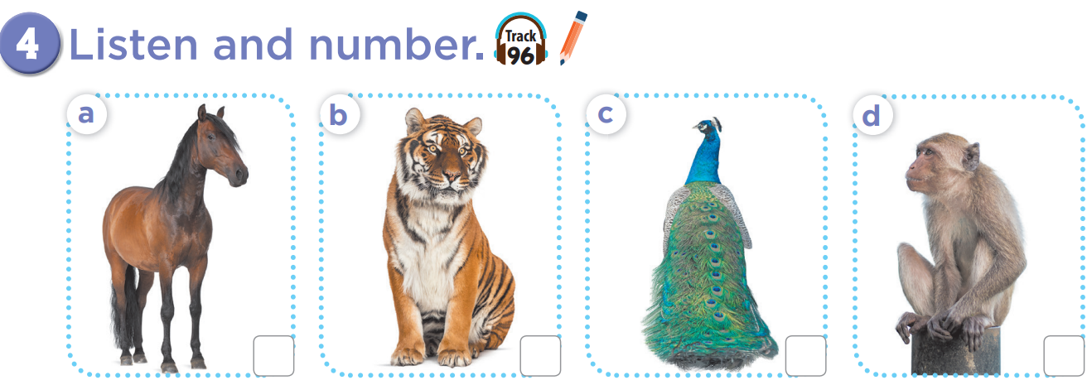
2
3
4
1
Notes:
Key: 1. d 2. a 3. b 4. c

Slide 11
Listen and write.
1
2
3
4
Notes:
Listen and write.
Ask pupils to listen carefully and write the correct names of animals on their mini boards/notebooks. This can be played in groups.

Slide 12
Listen and write.
1
monkey
2
horse
3
tiger
4
peacock
Notes:
Listen and write.
Ask pupils to listen carefully and write the correct name of animal.

Slide 13
3
Look, complete and read.

Slide 14
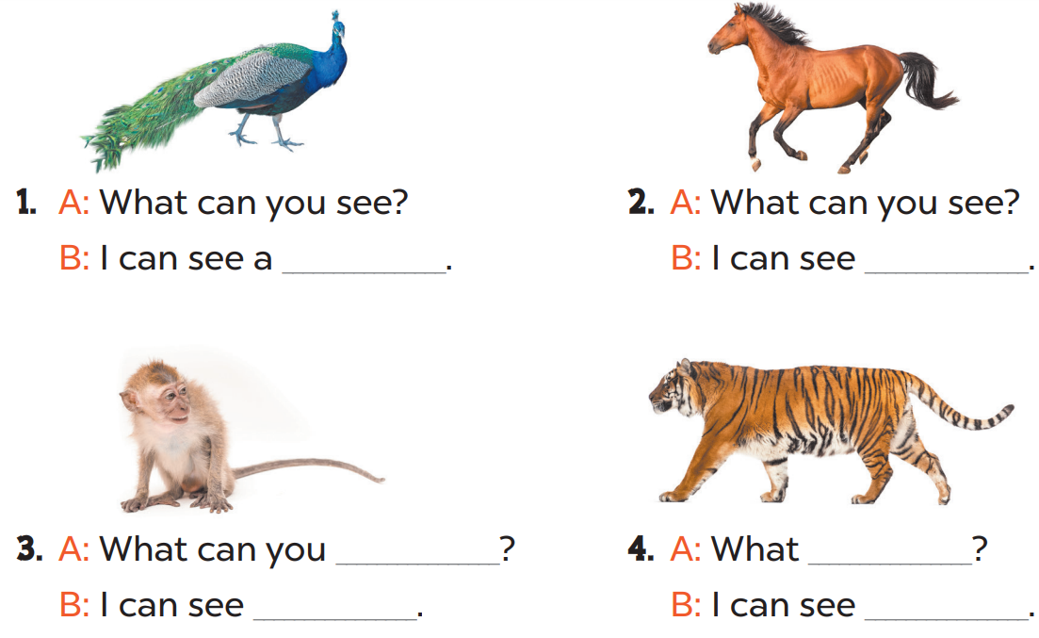

Slide 15
What can you see?
Notes:
Divide the class into 2 - 4 groups. Each group has a small board, look at the picture then write what they can see there. There are some letters for them to unscramble. The fastest pupils to finish will get points for their group.

Slide 16

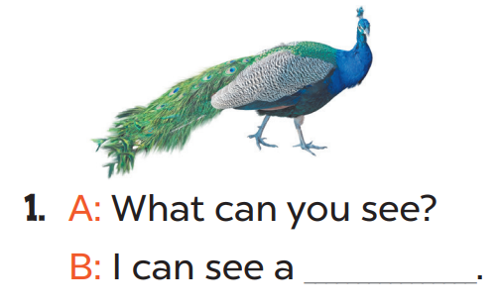

e o p
a c c k
+3
+3
peacock

Slide 17
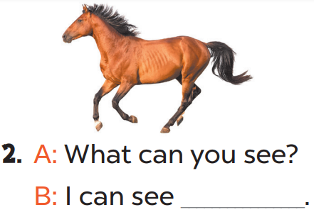
o h r
e s
+3
+3
a horse

Slide 18
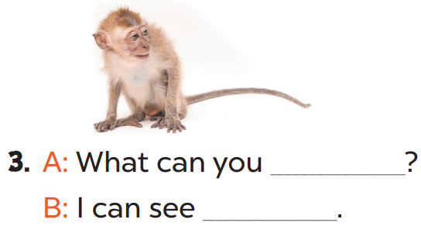
m k o y e n
+2
+2
see
a monkey

Slide 19
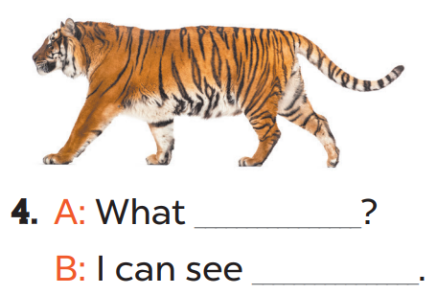
o h r
e s
+2
+2
can you see
a tiger

Slide 20
peacock
a horse
see
can you see?
a monkey
a tiger
Notes:
Key: 1. peacock 2. a horse 3. see; a monkey 4. can you see; a tiger

Slide 21
4
Let’s play.

Slide 22
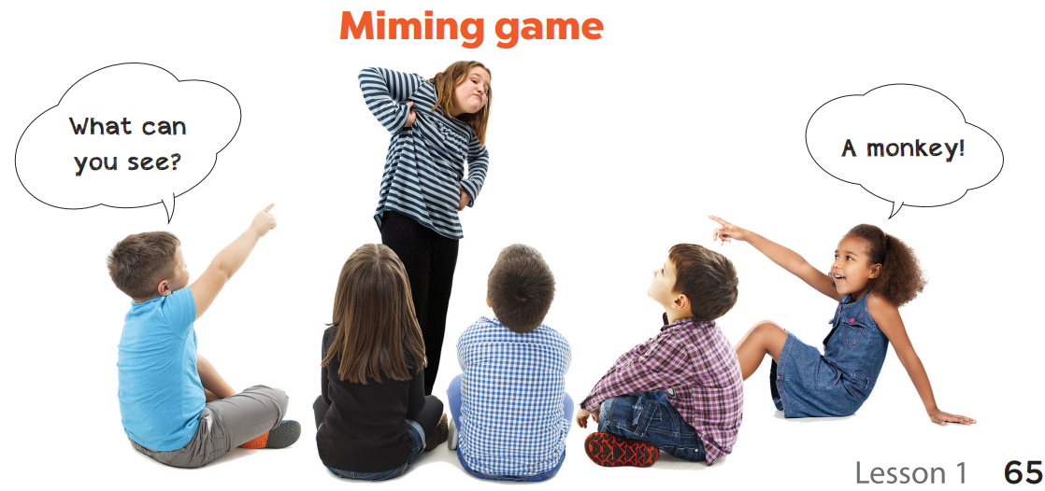

Slide 23
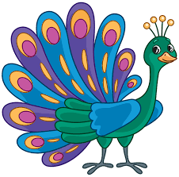
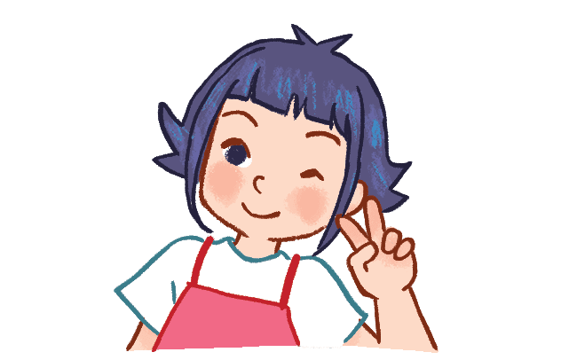
peacock

Slide 24


tiger

Slide 25
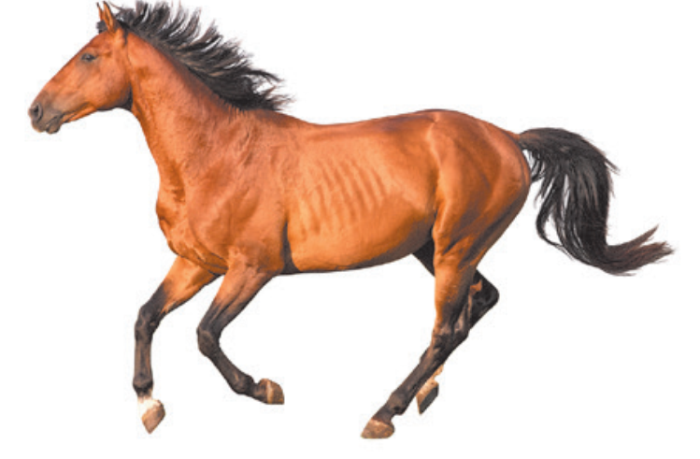
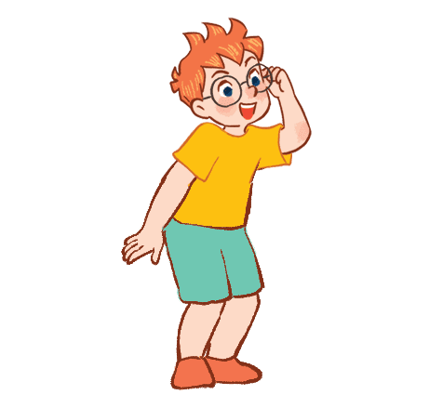
horse

Slide 26
5
Fun corner
and wrap-up

Slide 27
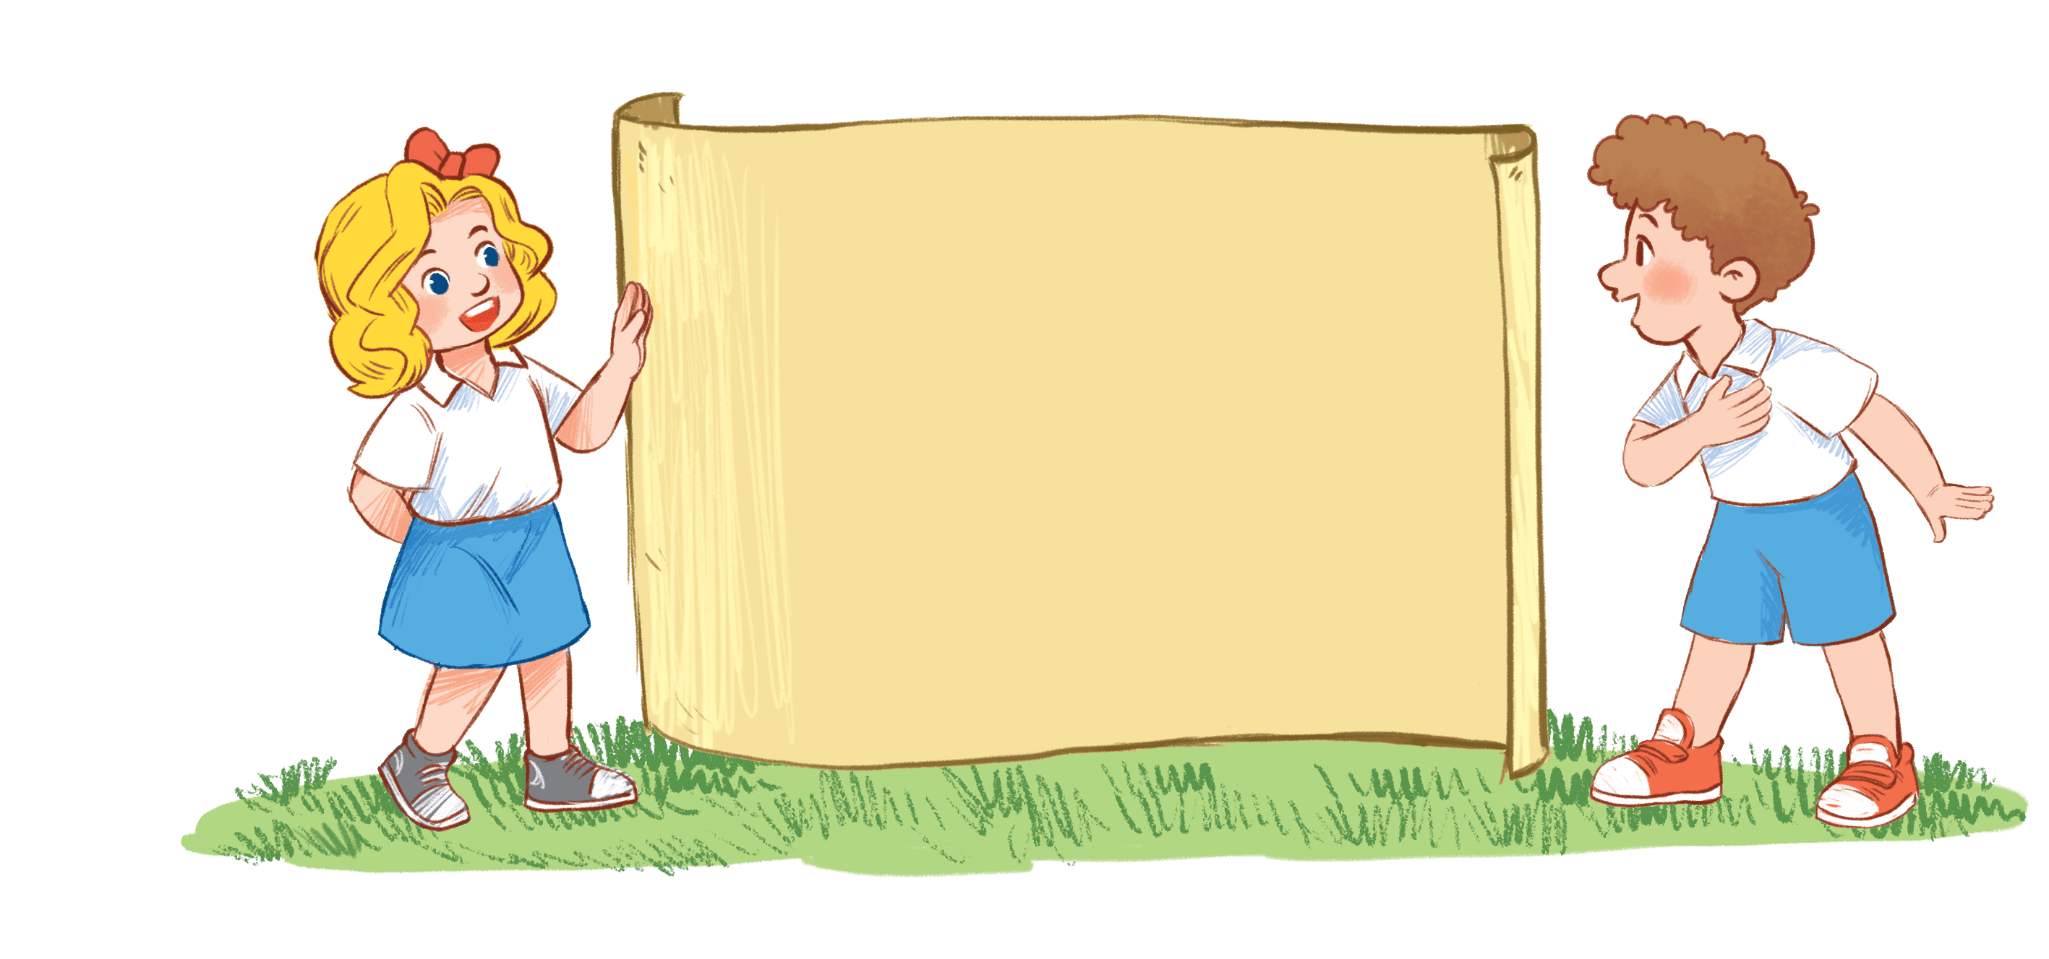

Tic tac toe
Notes:
Game: Tic tac toe
- Divide the class into 2 groups. (Group 1 is X, Group 2 is O.)
Teacher uses flashcards to ask:
+ What can you see?
+ Pupils act out the animal on the card.
+ Make the sound of an animal.
- Pupils in each group have to listen to the question from the teacher, then answer/do correctly.
- The first player to get 3 of the marks in a row (up, down, across, or diagonally) is the winner.

Slide 28

a horse!
a horse!

Slide 29

a tiger!
a tiger!

Slide 30
a peacock!
a peacock!

Slide 31
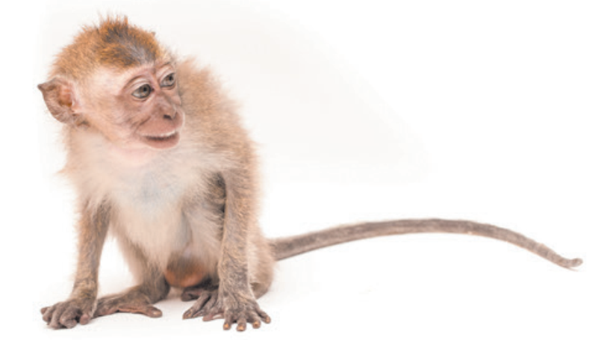
a monkey!
a monkey!

Slide 32

X
O
1
X
O
2
X
O
3
X
O
4
X
O
5
X
O
6
X
O
7
X
O
8
X
O
9
PLAY AGAIN
Notes:
Click once to reveal a circle.
Click again to reveal a cross.
Click once more to show the box number again.
Click play again to reset the board.

Slide 33



Thank you very much
Good bye! See you again!

