Slide 1


All teachers and students To English 4
unit 11:What time is it?
lesson 1 : Part 1,2/6
Teacher :Bui Thi Hang
Quoc Tuan primary school

Slide 2








25
Eleven
Twelve
Fifteen
Twenty
Twenty- five
Thirty
35
45
Forty- five
Fifty
Fifty- five
Thirty- five
Forty

Slide 3
PLAY A GAME

Slide 4




Slide 5











are
a. Thirteen b. Twelve
c. Eleven
a
b
c

Slide 6
old
a. Twoteen b. twelve
c. Twenty
a
b
c

Slide 7
you
a. Fifteen b. Fourteen
c. Fiveteen
a
b
c

Slide 8
old
25
a. Thirty b. Twenty-five
c. Twenty
a
b
c

Slide 9
are
a. Thirteen b. Twelve
c. Thirty
a
b
c

Slide 10
you
45
a. Forty-five b. Fourteen
c. Fourty
a
b
c

Slide 11
are
a. Twelve b. Twenteen
c. Twenty
a
b
c

Slide 12
old
a. Fourty b. Forty
c. Fourteen
a
b
c

Slide 13
you
a. Fifty b. Fivety
c. Fifteen
a
b
c

Slide 14
are
35
a. thirty-two b. thirteen
c. thirty-five
a
b
c

Slide 15
old
a. Fifty b. Fifty-five
c. Fifteen
a
b
c

Slide 16


GOOD JOB!
STOP

Slide 17
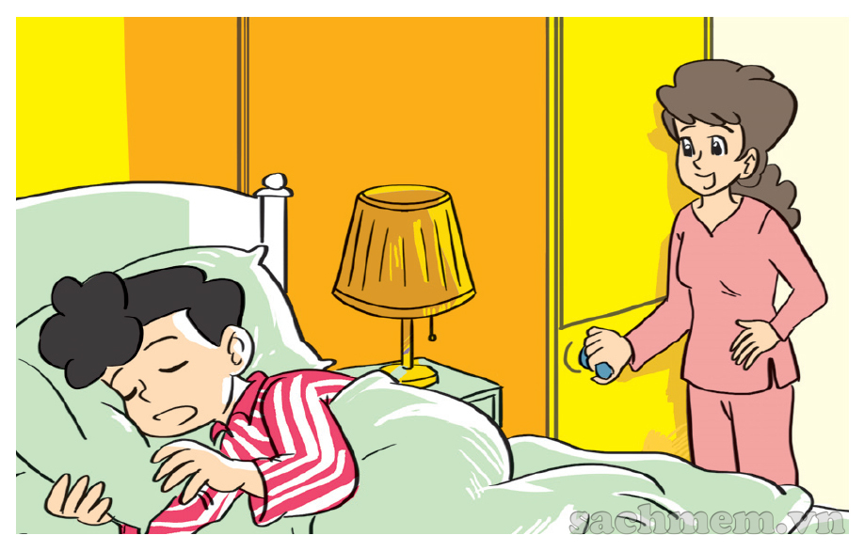
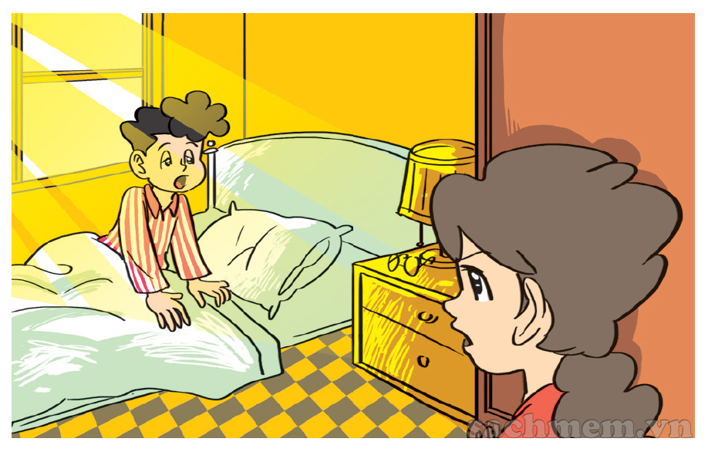
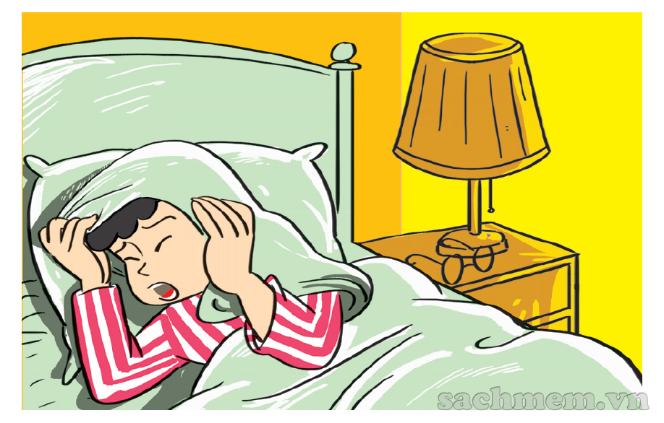
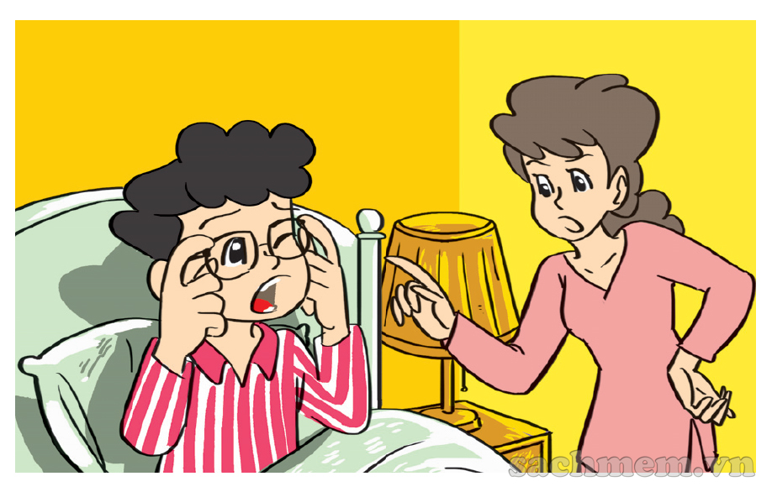


1. Look, listen and repeat.
What time is it, Mum?
It's time to get up, Phong.
It's seven o'clock
Today's Sunday and I
don't have to go to school.
But it's time
for breakfast.
Oh, yes, Mum.
1/ Who are they?
3/ What are they talking about?
2/ Where are they?

Slide 18
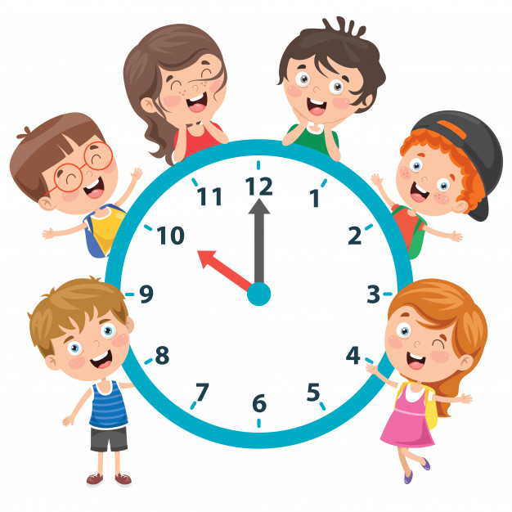
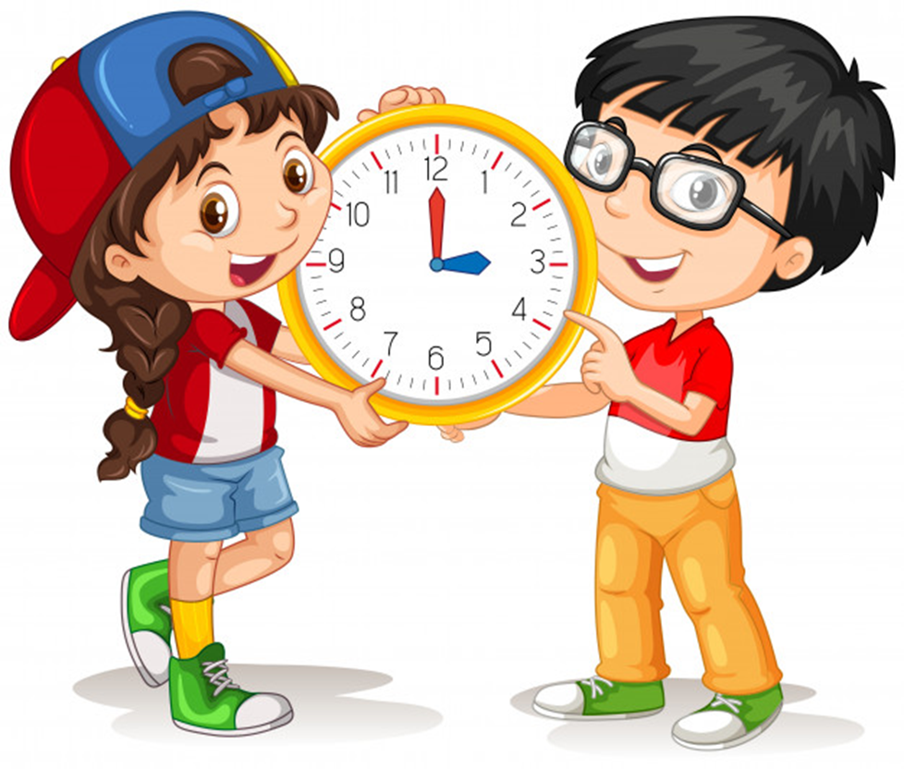
Unit 11
What time is it?
Lesson 1

Slide 19
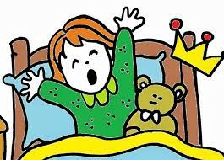
get up

Slide 20

go to school

Slide 21
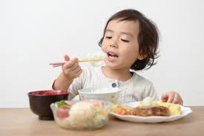
breakfast

Slide 22
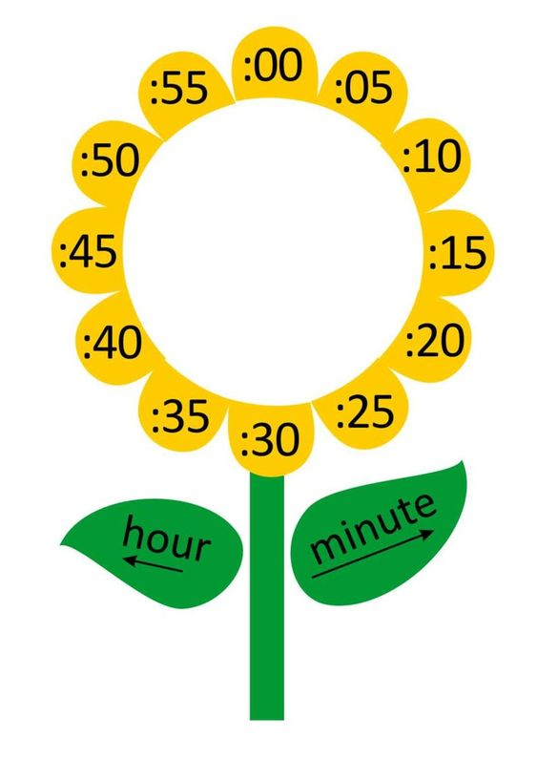
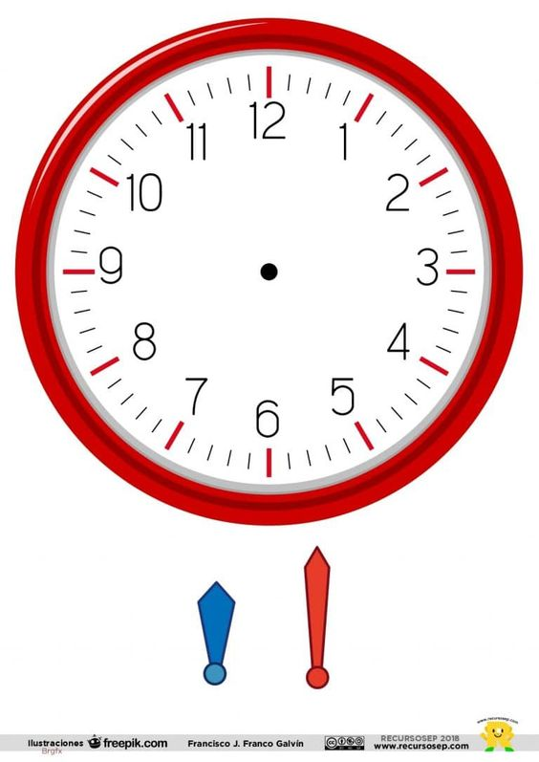

O’clock

Slide 23
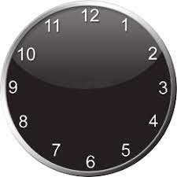

What time ?

Slide 24
1. | a.What time ?
2.
3.
4.
5.
b.get up
c.go to school
d.O’clock
e.breakfast

Slide 25
1. Look, listen and repeat.
What time is it, Mum?
It's time to get up, Phong.
It's seven o'clock
Today's Sunday and I
don't have to go to school.
But it's time
for breakfast.
Oh, yes, Mum.

Slide 26
1. Look, listen and repeat.
What time is it, Mum?
What time is it, Mum?
It's time to get up, Phong.
It's seven o'clock
It's seven o'clock
Today's Sunday and I
don't have to go to school.
But it's time
for breakfast.
Oh, yes, Mum.
1/ What does Phong ask his mother?
2/ What does his mother answer?

Slide 27
What time is it?
one
It's __________ o’clock.

Slide 28
What time is it?
two
It's __________ o’clock.

Slide 29
What time is it?
six
It's __________ o’clock.

Slide 30
What time is it?
one
fifteen
It's _________________.

Slide 31
What time is it?
one
thirty
It's _________________.

Slide 32

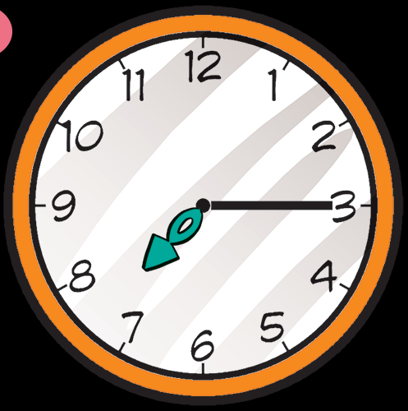
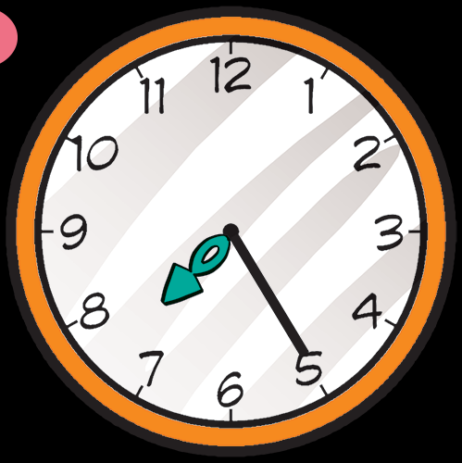
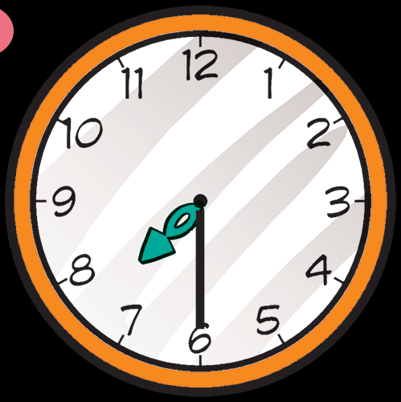
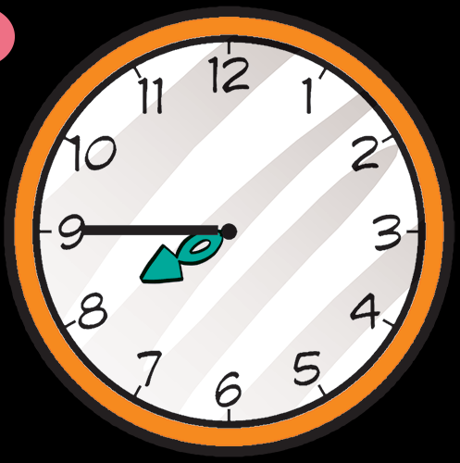
2. Point and say.
What time is it?
a
b
c
It's ______________.
o’clock
seven
seven fifteen
seven twenty-five
d
e
seven thirty
seven forty-five

Slide 33
2. Point and say.
What time is it?
a
b
c
It's __________.
seven
seven fifteen
seven twenty-five
d
e
seven thirty
seven forty-five

Slide 34
2. Point and say.
What time is it?
a
b
c
It's ______________.
seven
seven fifteen
seven twenty-five
d
e
seven thirty
seven forty-five

Slide 35
2. Point and say.
What time is it?
a
b
c
It's __________.
seven
seven fifteen
seven twenty-five
e
d
seven thirty
seven forty-five

Slide 36
2. Point and say.
What time is it?
a
b
c
It's _____________.
seven
seven fifteen
seven twenty-five
d
e
seven thirty
seven forty-five

Slide 37


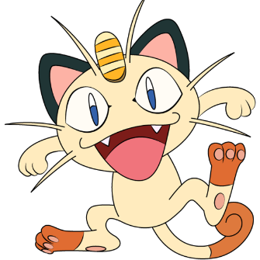




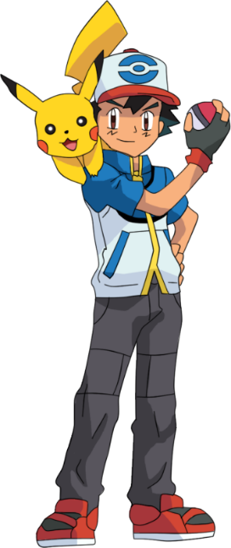
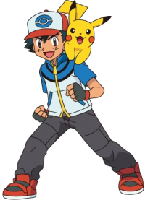


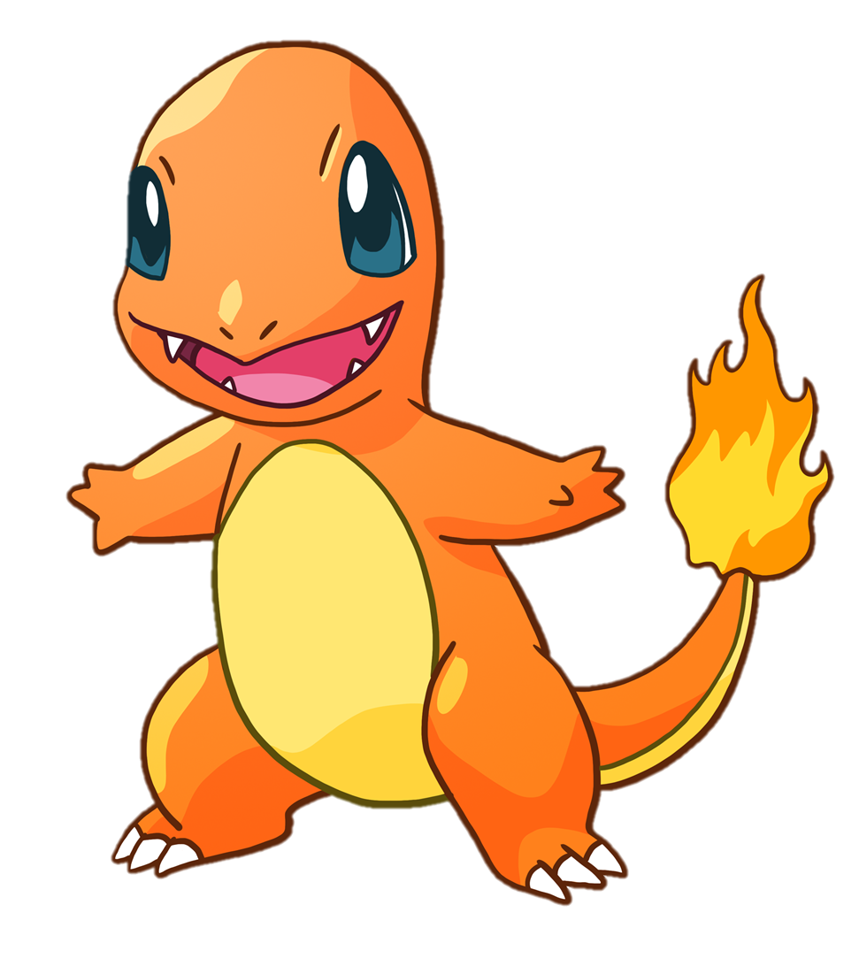


Notes:
Liên hệ: Ms Huyền Phạm - 0936.082.789 Nếu thầy cô muốn:
- Tham gia Khóa học làm powerpoint chuyên nghiệp
Học Tin học văn phòng từ cơ bản đến nâng cao
Đặt hàng thiết kế, soạn giáo án theo yêu cầu
Sở hữu các bộ giáo án powerpoint môn tiếng anh Mầm non và tiểu học.

Slide 38
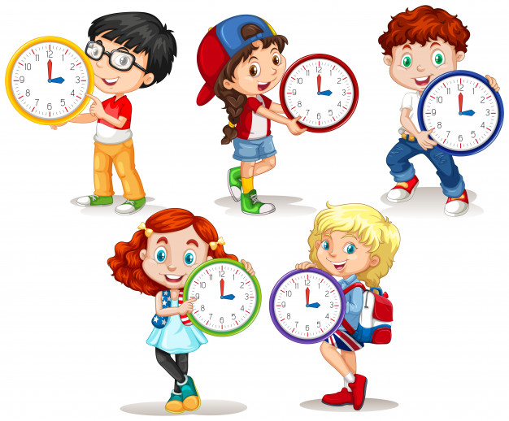




What time is it?
It’s three o’clock.
It’s twelve three.
It’s one o’clock.
1
0
5
3
4
time’s up
5 seconds
Notes:
Liên hệ: Ms Huyền Phạm - 0936.082.789 Nếu thầy cô muốn:
- Tham gia Khóa học làm powerpoint chuyên nghiệp
Học Tin học văn phòng từ cơ bản đến nâng cao
Đặt hàng thiết kế, soạn giáo án theo yêu cầu
Sở hữu các bộ giáo án powerpoint môn tiếng anh Mầm non và tiểu học.

Slide 39

What time _________?
It’s ten o’clock.
Ms Huyền Phạm
0936.082.789
It is
It’s
is it
1
3
4
5
0
time’s up
5 seconds
Notes:
Liên hệ: Ms Huyền Phạm - 0936.082.789 Nếu thầy cô muốn:
- Tham gia Khóa học làm powerpoint chuyên nghiệp
Học Tin học văn phòng từ cơ bản đến nâng cao
Đặt hàng thiết kế, soạn giáo án theo yêu cầu
Sở hữu các bộ giáo án powerpoint môn tiếng anh Mầm non và tiểu học.

Slide 40
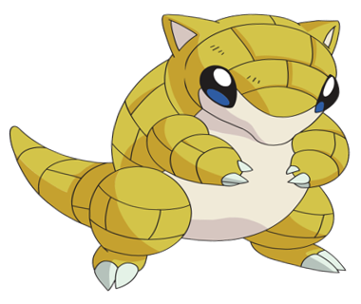

What time is it?
It’s six _________.
Ms Huyền Phạm
0936.082.789
o’clock
_{fifteen}
three
5
3
1
4
0
time’s up
5 seconds
Notes:
Liên hệ: Ms Huyền Phạm - 0936.082.789 Nếu thầy cô muốn:
- Tham gia Khóa học làm powerpoint chuyên nghiệp
Học Tin học văn phòng từ cơ bản đến nâng cao
Đặt hàng thiết kế, soạn giáo án theo yêu cầu
Sở hữu các bộ giáo án powerpoint môn tiếng anh Mầm non và tiểu học.

Slide 41
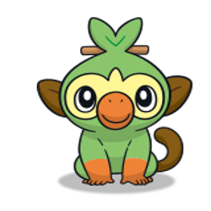
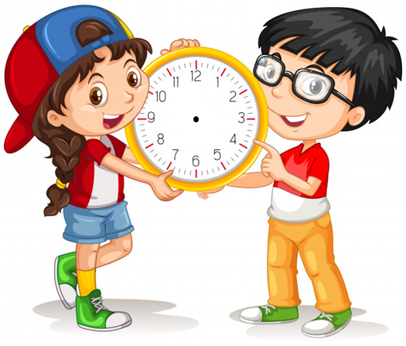
_________________?
It’s eleven fifty.
Ms Huyền Phạm
0936.082.789
What time it is?
What is time it?
What time is it?
5
0
1
3
time’s up
4
5 seconds
Notes:
Liên hệ: Ms Huyền Phạm - 0936.082.789 Nếu thầy cô muốn:
- Tham gia Khóa học làm powerpoint chuyên nghiệp
Học Tin học văn phòng từ cơ bản đến nâng cao
Đặt hàng thiết kế, soạn giáo án theo yêu cầu
Sở hữu các bộ giáo án powerpoint môn tiếng anh Mầm non và tiểu học.

Slide 42



GAME OVER!
Notes:
Liên hệ: Ms Huyền Phạm - 0936.082.789 Nếu thầy cô muốn:
- Tham gia Khóa học làm powerpoint chuyên nghiệp
Học Tin học văn phòng từ cơ bản đến nâng cao
Đặt hàng thiết kế, soạn giáo án theo yêu cầu
Sở hữu các bộ giáo án powerpoint môn tiếng anh Mầm non và tiểu học.

Slide 43
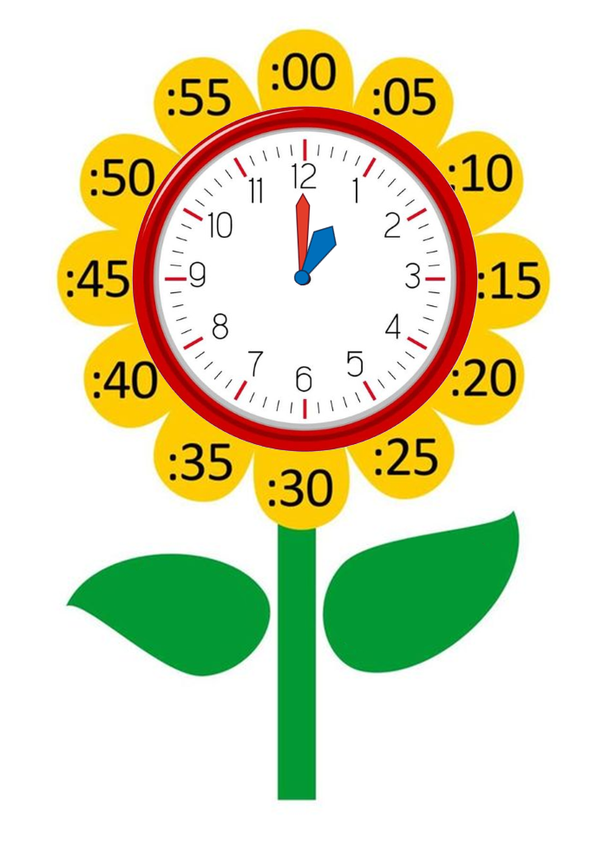
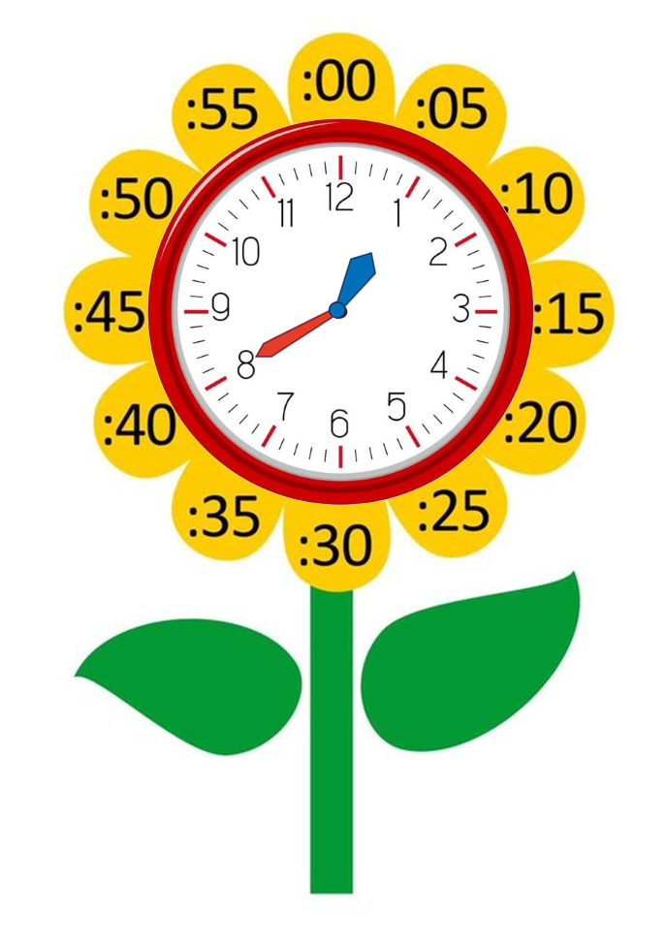
Model sentence
What time is it?
It's + số giờ + o’clock.
It's one o’clock.
It's + số giờ + số phút.
It's one forty.

Slide 44
FREE TALK

Slide 45


THANK YOU!
Welcome to join with me!

