Slide 1



Unit 14,part 1,2,3.page 26
to our class
Teacher :Nguyễn Thi Nhung

Slide 2


Slide 3
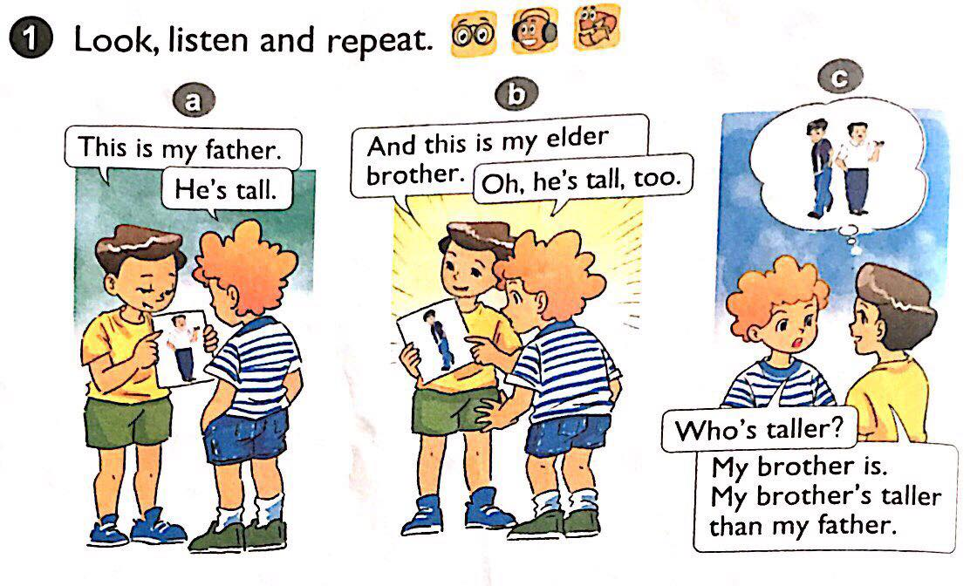




Slide 4
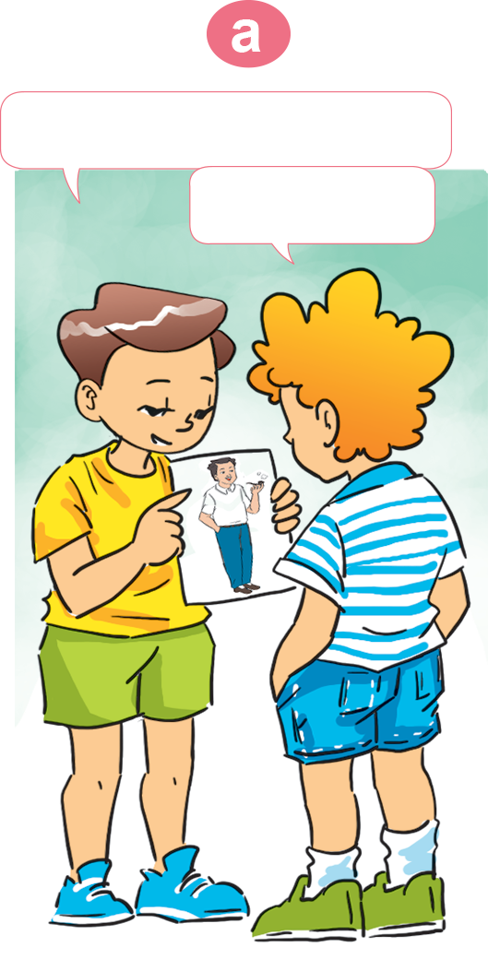
Activity 1:look, listen and repeat

Slide 5
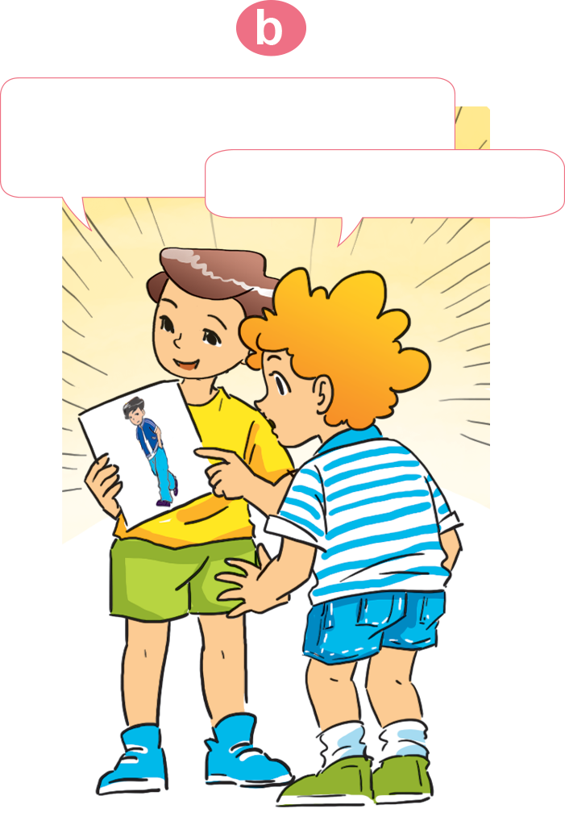

Slide 7
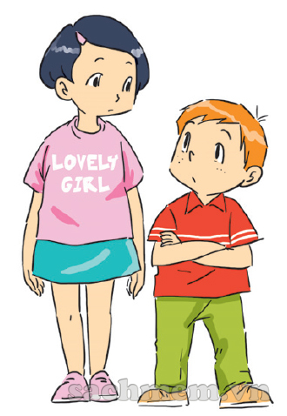


Activity 2: Point and say
taller

Slide 8



shorter

Slide 9
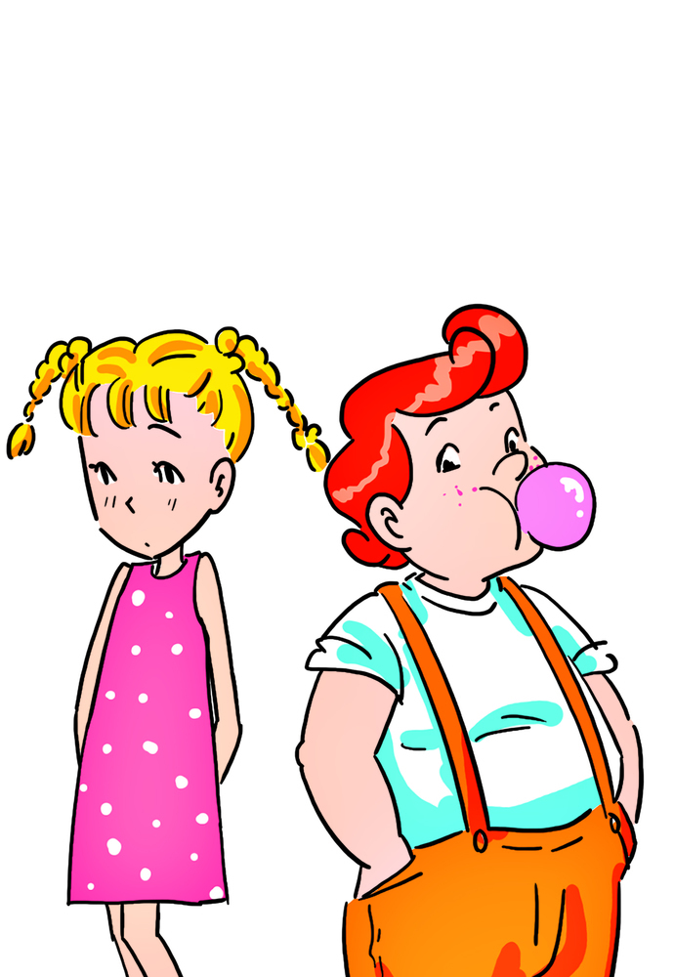



The girl

Slide 10

The girl
bigger

Slide 11
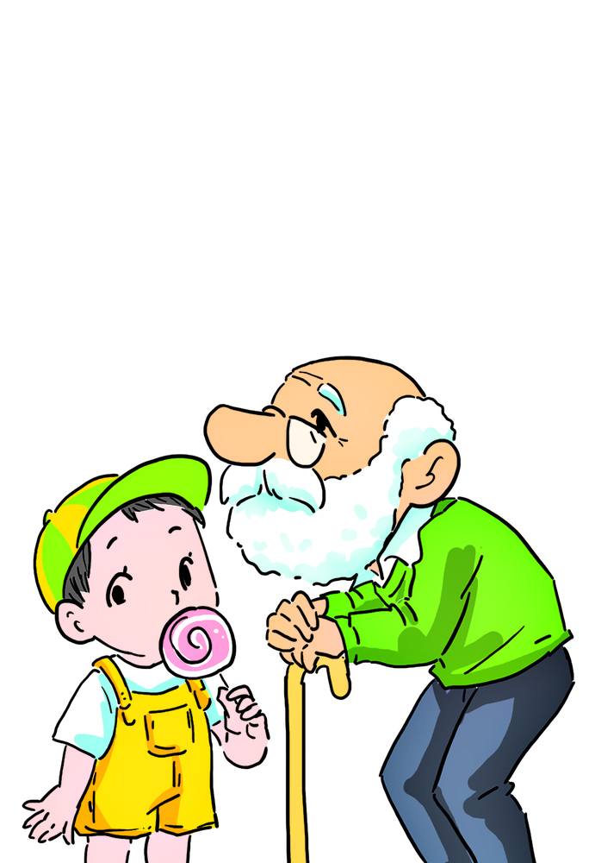



The boy

Slide 12

The boy
older

Slide 13

Activity 3: Let’s talk

Slide 14
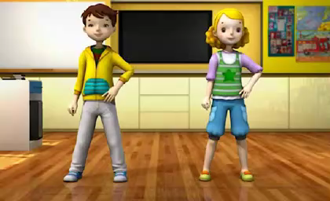

Slide 15
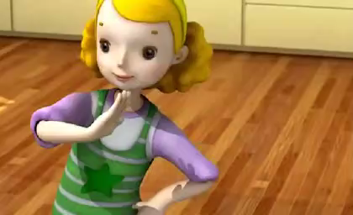

Slide 16
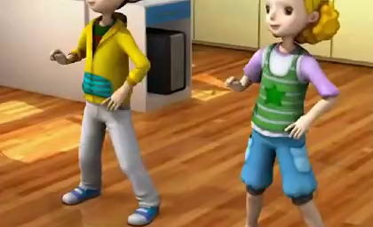

Slide 17
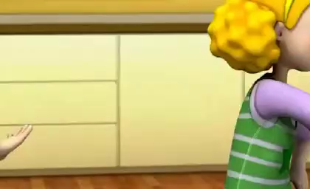

Slide 18


