Slide 1

WARM UP

Slide 2


1 – clap up
2 – clap down
3 – clap right
4 – clap left
5 – roll hands

Slide 3

We live in many different countries in the world.

Slide 4

Can you name any country in the world?

Slide 5




Unit 1:
My Friends
MsPham
0936082789
Lesson 1 – Part 1, 2, 3
MsPham
0936082789

Slide 6

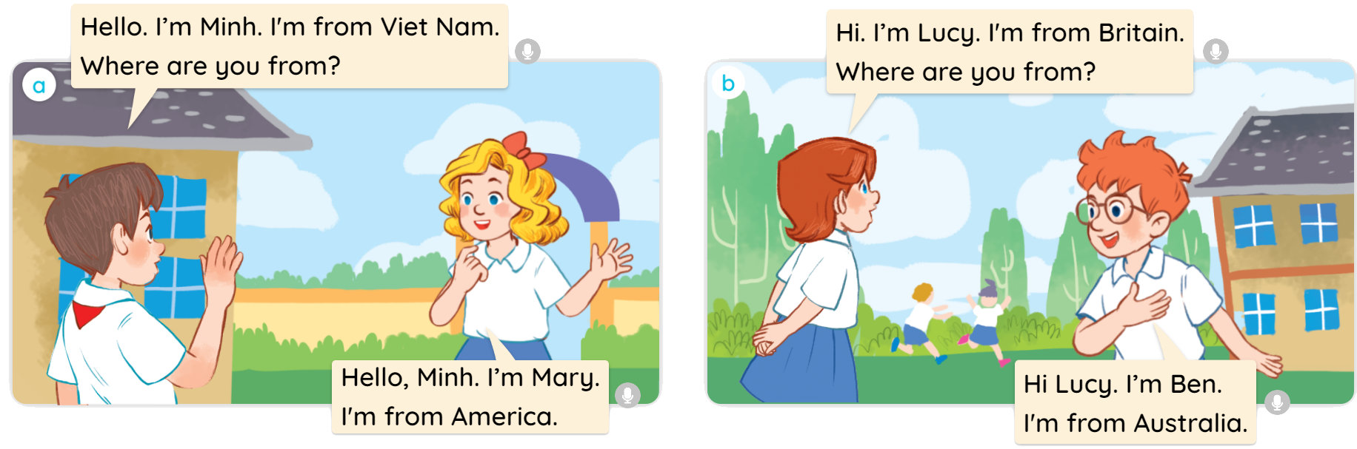

1
Look, listen and read.

Slide 7

Vocabulary
MsPham
0936082789

Slide 8






Slide 9

Vocabulary
Viet Nam
/ˌviːetˈnɑːm/
MsPham
0936082789
Nước Việt Nam

Slide 10









Slide 11

Vocabulary
Britain
/ˈbrɪtn/
MsPham
0936082789
Nước Anh

Slide 12





Slide 13

Vocabulary
America
/əˈmerɪkə/
MsPham
0936082789
Nước Mĩ

Slide 14

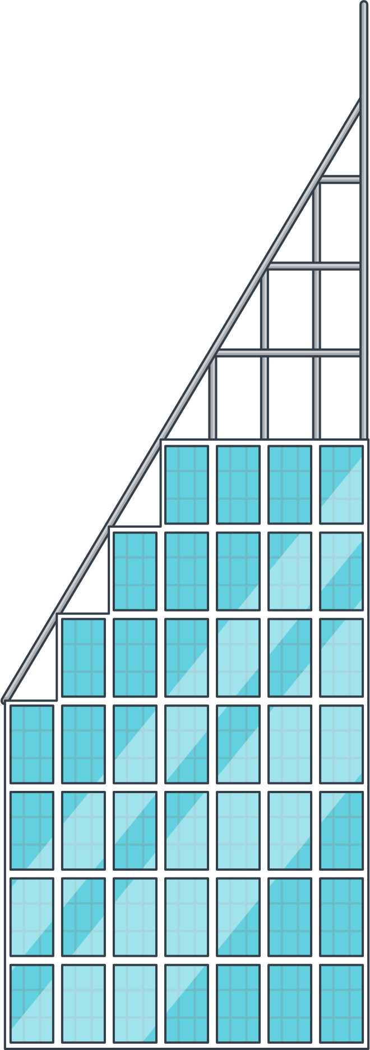







Slide 15

Vocabulary
Australia
/ɒˈstreɪliə/
MsPham
0936082789
Nước Úc

Slide 16

Vocabulary
Vietnam
/ˌviːetˈnɑːm/
: Nước Việt Nam
MsPham
0936082789
America
/əˈmerɪkə/
: Nước Mĩ
Britain
/ˈbrɪtn/
: Nước Anh
Australia
/ɒˈstreɪliə/
: Nước Úc

Slide 17
1
Look, listen and repeat.

Slide 18





2
Listen, point and say.
Where are you from?
I’m from _________.
a
b
Britain
Vietnam
a
b
America
Australia

Slide 19






3
MsPham
0936082789
Let’s talk.
Where are you from?
I’m from Vietnam.
I’m from Australia.
I’m from America.
I’m from Britain.

Slide 20







Where are you from?
Next
I’m from __________.
Check
VietNam
Notes:
更多模板123图文旗舰店：666

Slide 21



Where are you from?
Next
I’m from __________.
Check
Australia
Notes:
更多模板123图文旗舰店：666

Slide 22



Where are you from?
Next
I’m from __________.
Check
America
Notes:
更多模板123图文旗舰店：666

Slide 23


Where are you from?
Next
I’m from __________.
Check
Britain
Notes:
更多模板123图文旗舰店：666

Slide 24

Good job!
Notes:
更多模板123图文旗舰店：666

Slide 25
Review

Slide 26




Where are you from?
(Bạn đến từ đâu?)
MsPham
0936082789
I’m from _________.
(Tớ đến từ ____)
I am = I’m
Vietnam
MsPham
0936082789
Australia
America
Britain

Slide 27
MsPham Powerpoint
Thank you
Mspham
For joining!
MsPham
0936082789

