Slide 1


Slide 2


Slide 4
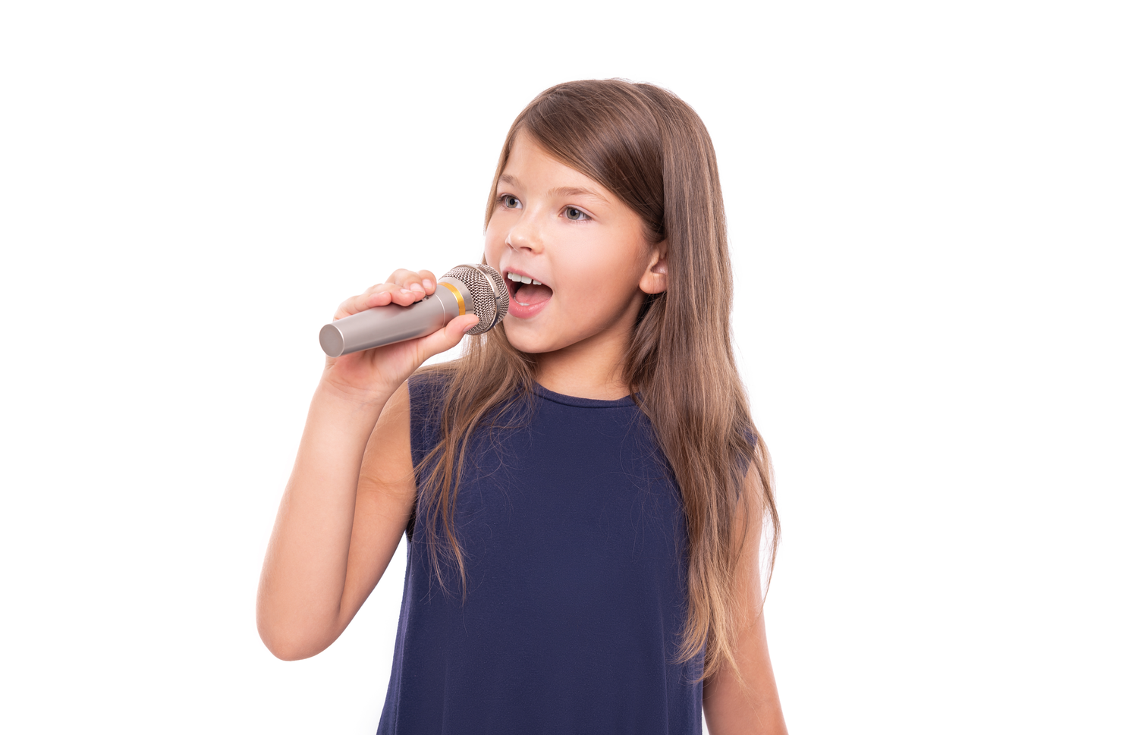
singing

Slide 5
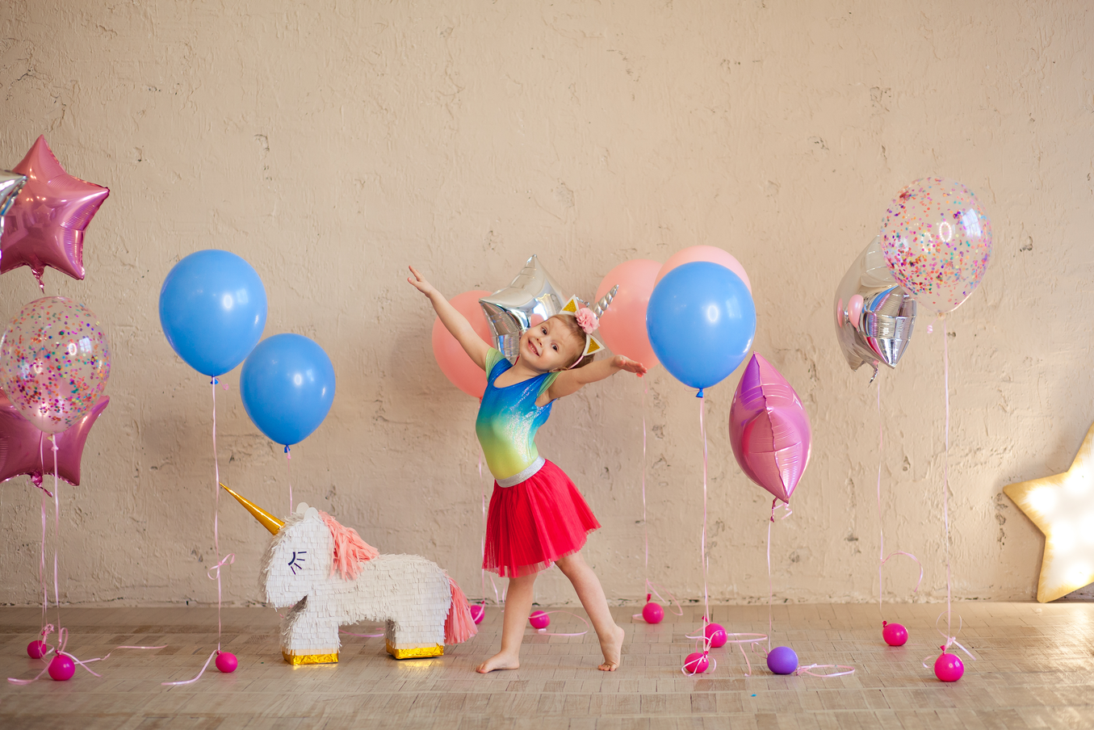
dancing

Slide 6
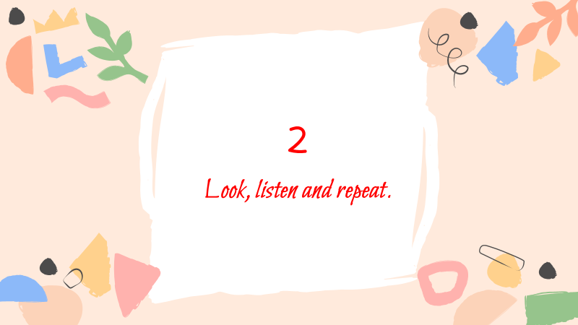

Slide 7
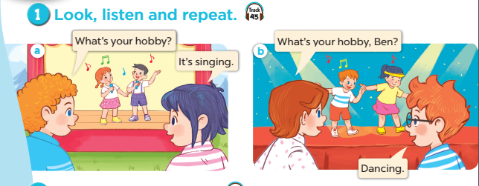

Notes:
Step 1: Ask pupils to look at context a. Play the recording for them to listen. Play the recording again, sentence by sentence, for them to listen and repeat. Correct pronunciation if necessary.
Step 2: Do the same with context b.
Step 4: Work in pair - role play.
Step 5: Invite few pairs to the front of the class and act.

Slide 9
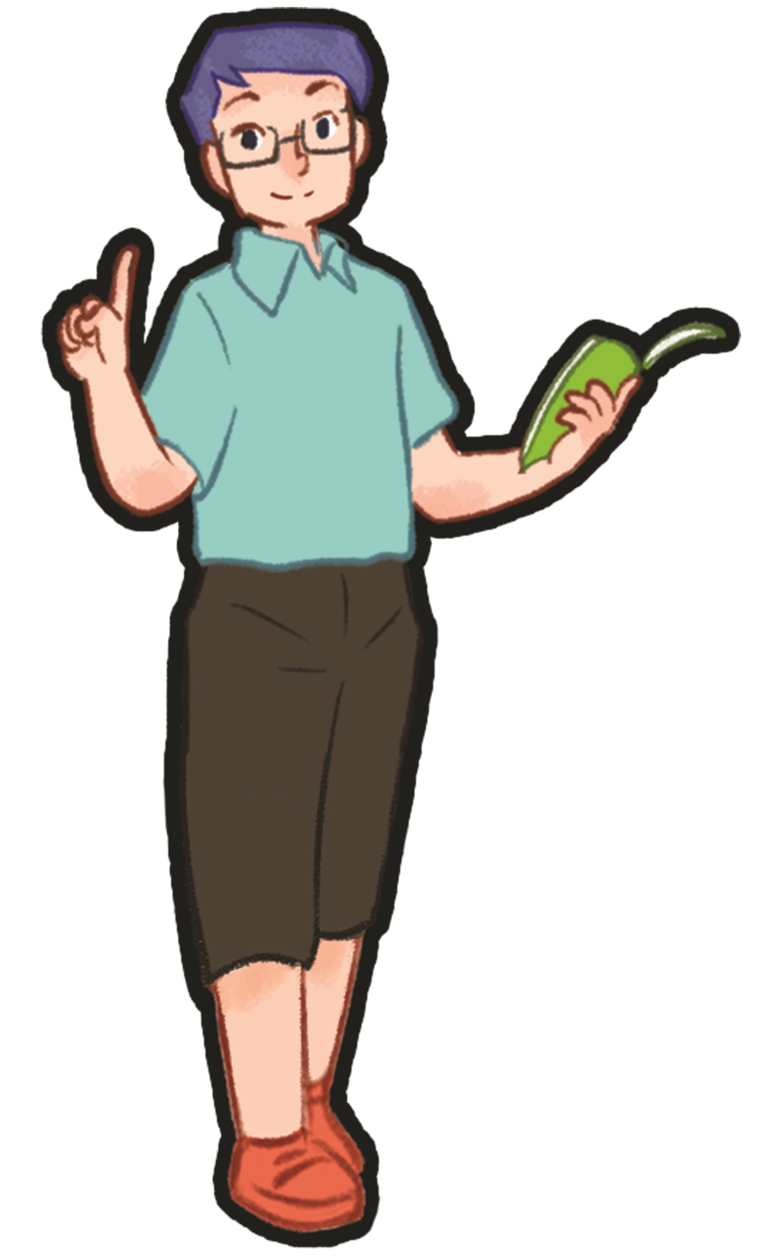
4 Let’s talk.

