Slide 1
WELCOME
TO OUR CLASS
THANH TO PRIMARY SCHOOL

Slide 2








Unit
3. Listen and chant.
4.Listen and circle.
5. Write and say.

Slide 3

Warm-up

Slide 4
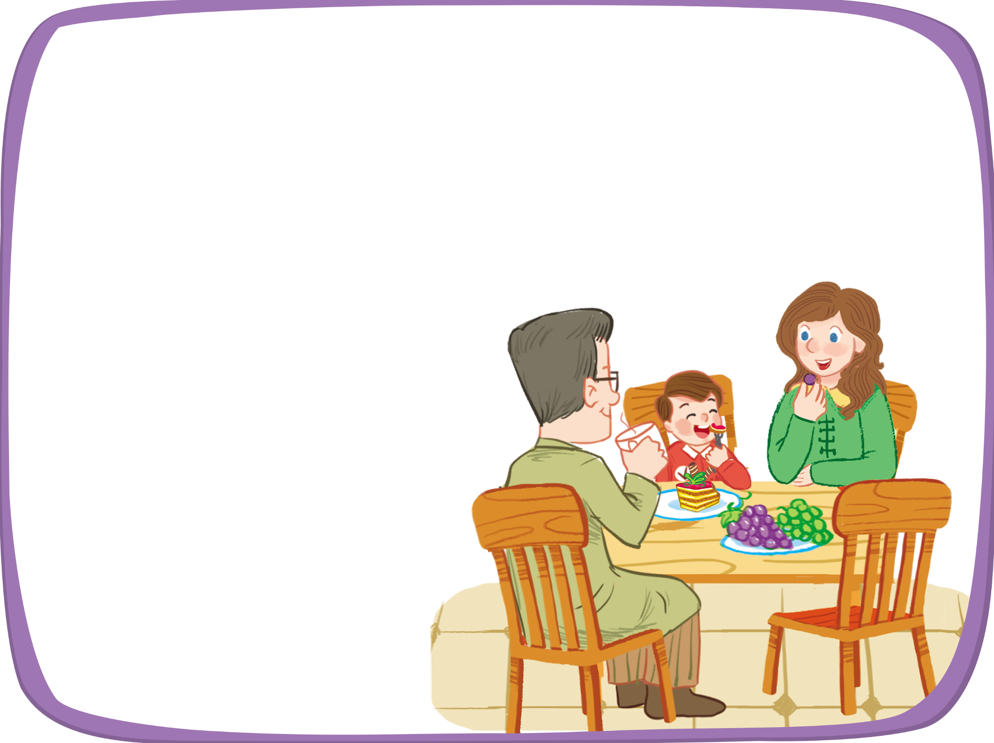



Listen and chant.
A, a, cake.
A, a, cake.
A, a, cake.
A, a, cake.
A, a, cake.
A, a, cake.
A, a, cake.
A, a, cake.
He’s having a cake.
He’s having a cake.
He’s having a cake.
He’s having a cake.
A, a, grapes.
A, a, grapes.
A, a, grapes.
A, a, grapes.
A, a, grapes.
A, a, grapes.
A, a, grapes.
A, a, grapes.
She’s having grapes.
She’s having grapes.
She’s having grapes.
She’s having grapes.

Slide 5


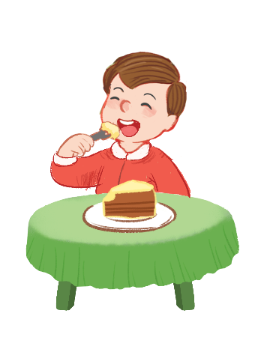
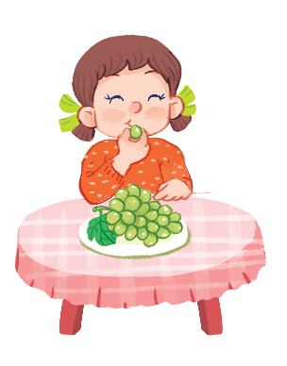
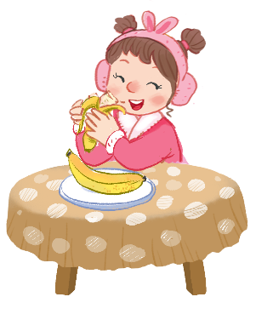
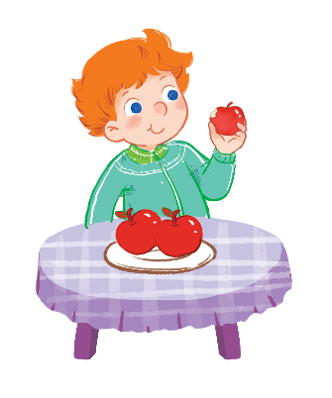


Listen and circle.
1
2

Slide 6
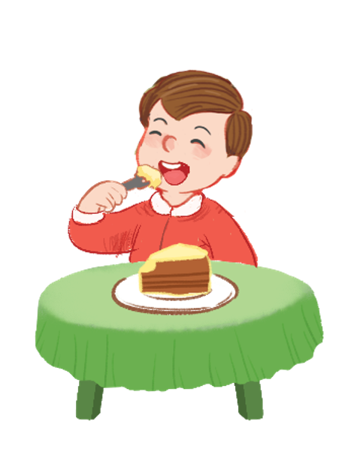

Listen and circle.
1

Slide 7

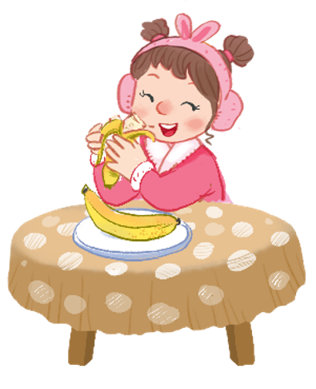
2
Listen and circle.
2

Slide 8


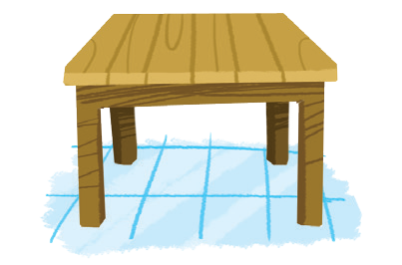

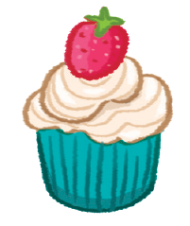
Look and write.
a
a
gr pes
c ke
t ble
a

Slide 9
Time to say goodbye!
a

