Slide 1








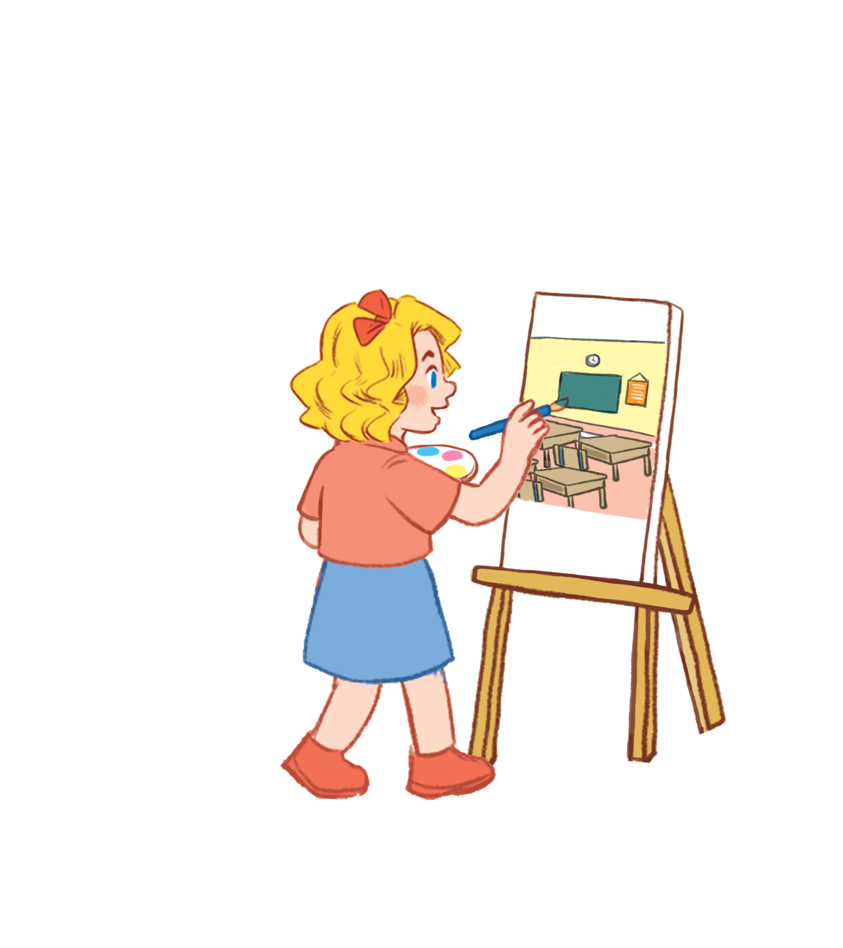

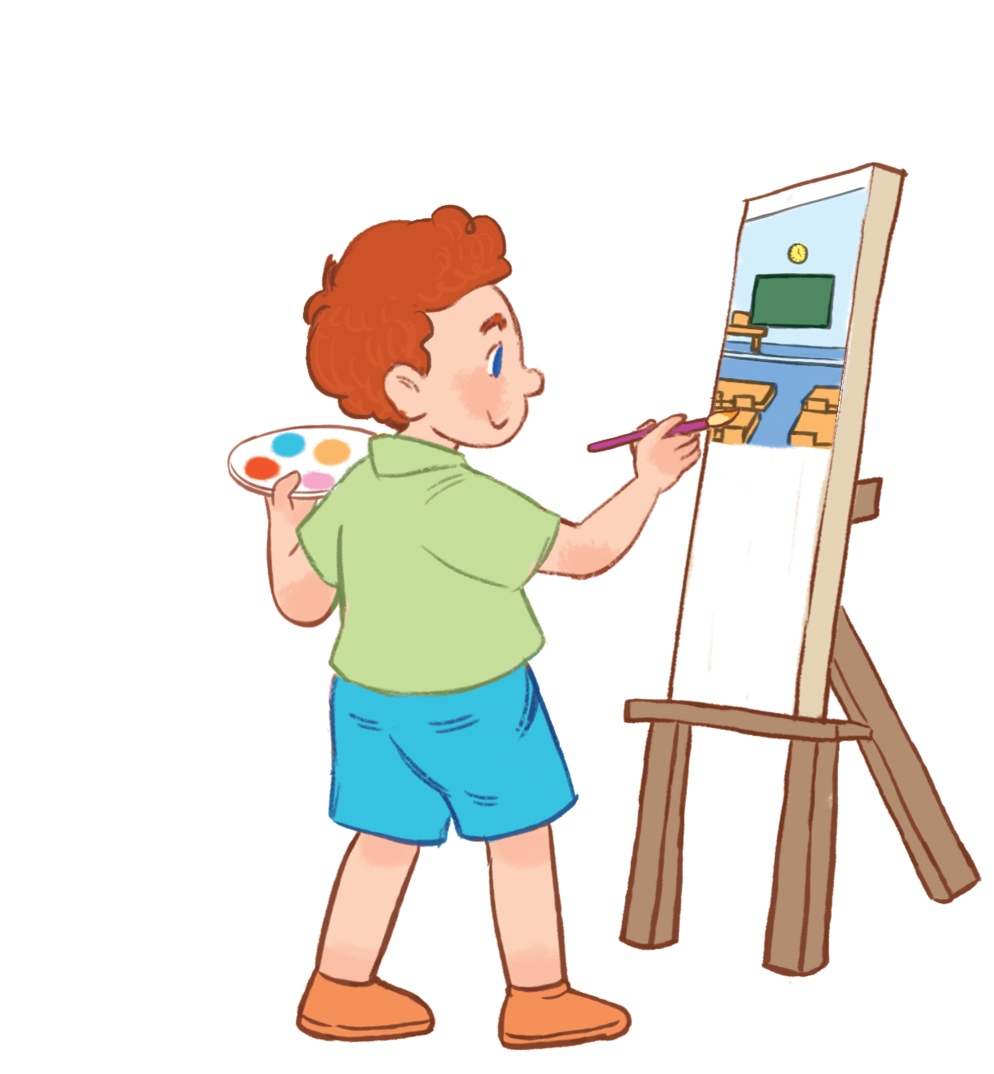


Unit 5
Our hobbies
Lesson 1
Nhóm : Tiếng Anh
Trường Tiểu học Thành Tô

Slide 2


Warm - up

Slide 3
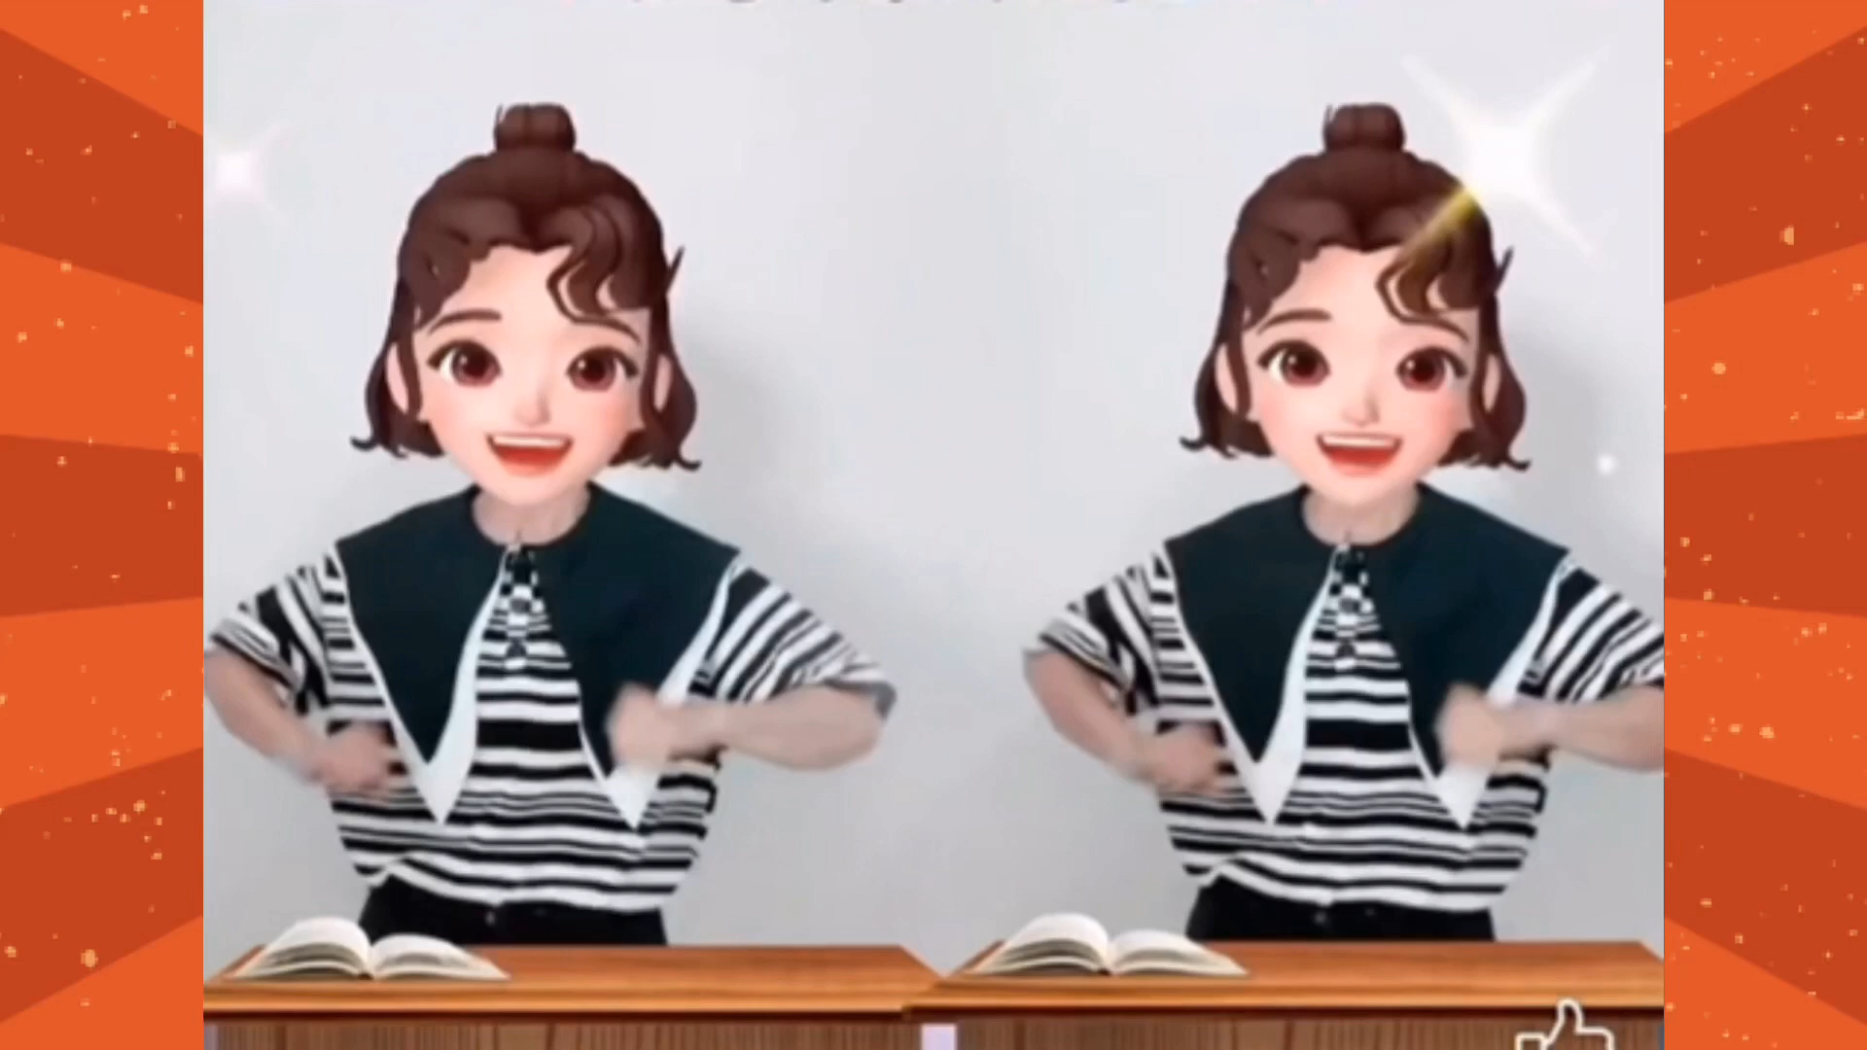

Slide 4


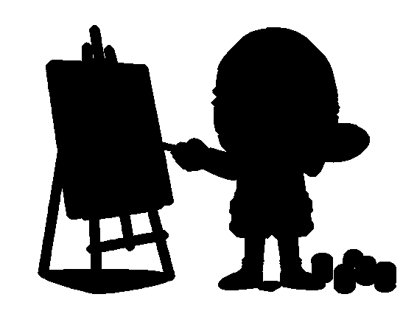

Action simulation
Notes:
- T shows picture.
- T asks some pupils who can simulate the actions in the pictures through the shadows. -> Choose the best ones and gives them points.

Slide 5

Notes:
T shows the shadows with their pictures and say the words and gives sentences: They are ____., She is _____., He is _____.

Slide 6
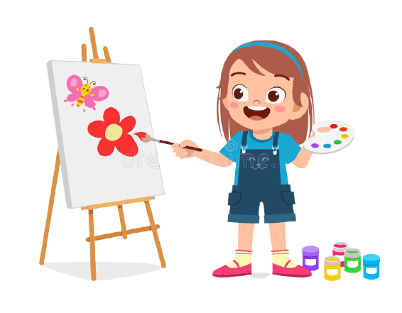
Notes:
T shows the shadows with their pictures and say the words and gives sentences: They are ____., She is _____., He is _____.

Slide 7

Notes:
T shows the shadows with their pictures and say the words and gives sentences: They are ____., She is _____., He is _____.

Slide 8
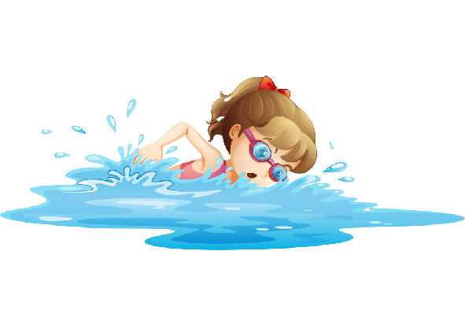
Notes:
T shows the shadows with their pictures and say the words and gives sentences: They are ____., She is _____., He is _____.

Slide 9
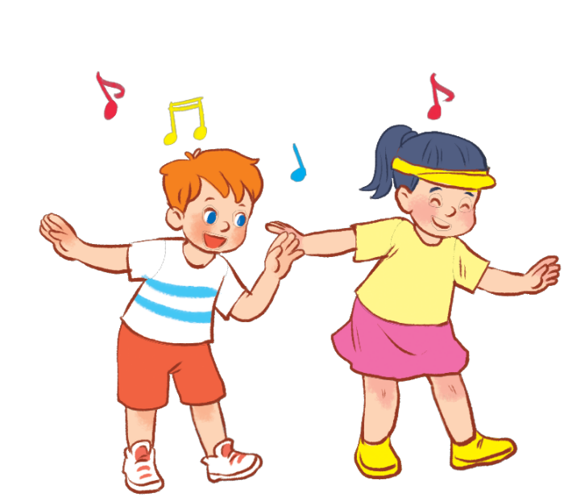
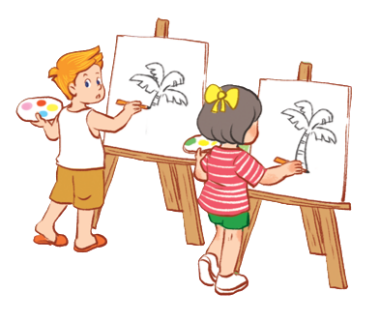
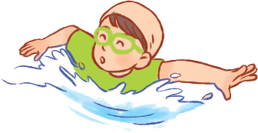
I. Vocabulary
dancing
: nhảy
singing
: hát
drawing
: vẽ
swimming
: bơi

Slide 10
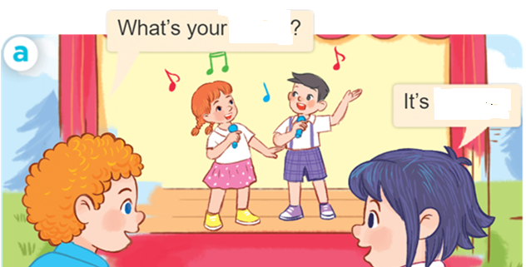
Fill in the blanks:
hobby
singing.
2.Structures
What’s your hobby?
(Sở thích của bạn là gì)
It’s + (hobby).
(Đó là ______)

Slide 11
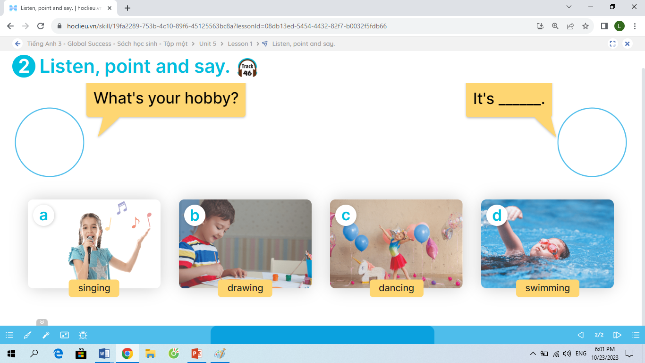

Slide 12


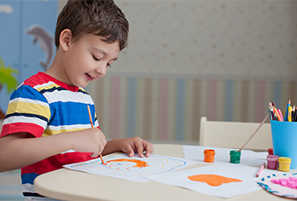
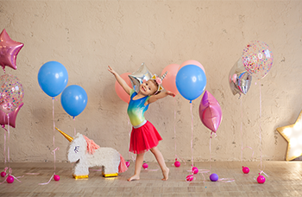
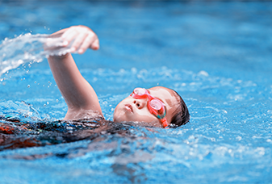
2
Listen, point and say.
What’s your hobby?
It’s _______.
MsPham-0936082789
singing
drawing
dancing
swimming

Slide 13





3
Let’s talk.
What’s your hobby?
…………………….

Slide 14





Game
Pass the ball
MsPham-0936082789
For enjoying!
MsPham-0936082789

Slide 15


Slide 16
Wednesday, October 25 th 2023
Unit 5: My hobbies – Lesson 1: 1,2,3
New words:
- dancing: múa
singing : hát
drawing : vẽ
swimming: bơi
2. Structures:
A: What’s your hobby?
B: It’s singing
3. Homelink:
-Learn by heart new words and structures.

Slide 17
Thank you
MsPham-0936082789
For enjoying!
MsPham-0936082789

