Slide 1

Unit 4: School Activities
Lesson 2/period 1
Teacher: Nguyen Thi Kim Chi
School: Tien Minh Primary school

Slide 2
Warm up
Chào hỏi.
Chia nhóm, check nhóm
- Hs khởi động bằng 1 bài hát để kết nối vào bài học

Slide 3

WARM-UP

Slide 5
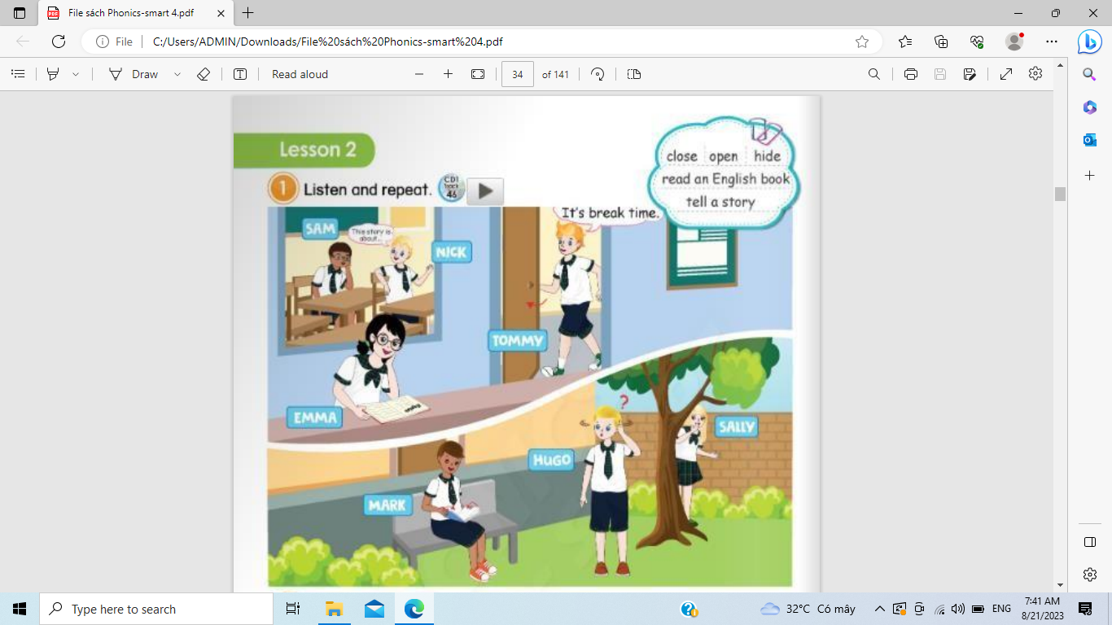

Slide 7




close
close
open
open
Tell a story
Tell a story
read an English book
read an English book
hide

Slide 9
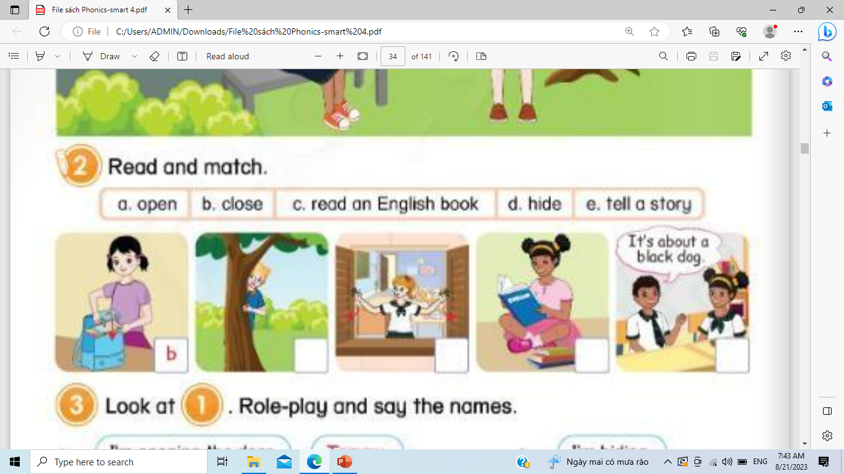

Slide 11
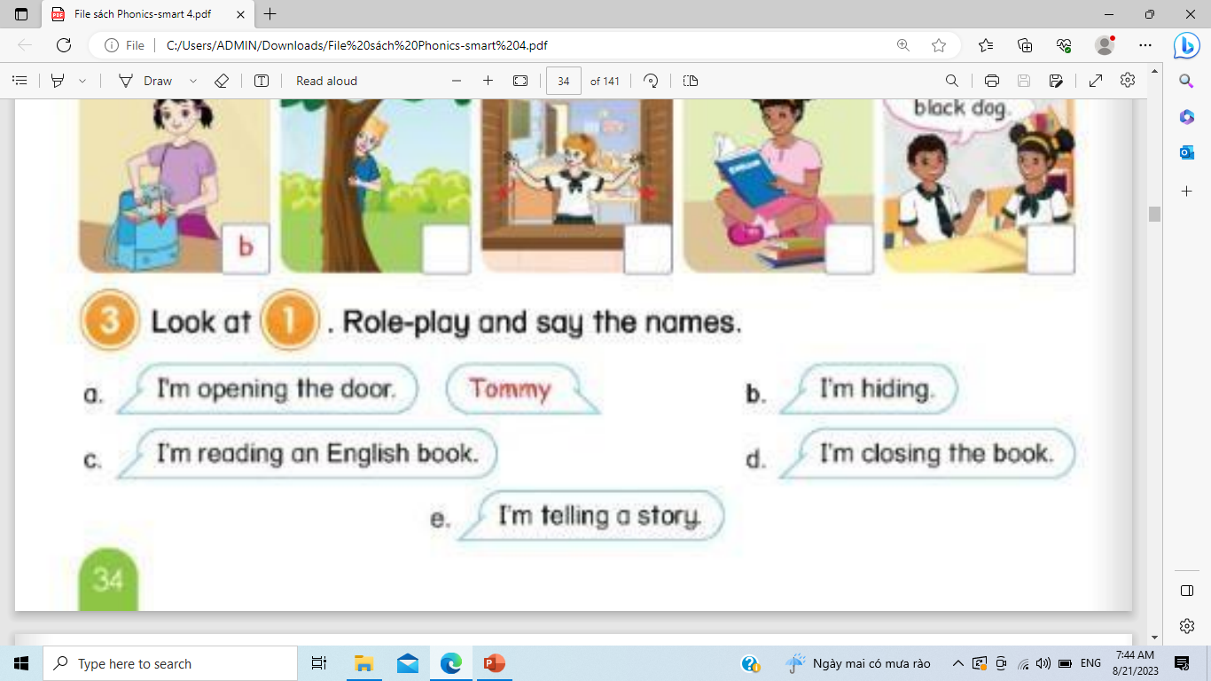

Slide 12


Slide 14
… Day … Month …. Date … Year
UNIT 4: School Activies
LESSON 2 – PERIOD 1
II. Structures:
I. Vocabulary
1. I’m + Verb + ing
Ex: I’m opening the door.
1.open
2.close
3.hide
4.read an English book
5. tell a story
III. Homework:
Practice speaking and writing the vocabularies and structures at home.
Notes:
Teacher lets the students write down the vocabularies and structures in their notebooks

Slide 15
WRAP UP
Hôm nay các em đã được học những gì ?
( What did you learn in this lesson ? )
Notes:
Review the vocabularies and structures

Slide 16



Slide 17
3. Look at 1, Role-play and say the names.
a. I’m opening the door
b. I’m hiding
Tommy
c. I’m reading an English book
d. I’m closing the book
e. I’m telling a story

