Slide 1




Slide 2
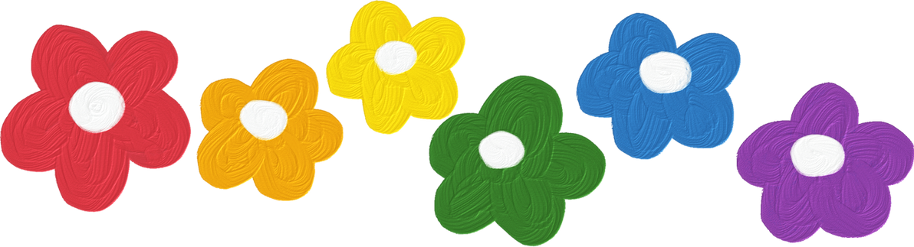




REVIEW 1
PERIOD 2

Slide 3



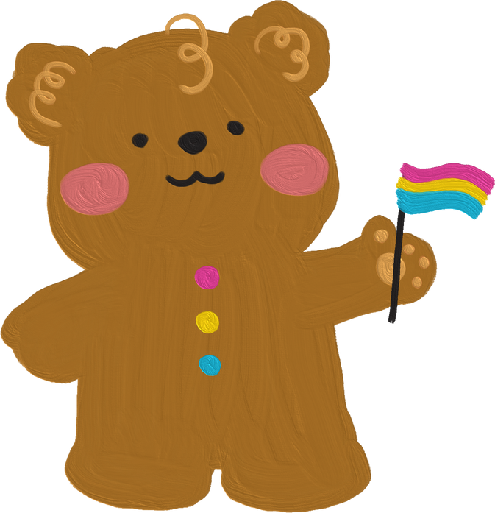
CONTENTS
1. Warm-up and review
2. Read and match.
3. Read and complete.
4. Ask and answer.
5.Fun corner and wrap-up

Slide 4

1.Warm-up and review

Slide 5
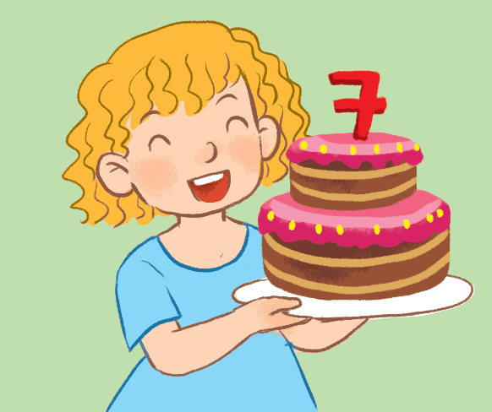
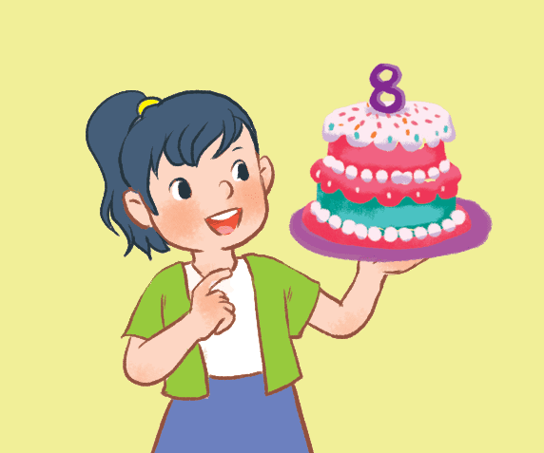
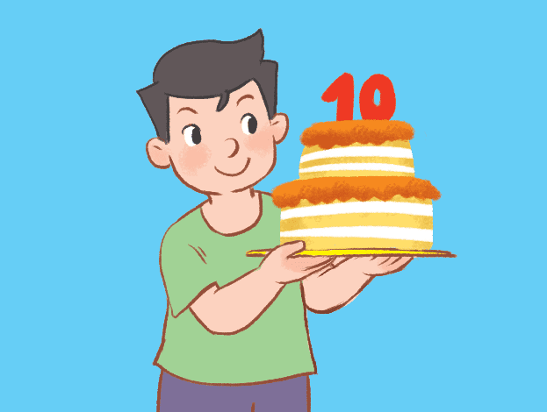
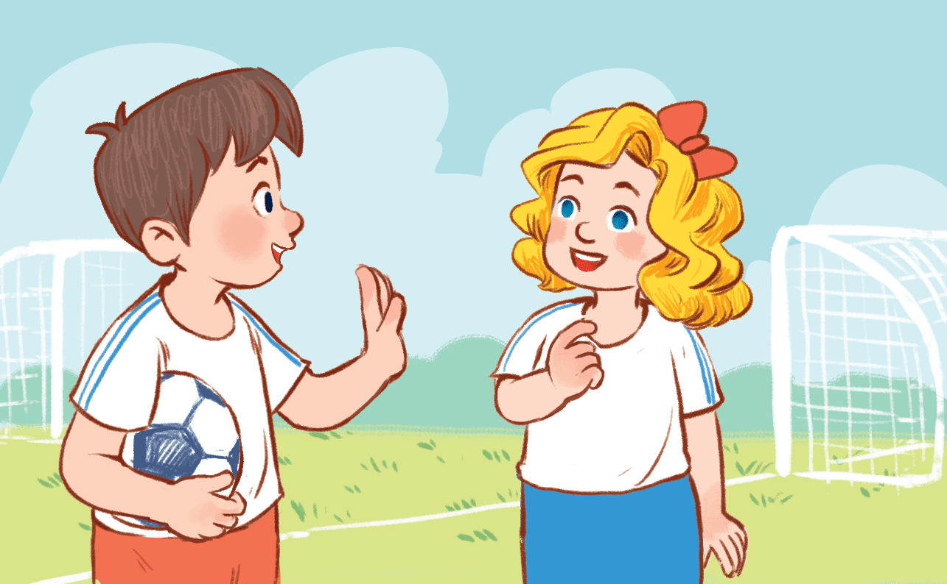

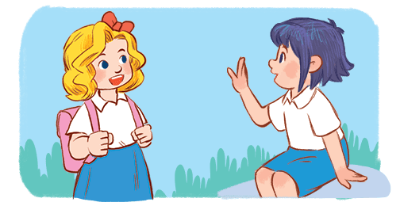
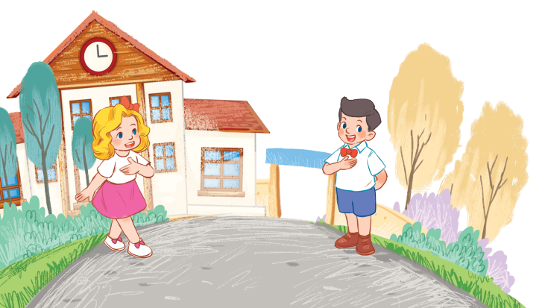
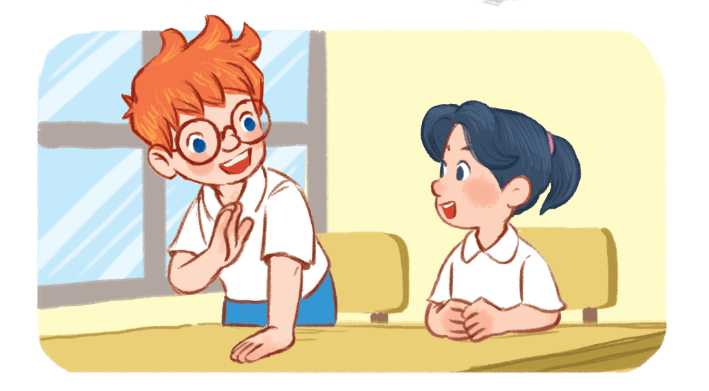
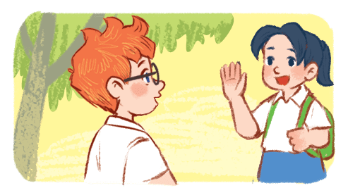
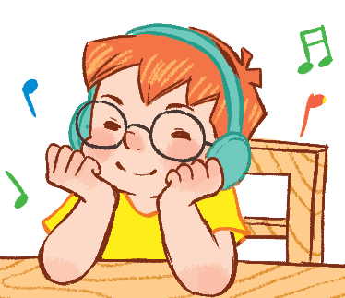
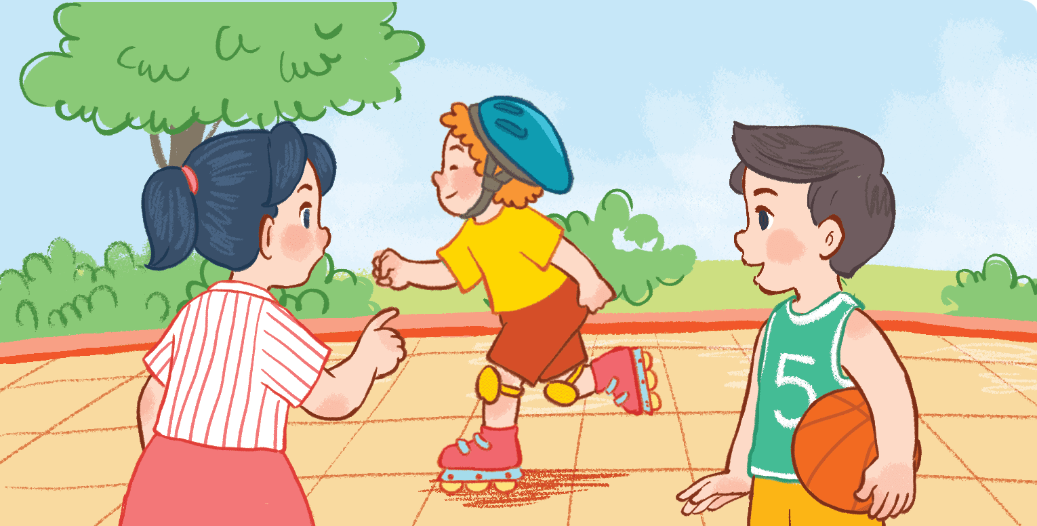
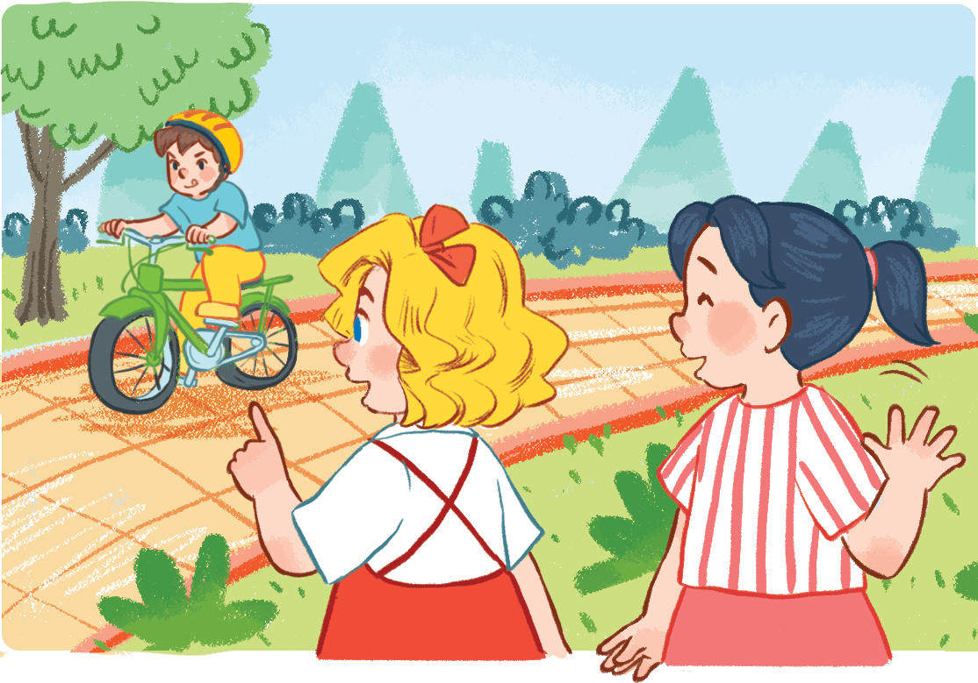
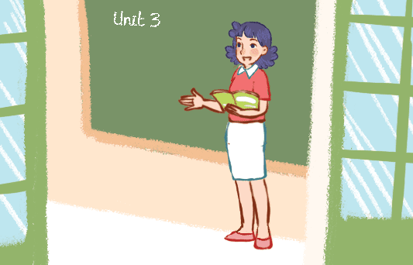
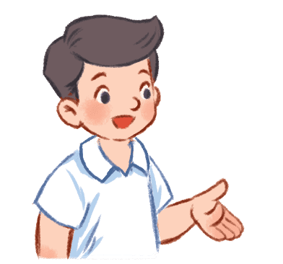
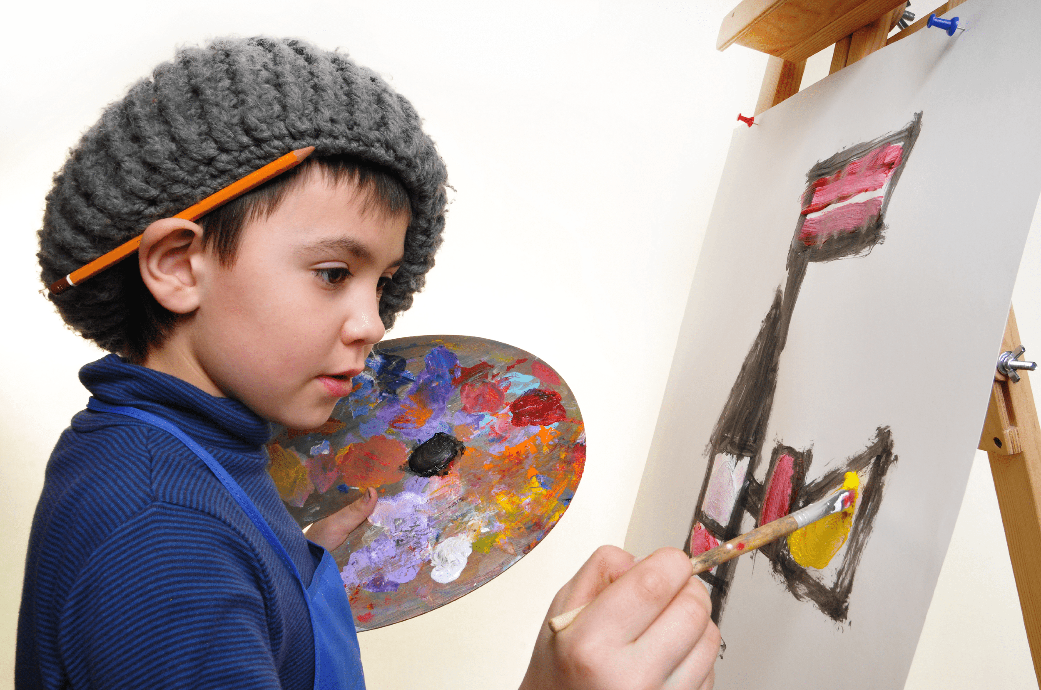
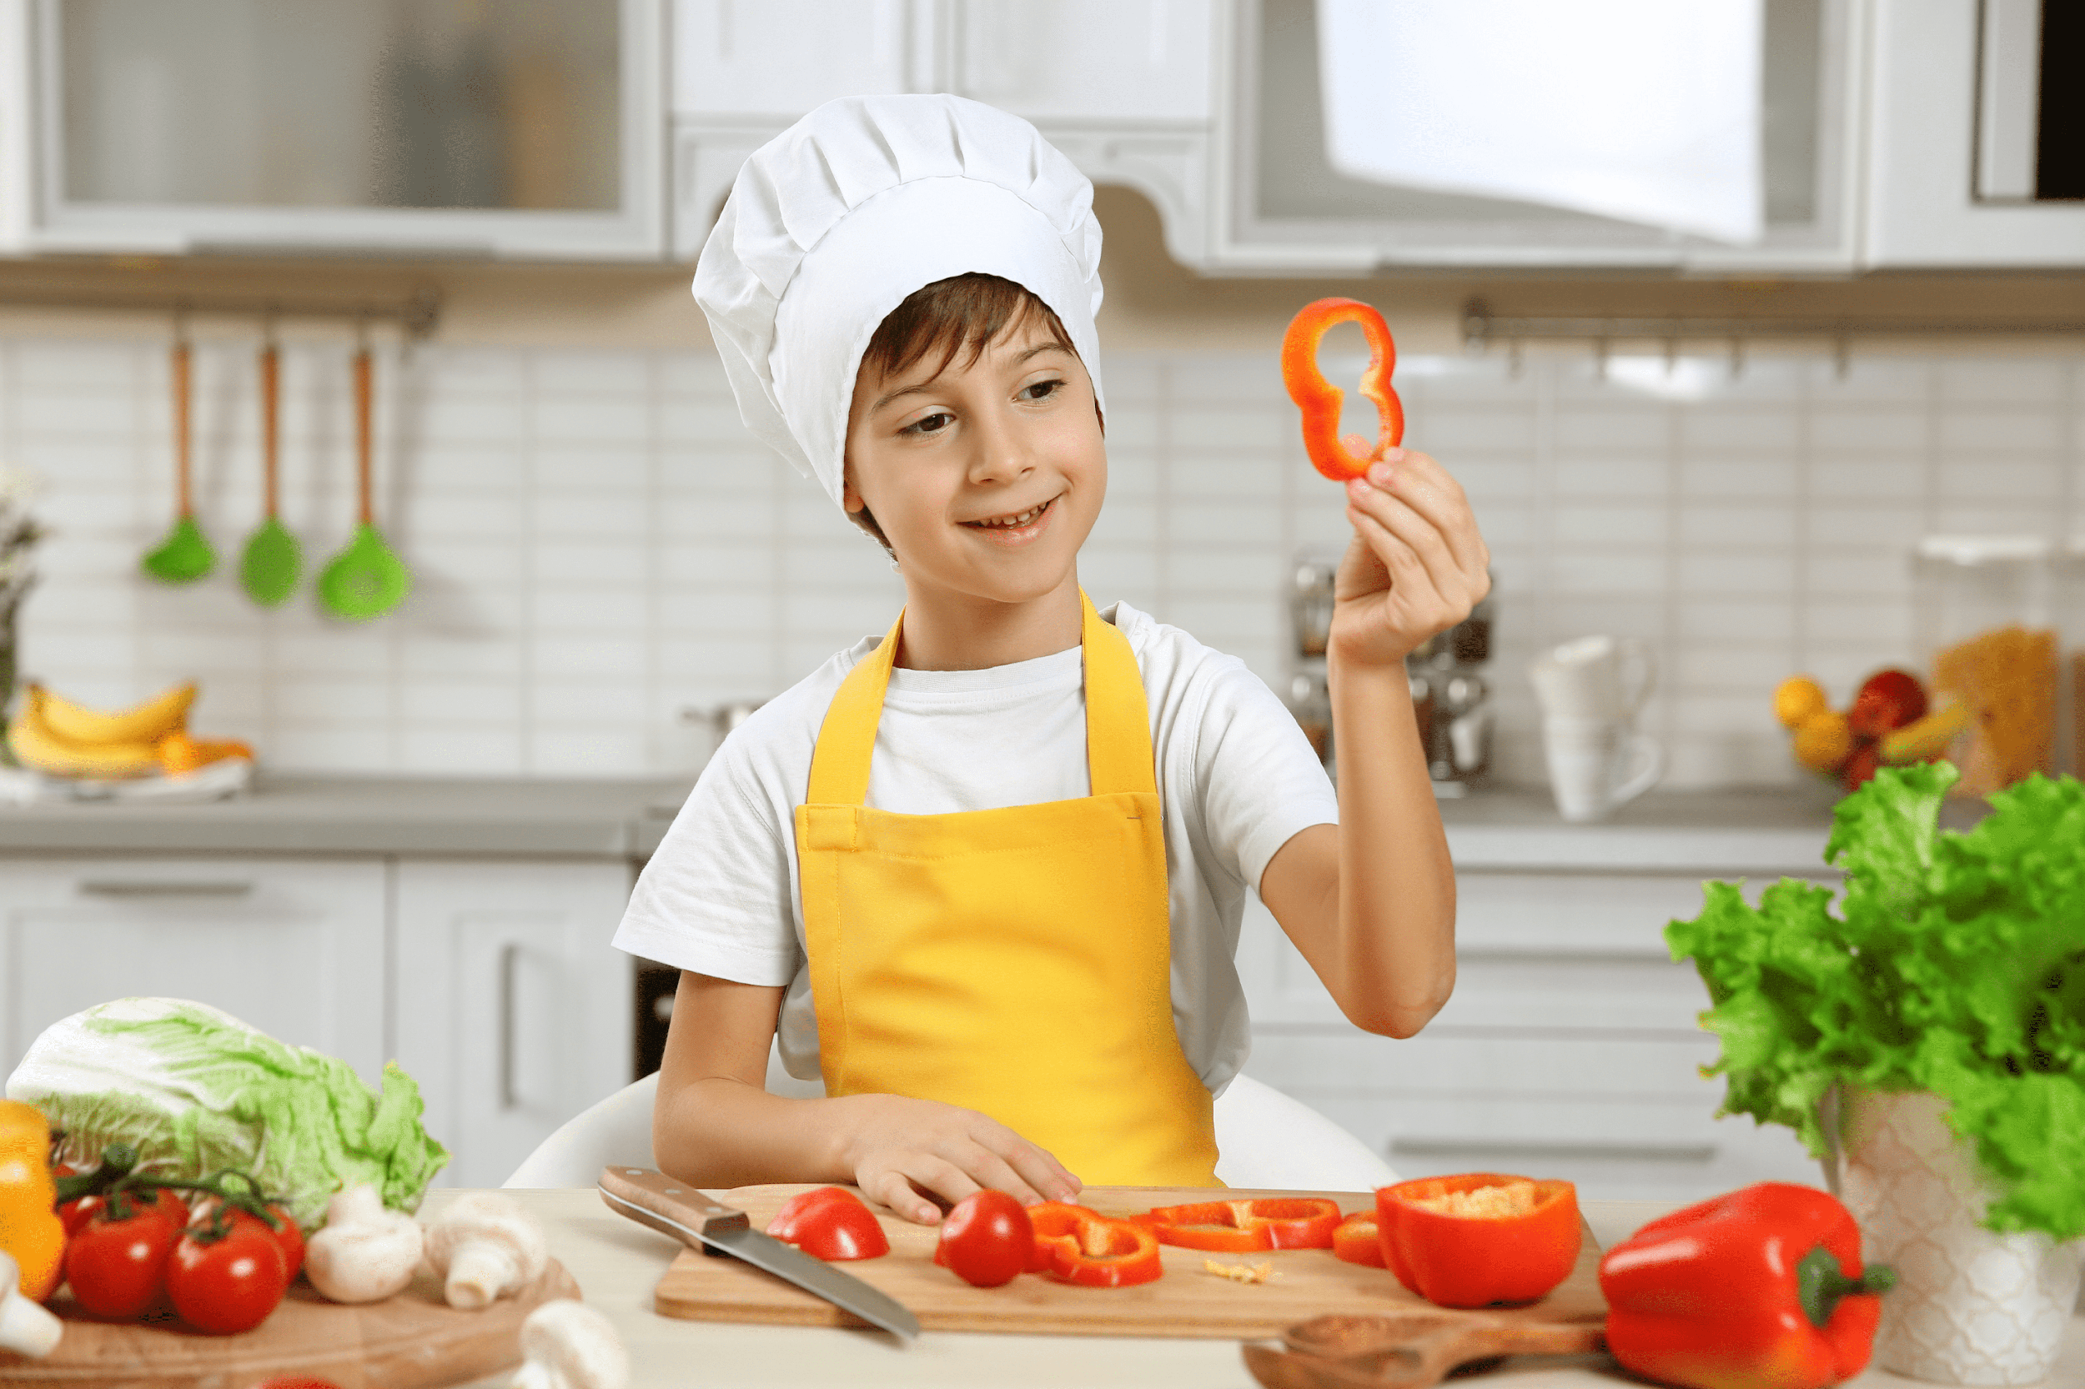
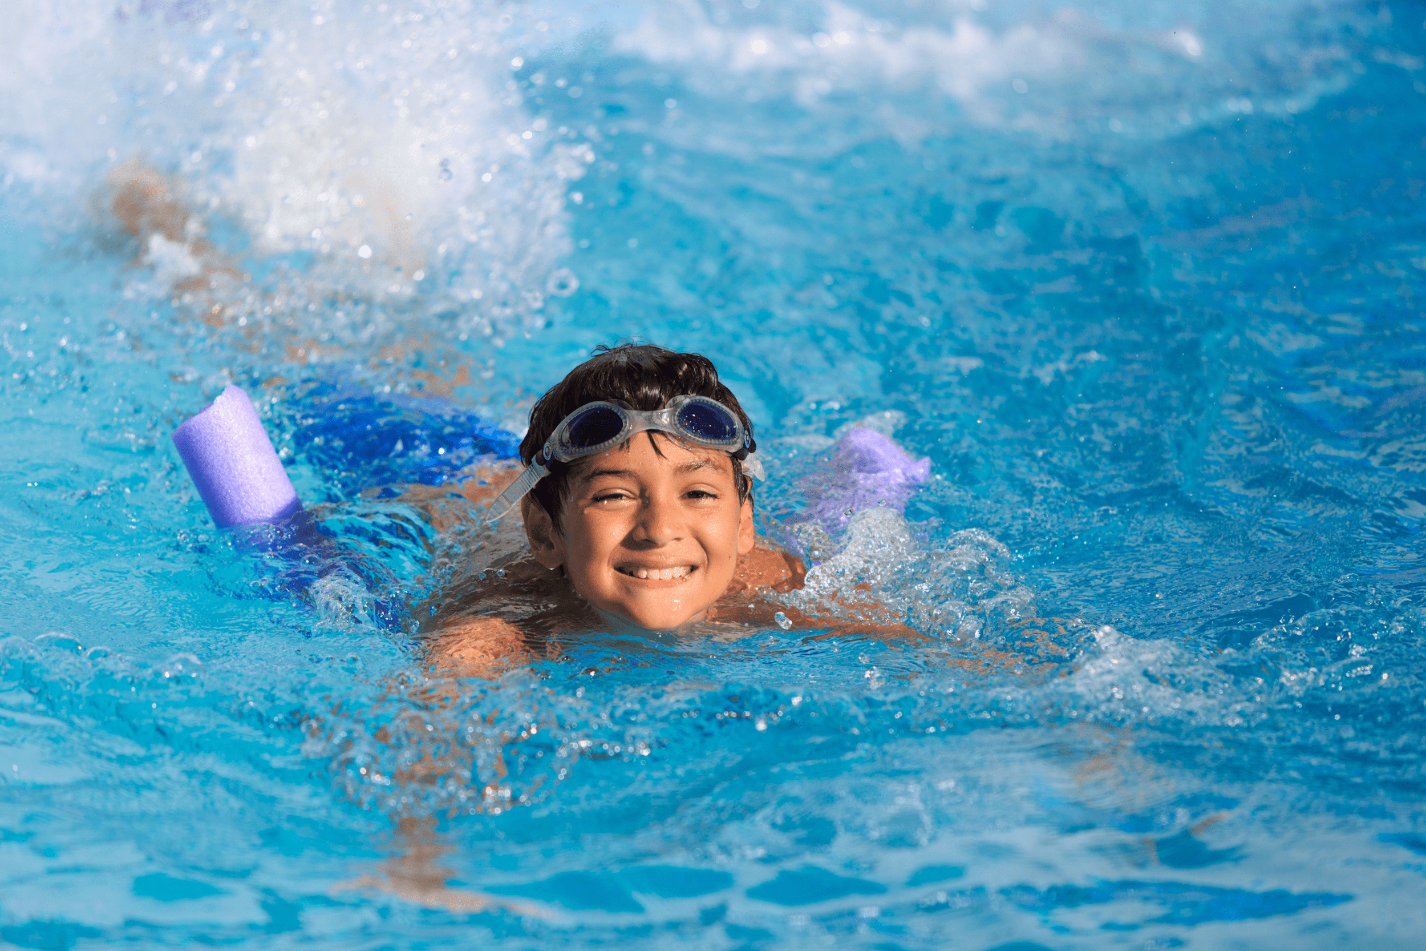
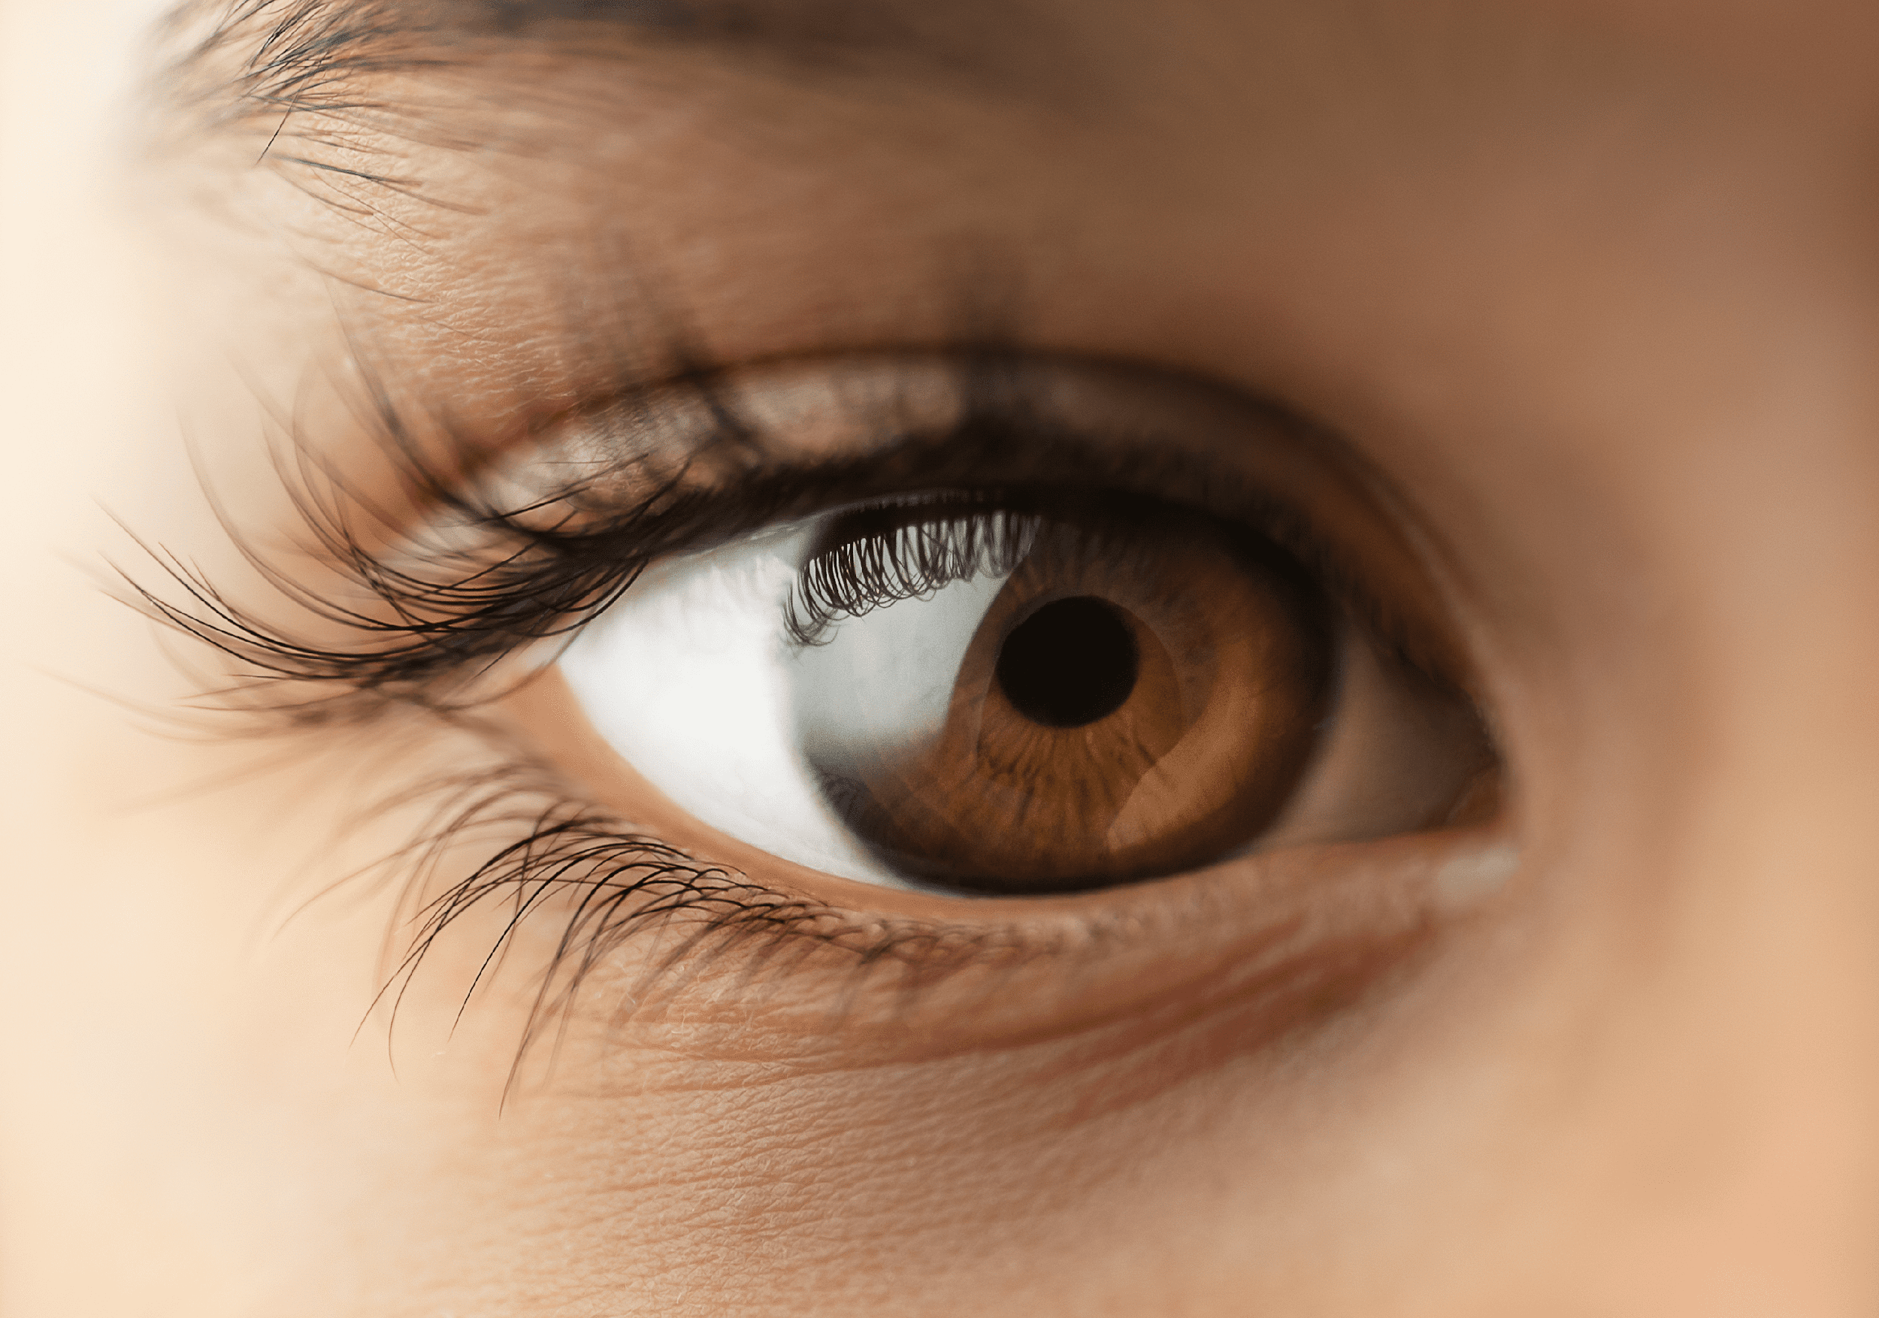
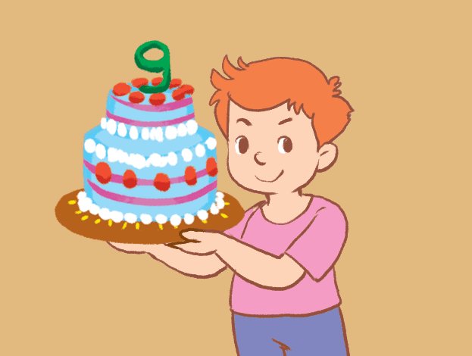
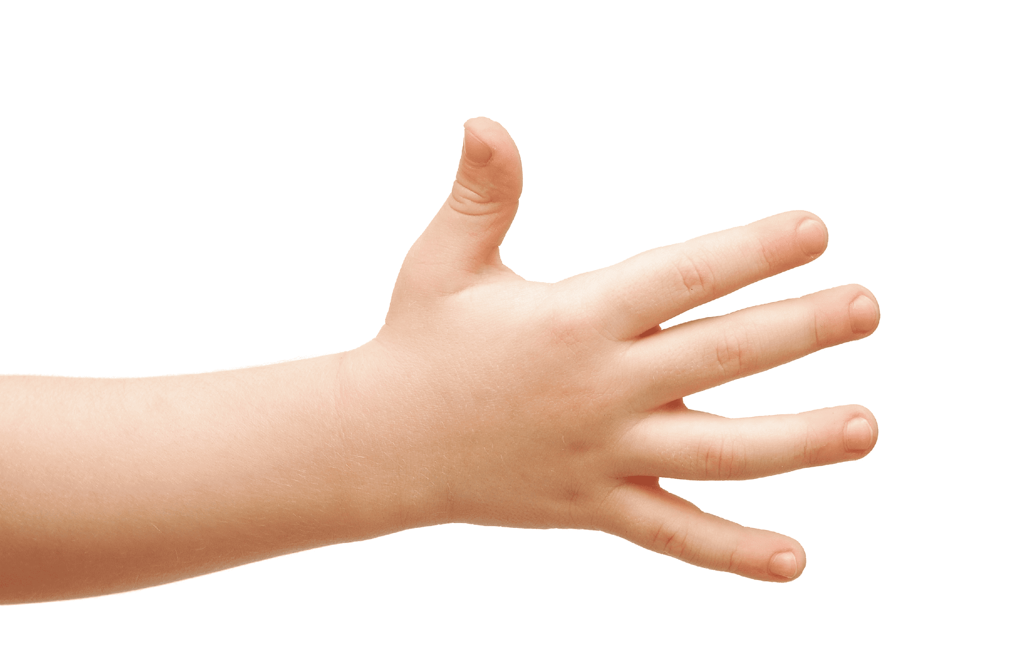
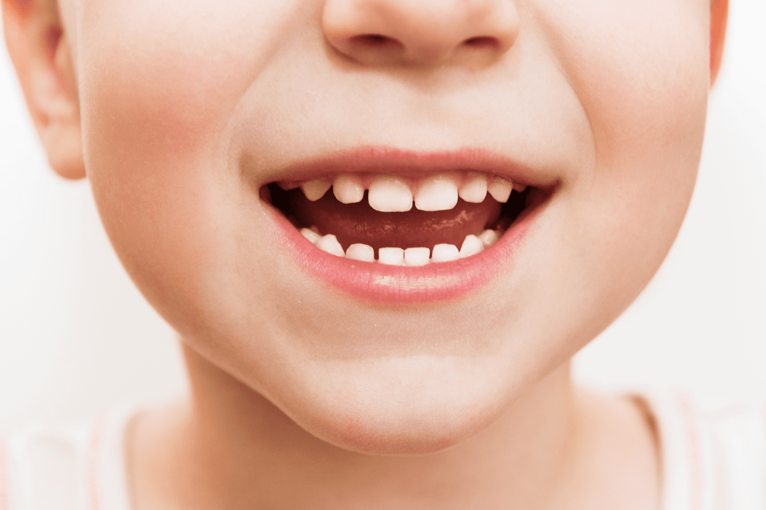
Hello
1
2
3
4
5

Slide 6
Hello
1
2
3
4
5

Slide 7
Hello
1
2
3
4
5

Slide 8
Hello
1
2
3
4
5

Slide 9
Hello
1
2
3
4
5

Slide 10
Hello
1
2
3
4
5

Slide 11


2. Read
and
match.

Slide 12

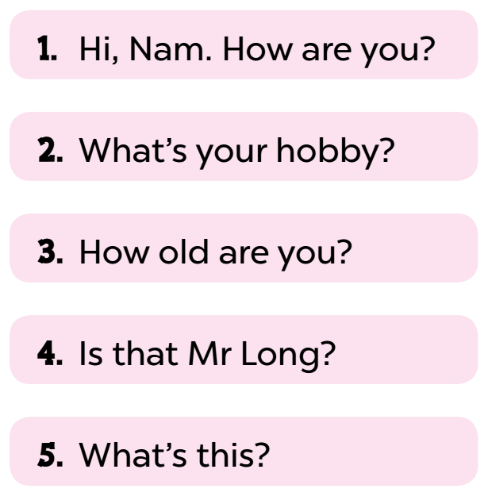
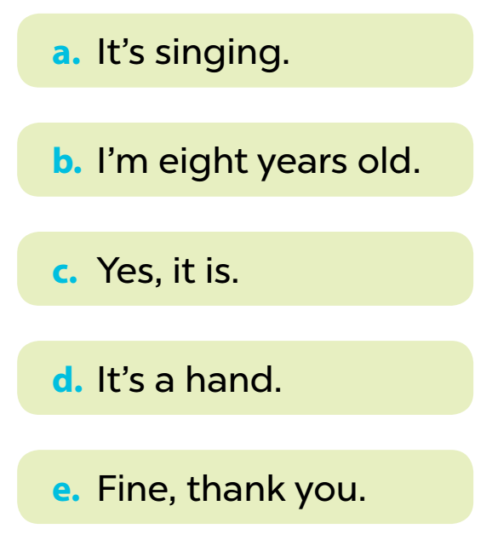

Notes:
Key: 1. e 2. a 3. b 4. c 5. d

Slide 13
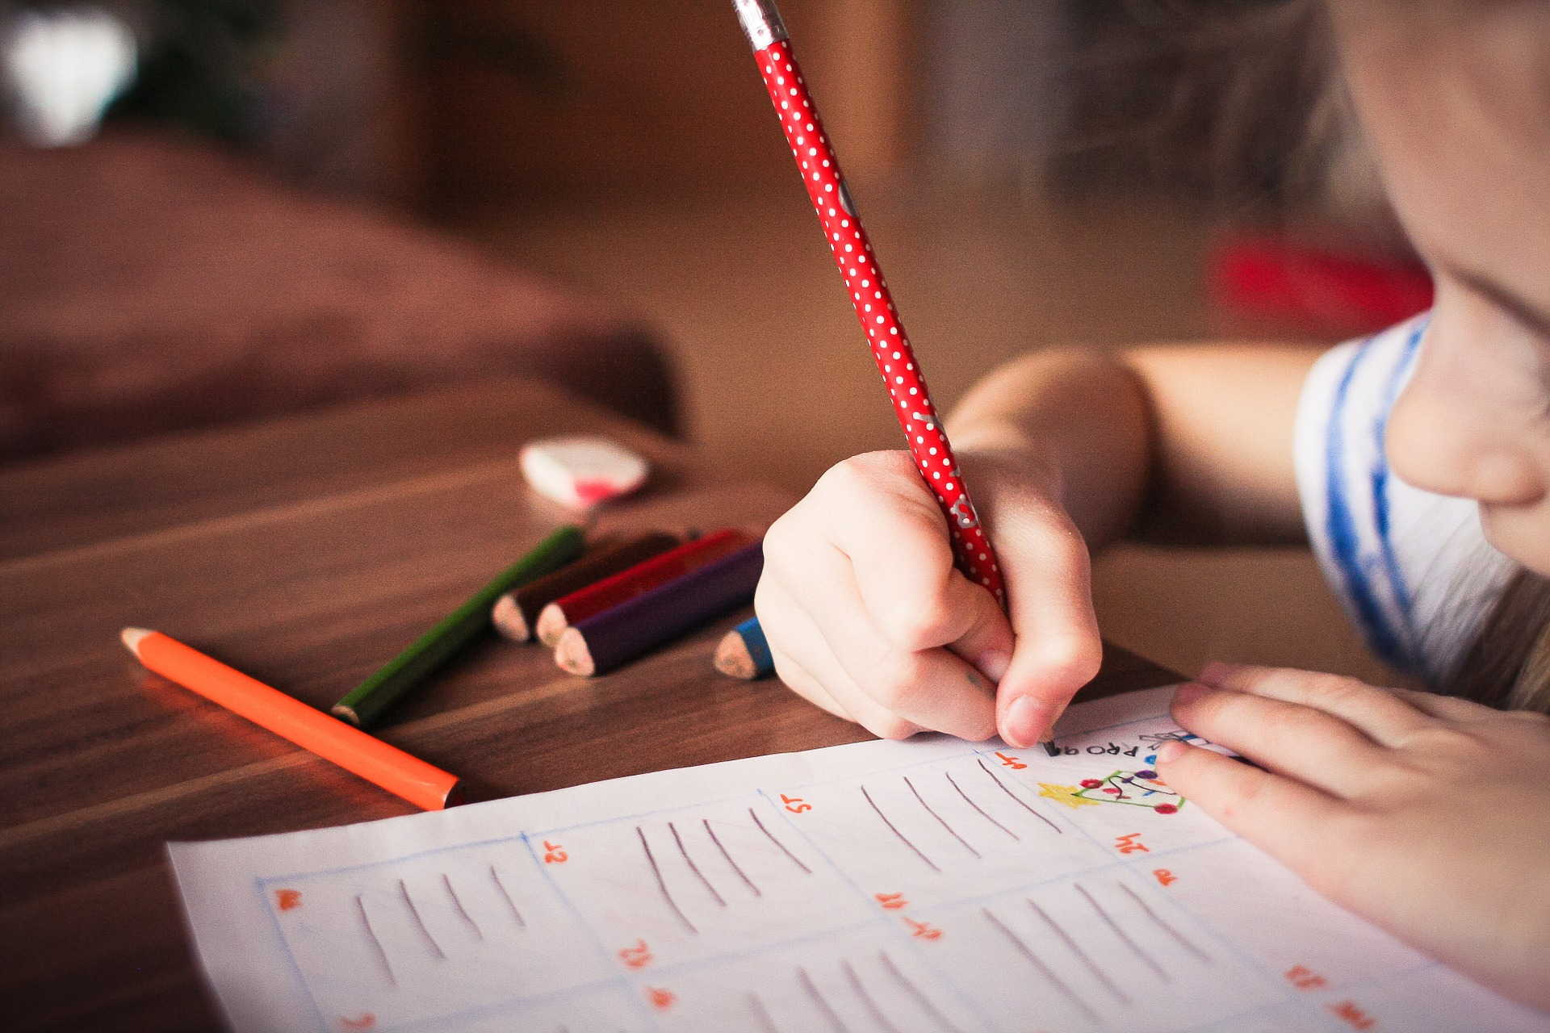
3. Read
and
complete.

Slide 14
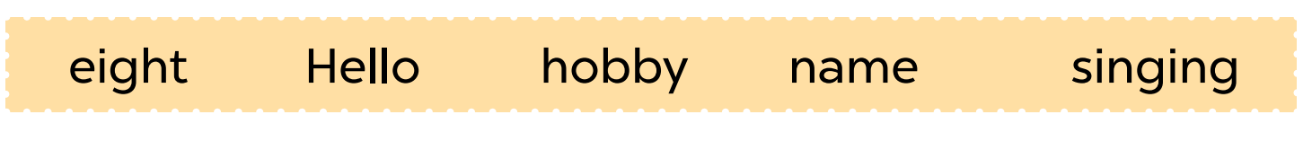
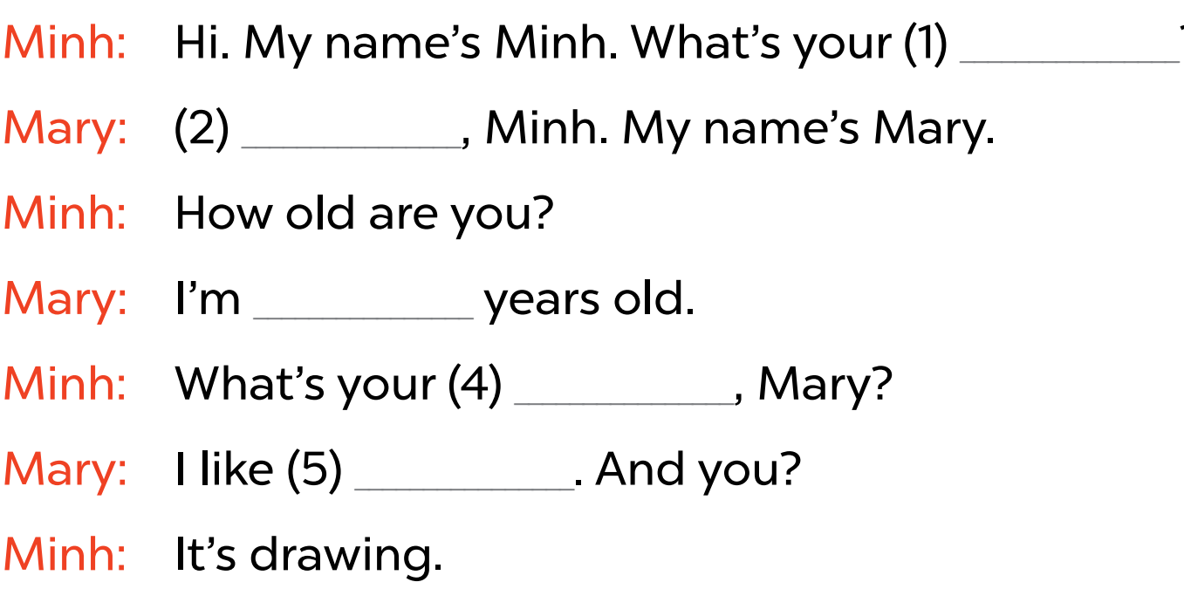

name
?
Hello
eight
hobby
singing
Notes:
Key: 1. name 2. Hello 3. eight 4. hobby 5. singing

Slide 15

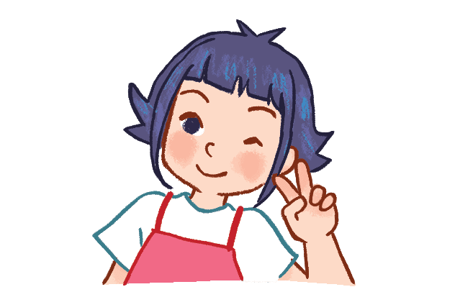
How many people are there
in the conversation?
2 people

Slide 16

What are their names?
Minh and
Mary

Slide 17
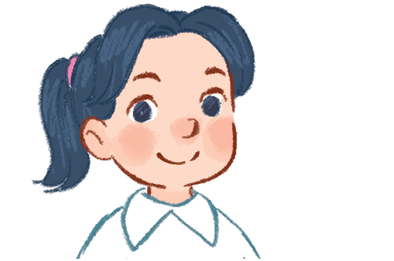
How old is Mary?
She’s 8
years old.

Slide 18
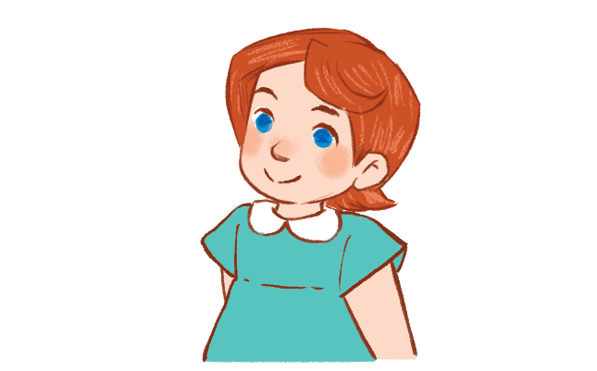
What is Mary’s hobby?
She likes
singing.

Slide 19
What is Minh’s hobby?
He likes
drawing.

Slide 20

4. Ask
and
answer.

Slide 21
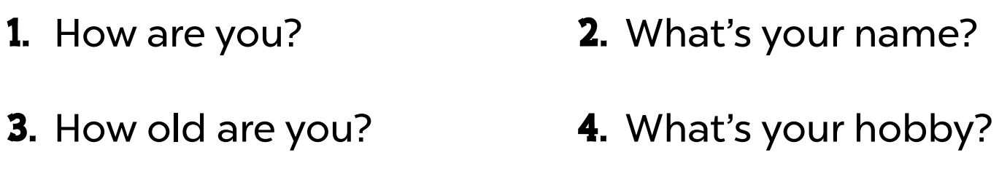
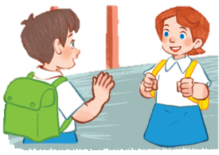


Slide 22
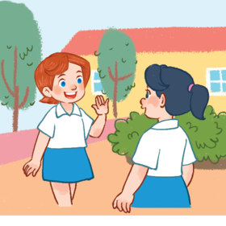
How are you?
Fine, thank you.

Slide 23
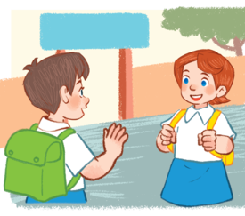
What’s your
name?
My name is ...
I’m ...

Slide 24


How old
are you?
I’m ... years old.

Slide 25
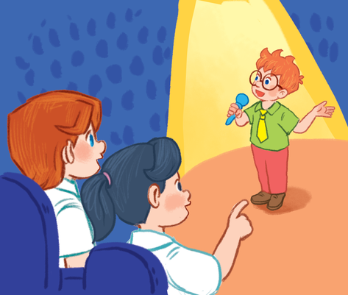

What’s your
hobby?
It’s ...
I like ...

Slide 26

5. Fun corner and wrap-up
Notes:
Quiz game
- Pupils use their mini boards to write A on one side and B on the other side.
- Teacher asks pupils to look at the question and choose the correct answer in only 10 seconds. Then hold up their board.

Slide 27



What’s your name?
A
B
My name’s
Hoa.
Hi, Ms Hoa!

Slide 28
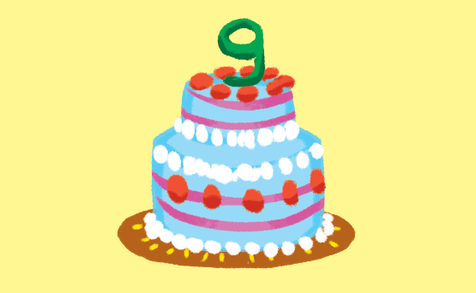
How old are you?
A
B
I’m nine
years old.
I’m fine.
Thank you.

Slide 29
What’s your hobby?
A
B
It’s Ben.
It’s drawing.

Slide 30
Is that Nam?
A
B
Yes, it is.
He is Mr Long.

Slide 31
What’s this?
A
B
Touch your
hand.
It’s a hand.

Slide 32
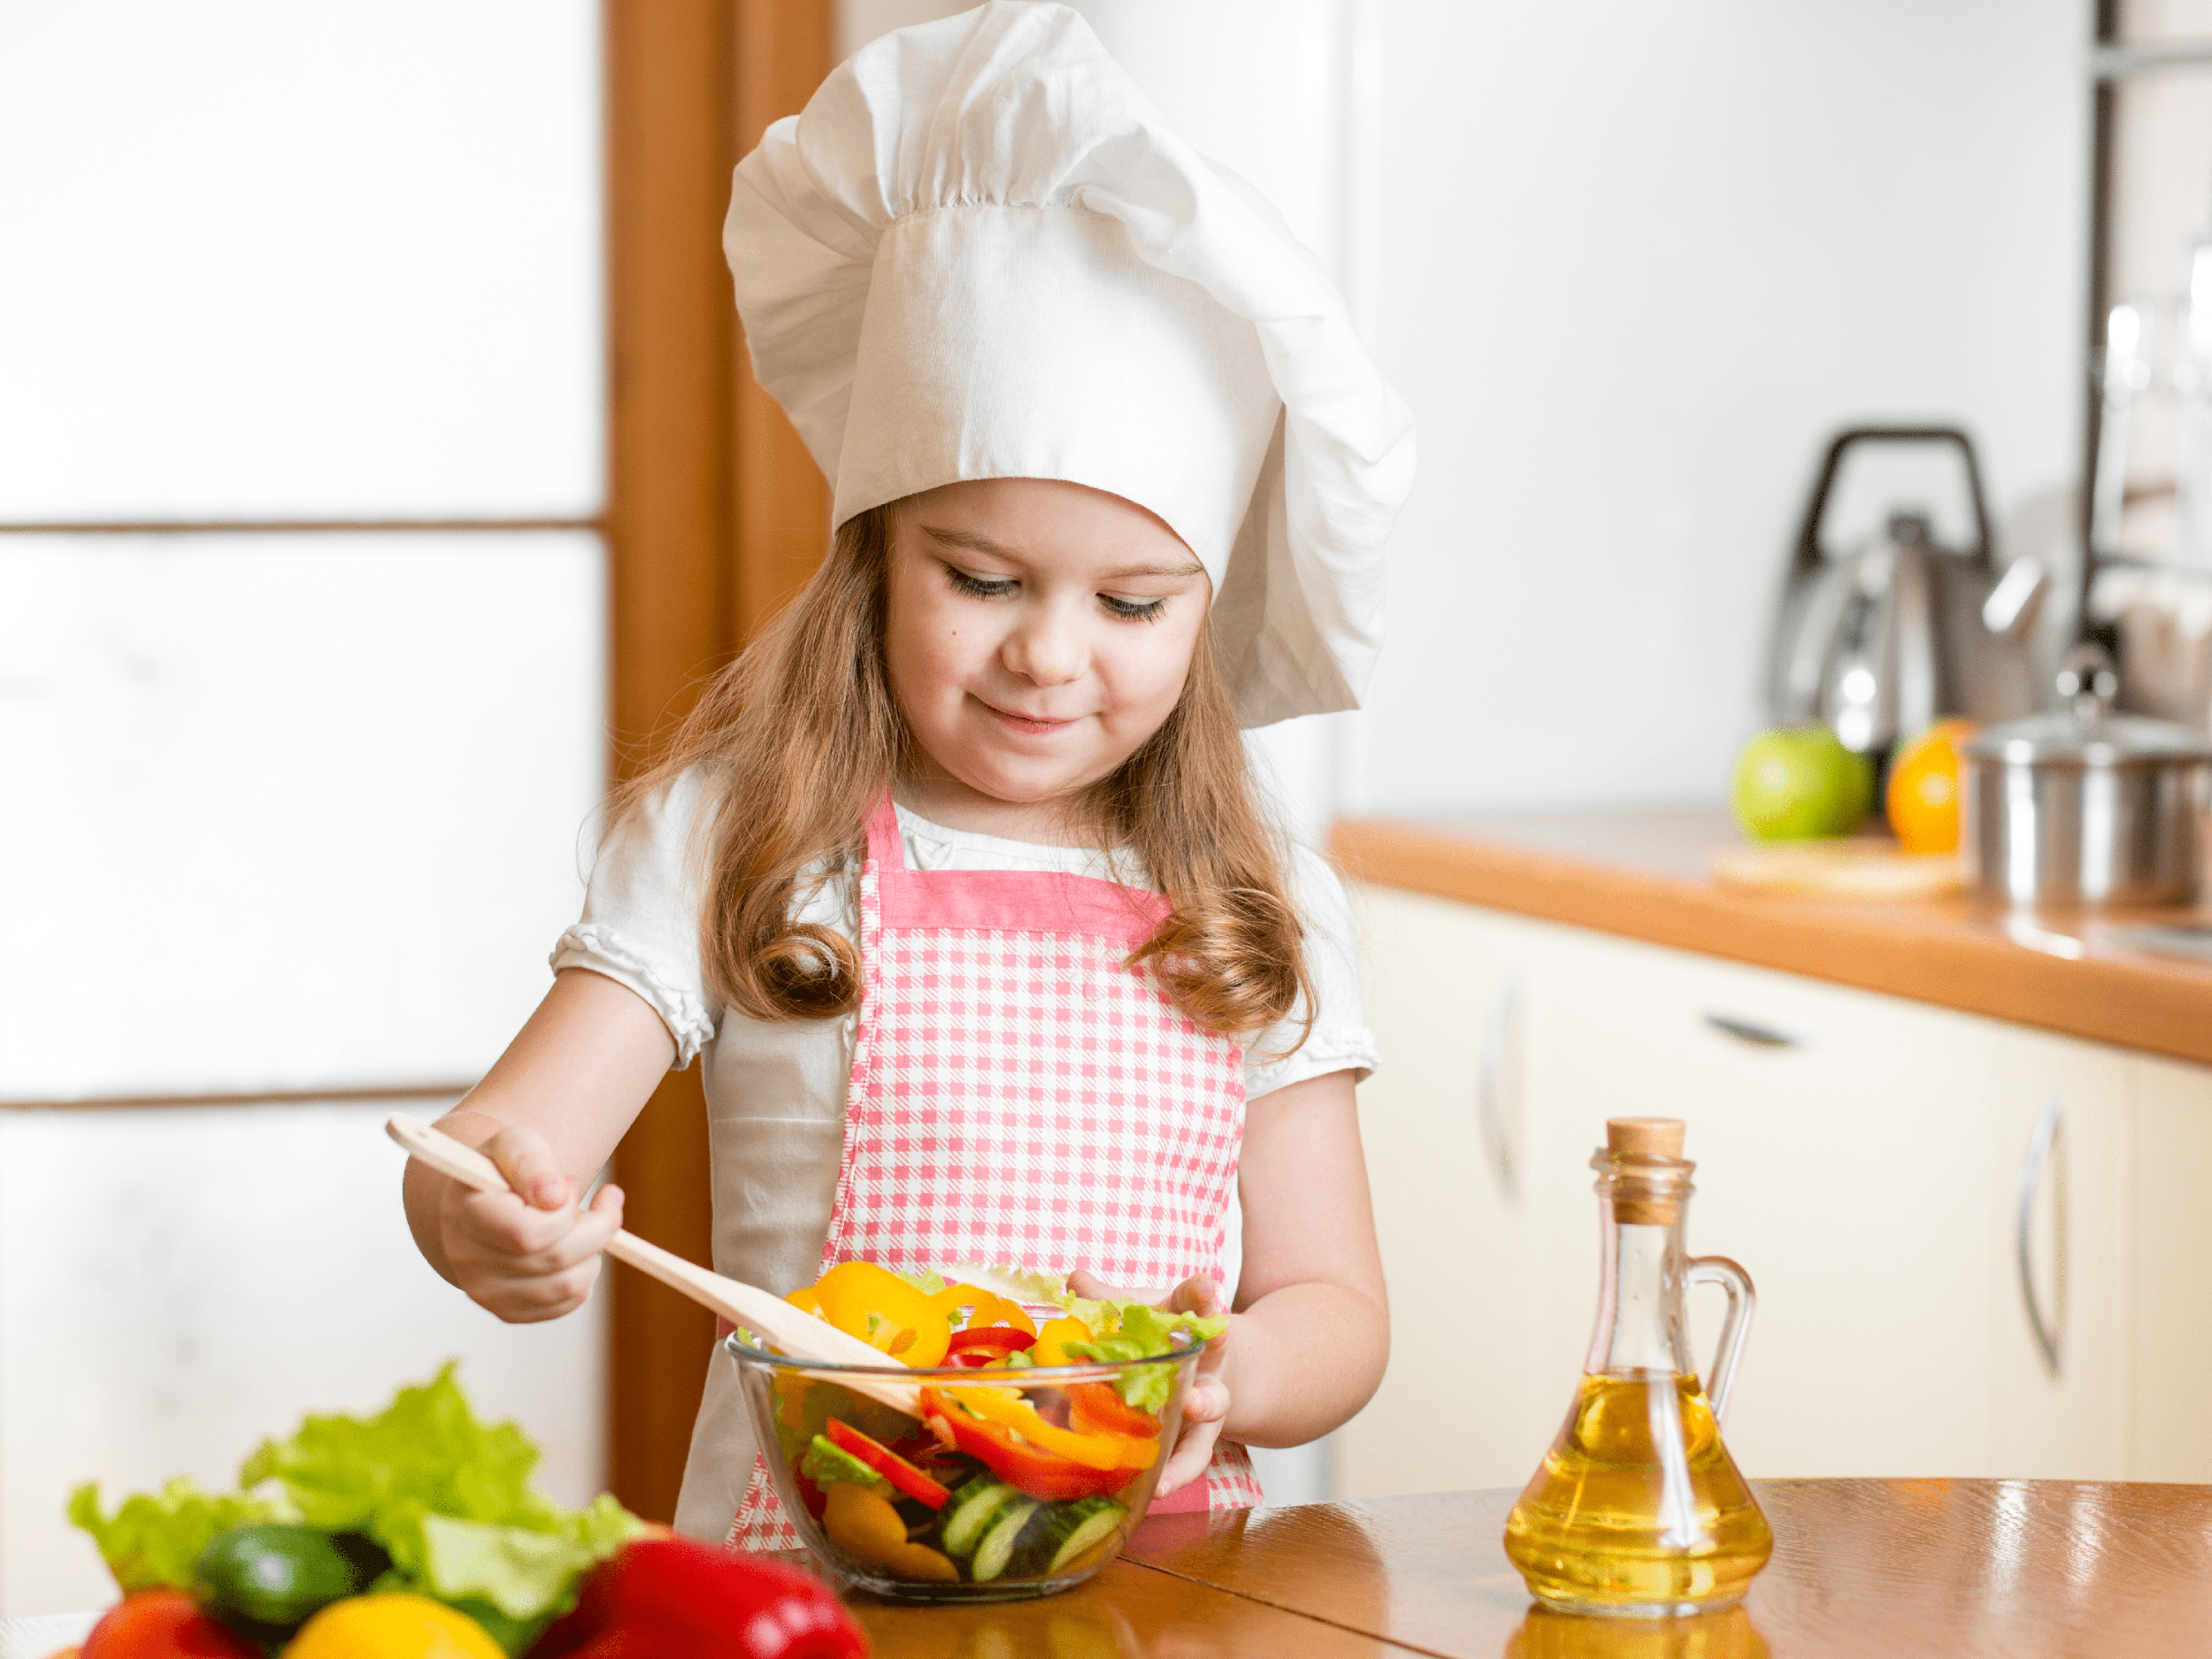
What do you like?
A
B
No, it isn’t.
I like cooking.

Slide 33

Website: sachmem.vn
Fanpage: www.facebook.com/sachmem.vn

