Slide 1



Slide 2



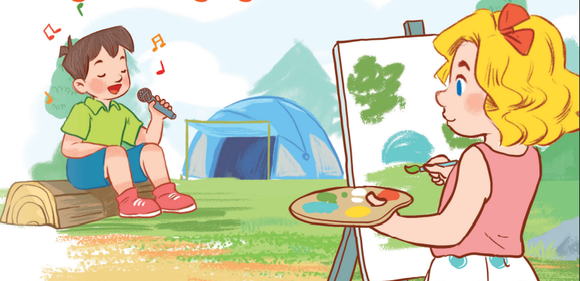
19
Outdoor activities
LESSON 1 – PERIOD 1

Slide 3
Warm-up
and review
Look, listen
and repeat.
.
Listen, point
and say.
Let’s talk.
Fun corner
and wrap-up

Slide 4




Warm-up
and review
GIRLS
0
1
2
3
4
5
6
7
8
0
9
1
2
3
4
5
6
7
8
0
9
1
2
3
4
5
6
7
8
9
BOYS
0
1
2
3
4
5
6
7
8
0
9
1
2
3
4
5
6
7
8
0
9
1
2
3
4
5
6
7
8
9
A
B
C
D
E
F
G
H
Notes:
- Divide the class into 2 teams.
- Each team chooses one letter to go to the question. Have pupils look, read and choose the right option.
- Back to the menu for pupils to choose another question.
- Pupils continue their turns until there is no letter left.
- The team with the most points wins.

Slide 5

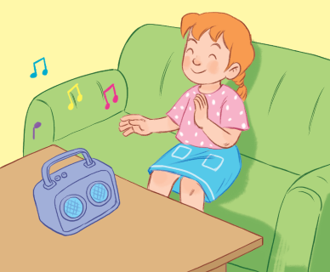


home
What are you doing?
10
I’m listening to music.
I’m reading a book.
I’m watching TV.

Slide 6
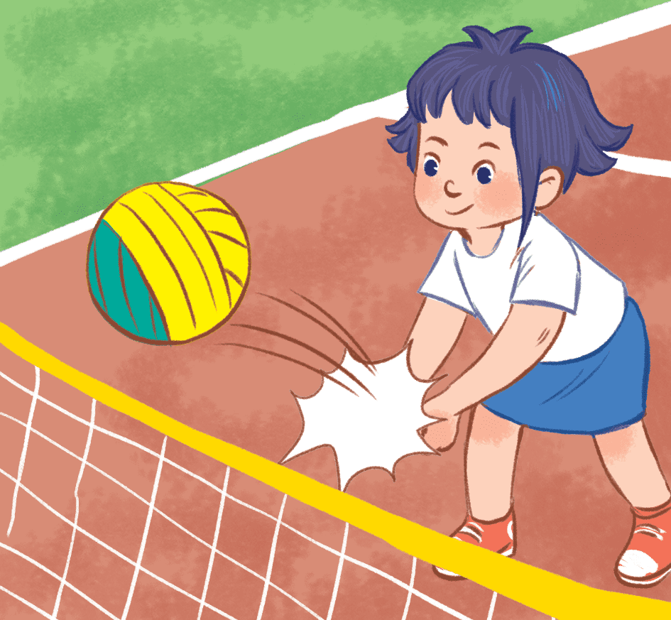
home
What are you doing?
20
I’m playing basketball.
I’m playing volleyball.
I’m playing badminton.

Slide 7
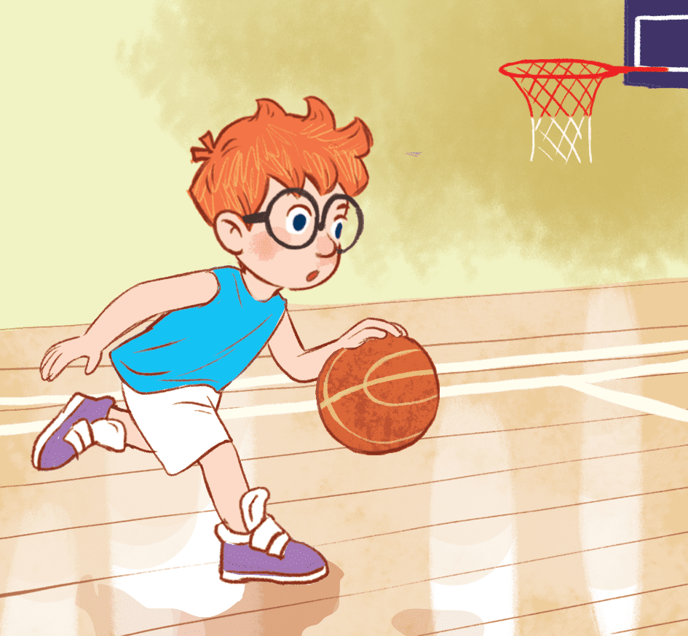
home
What are you doing?
30
I’m playing volleyball.
I’m playing table tennis.
I’m playing basketball.

Slide 8
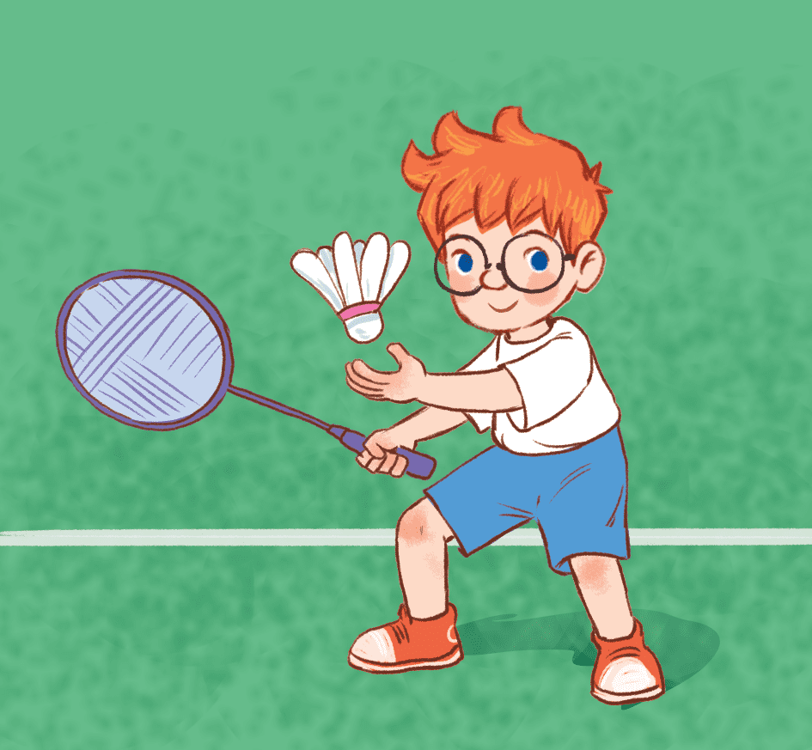
What are you doing?
home
40
I’m playing badminton.
I’m playing basketball.
I’m playing table tennis.

Slide 9

What are you doing?
home
50
I’m listening to music.
I’m reading a book.
I’m watching TV.

Slide 10
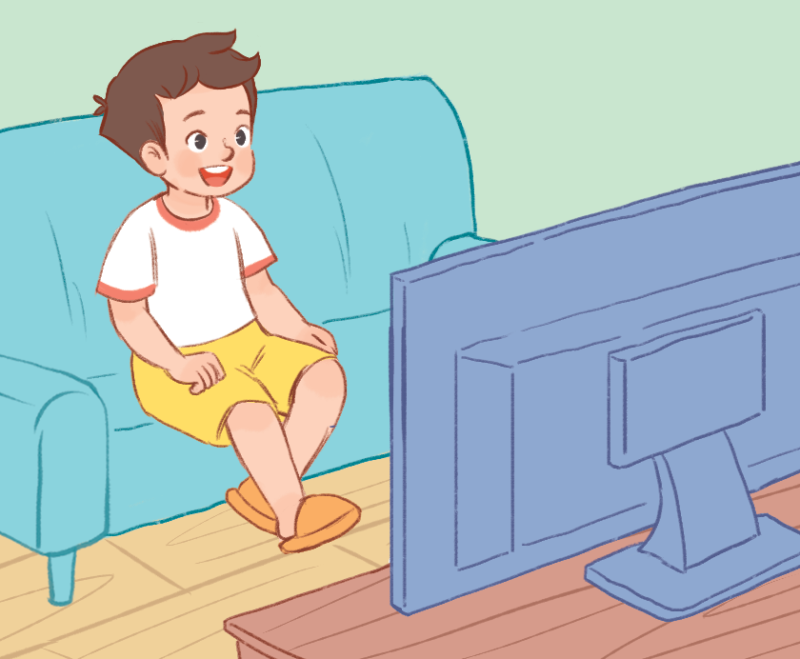
What are you doing?
home
40
I’m reading a book.
I’m listening to music.
I’m watching TV.

Slide 11
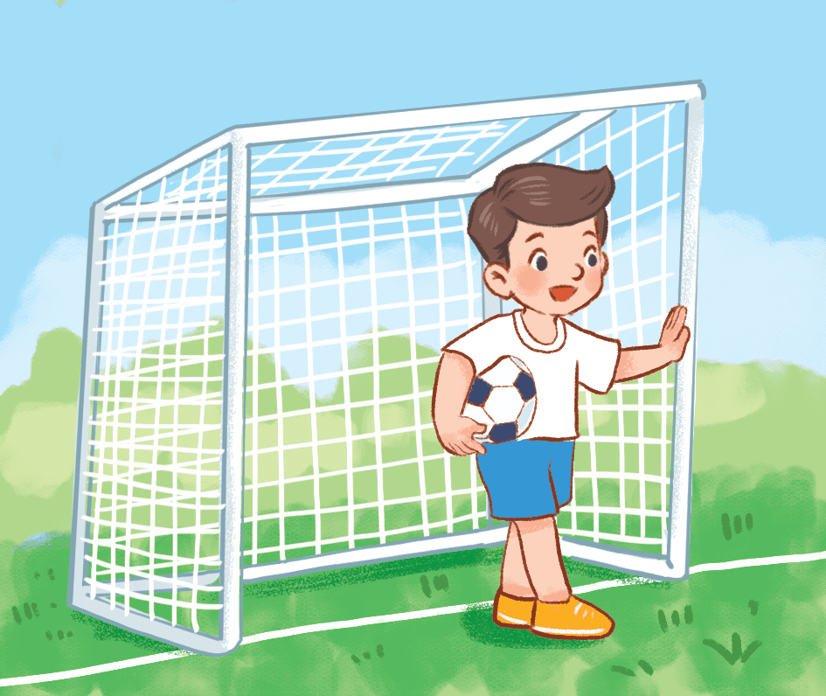
What are you doing?
home
10
I’m playing volleyball.
I’m playing football.
I’m playing chess.

Slide 12
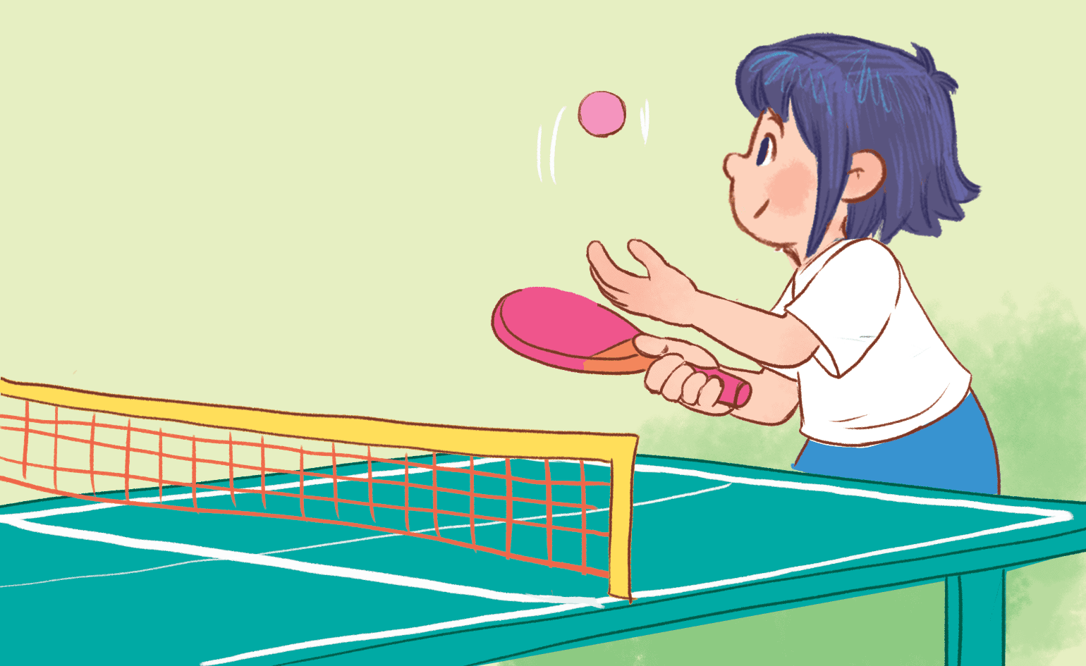
What are you doing?
home
20
I’m playing volleyball.
I’m playing badminton.
I’m playing table tennis.

Slide 13
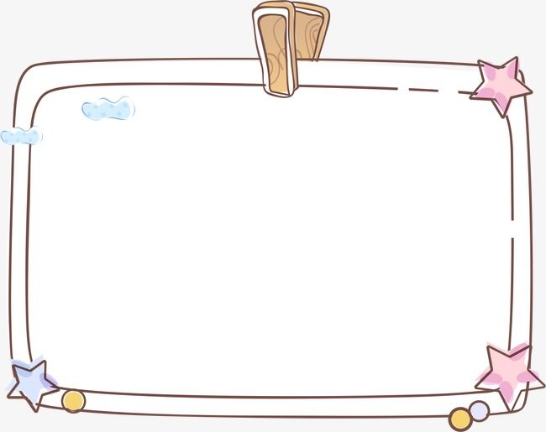
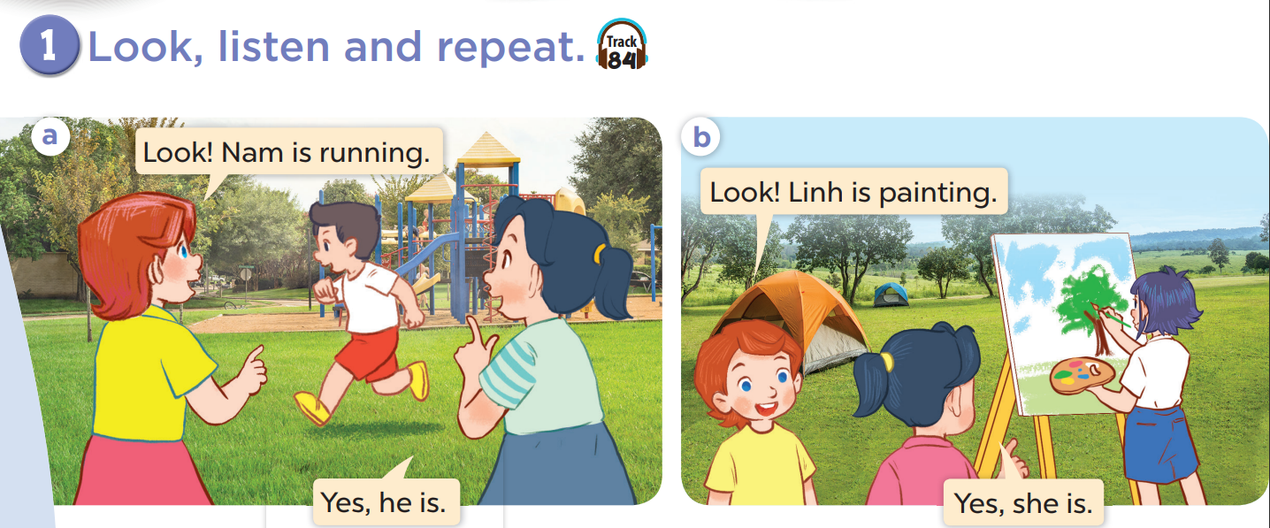


Slide 14
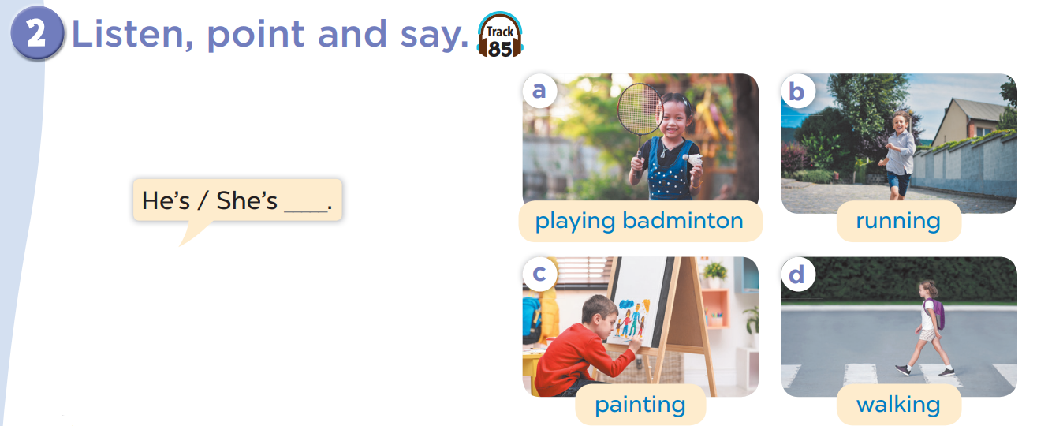

Slide 15
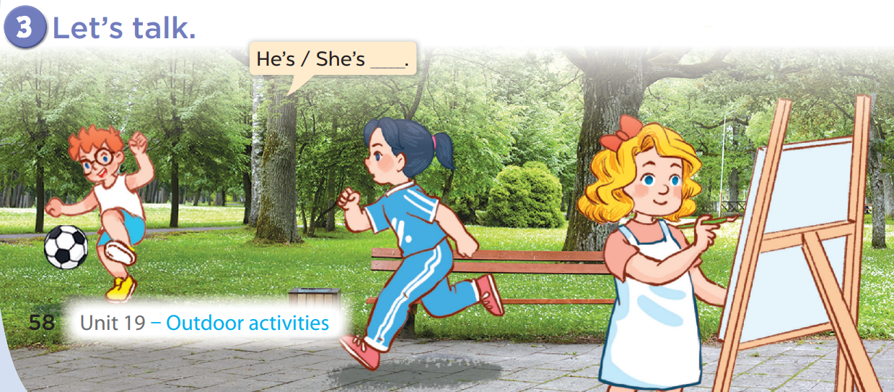

Slide 16
Fun corner
and wrap-up
LEVEL 2
GIRLS
0
1
2
3
4
5
6
7
8
0
9
1
2
3
4
5
6
7
8
0
9
1
2
3
4
5
6
7
8
9
BOYS
0
1
2
3
4
5
6
7
8
0
9
1
2
3
4
5
6
7
8
0
9
1
2
3
4
5
6
7
8
9
A
B
C
D
E
F
G
H
Notes:
- Divide the class into 2 teams.
- Each team chooses one letter to go to the question. Have pupils look, read and choose the right option.
- Back to the menu for pupils to choose another question.
- Pupils continue their turns until there is no letter left.
- The team with the most points wins.

Slide 17


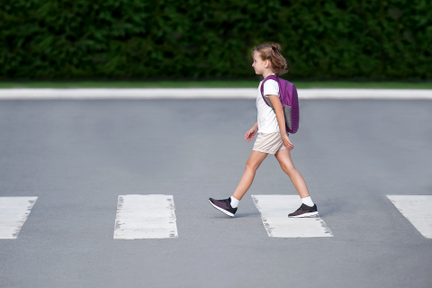

home
She’s ____.
10
She’s walking.

Slide 18
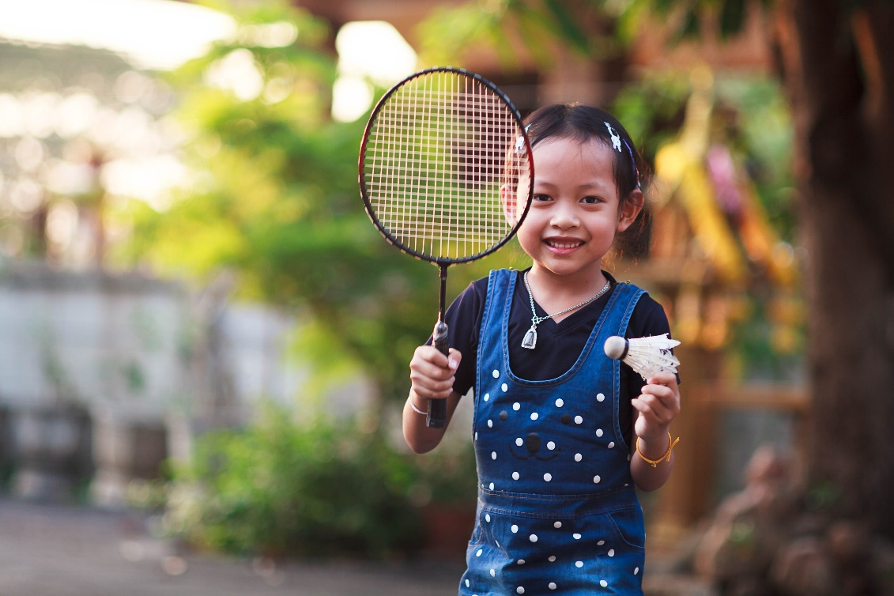
home
She’s ____.
20
She’s playing badminton.

Slide 19
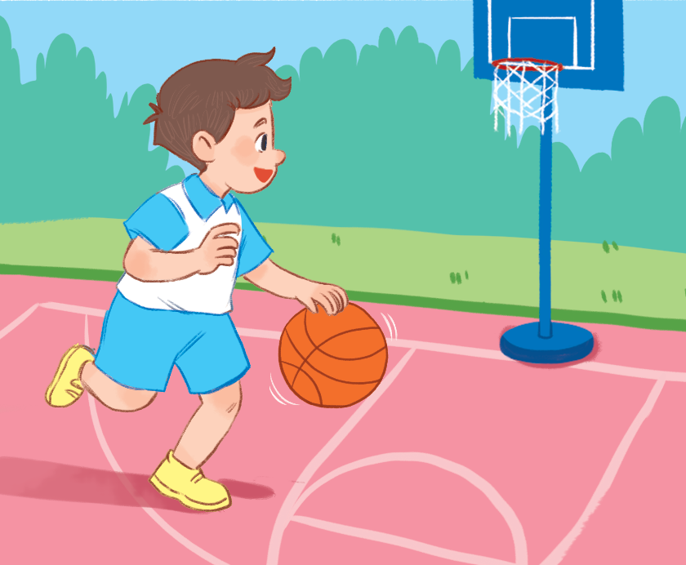
home
He’s ___.
10
He’s playing basketball.

Slide 20
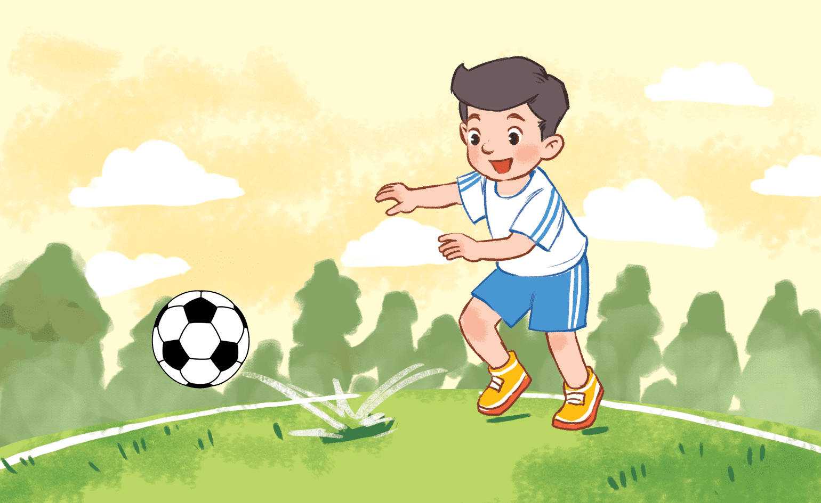
He’s ____.
home
20
He’s playing football.

Slide 21
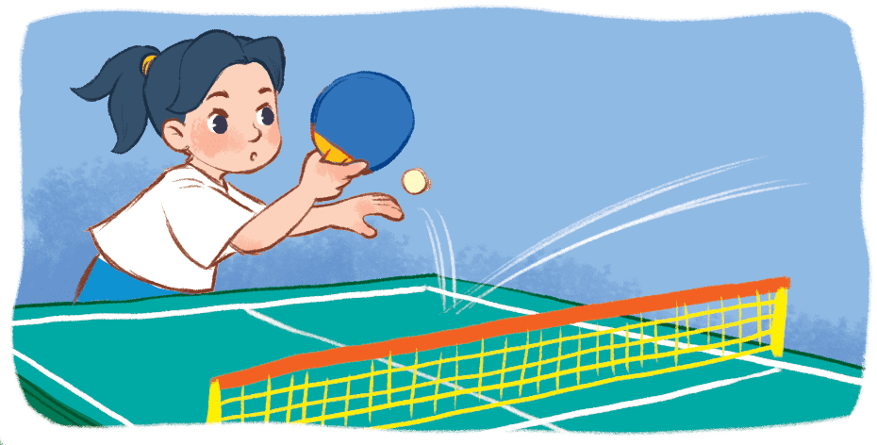
home
She’s ____.
30
She’s playing table tennis.

Slide 22
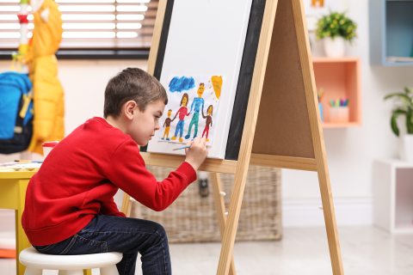
home
He’s _____.
20
He’s painting.

Slide 23
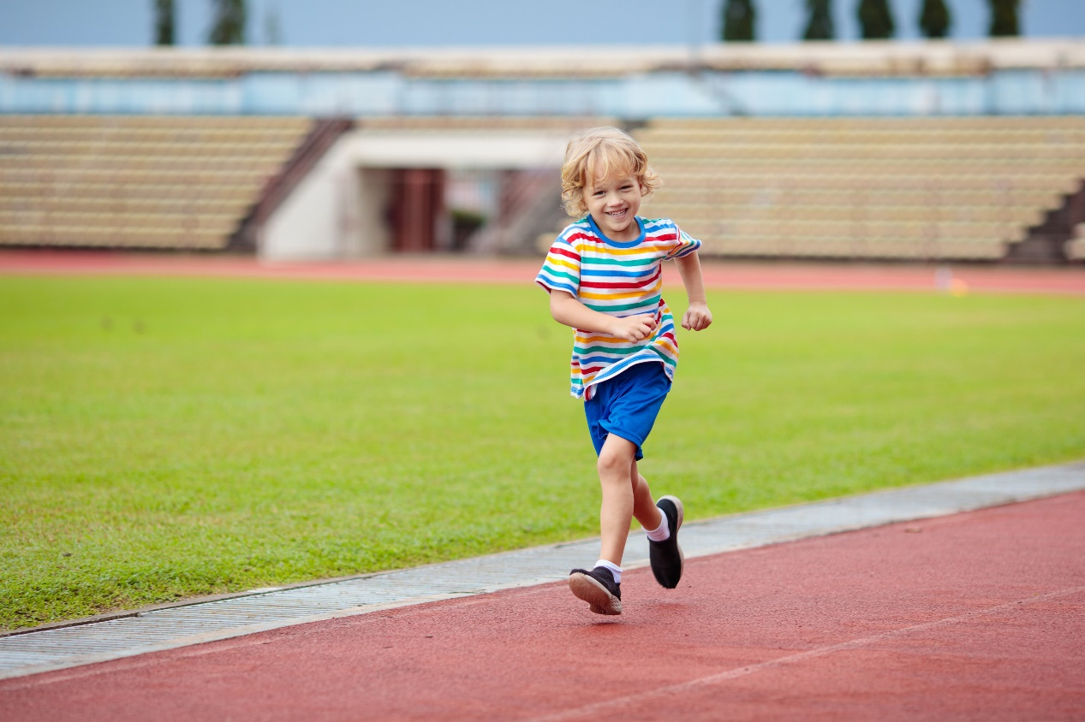
home
He’s ____.
30
He’s running.

Slide 24

home
She’s ____.
20
She’s singing.

Slide 25

Website: sachmem.vn
Fanpage: www.facebook.com/sachmem.vn

